Slide 1
A Whistle Stop Tour of how to identify and prevent Chronic Liver Disease.
Dr Ameet Dhar BSc (Hons) MBBS PhD FRCP
Lead for Hepatology, North West London ICS (NHS)
Consultant Hepatologist and Head of Specialty for Liver Services, Imperial College Healthcare NHS Trust.
Consultant in Liver Transplantation, Royal Free Hospital, London.
Honorary Senior Lecturer, Imperial College London.

Slide 2
Format of talk: How to squeeze it on all into 15-20 mins!
Burden of liver disease and liver fibrosis
Liver fibrosis and Cirrhosis
Assessing severity of liver disease and testing for fibrosis

Slide 3
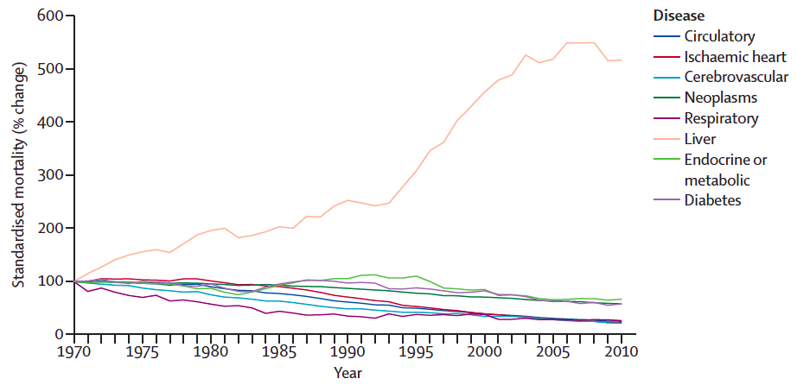
Increasing Burden of Liver Disease
Lancet commission report 2015

Slide 4
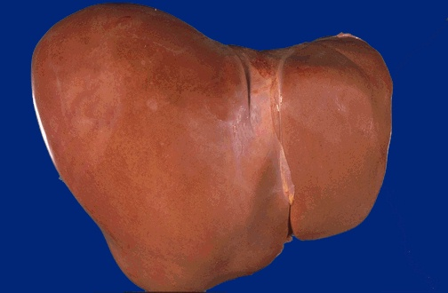
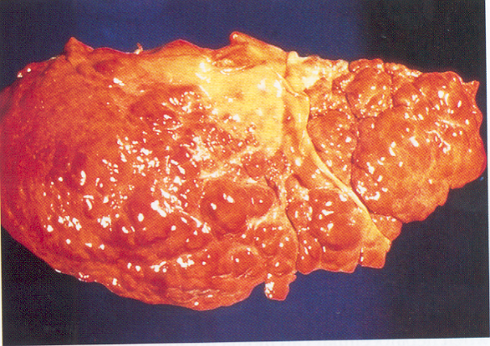
Key Concept: Liver Fibrosis
Progessive fibrosis leads to cirrhosis
Result = Disruption of liver architecture with fibrosis bands and nodule formation = CIRRHOSIS
Fibrosis (scarring) is the end result of many types of liver disease
Transition is gradual – over many years

Slide 5
Liver disease: Clinical Impact
Liver disease can develop silently
- often no symptoms until develop late stages of cirrhosis
Severity of liver enzymes alone not often indicative of stage of fibrosis (unless synthetic dysfunction)
84% of liver tests abnormalities persist beyond a month
Ballets Study 2013

Slide 6
Cirrhosis
ALD
Viral Hepatitis
NAFLD
AIH
Metabolic disorders
Cholestatic disorders
TISSUE INJURY
HOW DO YOU PREVENT CIRRHOSIS?
INFLAMMATION
FIBROSIS
Normal Liver
Cirrhotic Liver (Cirrhosis)
Compensated Cirrhosis
(Initially)
Decompensated Cirrhosis

Slide 7
Compensated Cirrhosis
- Preserved synthetic function
Often asymptomatic
Progresses to decompensated cirrhosis
Both compensated and decompensated cirrhosis confer a risk of developing HCC (hepatocellular carcinoma)
HENCE NEED SURVEILLANCE FOR HCC EVERY 6 MONTHS
(US liver and AFP).

Slide 8
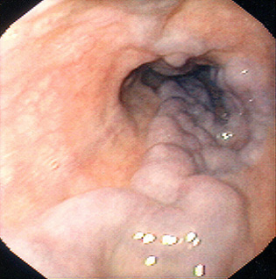
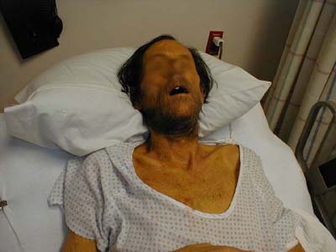
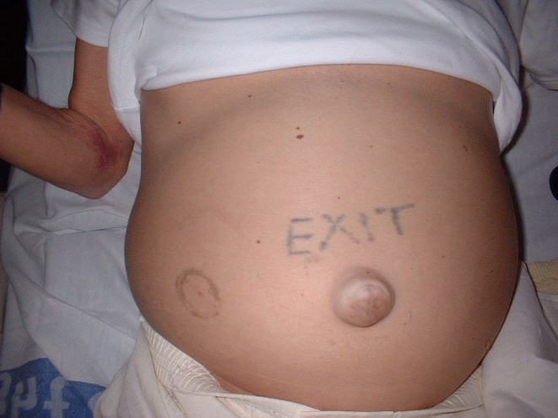
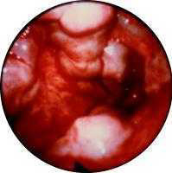
Decompensated Cirrhosis
Two key features:
Impaired synthetic function
(PT ↑, ALB ↓, BIL ↑)
Portal Hypertension:
Ascites
Varices (+/-Bleeding)

Slide 9
Determining survival in CLD: Clinical stages of liver cirrhosis
D’Amico et al, J Hepatol 2006; 44:217-31
Fattovich et al, Am J Gastroenterol 2002; 2886-95
Compensated cirrhosis
Decompensated cirrhosis
No Ascites
No Varices
Once decompensation occurs median survival reduces to 12-48 months.
1% 1 yr (mortality
No Ascites
Varices
3.4% 1 yr mortality
Ascites +/-
Varices
8% / year
20% 1 yr mortality
Compensated cirrhosis 5yr survival = 80%
Ascites
+/- Bleeding
57% 1 yr mortality

Slide 10
Diagnostics in primary care

Slide 11
Understanding components of LFTs
OUR ROLE IS TO DEFINE WHY PATIENTS HAVE LIVER DYSFUNCTION AND WHAT STAGE OF LIVER DISEASE THEY HAVE
Hepatitic enzymes:
ALT/AST
Cholestatic Markers:
Alkaline Phosphatase
GGT
Bilirubin
Synthetic markers
Albumin
Prothrombin time
Bilirubin
Markers of PHT
Platelets
NOTE LIVER TESTS CAN BE NORMAL IN COMPENSATED CIRRHOSIS

Slide 12
AST and ALT
Remember AST can be muscle derived too
Increased in hepatitic disorders:
NAFLD,
AIH,
ALD (AST >ALT)
AST is a marker required for the FIB-4 (AST:ALT ratio)

Slide 13
ALP
Remember liver and Bone derived
Increased in cholestatic disorders:
-PSC
-PBC
-biliary obstruction
-intrahepatic lesions (Mets etc)
Increased in congestion: HF

Slide 14
GGT
Cholestatic liver enzyme (in conjunction with ALP)
Isolated elevations
Alcohol
Drugs
…. Note can also may be elevated in fatty liver disease also….

Slide 16
Fibroscan: Transient Elastography (TE) for prediction of cirrhosis
TE standard for the measurement of Liver stiffness
• Well validated
• TE performs better for detection of
cirrhosis than for detection of significant
fibrosis
• TE is a reliable method for the diagnosis of
cirrhosis in patients with chronic liver
diseases (with negative predictive value
higher than 90%)
Cut values depend on aetiology.
LSM> 12 kPA suggest of cirrhosis (some aetiological variance)

Slide 17
Fibroscan: Not just a point and shoot test
Note a number of confounding variables:
• Non fasted states (no solid within 4 hours)
• Steatosis
Active Inflammation
• Venous congestion
• Solid lesions
• Ascites
Therefore has to be taken into context with clinical history, and blood tests

Slide 18
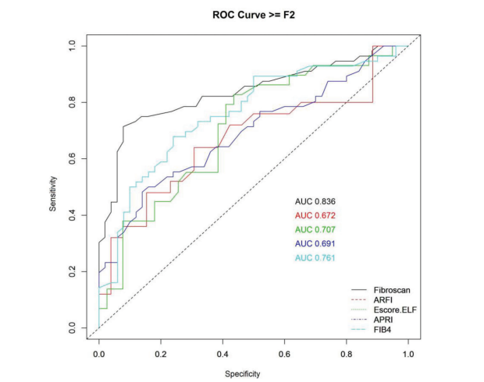
Fibroscan in comparison with other modalities (HCV)
AUC data for > F2
Fibroscan> Fib-4> ELF > others
Ragazzo et al. Clinics 2017; (09)01
Notes:
Ragazzo et al. Clinics 2017; (09)01

Slide 19
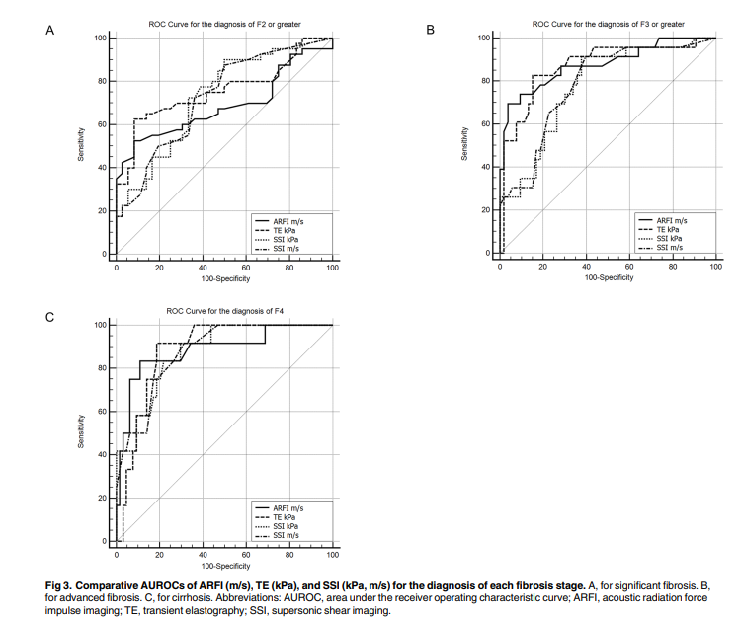
Fibrosan: Comparison with other modalities to measure elastrography - NAFLD
Compared to liver biopsy in NAFLD:
Liver stiffness correlated with fibrosis stage <0.05
AUROCs:
0.757 (Fibroscan)
0.759 Supersonic shear imaging
0.657 ARFI
For Significant Fibrosis
0.870 (Fibroscan);
0.809 Supersonic shear imaging
0.873 ARFI
Lee SM, PLoS ONE 2017; 12(11): e0188321
Notes:
Lee SM, PLoS ONE 2017; 12(11): e0188321

Slide 20
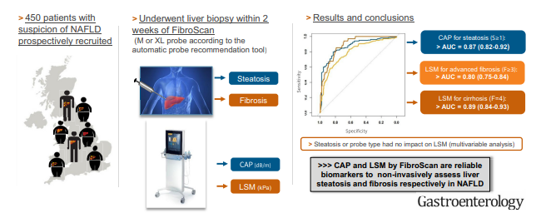
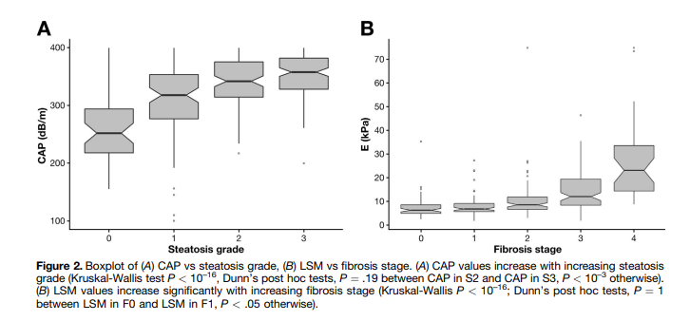
Fibroscan measurements - NAFLD
Paired biopsy analysis:
Steatosis grade 1 302 dB/m
Steatosis Grade 2 331 dB/m
Steatosis grade 3 337 dB/m
Fibrosis F2 8.2 kPa
Fibrosis F3 9.7 kPa
Fibrosis F4 13.6 kpa
Eddowes et al. Gastroenterology 2019; 156:1717-30
Notes:
Eddowes et al. Gastroenterology 2019; 156:1717-30

Slide 21
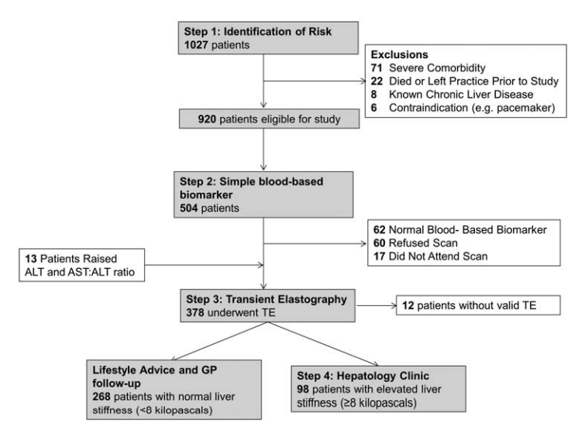
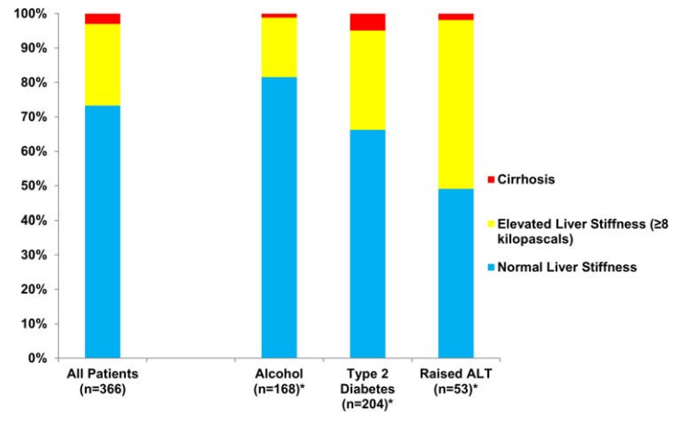
Primary Care Targeted Screening: Nottingham Study
71/98 had normal LFTs
Harman DJ et al. BMJ Open 2015
ROLE FOR FIBROSCAN (or fibrosis screening) IN POPULATION HEALTH SCREENING FOR LIVER DISEASE
Notes:
Harman DJ et al. BMJ Open 2015

Slide 22
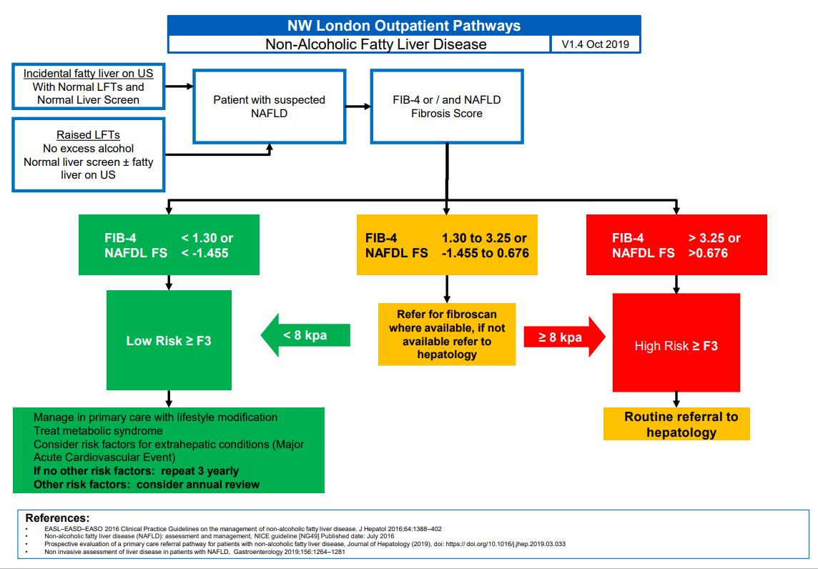
Fatty Liver Pathway: NW London

Slide 23
When to suspect cirrhosis - NICE
Constitutional Symptoms:
Malaise, fatigue, anorexia, nausea, weight loss, muscle wasting
If examination identifies
Palpable left lobe of liver, organomegaly - spleen
Chronic stigmata of CLD
Features of decompensated disease including bruising

Slide 24
When to suspect cirrhosis – NICE (2)
Bloods:
Low platelets
Raised AST:ALT ratio
Hyperbilirubinaemia
Hypoalbuminaemia
Raised INR
Imaging: often incidental

Slide 25
When do we suspect Portal Hypertension?
Non invasive tests
- Physical examination – ascites / splenomegaly / HE
- Blood tests – Low platelets count
- Imaging (splenomegaly, ascites, collaterals etc)
- LSM > 15 kPA // > 20 kPA clinically significant varices
Kazemi et al 2006, Lemoine et al 2006
Invasive tests
- Presence of varices on endoscopy
Remember it is important to identify as it infers an increased risk of mortality
Notes:
Increased intrahepatic resistance: incorporates both static and dynamic factors
The initial event leading to PH is – increased vascular resistance to portal blood flow at the hepatic microcirculation. Increased hepatic vascular resistance is not only –mechanical consequence of hepatic architectural distortion casued by fibrosis, regenerative nodules, sinusoidal remodelling and vascular occlusion that is characteristic of a cirrhotic liver.
Increasingly recognised is a dynamic component: that is thought to account for a 1/3 of increased resistance to portal blood flow
Active contraction of portal/septal myofilbroblasts
Activated hepatic stellate cells/vascular smooth muscle cells
Hepatic endothelial cell dysfunction
- These events are believed to reflect an imbalance between endogenous vasocontrictors and vasodilatory mediators
Second factor contributing to PH: increased blood inflow through portal venous system due to splanchnic arteriolar
Vasodilatation
Splanchnic vasodilatation - occurs due to increase in levels of vasodilators e.g. NO, glucagon etc. This results in the hyperkinetic/hyperdynamic circulatory syndrome that we will discuss shortly.

Slide 26
Conclusions
The burden of liver disease is increasing and cirrhosis and portal hypertension still have increased risk of mortality
Imperative to screen and treat patient to prevent the burden of chronic disease.
Remove the insult – remains the best option in prevention of cirrhosis.
Treatment based on identifying and treating the specific complications
Non invasive methods of identifying fibrosis – Fib4 and fibroscan have important role in stratifying risk of progression of liver disease and even PHT now.

Slide 27
Thank you
Dr Ameet Dhar
Email: ameet.dhar1@nhs.net

