Slide 1
Approach to Abnormal Liver blood tests /Liver Function Tests ?
Dr Jayshri Shah
Consultant Hepatologist
Trust lead for Hepatology at LNWUH
Visiting Consultant Hepatologist
Department of Liver Transplantation,Royal Free Hospital
IQILS Assessor , Royal College of Physicians
Private Practice: The London Clinic and Trustplus, St Marks hospital (Northwick Park site)

Slide 2


Slide 3
Abnormal Liver blood tests : Does it matter ?
Over 50% of patients presenting with end-stage liver disease, without a previous diagnosis of chronic liver disease, were previously noted to have abnormal liver blood tests in their health records, indicating inadequate investigation
An abnormal liver blood test is defined as being a value outside the standard reference interval

Slide 4
Liver disease : Entirely preventable
Alcohol accounts for 60% cases
Obesity
CHB and CHC
Alcohol, NAFLD and Viral hepatitis account for 90% cases
70 % liver damage and still no symptoms. SILENT KILLER : Hit early, Hit Hard

Slide 5
What is the difference : Abnormal Liver function tests / Liver Blood Tests ?
What constitutes a liver blood test?
Markers of Hepatocellular injury
Markers of synthetic function
Markers of fibrosis

Slide 6
Liver Blood Tests :Markers of Hepatocellular Injury
AST and ALT are enzymes present in hepatocytes and are released into the blood stream in response to hepatocyte injury or death (hepatitis). Elevations in either of these enzymes are the most common abnormality seen on liver blood
ALT is considered more liver-specific since it is present in low concentrations in non-hepatic tissue, and non-liver related elevations are uncommon.
AST is abundantly present in skeletal, cardiac and smooth muscle and so may be elevated in patients with myocardial infarction or myositis. Although ALT is considered a more specific indicator of liver disease
The concentration of AST may be a more sensitive indicator of liver injury in
alcohol-related liver disease and in some cases of autoimmune hepatitis (AIH).
In children, creatine kinase measurement may help to determine whether an isolated rise in ALT or AST is due to an underlying skeletal muscle disorder, such as muscular dystrophy

Slide 7
Liver Blood Tests :Markers of Hepatocellular Injury
Alkaline phosphatase (ALP) is produced mainly in the liver (from the biliary epithelium) but is also found in abundance in bone and in smaller quantities in the intestines, kidneys and white blood cells.
When ALP is elevated in isolation, the measurement of γ-glutamyltransferase GGT can indicate whether the ALP is of hepatic or non-hepatic origin
γ-Glutamyltransferase (GGT) is abundant in the liver and also present in the kidney, intestine, prostate and pancreas but not in bone
GGT is most commonly elevated
obesity, excess alcohol consumption or may be induced by drugs.
Although an elevated GGT has a low specificity for liver disease, it is one of the best predictors of liver mortality.
It is useful in children to establish the likelihood of biliary disease when ALP is not a reliable indicator.

Slide 8
BALLETS Study
The Health Technology Assessment commissioned Birmingham and Lambeth Liver Evaluation Testing Strategies (BALLETS) study reported that ALT and ALP identified the vast majority of adults with necro-inflammatory liver disease
Addition of GGT to a liver blood test panel increases the likelihood of an adult having abnormal liver blood tests from around 15% to 30%
In addition, the routine addition of AST to the initial panel did not improve the detection of specific disease.

Slide 9
Liver Synthetic function
Bilirubin is predominantly the by-product of the breakdown of the haem component of haemoglobin by the reticuloendothelial system. It exists in two forms, unconjugated and conjugated.
Albumin is a protein that is produced only in the liver and has multiple biological actions, including maintenance of oncotic pressure, binding of other substances
Prothrombin time (PT) and INR are assessments of blood clotting, which are used to measure liver function, as the underlying protein clotting factors (II, V, VII, IX and X) are made in the liver. If there is significant liver injury (usually loss of >70% of synthetic function), this results in a reduction in clotting factor production and subsequent coagulopathy, as confirmed by a prolonged PT or INR. Other causes of prolonged PT/INR : vitamin K deficiency as seen in fat malabsorption and chronic cholestasis.

Slide 10
Common Hematological abnormality
Platelet Count : A reduction in platelets, termed thrombocytopenia, is the most common haematological abnormality found in patients with chronic liver disease and is an indicator of advanced disease.

Slide 11
Recommendation 1
Initial investigation for potential liver disease should include the following :
Bilirubin, albumin,
alanine aminotransferase (ALT),
alkaline phosphatase (ALP) and γ-glutamyltransferase (GGT),
together with a full blood count if not already performed within the previous 12 months.

Slide 12
Case Scenario
33 year male moved from Poland to UK , required to attend as had been on antipeileptics for a prescription.
Bloods done LFTS :
AST 28 ALT 55 Bil 21 ALKP 135 GGT 67 Alb 39 PLT 216

Slide 13
Recommendation 2
Abnormal liver blood test results should only be interpreted after review of
the previous results,
past medical history and
current medical condition.

Slide 14
Case Scenario 2
55 year female came with symptoms of fatigue
Blood panel FBC normal, U&E normal, HBA1c 48 ALT 44 AST 49 rest of LFT normal , Bil, AlkP normal GGT 55 , Lipid profile deranged
PMH Hypertension on medication for 3 years
BMI 34

Slide 15
Recommendation 3
The extent of liver blood test abnormality is not necessarily a guide to clinical significance. This is determined by the specific analyte which is abnormal (outside the reference range) and the clinical context

Slide 16
Recommendation 4
Patients with abnormal liver blood tests should be considered for investigation with a liver aetiology screen irrespective of level and duration of abnormality.
Abnormal refers to an analyte which is outside the laboratory reference range

Slide 17
Recommendation 5
In adults a standard liver aetiology screen should include
abdominal ultrasound scan (USS),
hepatitis B surface antigen, hepatitis C antibody (with follow-on polymerase chain reaction (PCR) if positive),
anti-mitochondrial antibody, anti-smooth muscle antibody, antinuclear antibody, serum immunoglobulins,
simultaneous serum ferritin and transferrin saturation

Slide 18
Recommendation 6
In children, ferritin and transferrin saturation may not be indicated, but autoantibody panel should include antiliver kidney microsomal antibody and coeliac antibodies.
Alpha-1-antitrypsin level and caeruloplasmin (age >3 years) should be included, and abnormalities discussed with an appropriate inherited metabolic disease specialist.

Slide 19
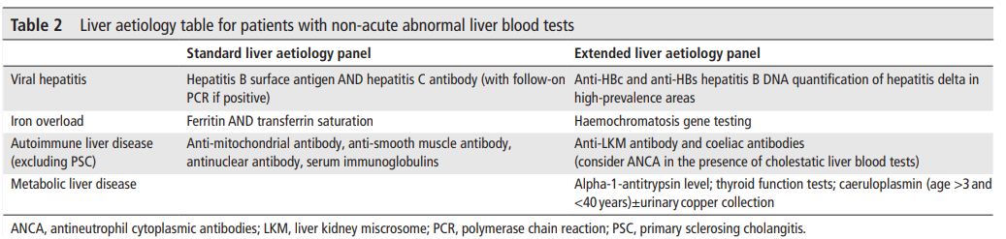
Aetiology For liver disease investigations in Adults and children: Summary

Slide 20
Recommendation 7
Adults with NAFLD should undergo risk stratification to determine the extent of their liver fibrosis .
First-line testing should use either fibrosis-4 (FIB-4) or NAFLD Fibrosis Score (NFS) . Calculation facilities for FIB-4 and NFS should be incorporated in all primary care computer systems.
Second-line testing requires a quantitative assessment of fibrosis with tests such as serum enhanced liver fibrosis (ELF) measurements or Fibroscan/acoustic radiation force impulse (ARFI) elastography.
We recommend that hepatologists at a local level champion this idea and discuss it with commissioners of health to deal with the burden of liver disease in their area

Slide 21
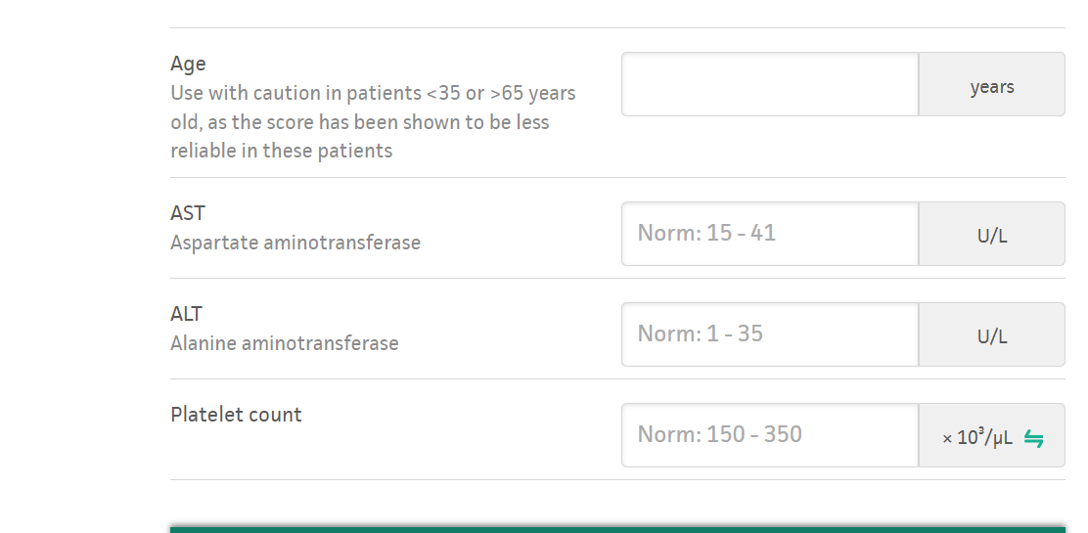
FIB-4 Testing

Slide 22
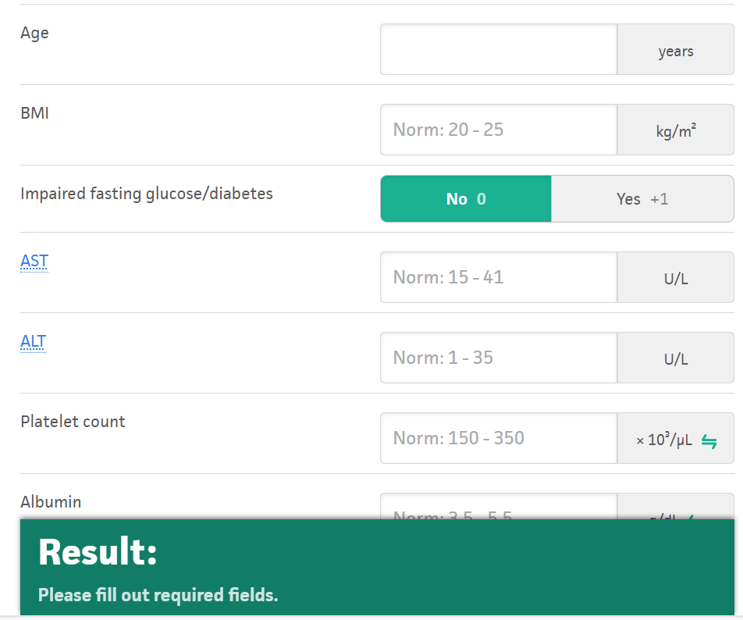
NAFLD fibrosis score testing

Slide 23
ELF Testing
The ELF Test is a non-invasive blood test that measures three direct markers of fibrosis: hyaluronic acid (HA), procollagen III amino-terminal peptide (PIIINP), and tissue inhibitor of matrix metalloproteinase 1 (TIMP-1).
NICE guidance : IF ELF is >10.51 s/o advanced fibrosis , if < 10.51 can retest in 3 years, optimise risk factors for NAFLD

Slide 24
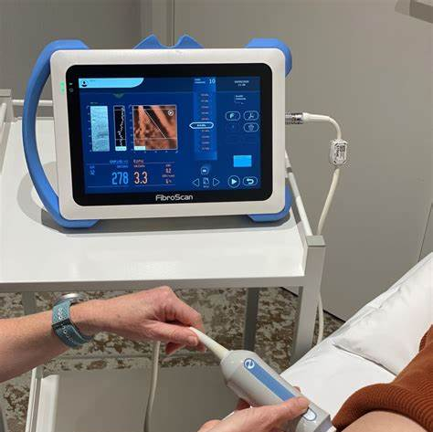
What is Fibroscan
It is a non invasive test to assess the degree of steatosis and Fibrosis in the Liver
Steatosis : CAP score in dB
Fibrosis : Stiffness score in kpa

Slide 25
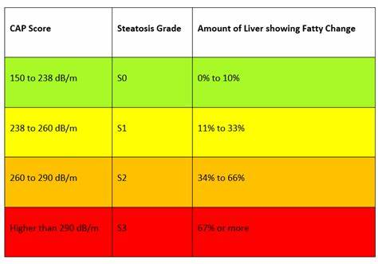
How to interpret Fibroscan CAP score results

Slide 26
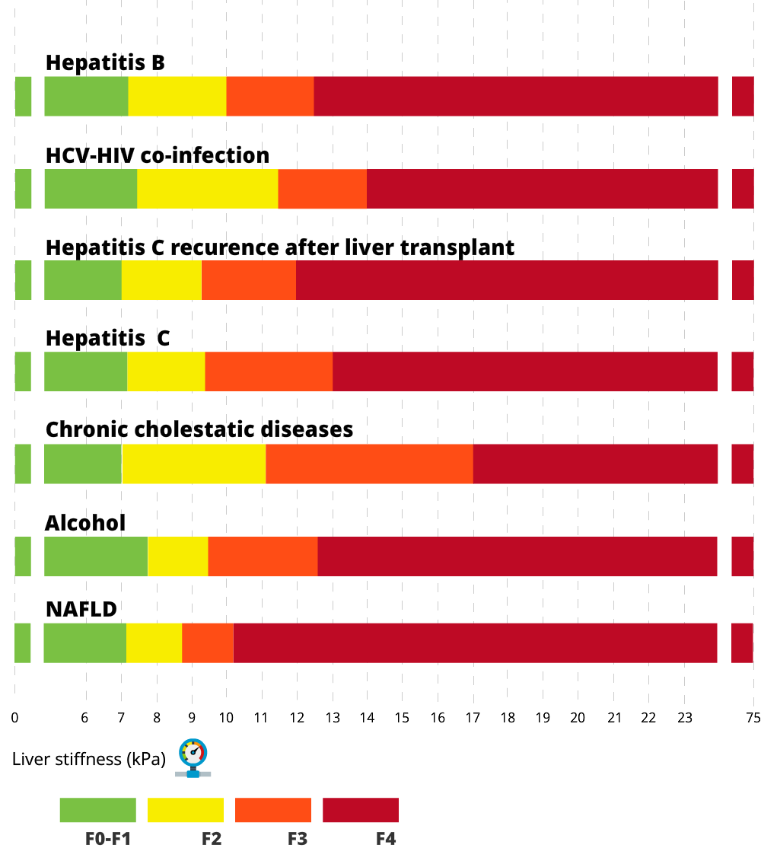
How to interpret Fibroscan E score

Slide 27
Recommendation 10:
Adults with abnormal liver blood tests, even with a negative extended liver aetiology screen and no risk factors for NAFLD, should be referred/discussed to a gastroenterologist with an interest in liver disease/hepatologist for further evaluation (figure 1)

Slide 28
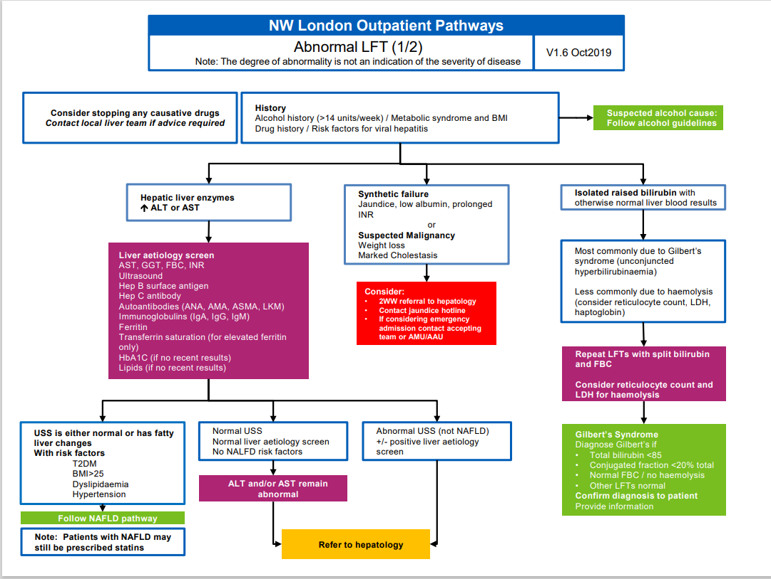
NW London Outpatient pathways for Abnormal LFTS

Slide 29
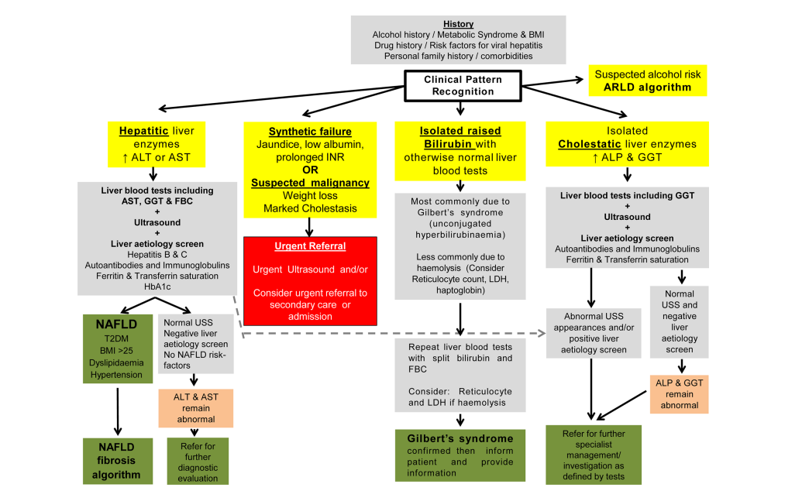
BSG guidance : Abnormal LFTS

Slide 30
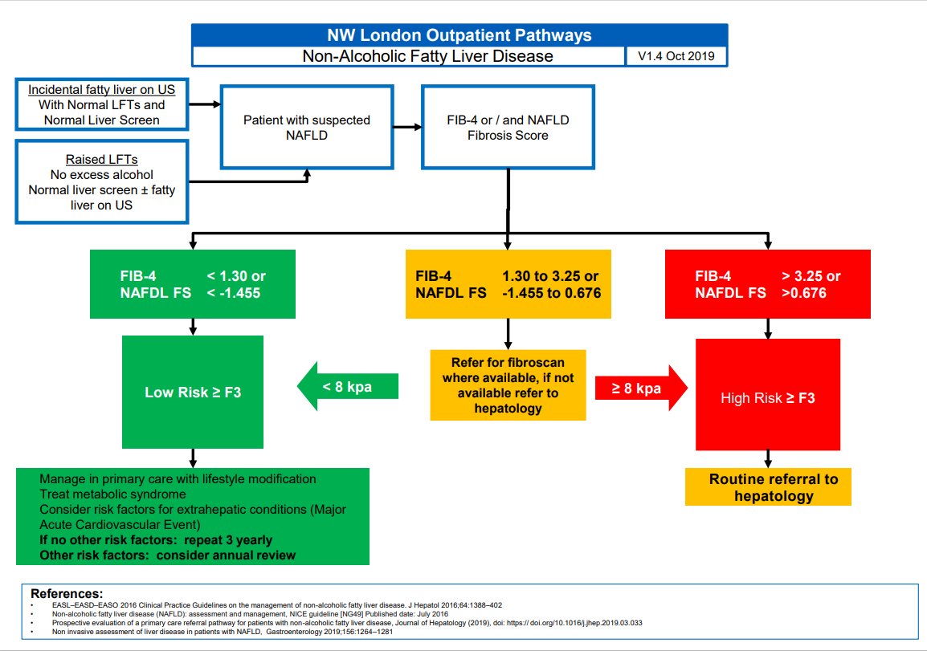
NW London Outpatient Pathways
NAFLD

Slide 31
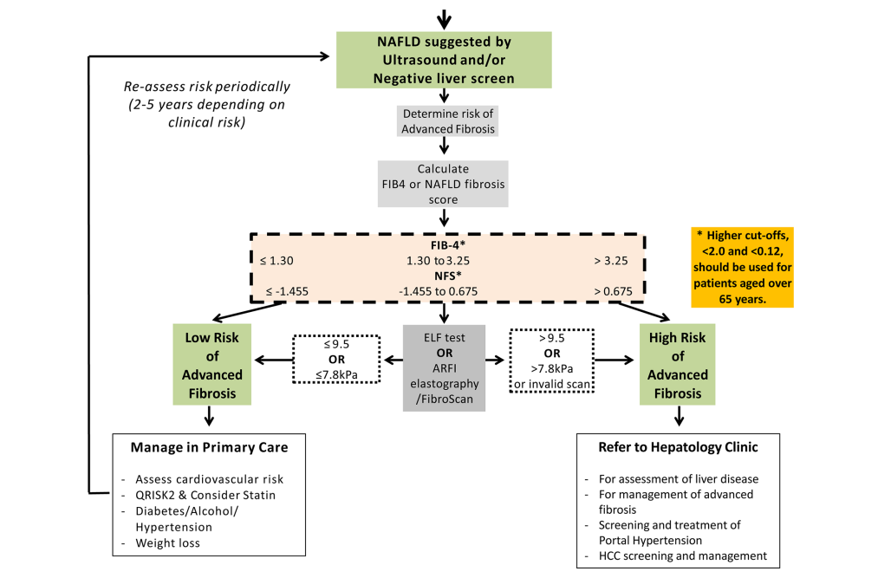
BSG guidance for NAFLD

Slide 32
Case Scenario 3
33 year male has been taking alcohol approx. 8-10 units daily for several years
Admitted with nausea , vomiting , discharged and presented to GP with generalised malaise
LFTs AST 38 ALT 29 Bil 19 Alb 36 PLT 201 GGT 77
USG liver mild fatty

Slide 33
Recommendation 8:
Consider referral to alcohol services for all adults with alcohol-related liver disease (ARLD) with evidence of alcohol dependency as defined by an AUDIT score of >19.

Slide 34
Recommendation 9
Harmful drinkers should undergo risk stratification with clinical assessment and Fibroscan/ARFI elastography. Adults should be referred to secondary care if there is evidence of advanced liver disease (features of cirrhosis or portal hypertension on imaging or from blood tests) and/or Fibroscan reading is >16kPa (if available)

Slide 35
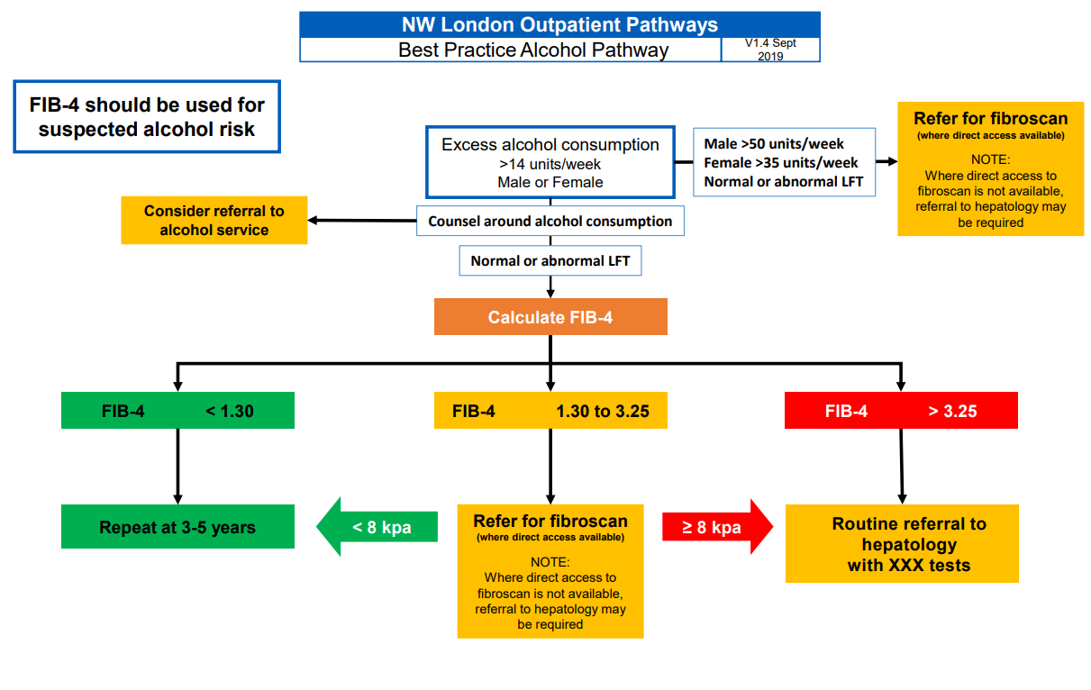
NW London Outpatient Pathways
Alcohol Liver disease

Slide 36
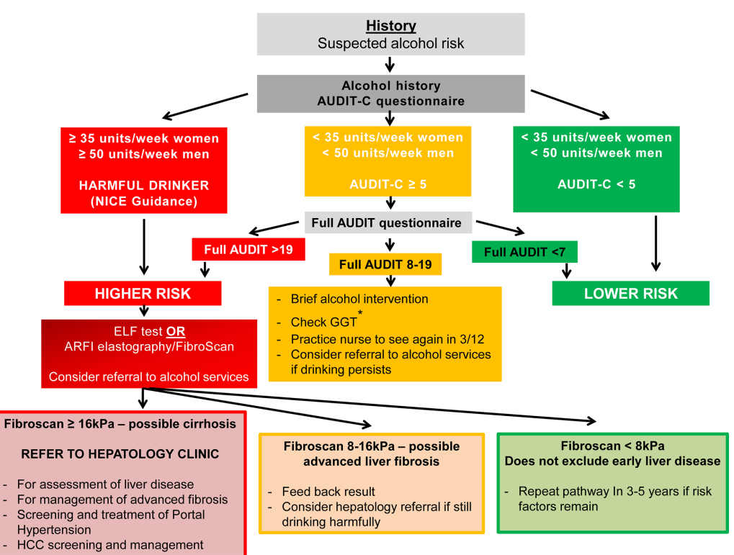
BSG guidance for Alcohol related liver injury

Slide 37
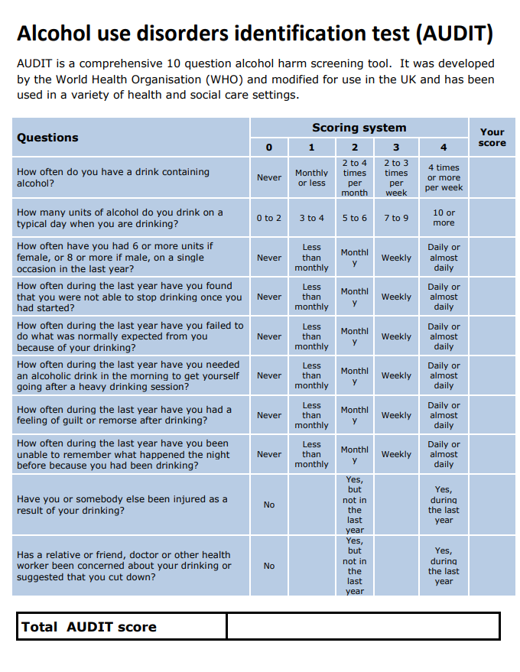
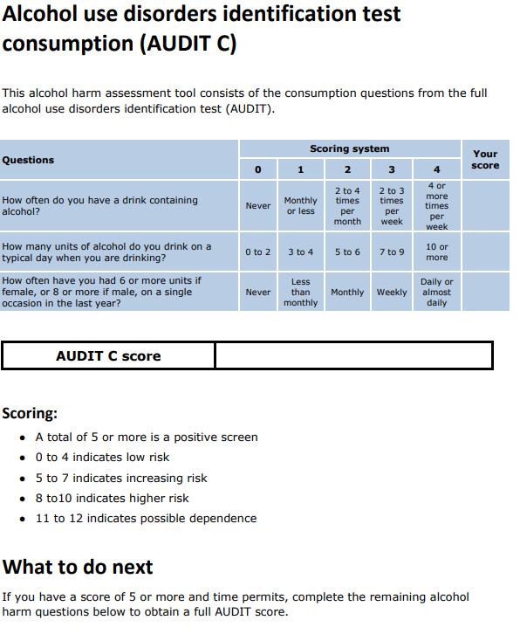
Alcohol Screening Tool

Slide 38
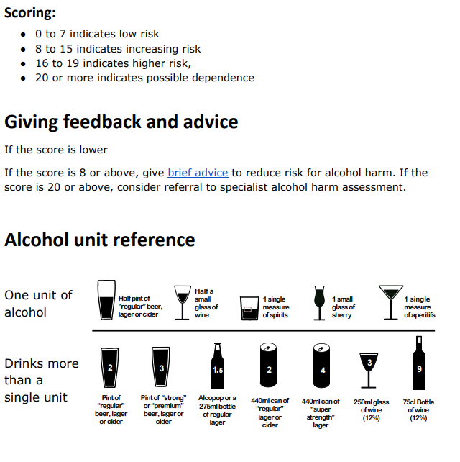
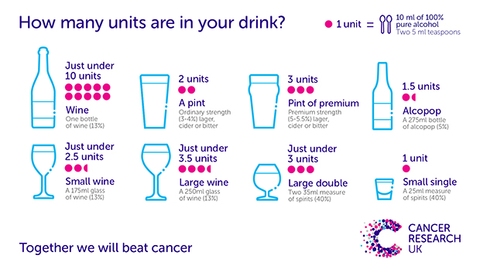
Alcohol Screening Tool

Slide 39
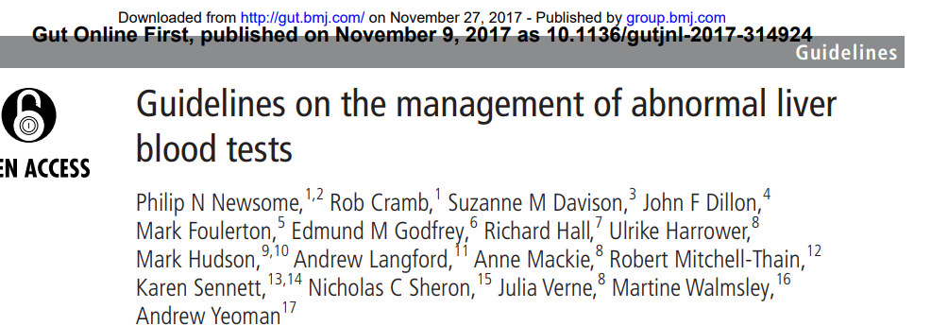
Resource

