Slide 1
Matthew Coulam - EAS Service Development Manager
Ealing Mencap

Slide 2
Supporting partners (externally funded)
Delivery partners (funded by the LBE advice grant)
Funders

Slide 3
IT literacy
Local services
GOSAD
ESOL
Out of Hospital
Befriending
Age UK Ealing
ECIL
Anchor Foundation
Ealing Advice Service
Ealing Law Centre
Equipment
Contact
DeafPlus
H4W
National services
EASE Community
Local services
Parents Support
Ealing Mencap
BAME & Housing MH advice
HFEH MIND
MAFTB
Legal Aid (eg. MTG solicitors)
Digital Advice
Safe Space
Housing, Debt, Employment
Pathways
Havelock Family Centre
ERSCAG
Nucleus
WLEC
Pro Bono
Your Voice (YVHSC)
EAF / CAIA
Child contact
CAP
K&C services
Parentwise
Other local Advice services
PTAS
Hate Crime
SEND IAS
Carers Hub
Services for the Armenian community

Slide 4
Advice areas covered by EAS:
Education
Disability rights
Aids, adaptations, equipment
Travel concessions
Family
Legal
Food bank vouchers
EAS is a one-stop-shop advice service available to all residents of Ealing. We cover:
Benefits
Housing
Debt
Immigration (up to OISC level 1)
Community Care
Consumer
Employment

Slide 5
Our limitations
Only funded to advise Ealing residents (depending on the inquiry this can include people placed in temporary accommodation in neighbouring boroughs)
Certain advice areas require referrals to specialist services - mortgages and complex debt, OISC above level 1, DV, civil litigation, conveyancing, wills & trusts, Power of attorney & Guardianship; small claim applications & Judicial Reviews
We cannot offer counselling, statutory advocacy, health advice, mediation, job club activities or finding accommodation in the private sector but can signpost or refer
Cannot represent in-person for tribunals and hearings but can refer to legal advice providers
We cannot accompany to welfare benefit medical assessments or social services meetings
Cannot duplicate work carried out by other advice services, floating support, residential or supported housing services (eg. maintaining tenancies etc)
Cannot provide long term, regular outreach (eg. a client needing regular home visits to manage correspondence)
Other areas we do not assist with - Financial Circumstances Forms for care charges (Financial Assessment Team); Carers Assessments (Carers Service); Initial UC applications (Help to Claim); initial online council applications if a client can access a digital hub at the library

Slide 6
Who we see & what we do:
Anyone resident in the borough. Includes deaf people who use BSL, people who cannot read or write, people facing language barriers, elderly and disabled people who are restricted to their homes.
We provide advice to between 5000 and 6000 people annually (~2100 per quarter) – mainly older people, people with MH issues, health conditions and disabilities.
EAS partners use a shared database (Advice Pro)
Highest demand is currently for disability benefits (PIP, AA, DLA), benefit entitlement checks, housing (disrepair, Locata, eviction), travel concessions and debt.

Slide 7
Service delivery
A lot of inquiries are resolved at the first point of contact - usually the phone line. The line is staffed by interns, law and social work students and experienced volunteers overseen by a supervisor. It can be very busy, so callers should try later in the day if they can’t get through.
Cases that cannot be resolved at the first point of contact are added to a waiting list to be allocated to a caseworker
Waiting times depend on the type of case, the level of urgency, deadlines and service demand. We try to contact clients with urgent cases as soon as possible. Clients with non-urgent cases (eg. Locata if they are not homeless, benefit checks if they already have income) may have to wait a number of weeks.
Drop in Welfare benefit checks are held at the Lido on a Wednesday morning, and a signposting/information/warm hub service is held on a Thursday with A2 Dominion. Apart from this, EAS is delivering online, telephone advice and pre-arranged appointments only. Very occasional home visits in exceptional circumstances if a client is restricted to their home due to physical disability.
The main hub is based at the Lido Centre. Other appointment locations include the Carers Centre, Greenford Community Centre, GOSAD Community Centre and Havelock Family Centre
Professionals can use the link at the bottom of the EAS website to make an online referral. (please note any deadlines for forms, risks and communication needs)

Slide 8
Referrals
Issue resolved at point of contact. (Enquiries)
Telephone advice (focus on self-resolution of issues)
Email / online
Drop-in - client/advice area specific
Drop-in surgeries - location specific
Anchor clients requiring casework
Direct contact with partner including alternative methods of communication
EAF
Issue not resolved at point of contact (Cases)
Telephone casework, debt & immigration cases
External referral partners
Triage / waiting list (shared record of referrals that cannot be dealt with at first point of contact)
Key
Nucleus
Other partners
Externally funded Face to Face caseworkers employed by partners eg. PSS, housing, travel, Digital advice project etc.
Face to Face caseworkers employed / contracted by partners and funded by the advice grant

Slide 9
Advice projects linked to EAS partners
GLA Funded - Digital Social Welfare Advice Group Sessions (GOSAD, Ealing Law Centre, Nucleus, Ealing Mencap, Turn2Us)
Advising groups of residents about how to access Locata, My Account, Council application, UC online journal etc.
Training front line staff in statutory services to support residents to use the Turn2Us online benefit calculator
HMCTS Funded - We Are Digital online forms
Providing assistance with online SSCS1 And fee waiver forms
Referrals have to come through ‘We Are Digital’
Specialist Advice (Nucleus)
Housing (eviction, possession orders); Debt; pro-bono legal advice on wills, immigration and family law
Deaf Plus Aids, Adaptations and Equipment advice service
Advice relating to hearing aids, telephone equipment, alarms etc.
Access Social Care membership
Second tier specialist advice about adult social care matters
WLNHST funded - BAME & MH advice
Dedicated advice for people who have mental health issues from BAME communities

Slide 10
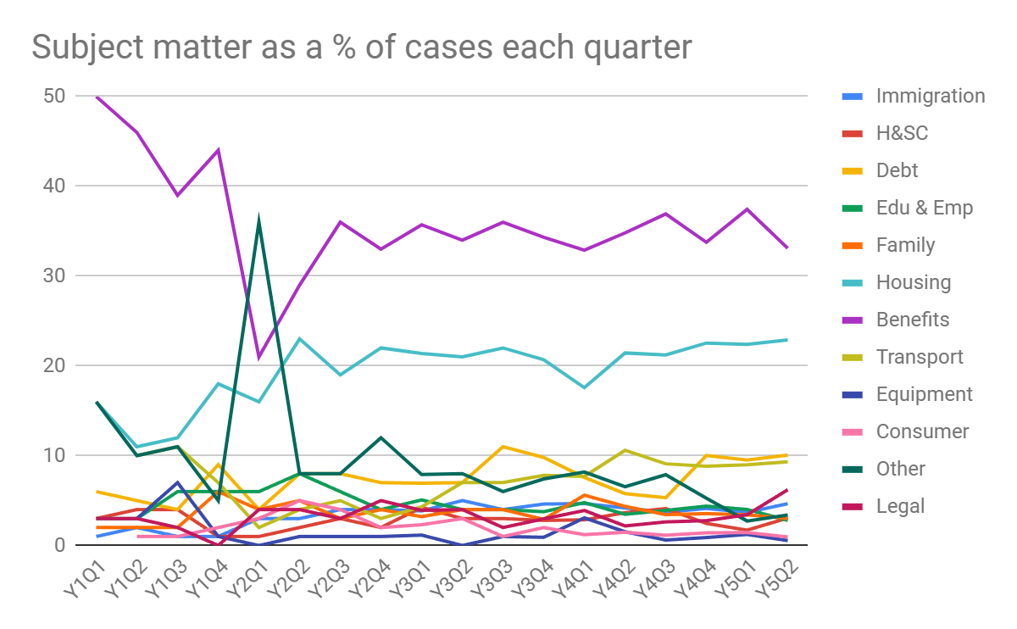
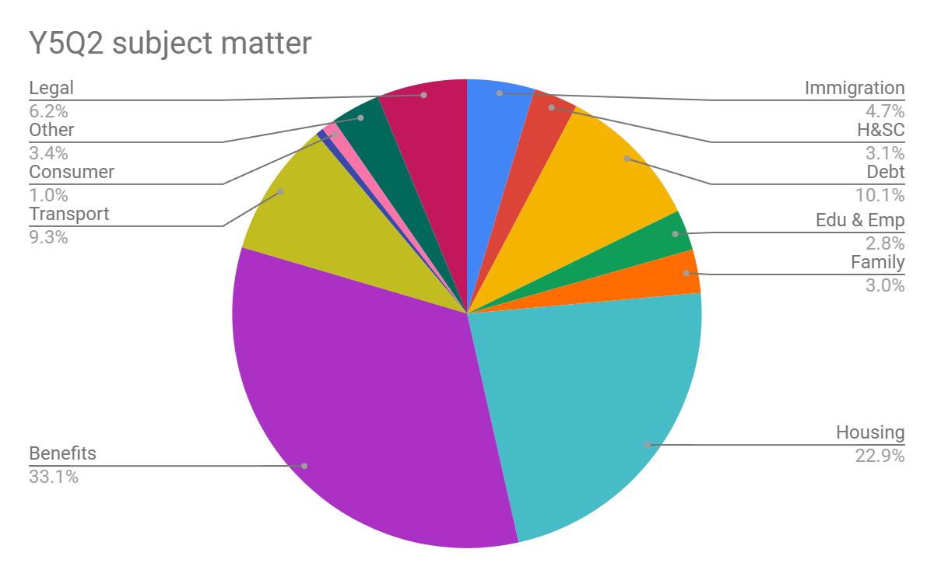
Outcomes, trends and findings (Y5Q2 data)
Financial outcomes for the quarter were £1348924.82 - benefits awards, one off payments, successful appeals, individual grants and debts written off
The most prevalent languages among clients who do not communicate in spoken English were Punjabi, Hindi, Arabic, Farsi, Urdu, Polish and BSL.

Slide 11
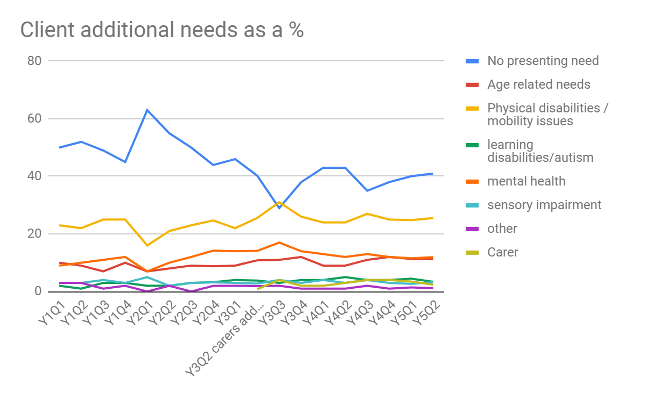
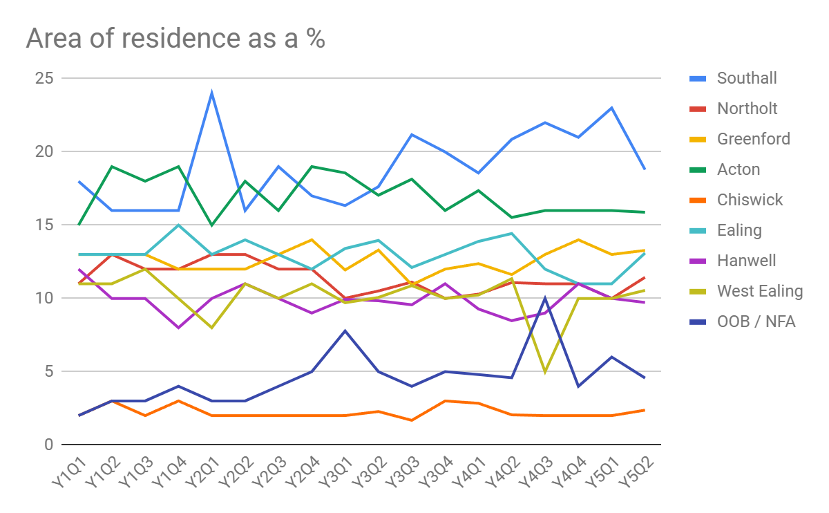
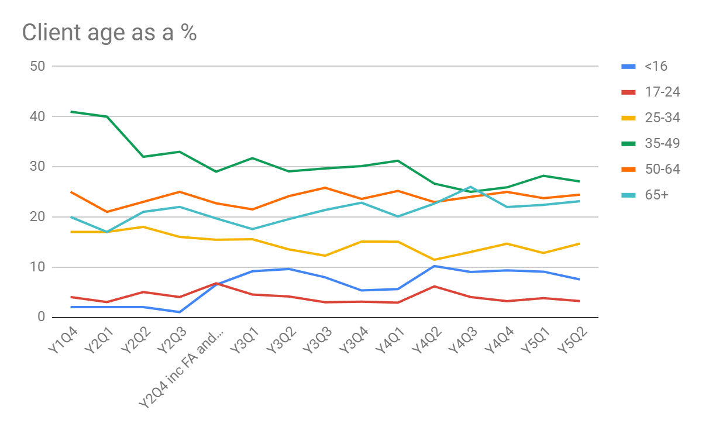
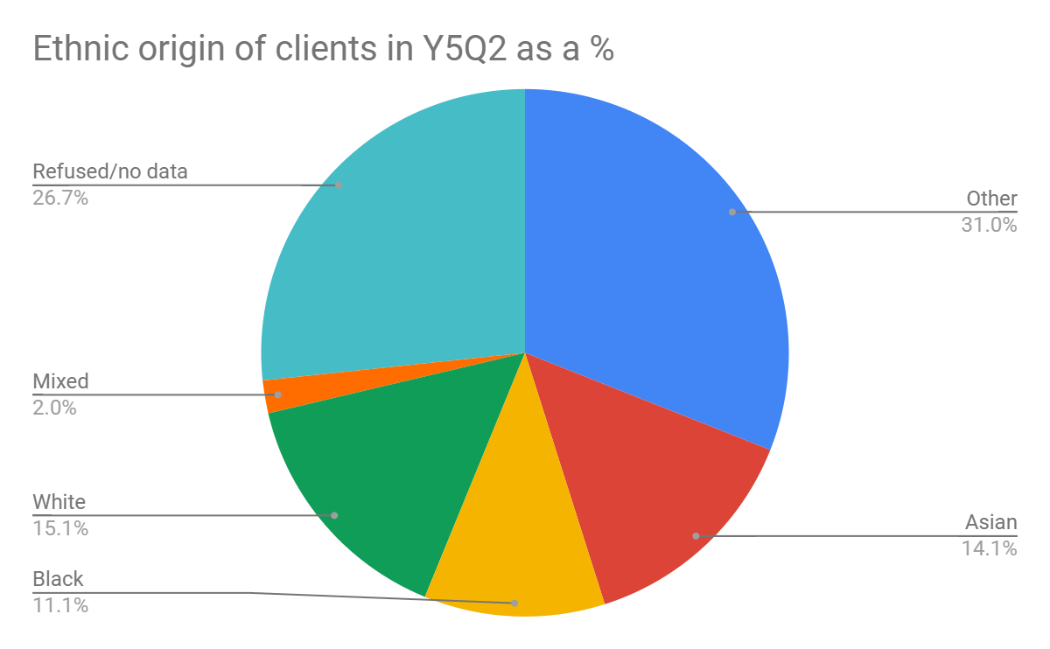

Slide 12
How to refer clients
Main number: 0208 579 8429 – option 1 – Monday – Friday 10am-4pm
Backup number 03000 125 464
Text only 07837186733
Online referrals:
EAS website: www.ealingadvice.org
Emails: info@ealingadvice.org / info@ealingsas.org.uk
Direct referrals for legal advice - complex/consumer debt, employment law, eviction/possession/homelessness:
www.nucleus.org.uk/agency-enquiry-form

