Slide 1
Gynaecology Update with clinicians: Specialist Endometriosis Service London North West University Hospitals NHS Trust
Mr Stewart Disu, MRCOG, Consultant Obstetrician and Gynaecologist, Endometriosis Centre Lead
Mr Nick Dixon, Consultant Obstetrician and Gynaecologist
Tracey McIlwraith, Endometriosis Clinical Nurse Specialist
Prabha Greedhun, General Manager Women’s Health
Tracey McIlwraith Endometriosis Clinical Nurse Specialist, Northwick Park Hospital

Slide 2
ENDOMETRIOSIS
Endometriosis is a condition where tissue similar to the uterus lining (endometrium) is present outside the uterus.
This can cause a chronic, inflammatory response and formation of internal scar tissue.
Although a benign condition, symptoms can be extreme and can have a huge impact on a patients’ quality of life.

Slide 3
ENDOMETRIOSIS
affects 1 in 10 women in the UK.
a long-term, chronic condition that can affect anyone of reproductive age who has a uterus.
can be difficult to diagnose and takes on average 8 years to get a confirmed diagnosis.
symptoms can include heavy and painful periods, chronic pelvic pain, dyschezia, dyspareunia, dysuria, chronic fatigue, anxiety and depression.
can lead to fertility problems

Slide 4
Aetiology
exact cause unknown
known to be hormone dependent
Retrograde Menstruation identified by John Sampson, 1920. Most common theory but not conclusive.
inflammatory or immune dysfunction.
genetic predisposition, more likely to develop if a family member has it, accepted but no definitive research.

Slide 5
Diagnosis
can be difficult to diagnosis as symptoms vary from patient to patient
can often be similar to Irritable Bowel Syndrome or Pelvic Inflammatory Disease.
ultrasound is usually preformed to check the uterus and ovaries and can identify the presence of Endometrioma (chocolate cyst).
laparoscopy is the only way to get a definitive diagnosis.

Slide 6
Treatment Options
Analgesia
Hormonal treatments eg COCP, POP, Mirena coil
GnRHa
Surgery
Complementary therapies
Other options eg diet, exercise, counselling

Slide 7
London North West Endometriosis Centre
British Society of Gynaecological Endoscopy accredited centre since 2014

Slide 8
BSGE Accreditation
In order to achieve accreditation a minimum of 12 complex pararectal space dissections must be performed annually by each accredited surgeon.
Exemplar videos of the procedure must be provided to ensure surgeon skills meet the criteria.
Patients undergoing this complex surgery are followed up for 2 years, completing a PPQ at 6, 12 and 24 months post op.

Slide 9
The Team
Endometriosis Clinical Nurse Specialist - 1
Multi-disciplinary team working with Colorectal, Urology, Radiology and Physiotherapy
Dedicated Colorectal Surgeons - 2
Endometriosis Specialist Consultants -2

Slide 10
Referral Pathway – Primary Care
On presentation to primary care please follow NHS North West London CCG Chronic Pelvic Pain pathway
Only after all other investigations are completed should the patient be referred to secondary care.

Slide 12
Referral Pathway – Secondary Care
Referrals to the Specialist Endometriosis Service can be accepted directly from GP once Chronic Pelvic Pain pathway has been followed and referral to Gynaecology is indicated.
Referrals will also be accepted internally from benign General Gynaecology and from other specialties such Colorectal or Urology.
Patients with suspected/identified endometriosis who present via ED or RAC must be directed back to primary care and re-referred to the Specialist Endometriosis Service.

Slide 13
Indications for referral to specialist service
Chronic pelvic pain likely due to endometriosis
Suspected or identified endometriosis
Deep dyspareunia
Bowel/bladder pain – can be cyclical
Imaging suggestive of endometriosis eg endometrioma, kissing ovaries
Previous endometriosis surgery
Post complex endometriosis surgery

Slide 14
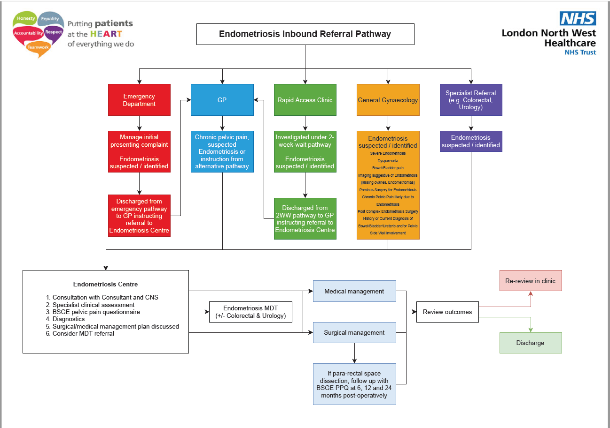

Slide 15
Specialist Endometriosis Service
Consultation with Consultant and Endometriosis Clinical Nurse Specialist
Full medical and surgical history is taken as well as an in depth gynaecological history
British Society of Gynaecological Endoscopy pelvic pain questionnaire is completed. This will be used as a baseline throughout patients care pathway
Further diagnostics requested eg MRI
Discuss at MDT if indicated
Surgical or medical management plan agreed following discussion and input from patient

Slide 16
Thank you
Any Questions?

