Slide 1
Adult Day Centre
Monday - Friday
10 am – 3 pm

Slide 2
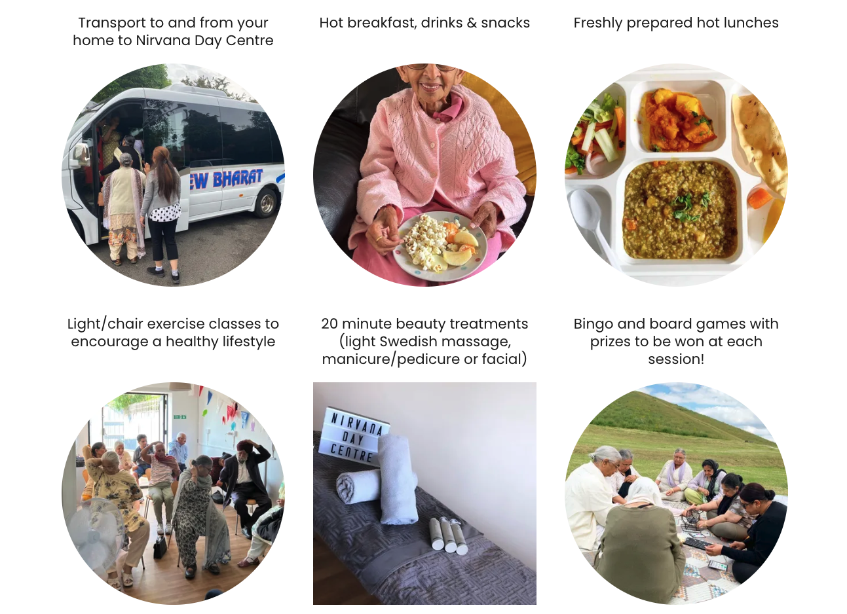
Services

Slide 10
Contact us
Business WhatsApp – 07411443142
info@nirvandaycentre.co.uk
Duty mobile – 07411443142
Nirvana Day Centre, 12 Mandarin Way, Hayes, UB4 9TU.

