Slide 1
Ealing Training Hub
Apprenticeships Information

Slide 2
EALING APPRENTICESHIP PLAN
Aims | Success Criteria | Tasks
To increase the number of apprenticeships offered in GP practices in Ealing ICB | More apprenticeship roles offered across ICB especially in Customer Service and Business Administration | Create guidance information to include types of apprenticeships, employer responsibilities, apprentice responsibilities
 |  | Find effective ways to disseminate information to GP practices eg through PM forum, newsletter, flyers etc
 |  | Support surgeries in offering apprenticeships
To find local apprenticeship training providers we can work with | Relationships established with at least one, hopefully two providers | Contact local providers and arrange to meet about their offers
To encourage potential and current employees locally to take up apprenticeships | Apprenticeship roles filled by locals | Find effective places to advertise apprenticeship roles eg community noticeboards, gov.uk website, job fairs

Slide 3
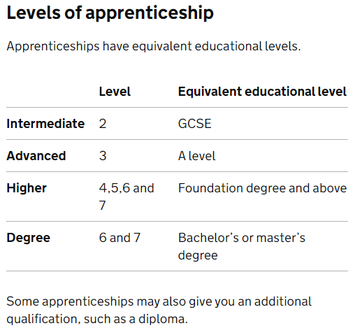
APPRENTICESHIPS
Who are they for?
Individuals over the age of 16 who will be spending 50% or more of their time working and not in education.
They can be used to hire new staff or grow current talent among current workforce
Length if apprenticeship
L2 -Usually 12-18 months
L3 -Usually 18-48 months
L4 and above – 24+ months

Slide 4
APPRENTICESHIPS SUITABLE FOR PRIMARY CARE
Types of apprenticeships
With more than 350 different NHS careers, there are hundreds of different jobs which can be done through an apprenticeship. Here are just a few:
Senior therapy support worker (level 3)
Business administrator (level 3)
Informatics (levels 2 to 7)
HR consultant (level 5)
Healthcare science assistant, associate and practitioner (levels 2, 4 and 6 respectively)
Nursing associate apprenticeship (level 5)
Registered nursing degree apprenticeship (level 6)
Pharmacy services assistant (level 2)
Digital and Transformation leads(Level 4)
Customer Service (Levels 2 and 3)

Slide 5
PMA Online Training specifically aligned to working in Primary Care
PROVIDERS
West London College
Local Training with in person sessions that can be adapted for Primary Care with sufficient candidates
Level 2 Healthcare Support Worker
Level 2 Customer Service Practitioner
Level 3 Senior Healthcare Support Worker
Level 3 Customer Service Specialist
Level 3 Business Admin- GP Contextualised
Level 3 Business Admin
Level 3 Business Admin with clinical coding
Level 3 Community Health and Wellbeing Worker
Level 3 Team Leader / supervisor
Business Analyst Level 4 to support the Digital Transformation Lead Role
Level 7 Senior Leader

Slide 6
HOW TO HIRE AN APPRENTICE
Choose and apprenticeship for your surgery
Find and organisation that offers training
We are working with West London College and PMA as per previous slide.
3. Check the training funding you can receive
If you do not pay the apprenticeship levy then the Government pay 95% of the cost of training the apprentice up to the funding band maximum. This is paid directly to the training provider.
The remainder 5% is to be paid by the employer, however we may be able to access additional funding to cover this 5%

Slide 7
HOW TO HIRE AN APPRENTICE continued
4. Create an account
You will need this to manage funding and recruit apprentices
5. Advertise your apprenticeship
This can be done via the gov.uk website and local avenues such as Work Ealing – remember we are trying to recruit local people into local jobs
6. Make an apprenticeship agreement and training plan with you apprentice

Slide 8
Employer Responsibilities
Ensure you have a job available with a contract long enough for the apprentice to complete their training. This should be the apprenticeship training length +3 months to give them time to complete all of their assessments
e.g If an apprenticeship is 18 months long they will need a contract that is 21months long
Know that apprentices spend 20% of their working week time involved in off the job training. This could be attending college face-to–face or online, special training days or workshops.
Know that each week apprentices need 6 hours to complete experience logs at their place of employment. This may not have to be a set 6 hours but can be fitted in flexibly over weeks / months/ the whole apprenticeship.
To support the apprenticeship in gaining the skills and knowledge required of the course

Slide 9
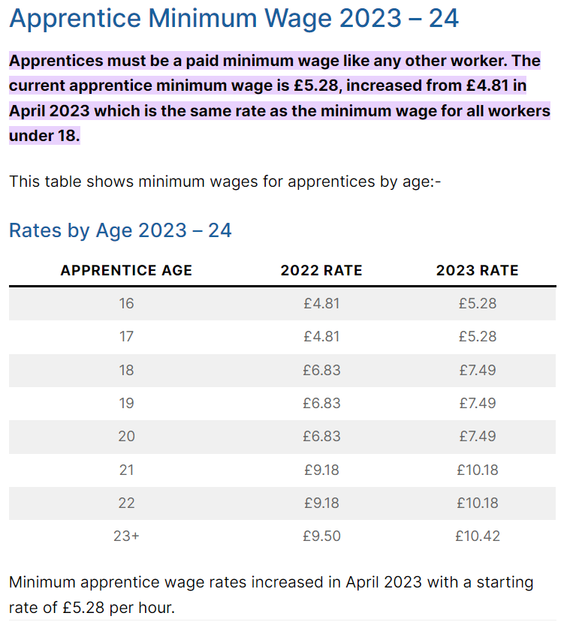
Employer Responsibilities continued
To pay the apprentice the correct wage
The table shows the Apprentice minimum pay requirements but we would encourage employers to pay the London Living Wage, or as close as possible (this is more likely to attract good candidates) which is currently set at £13.15 and hour

Slide 10
Thank you for your time

