Slide 1
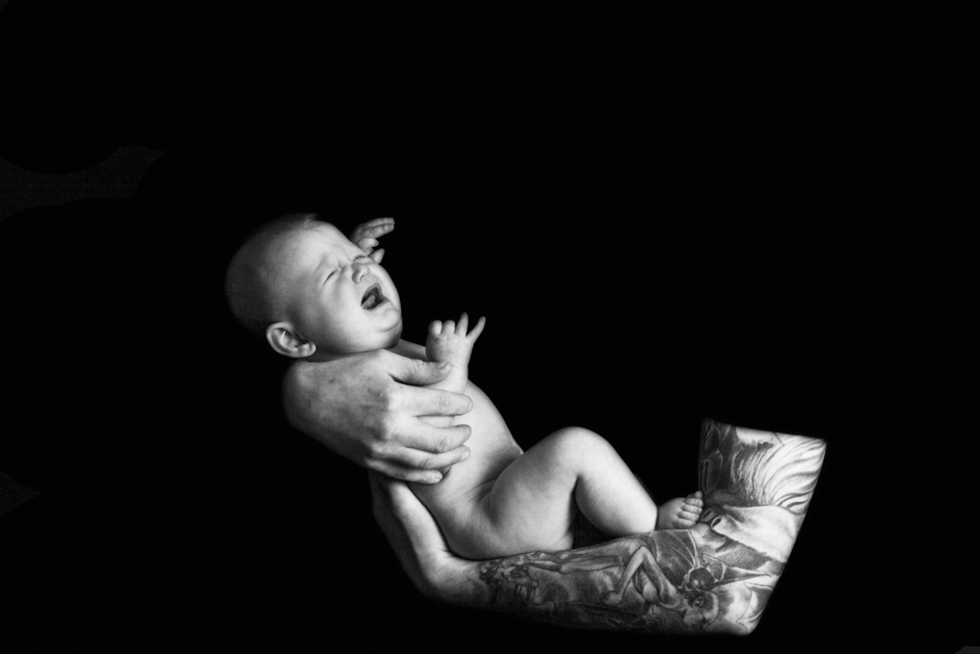
Training for trainers and professionals: The ICON message
© ICON
Notes:
Welcome to this training for trainers and professionals about the ICON: Babies Cry, You Can Cope programme.

Slide 2
Aims of this training session
This training is designed to equip you with the knowledge, information and skills that you will need to discuss ICON: ‘Babies cry, you can cope’ with parents and carers
The training will help you to:
share the message that crying in babies is normal
support parents/carers to soothe their baby
support parents to cope with a baby’s crying
understand more about Abusive Head Trauma
Notes:
This training will equip you with the knowledge, information and skills that you will need to discuss the ICON message with parents and carers. It will help you share the message that crying in babies is normal, support parents/carers to soothe their baby, help them cope with their baby’s crying and understand more about the dangers of shaking a baby and abusive head trauma.

Slide 3
What is Abusive Head Trauma?
Also known as Shaken Baby Syndrome, is Child Abuse
Catastrophic injuries:
Brain injuries
Bleeding behind the eyes
Bony injuries
Our goal for ICON is to communicate to parents/carers that they can expect crying, prepare for it and cope with it
Our aim is to reduce the incidence of AHT triggered by crying
https://iconcope.org/parentsadvice/
Notes:
Slide 3
Abusive Head Trauma is also sometimes referred to as Shaken Baby Syndrome. It is a form of child abuse that causes catastrophic injuries such as brain injuries for example, subdural haemorrhages, retinal haemorrhages and bony injuries. The ICON website provides a link to a BBC Inside Out programme that provides a good explanation of what happens when a baby is shaken. Our goal is to help parents expect crying, prepare for it and cope with it and to reduce the incidence of AHT triggered by crying.

Slide 4
More facts about Abusive Head Trauma
AHT is the most common cause of death or long term disability in babies
24 out of 100, 000 hospital admissions for babies are due to abusive head trauma
200 children are killed or hurt annually in the UK
These figures certainly underestimate the real numbers involved
Notes:
These are some facts and figures about AHT. The key point is that these are an underestimation of the true numbers involved. We want to make a difference to this form of abuse as it is 100% preventable.

Slide 5
WHO SHAKES and why?
70% perpetrators are males – fathers/male surrogates
Coping with crying can feel like living on a cliff edge
Caregivers lose control and shake
Can occur in every socio-economic group
Demonstrable relationship between the normal peak of crying and babies subject to AHT.
Increase in babies in the 1st month of life, a peak at 6 weeks during the 2nd month and a decrease during the 3rd to 5th months of life
Research shows that babies are most likely to be shaken when they are 2-4 months old… the time when babies cry the most.
Notes:
It is important to note that 70% of babies who are shaken are shaken by men. It is important to keep this in mind when delivering the programme and working out how to ensure men get the ICON message. A crying baby can make parents and carers feel like they are approaching or living on a cliff edge testing their ability to cope to the limit. Some lose control and shake their baby causing some or all of the catastrophic injuries described previously. This frustration happens to parents/carers in all socio-economic groups. Research has shown a demonstrable relationship between what is described as the normal peak of crying and babies subject to AHT. The normal peak of crying sees crying start to increase in the first month of life, round about 2 weeks of age, reaching a peak about 6 – 8 week and decreasing during the 3rd to 5th months of life. Research also shows that babies are more
likely to be shaken when they are between 2 and 4 months old – the time when babies cry the most.

Slide 6
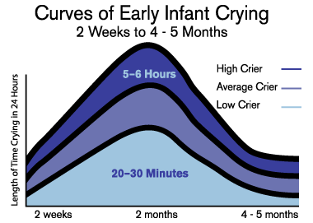
Normal Crying curve (Barr 1990)
Notes:
This is the Normal Crying Curve described by Ronald Barr in 1990 and shows the peak at 2-4 months when some babies can cry for up to 6 hours in a 24 hour period.

Slide 7
Notes:
This slide shows the Normal Crying Curve adjusted for premature infants – also based on Barr's work. You can see that the increase in normal crying happens around two weeks after the baby's expected due date, and then follows the same pattern as for term infants. It is helpful for parents of premature babies to work out with them just when they can expect to see this increase in their baby

Slide 8
Coping strategies
Success depends on controllability
Problem solving where the stressor cannot be controlled can lead to frustration and distress
support through the problem rather than solving the problem
The need for a careful approach towards a responsive professional intervention that is rooted in evidence is, therefore, crucial
Notes:
The success of any coping strategy depends on the controllability of the situation. Coping strategies relying on problem solving may lead to increased frustration and distress when used in a context where the stressor cannot be controlled and where there is no response (Folkman 1992; Compas et al 1988). Taking excessive infant crying as an example, Long and Johnson (2001) found parents eventually accepted that coping involved support through the problem rather than solving the problem (i.e. stopping the baby crying) which was frequently an impossible task. The need for a careful approach towards a responsive professional intervention that is rooted in evidence is, therefore, crucial.

Slide 9
Living on a cliff edge!
Excessive infant crying can be associated with:
Parental stress
Depression
Possible relationship problems
Feelings of guilt, inadequacy and helplessness
https://youtu.be/Q3mc0FhrNF8
Notes:
That feeling of living on a cliff edge that I talked about earlier can have a huge impact on parents/carers and families including stress, depression, feeling of guilt, inadequacy and helplessness. The video ‘I am Unshakeable’ is a 3 minute animation on our website that can be downloaded by following the link, and that powerfully portrays how real these feelings are when a baby won’t stop crying. It’s a good video to show parents/carers when the opportunity arises. It also has subtitles so can be played with no sound in waiting areas etc.

Slide 10
Are some babies more at risk than others?
Research shows that the most at risk babies are:
Baby boys
Babies under 6 months old
Babies born pre-term or at low birth weight
Babies who have previous involvement with child protection services.
Notes:
There are some babies who are more at risk of abuse and AHT than others. Baby boys, babies under 6 months, pre-term/low birth weight babies feature in research studies as being more at risk.

Slide 11
Why are premature/LBW babies at increased risk?
Pre-existing factors within the family or environmental context which may have contributed to premature/LBW delivery and which are also risk factors for abuse and neglect (e.g. substance misuse, domestic abuse)
Increased risk of disability which can also be associated with increased risk of abuse or neglect
Disruption of attachment due to need for ongoing neonatal intensive care
Increased care needs for baby
Notes:
Sadly, some of the factors which we know can predispose to abuse and neglect can also be seen in the families of premature babies and can even contribute to premature or low birthweight delivery - drug and alcohol misuse, and domestic abuse in particular. Other factors such as disability, increased care needs, and problems with attachment can also present parents with very real challenges. Continuous infant crying may simply be the last straw for some parents of these really vulnerable babies.

Slide 12
Cost
Human and Emotional
Financial
Hospitalisation
Long term health and educational needs
Medical equipment
Legal proceedings
Child Safeguarding Practice Review
Loss of societal productivity
Ellis’s Story: https://youtu.be/aqCbREcduMA
Notes:
The human and emotional cost of AHT is incalculable. The financial cost runs into many thousands. They include the cost of hospitalisation and investigations, if the baby survives there will be long term health and educational needs, the medical equipment needs are many and complicated and then there are potential legal proceedings in criminal and civil courts. In some cases, there will also be the significant costs of a Child Safeguarding Practice Review. Ellis’s story is a powerful video describing all of these things. Mae tells the story of her son Ellis who was shaken as a baby, and who lived with profound disabilities until the age of 14. Use of this video is important in making this topic real and allowing the voices of parents and children to be heard.

Slide 13
Does prevention work?
A co-ordinated, hospital based parent education programme targeting parents of all newborn infants can significantly reduce the incidence of abusive head trauma in children less that 36 months.
Dias et al (2005) Preventing Abusive Head Trauma Infants and Young Children: a hospital based prevention program Pediatrics 115: 470 – 477
16 infants who were born in the 8 year study period were treated at the children’s hospital for shaking injuries sustained during their 1st year of life. Of those infants 14 were born during the 5 year control period and 2 during the 3 year post implementation period. The decrease from 2.8 injuries/year to 0.7 injuries/year represents a 75% reduction (P=03).
Altman et al (2010) Parent Education by Maternity Nurses and Prevention of AHT.
Notes:
ICON was established after years of research into what makes a good effective prevention programme. It is founded on a solid evidence base and evaluation of the programme itself is in the very early stages. However, the question ‘does prevention work’ is often asked and the next two slides give details of just 4 studies out of many more, that demonstrate positive outcomes ranging from 2005 to 2020. The studies show a reduction in the incidence of AHT …

Slide 14
Does prevention work?
The primary aim of this study was to determine whether there was any change in visits of 0 to 5 month old infants to the Medical Emergency Room (known as the Emergency Department in the UK). After program implementation, crying cases were reduced by 29.5% (p < .001). The most significant reductions were for crying visits in the first to third months of life.
Barr R G, Rajabali F, Aragon M; Colbourne M., Brant R., Education About Crying in Normal Infants Is Associated with a Reduction in Pediatric Emergency Room Visits for Crying Complaints J Dev Behav Pediatr 36:252–257, 2015
A New Haven AHT prevention programme that chose to teach parents how to recognise their feelings of frustration with their infants crying and to walk away from the baby found that those who received the programme were 79% less likely to have been diagnosed with AHT.
Bechtel et al (2020) Impact of the Take 5 Safety Plan for Crying on the Occurrence of Abusive Head Trauma in infants. Chlid Abuse Review vol 29: 282-290
Notes:
Slide 14
… a reduction in attendance at an Emergency Department and a reduction in likelihood of an AHT diagnoses. It is always difficult to prove cause and effect but the body of evidence is great enough to suggest prevention does make a difference helping parents cope with crying and protecting babies from AHT.

Slide 15
What is ICON?
Notes:
So what does ICON stand for. It is a mnemonic that is easy to remember. Stepping through each letter:

Slide 16
Implementing ICON
Research shows that AHT prevention programmes are most effective when the same message is given by different professionals on a number of occasions.
For those babies born prematurely or requiring neonatal intensive care, it is recommended that the Premature Baby ICON leaflet should be given to both parents and the ICON message discussed with them as part of the discharge planning for their baby
The ICON message can then be reinforced and parents supported by Health Visitors, specialist community neonatal nursing teams and GPs
Notes:
As with all good prevention programmes, the core ICON message needs to be repeated at key touchpoints by different professionals. For parents of babies on Special or Neonatal Intensive Care Units, it is recommended that the ICON message is introduced to BOTH parents or carers as an integral part of discharge planning, along with the specially designed Premature Baby ICON leaflet.

Slide 17
The ICON Touchpoints
Each area can deliver ICON through additional routes e.g. antenatally, via 0-19 teams. The touchpoints below represent the CORE ICON programme.
In hospital/at home following delivery before the Mother and baby are discharged (this is the time when men are often present and the opportunity to engage with men at this point is crucial). The leaflet provided and explained in detail using the ICON script as a guide if necessary.
Notes:
ICON has been deliberately designed so that local areas can adapt it slightly to suit the needs of their local population e.g. providing antenatal ICON interventions, offering day nursery input, and interventions via 0 – 19 teams. What is going to be described now is the CORE minimum ICON programme. It starts soon after delivery when the baby is discharged home from hospital or if born at home, before the midwives leave the home of the family. This is the time when men are often present and the opportunity to engage with men at this point is crucial. The ICON leaflet is provided and explained in detail using the ICON script as a prompt if necessary. A recent survey shows that this usually takes about 5 – 6 mins but not normally more than 10.

Slide 18
ICON Touchpoints (cont)
Within the first 10 days during Community Midwife visit (a light touch reminder)
Between 10 and 14 days during Health Visitor contact (a light touch reminder and conversation about comforting techniques)
Around 3 weeks via text/telephone/visit/clinic contact by Health Visiting service (a light touch reminder and conversation about a plan about how to cope)
At the 6/8 week check with GP (a questionnaire included in RCGP national toolkit)
Notes:
Slide 18
A community midwife will see the family at home and will provide a light touch reminder of the ICON message before baby is 10 days old. That might just be as simple as ‘do you remember getting that leaflet about coping with crying, ICON? Might be worth you having another look in the next few days because 2 weeks old is when babies usually start to cry more…’ etc. A health visitor will make contact usually between 11 and 14 days and again will offer another light touch reminder perhaps exploring with parents what comfort techniques they’ve heard about or have used with their other children when they were babies. The next touchpoint is at 3 weeks which is outside of core service delivery but areas are being quite creative in finding ways to reach out to parents, by phone, by text, at clinic, to once again, offer a light touch reminder and maybe prompt them to consider getting a plan ready for when the crying reaches a peak – the back of the ICON leaflet provides a template for this. At 6/8 weeks baby will have a review by the GP. This is the age when the crying is either at a peak or approaching it. GPs have available to them a short questionnaire that is part of the National Toolkit for GPs and which helps them structure a conversation around coping with crying, postnatal depression and domestic abuse. It’s another opportunity to go through or hand out the ICON leaflet. So that is the core programme. Very simple, light touch and doesn’t require much extra resource as these are the times professionals are engaging with a family with a new baby.

Slide 19
How can professionals help parents?
By offering ICON as a way to avoid a situation where frustration can lead to abuse
By discussing the issues raised
By talking through the key points in the ICON leaflet
Showing ‘I Am Unshakeable’ video
Notes:
This simple message will help support parents and public health research suggests the staggered points of delivery by different professionals is likely to have a positive impact.

Slide 20
Introducing ICON to a parent/carers
Help parents understand that crying is normal… all parents can feel like this
Make a positive effort to engage with male carer/dad
Explain that crying is a normal part of development
Reassure parents that babies are not doing this on purpose
Support parents in coping with their own emotions and stress (Coping with Crying Plan)
Teach parents soothing and safe sleep techniques
Inform parents/carers about sharing the ICON leaflet with anyone who cares for your baby.
Notes:
It is important that parents understand crying is normal and everyone feels frustrated by a crying baby. It is really important to make every effort to engage with the dad/male carer and also encourage parents to share the information with anyone who is going to be caring for the baby – relatives/ childminders/nannies etc. The ICON leaflet and resources anticipate parents anxiety and worries about their baby’s health and encourage them to seek advice if they are worried. The C is for comfort methods resource provides information on when to seek emergency medical assistance. The key message is that if baby is well and all their basic needs are met, they may still cry between these ages for what seems like no apparent reason and if this is getting to you, your job is to recognise when you are feeling frustrated and cope rather than trying to stop the crying.

Slide 21
ICON resources
Leaflet
Stickers
Fridge magnets
I Am Unshakeable video
Coping with Crying Plan
GP questionnaire
Series of short videos
C is for Comforting methods infographic
Notes:
There are a variety of ICON resources available. Individual areas have ideas for creating their own. They are being developed all the time. It is important to highlight a wider public health campaign via social media that runs behind the touchpoints. Analytics show that social media is an effective method of reaching men and encouraging them to engage with the message. So it is really important, as professionals promoting ICON, for you to go onto the different social media sites, facebook, twitter and Linkedin and like/share/comment/repost/retweet etc

Slide 22
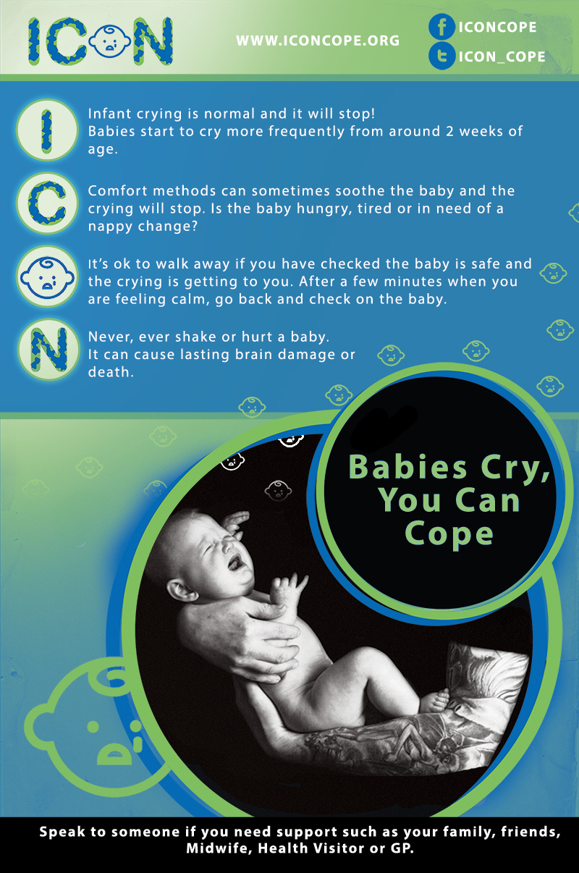
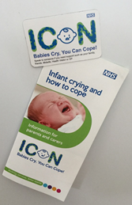
Notes:
Posters, leaflets and fridge magnets are available and you can have your area’s logo added if you wish.

Slide 23
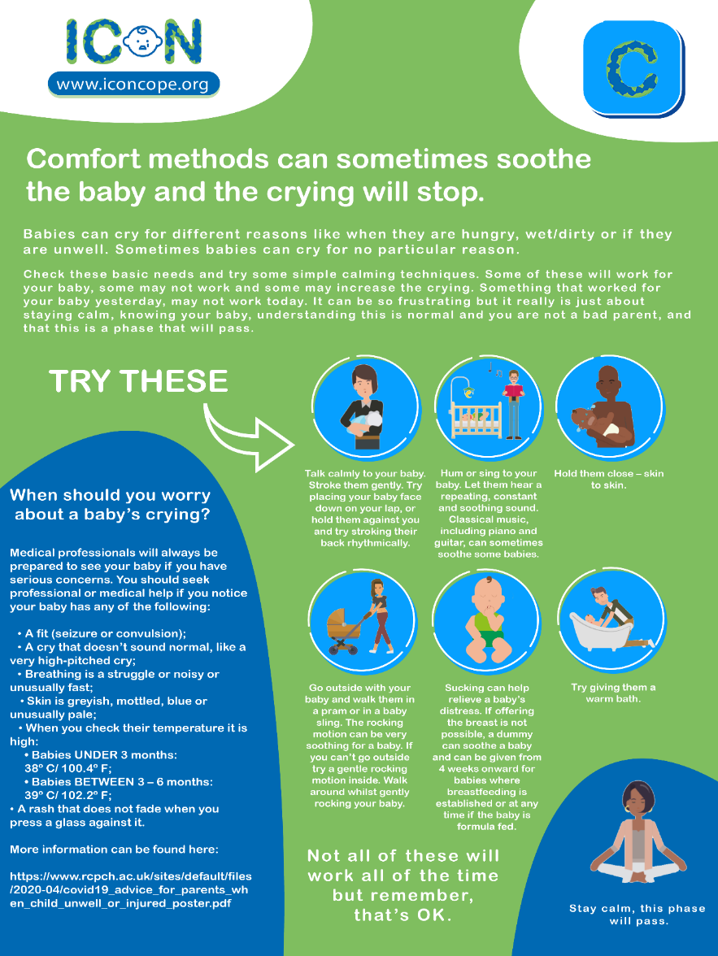
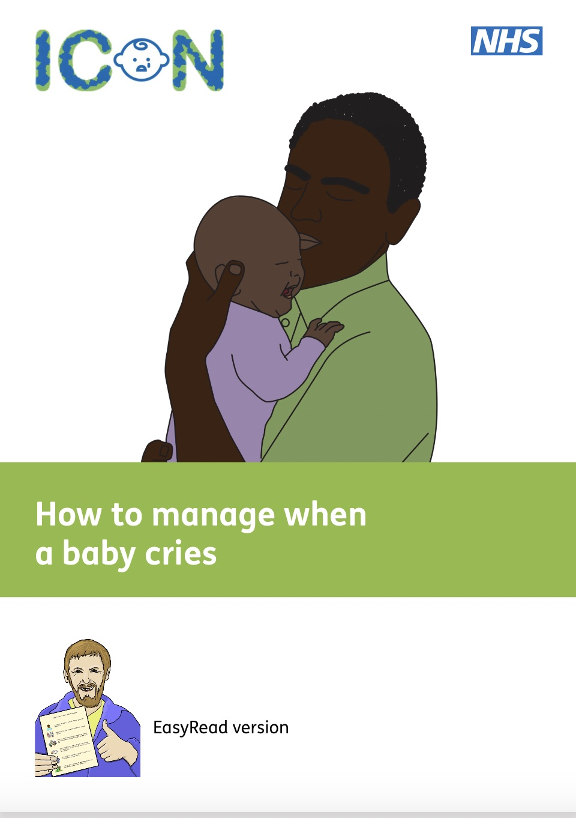
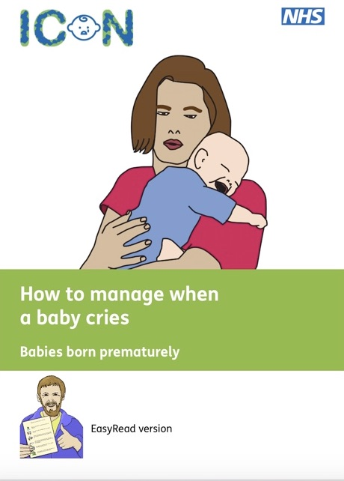
Notes:
Slide 23
We are developing a suite of infographics and social media animations to accompany them based on each letter of ICON. This is an example of C is for comfort methods. For parents with Learning Disabilities or for whom English is not the first language, Easy Read versions of the leaflets and a 'Browsealoud' facility on the ICON website will help you to share this important information. If you have any queries about how to deliver the programme contact your Designated Nurse Safeguarding Children in your area, or contact the ICON team at info@iconcope.org. Have a look at the ICON website where you’ll find a lot of information about the programme, where it came from and what inspired it as well as all the resources.

Slide 24
Ellis’s Story
https://youtu.be/aqCbREcduMA

Slide 25
Shaken Inside Out Programme by BBC Yorkshire – YouTube

Slide 26
Thank you!
Notes:
Finally, thank you, on behalf of babies and parents, for supporting parents to cope with crying and reducing the risk of abusive head trauma.

