Slide 1
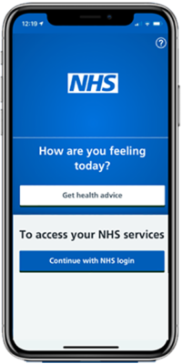
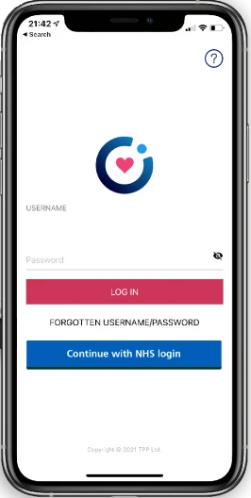
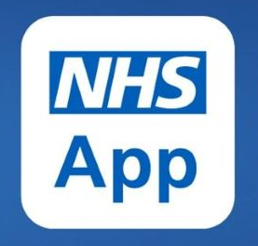
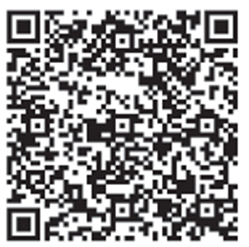

Your Practice Name
NHS App & Airmid app
We recommend you download both these apps, so you can:
• Order repeat prescriptions
• Contact your GP surgery
online
• Manage appointments
• Use NHS 111 online
• Find NHS services
• View your heath record
• Get reminders and
messages
• Check your NHS number
• Register your organ
donation decision
• Complete questionnaires
• And much more….
Both Apps give you secure access via your NHS Login, which you can create through the NHS App.
Download NHS App
Download Airmid app

