Slide 1


Health & Wellbeing through Community-based Recovery
and Prevention Services

Slide 2

Jasmine
Jasmine Project provides free, confidential counselling and support to women living in Ealing who are affected by substance misuse and experience mental health and/or domestic abuse. Through a structured programme of counselling, group work and activities, we develop a support plan at assessment. We work closely with local substance misuse and mental health services and are able to support you within the community at various locations.
The Jasmine Project is base at:
EACH Counselling & Support
4th Floor
84 Uxbridge Road
Ealing
W13 8RA
New leaflets will be sent out with new address shortly.

Slide 3
THE JASMINE PROJECT
For Women 18+ based and living within the Borough of Ealing
The Jasmine Project offers 1:1 counselling from 12-21 weeks depending on the need of the individual
Therapeutic group-support during and after counselling sessions
Clients can self-refer or you can reach us using the Jasmine project referral form and send it to:
jasmine@eachcounselling.org.uk

Slide 4
Our Counselling and Support Groups for all women cover:
Building self esteem
Dealing with Anxiety and Depression
Healthy relationships positive psychology mindfulness helping build confidence and wellbeing

Slide 5
The Jasmine Program is tailored for Women 18+ that:
Have Substance Misuse (current or historic)
Have experienced Domestic and Sexual Abuse (current or historic)
Have Mental Health issues
Have no history of suicide within the last 3 months
The client has intent to reduce/abstain from substance misuse
We aim to respond and assess clients as quickly as possible.
We hope to build up our network of referrers to fulfil our project aims and serve women with multiple needs based in Ealing.
Who can you refer

Slide 7
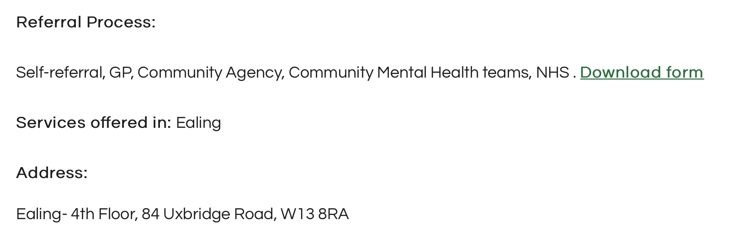
EACH Services Ealing
Ariane Pouillet
Counsellor and Jasmine Project Coordinator
Monday-Wednesday 9-17:00 Thursday 9-14:30
Friday 9-17:00
EACH Counselling & Support
4th Floor
84 Uxbridge Road
Ealing
W13 8RA
Mobile: +44 7867 362041
Website: https://eachcounselling.org.uk/

Slide 8

New Projects:

Slide 9
