Slide 1
Childhood Immunisations Ealing Practice Manager Forum
Rebecca Wilson
Immunisation Coordinator (Brent & Ealing)
NWL ICB Immunisation Team
March 2023

Slide 2
Childhood Immunisations G.P Contract 2020 - 2024
All practices to have a named lead for immunisations.
Practices should ensure the availability of sufficient trained staff and convenient, timely appointments to cover 100% of their eligible population.
Practices should ensure their call/recall and opportunistic offers are being made in line with national standards.
Good Practice-Immunisation-Invite-Reminder-Guide.pdf (england.nhs.uk)
4. Practices should participate in agreed national catch-up campaigns.
www.england.nhs.uk/long-read/confirmation-of-national-vaccination-and-immunisation-catch-up-campaign-for-2023-24/
5. Practices should adhere to defined standards for record keeping and reporting of coverage data.
www.england.nhs.uk/wp-content/uploads/2020/03/udate-to-the-gp-contract-agreement-v2-updated.pdf

Slide 3
Childhood Immunisations G.P Contract 2024/25
The GP Contract will be changed in 2024/25 so that practices are required to:
share vaccination status (both vaccinated and unvaccinated) with the local Child Health Information Services (CHIS), and any other system nationally required, and support CHIS data cleansing.
improve data recording of vaccination status for all patients, including where they have arrived from overseas and where there is an unknown or incomplete history to offer vaccinations in line with the UK Schedule and Green Book.
improve data quality for vaccination events, with this being supported through a rationalisation of SNOMED codes used for vaccination event recording.
following an impact assessment by NHS England, with practices ensuring they are using the relevant codes within their clinical system templates; and
maintain accurate and up-to-date patient vaccination records, including correcting vaccination records as and when they are made aware of any errors.
PRN01111-letter-gp-contract-arrangements-24-25.pdf (england.nhs.uk)

Slide 4
Childhood Immunisations Personalised Care Adjustment
A new PCA was introduced for VI001, VI002 and VI003 to take into account patients who registered at the practice too late (either too late in age, or too late in the financial year) to be vaccinated in accordance with the UK national schedule (or, where they differ, the requirements of the relevant QOF indicator).
The automated PCA has been built into the business rule logic underpinning the QOF V&I GPES extracts and applies in circumstances where a child is registered with a practice and:
there is insufficient time to provide any incomplete vaccinations either within the required timeframes to meet the indicator requirements, or
where a child has an incomplete vaccination status and is now older than the cut-off age required by the indicator.
The PCA cannot be applied manually and will be automatically applied by the indicator logic. The PCA applies once the individuals are registered with the practice and the relevant logic parameters are met. Where the PCA is applied, it will remove the child from both the denominator and numerator thus not impacting on achievement of the relevant indicator.
Quality and Outcomes Framework (QOF) business rules v48.0 2023-2024 - NHS Digital
NHS England » Quality and outcomes framework guidance for 2023/24

Slide 5
Childhood Immunisations Recording Vaccination from Overseas
Quality and Outcomes Framework guidance for 2023/24 (england.nhs.uk) says:
Where a patient has been vaccinated overseas in accordance with the UK National Vaccination Schedule – i.e. the schedule of the overseas country conforms to the UK schedule – practices can record delivery of the vaccination in their clinical system to ensure that the vaccination counts towards QOF achievement’.
For avoidance of doubt, if a patient has been vaccinated overseas in accordance with the UK national schedule and appropriate evidence has been provided of this vaccination event, the patient should count as a success in respect of any relevant QOF indicator – it should not simply trigger a Personalised Care Adjustment.
Where a patient has been vaccinated overseas in accordance with the UK national schedule, the practice can ensure that the vaccination counts towards QOF achievement but does not attract an item of service payment by coding the vaccination.
UK and international immunisation schedules comparison tool - GOV.UK (www.gov.uk)
WHO Immunization Data portal
Vaccination of individuals with uncertain or incomplete immunisation status (publishing.service.gov.uk)

Slide 6
Childhood Immunisations What a Load of QOF…
The QOF parameters for 2023/24:
VI001: 89 - 96% (previously 90 – 95%) The percentage of babies who reached 8 months old in the preceding 12 months, who have received at least 3 doses of a diphtheria, tetanus and pertussis containing vaccine before the age of 8 months.
VI002: 86 - 96% (previously 90 – 95%) The percentage of children who reached 18 months old in the preceding 12 months, who have received at least 1 dose of MMR between the ages of 12 and 18 months.
VI003: 81 - 96% (previously 87 – 95%) The percentage of children who reached 5 years old in the preceding 12 months, who have received a reinforcing dose of DTaP/IPV and at least 2 doses of MMR between the ages of 1 and 5 years.
Give vaccination within time frames (as best as possible) – please do not use your QOF list as a call and recall list.
Quality and Outcomes Framework (QOF) business rules v48.0 2023-2024 - NHS Digital

Slide 7
Childhood Immunisations Changes to Childhood Routine Vaccination Schedule (UKHSA)
Immunisation training webinar 2023 - Horizon scanning routine immunisation schedule changes - Health Publications

Slide 8
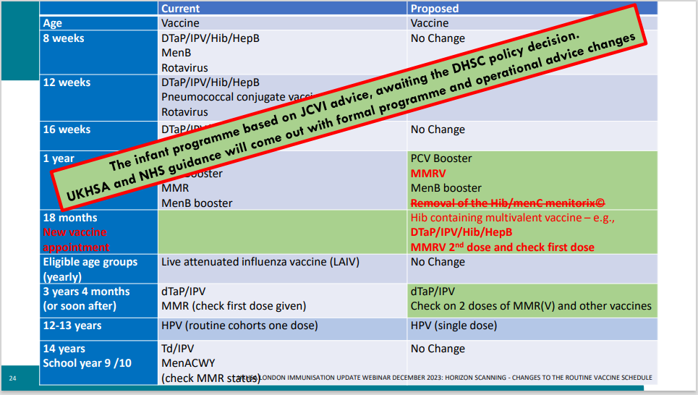
Childhood Immunisations Changes to Childhood Routine Vaccination Schedule
Immunisation training webinar 2023 - Horizon scanning routine immunisation schedule changes - Health Publications

Slide 9
Childhood Immunisations Ealing Borough Data – Quarter 2 2023/24
Quarterly COVER data: Child Imms COVER Dashboard - Vaccinations and Screening - FutureNHS Collaboration Platform

Slide 10
Childhood Immunisations Ealing Borough Data – Quarter 2 2023/24
Quarterly COVER data: Child Imms COVER Dashboard - Vaccinations and Screening - FutureNHS Collaboration Platform
Notes:
Current Q2 2023/24 COVER data for Ealing PCN’s– available on Futures Platform (web address on slide) – As per previous data reviews and public health intelligence the areas of Southall continue to have good uptake where as the areas of Acton, Northolt and Greenford have low uptake.

Slide 11
Childhood Immunisations Borough Data – Annual 2023/24
Ealing COVER Data:
MMR1 at 24 months for 2022/23: 85.8% - last time it was lower than this percentage was 2019/20.
MMR2 at 5 years for 2022/23: 81% - last time it was above this percentage was 2013/14.
MMR1 at 5 years for 2022/23: 89.1% - this is the lowest % uptake in the 10 years of published COVER data.
Ealing QOF Data:
VI001: 90 – 95% threshold in 2022/23: 47/70 Practices D: 4,361 (N:4,020) = 431 (over 12 months = 35 ÷ 70 practices = 0.5)
VI002: 90 – 95% threshold in 2022/23: 28/70 Practices D: 4,469 (N:3,855) = 641 (over 12 months = 53 ÷ 70 practices = 0.7)
VI003: 87 – 95% threshold in 2022/23: 20/70 Practices D: 4,865 (N:3,746) = 1119 (over 12 months = 93 ÷ 70 practices = 1.3)

Slide 12
Childhood Immunisations Measles
Since 1 October 2023, there has been an increase in measles cases across England, with a disproportionately high rate seen in the West Midlands. There has been a sharp rise in case numbers over the last 4 weeks.
From 1 October 2023, there have been 730 laboratory confirmed measles cases reported in England, 52 new cases since the 7 March 2024 (17 cases were reported in October, 42 in November, 156 in December, 267 in January, 213 in February and 35 so far in March).
60% (438 of 730) of these cases have been in the West Midlands, 18% (131 of 730) in London, and 7% (48 of 730) in the Yorkshire and The Humber. The majority (462 of 730, 63.3%) of these cases are in children under the age of 10 and 29.2% (213 of 730) in young people and adults over the age of 15.
In the past 4 weeks (since 12 February 2024), there have been 151 newly confirmed measles cases. The highest number of cases continue to be reported from the West Midlands (41% of cases, 62 of 151), followed by London (26%, 39 of 151), the North West (12%, 18 of 151), Yorkshire and The Humber (7%, 11 of 151) and the East Midlands (7%, 10 of 151).
NWL has had the most cases in London.
Latest measles statistics published - GOV.UK (www.gov.uk)

Slide 13
Childhood Immunisations MMR Campaign: 2023/24
The 2023/24 national vaccinations and immunisations catch-up campaign focus is on measles, mumps, and rubella (MMR). www.england.nhs.uk/long-read/confirmation-of-national-vaccination-and-immunisation-catch-up-campaign-for-2023-24/ . The campaign will run from November 2023 to March 2024 in two stages:
From November 2023 to March 2024 – practices will be required to undertake local call and recall for eligible individuals aged 12 months up to and including 5 years.
From January 2024 to March 2024 – practices are asked to support requests for vaccination from individuals aged 6 years up to and including 25 years. This cohort will be identified through phased national call and recall, and where individuals or parents/carers contact their practice following receipt of the invitation.
UKHSA and NHS England have launched the campaign to support efforts to increase uptake of childhood immunisations among children aged 0-5, and highlight the serious risk childhood diseases can pose if children aren’t vaccinated.
The campaign will have a particular focus and up weighted marketing activity across the North West, the West Midlands and London. Marketing campaign launches to drive up childhood vaccinations - GOV.UK (www.gov.uk)

Slide 14
Childhood Immunisations MMR Campaign: 2023/24
This catch-up will be supported by the School Age Immunisation Service (SAIS) for the relevant age cohorts, alongside general practice activity. Brent, Ealing and Hillingdon School-based Immunisation Service (cnwl.nhs.uk) (Vaccination UK from Sept 2024)
The ROVING team will also be providing additional capacity clinics at CP House as well as offering outreach to communities in Ealing which Ealing Public Health are supporting with by identifying community groups and venues.
Measles, mumps and rubella (MMR) :: North West London ICS (nwlondonicb.nhs.uk)
The NHS in North West London has launched a targeted initiative to support communities with low MMR vaccination uptake among children.
Funding is available to support communities and information for people to make informed choices and provide better access around vaccinations.
Expressions of interest for community funding :: North West London ICS (nwlondonicb.nhs.uk)
Pharmacy Pilot in early stages – more to follow.

Slide 15
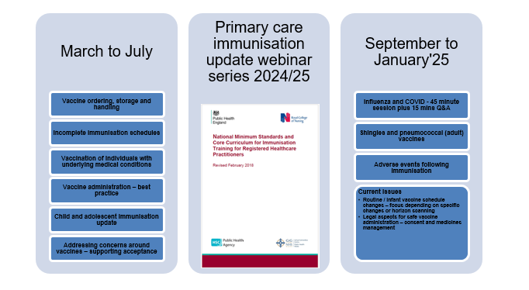
Childhood Immunisations UKHSA Primary Care Immunisation Update Series 2024/25
www.gov.uk/government/publications/immunisation-update-webinars-for-primary-care-immunisers/primary-care-immunisation-webinar-series

Slide 16
Childhood Immunisations JITSUVAX Training
www.jitsuvax.info/discover/

Slide 17
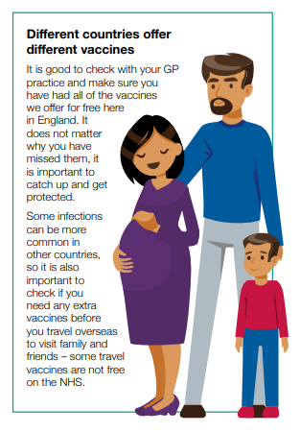
Childhood Immunisations Uncertain or Incomplete Vaccination

Slide 18
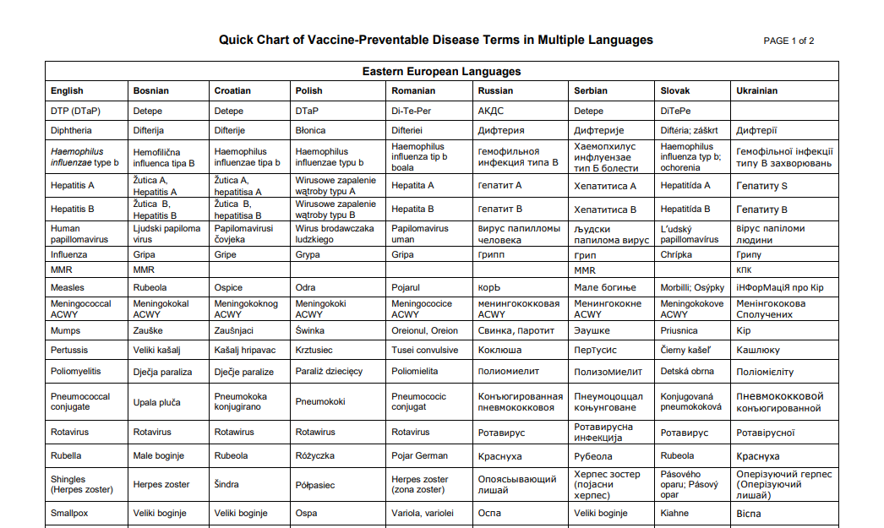
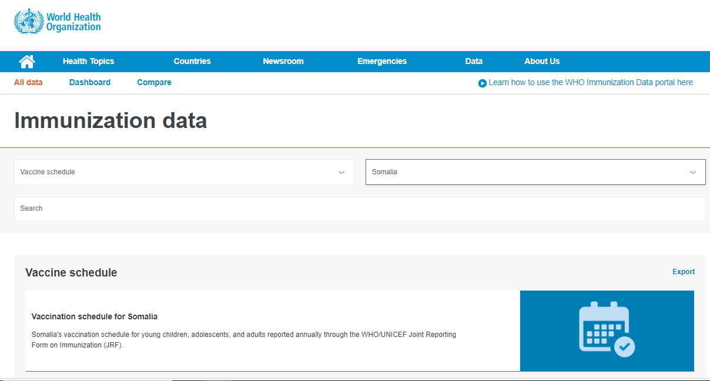
Childhood Immunisations Useful Tools
www.immunizationdata.who.int/listing.html?topic=vaccine-schedule&location=
www.immunize.org/wp-content/uploads/catg.d/p5122.pdf

Slide 19
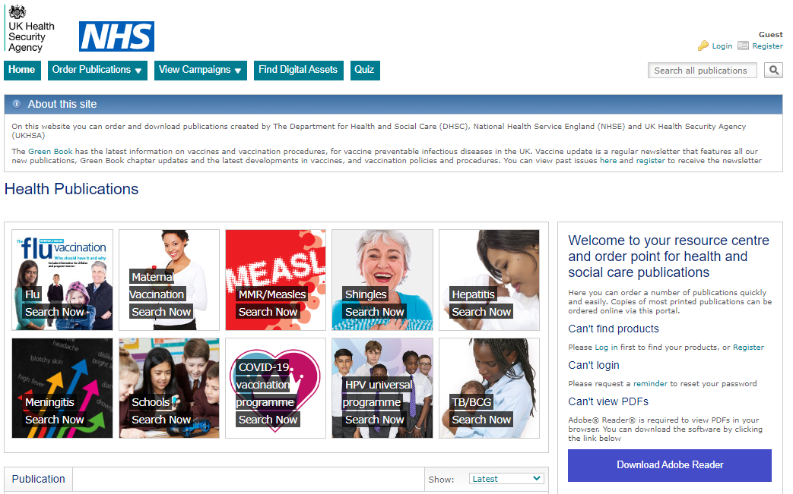
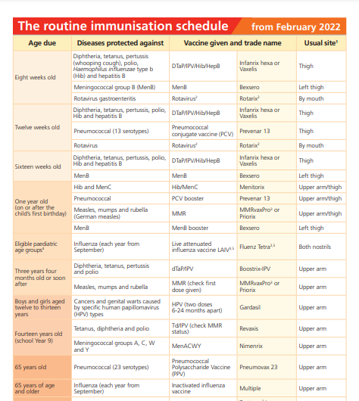
Childhood Immunisations UKHSA Health Publications: https://www.healthpublications.gov.uk
Currently 30+ languages

Slide 20
Childhood Immunisations Vaccine Knowledge Project: https://vaccineknowledge.ox.ac.uk/home
Over 130 languages available

Slide 21
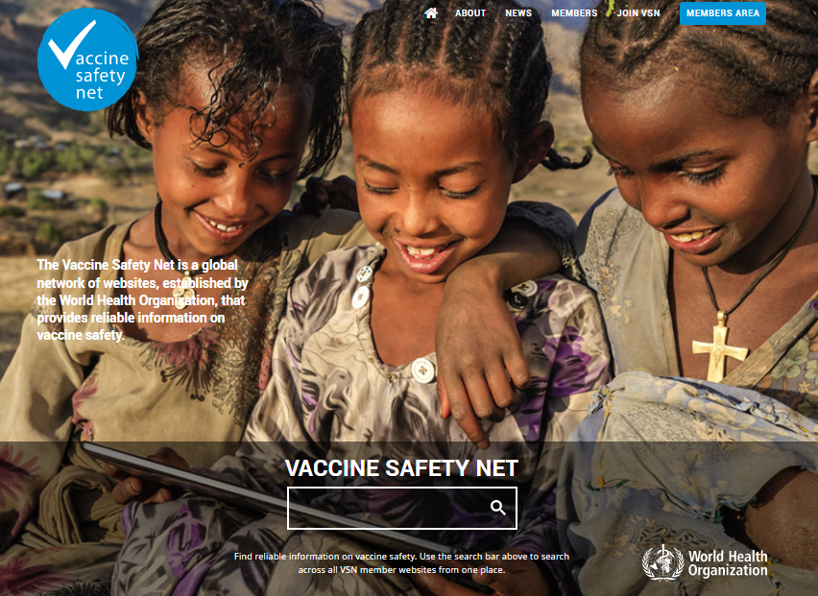
Childhood Immunisations Vaccine Safety Net: https://vaccinesafetynet.org

Slide 22
Childhood Immunisations Resources
NWL CYP Webinar: Measles (Jan 2024) https://www.youtube.com/watch?v=9z4QVtacidM&feature=youtu.be
NWL Comms Resources Page Communications resources for staff :: North West London ICS (nwlondonicb.nhs.uk)
UKHSA Immunisation Immunisation - GOV.UK (www.gov.uk)
WHO Vaccination and Immunisation Vaccines and immunization (who.int)
British Society for Immunology Home | British Society for Immunology
Vaccine Knowledge Project Home | Vaccine Knowledge Project (ox.ac.uk)
Jitsuvax Discover – Jitsuvax
Vaccine Safety Net Vaccine Safety Net
Health Publications Home - Health Publications
NHS Vaccination Strategy NHS England » NHS vaccination strategy

Slide 23
Rebecca Wilson Immunisation Coordinator rebeccawilson5@nhs.net

