Slide 1
Enhanced Services

Slide 2
2023/24 Reconciliation
2023/24 NWL and Local Enhanced Services Dashboards and data was available from the 19th April 2024.
Practices have until the 8th May 2024 to check this information and correct any mistakes.
The final position will be published on the 29th May 2024
Any additional payments required as a result of performance will be issues in the July payment schedule. This is done at PCN level.
Clawback will be discussed on an PCN to PCN basis about the most appropriate course of action.
PCNs will need to agree with practices how they are reconciled after this point, as we no viability as to onwards payments made to practices.
There is no data validation for Diabetes (Level 1 and NDH) and Mental Health (SMI and CCMI) as patient denominator will change and therefore it would impact performance.
Medication Management will be addressed at a later date because the publication dates for ePACT data are different.
If PCN A subcontracts a service to PCN B, who will be paid for the service by North West London? (Spirometry)
PCN A will be paid by North West London as the responsibility lies with PCN A for delivering the full range of services covered by this contract to 100% of the population registered to membership practices within the network. If the responsibility has been subcontracted to PCN B, PCN A is responsible for paying PCN B as per their subcontracting agreement. The North West London dashboard for the Single Offer activity based services, can be switched between the PCN/practice delivering the activity vs patient registered PCN/practice.

Slide 3
2023/24 Appeals
There is a mechanism under the North West London Primary Care Enhanced Services Single Offer contract to challenge where the PCNs believes there to be discrepancies in the data or performance recorded in the year-end enhanced service reports, including Diabetes and Mental Health if applicable. Where this is the case,
A challenge must be submitted by the provider to the local borough team within 15 working days after the publication of the year end reconciliation position (Deadline 19th May).
Any appeals which are raised after the 15 days cannot be considered
Appeals will only be head at a PCN level, individual practices cannot submit their own appeals, this should be done via the PCN
Appeals should contain all relevant evidence required and a description of the rationale behind the challenge.
Local borough teams will aim to respond to within 15 working days after the receipt of the completed challenge.
Payments associated with successful appeals will be made at the earliest possible oppurtunity.

Slide 4
2024/25 NWL Single Offer Services
Services
Spirometry
Prescribing
Mental Health (SMI/CCMI)
Phlebotomy
Wound Care
ABPM
ECG
Diabetes (Level 1)
NDH (Diabetes)
Warfarin Initiation/Monitoring
Latent TB Testing
Ring Pessary
Near Patient Testing
Paediatric Phlebotomy
Tier 2 - Insulin Initiation
Atrial Fibrillation Screen
Respiratory
Hypertension
Safeguarding
Non-Contraceptive IUD - Fitting & Removal
Asylum Seekers - Long/Short Stay
CKD
There are a total of 52 service lines in the 2024/25 NWL Single Offer, these are consolidated into 22 different areas as listed.
Rewind has been removed due to the programme coming to an end in July 2023
Paediatric Phlebotomy has moved from the Ealing local offer to the NWL single offer. The specification is based on Ealing's existing specification
Insulin Initiation has moved from the Ealing local offer to the NWL single offer, this is an expanded service offer and includes GLP1, MDTs and optimisation.
Respiratory has been moved to the NWL single offer, however there are different expectations for the specification than PCNs are currently doing.
CKD has been moved to the NWL single offer, it follows the same structure as the current Ealing Specification however the ask is reduced.
Access is not included in this list.
New Specifications
AF Screening
Hypertension
Safeguarding
Non-contraceptive IUD Fitting and removal
Asylum Seekers

Slide 5
2024/25 NWL Single Offer Services

Slide 6
2024/25 NWL Single Offer Services

Slide 7
2024/25 Ealing Local Offer Services
Services
Musculoskeletal Health
Last Phase Of Life
Dementia
Health Child
Carers
Green Initiative
Domestic Abuse
Proactive Care Planning
INT Leads
Homelessness
Ankle-Brachial Pressure Index
There are a total of 11 service lines in the 2024/25 Ealing Local Offer, 9 capitated services and 2 activity based
The intention was to expand upon our existing offer rather than introduce new services at short notice
While there are no new service lines within the local Ealing offer some of the required KPIs have been altered or amends with increased tariff prices where appreciative
Where KPIs have been amended they highlighted in red on the detail pages.
The INT Lead fund has been separated out from the proactive care planning specification for clarity
The split remains 70/30
Where there is a NWL comparable service offer it has been removed from the local offer, services that have moved to the NWL offer are as follows
  CKD
  Respiratory
  Insulin Initiation
  Paediatric Phlebotomy
  Access
Local and NWL Specifications were released 28th March 2024

Slide 8
2024/25 Ealing KPIs (1/2)
No. | Clinical Area | 2023/24 KPI
1 | Musculoskeletal Health | 1. 95% of people with a new fragility fracture between 1st April 2024 and 28th February 2025 at each practice are offered a falls assessment by 31st March 2024 using FRAT score and referral to falls team if deemed appropriate.
 |  | 2. All patients identified as having a fragility fracture between 1st April 2024 and 31st February 2025 are screened for osteoporosis including requesting a DEXA scan if appropriate and considered for bisphosphonate if osteoporosis is confirmed.
2 | Last Phase of Life | 1. Every patient on end of life pathway to have a Universal Care Plan record which is regularly reviewed and updated. (Target: 80%)
 |  | 2. All patients with Universal Care Plan should have Preferred Place of Care/Preferred Place of Death recorded within the plan (this should write back to clinical system if Valida used) and clinical system. (Target: 75%)
 |  | 3. The Primary Care Network palliative care register should be 0.3 %
3 | Dementia | 1. End of year self-declaration of case finding searches
 |  | 2. End of year self-declaration of practice approach to becoming dementia aware/dementia friendly
4 | Healthy Child | 1. Name of PCN Child Health Champion to be shared with local borough team
 |  | 2. All children (0-17) receive age relevant healthy child leaflet
 |  | 3. PCN level report detailing/ evidencing ‘targeted healthy child’ offer
 |  | 4. All Children & young People prescribed more than six short acting bronchodilator reliever inhalers (SABAs) in the previous year prescribed inhaled corticosteroids (or another preventer drug) clinically coded with asthma/ ‘suspected asthma’ and reviewed as per QOF requirement
5 | Carers | 1. Review carers register and ask carers if they would like an ‘In Case of Emergency’ (ICE) card, which logs the details of the person they care for with Local Authority and London Ambulance Services in case something happens to them then the person they care for can be looked after
 |  | 2. Offered all carers a health check and flu jab, and complete a health check for at least 50% of carers on the carers register in order to review their physical and mental health and refer for further support as needed
 |  | 3. Practice to keep a carers register which should be clinically reviewed and updated on an annual basis.
 |  | 4. Practices to give priority to carers for appointments and offer double appointments so carer and patient can be seen if needed as carer may not be able to attend if no one to look after their cared for person

Slide 9
2024/25 Ealing KPIs (2/2)
No. | Clinical Area | 2023/24 KPI
6 | Green Initiative | 1. Designate a Green Champion Lead within each practice and a PCN Green Champion.
 |  | 2. Ensure quarterly attendance at educational events and/or review resources, followed by dissemination within the practice (documentation).
 |  | 3. Bucket List Activity Completion: a) Complete a minimum of 2 activities per Bucket List item, from 5 of the 8 Bucket List items specified in the Delivery section, totalling 10 activitiesor b) i) Alternatively, select a minimum of 2 activities from the Bucket List items and ii) provide evidence showcasing a decrease in carbon emissions compared to the initial baseline. This evidence can be demonstrated through a carbon footprint assessment and/or improved wellness metrics.
7 | Domestic Abuse | 1. Completion of survey questions evaluating the impact of 2023/2024 domestic abuse specification implementation (by latest 30th June 2024)
 |  | 2. Team Engagement and Training: a) Assign 1 or 2 clinical ‘Domestic Abuse Leads/Champion(s)’ within each practice and a PCN Domestic Abuse Champion. b) DA PCN Champions should encourage their PCN staff to take up the offer of DA training that will be rolled out by the NW London Safeguarding team during 2024-25 c) PCNs should ensure that their staff receive safeguarding training (Adult and Children) in line with the Intercollegiate Document for Adults and Children
 |  | 3. Maintain Updated DA Register: • Create and maintain a domestic abuse register for adults and children. • Conduct annual clinical reviews to update and ensure accuracy of the register
 |  | 4. Establish Collaborative Partnerships: • Provide evidence of collaboration with at least one local domestic abuse advocacy/support service
8 | Proactive Care Planning (Including High Intensity Users) | 1. Number of patients with a completed practice care plan should be at least 2.5% of the PCN population (weighted).
 |  | 2. A care plan in place for each patient referred to the locality HIU service (unless referral is rejected).
 |  | 3. Locality end of year report on HIU service progress, outcomes and learning by 31st March 2025.
8a | INT Leads | 4. Confirm the name and weekly time commitment of each PCN INT Clinical lead and INT Management Lead to the INT Programme team.

Slide 10
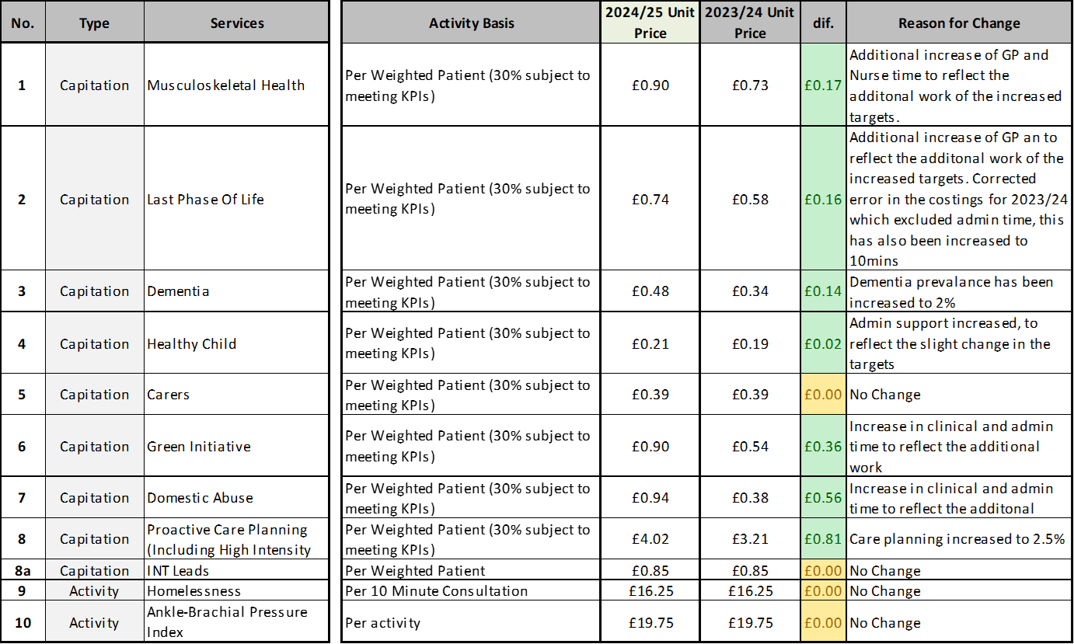
2024/25 NWL Single Offer Services

Slide 11
Investment
Total contract offer for Ealing borough PCNs remains £13.9million, however this is split into two contracts, the single offer (which included local services) and a Same Day access Specification
The NWL Single offer totals £8.2million this is based on an extrapolated current performance (Month 9), an additional £516k is aligned to the Single Offer for over performance and activity performance not taken into consideration for the final quarter of the year
In any event, PCNs that exceed the Single Offer activity across the service lines in 2024-25, will be paid for that additional activity.
Ealing's current access specification has been replaced by the Same Day Access offer totally £1.07million which is offered in a separate contract, the difference (£467k) is reinvested into NWL schemes.
Ealing’s Local Offer totals £4.1million, the reduction due to services moving from local to the NWL Single Offer

Slide 12
2024/25 Next Steps
Contract Variations are currently with your PCN Clinical Directors or nominated contract lead for signature
Once this contract variation is signed then new activity plans will be put in place with additional services
Current activity plans and contract conditions will continue until variation is signed however the ICB will continue to review its position on this matter.
The access specification will continue to be developed and offer to PCNs in a separate contract.

