Slide 1
Palliative Care for GPs
Module 1:
Introduction to Palliative Care
Notes:
Welcome to the first session of the teaching programme. Recap on resources.

Slide 2
Ground Rules
Troubleshooting
Interactive session
Confidential discussion
Bring any cases
Ask questions along the way
Feedback after session
Notes:
Welcome
Introduction

Slide 3
Disease Trajectory
With conditions such as heart failure or respiratory disease - patients are usually ill for many months or years with occasional acute exacerbations
Exacerbations are associated with admission and intensive treatment
Each exacerbation could result in death
If the patient recovers, a gradual deterioration in health and functional status is typical
For this reason, deterioration or death can be harder to predict or identify in chronic disease
Notes:
https://www.cheshire-epaige.nhs.uk/wp-content/uploads/2018/11/NEW-PIG-20.1.17-KT-vs17.pdf
May come across these patients in discharge summaries or on duty, bigger picture can be less obvious

Slide 4
Early Identification
Surprise question - range of clinical, social and psychological factors that give a whole picture of deterioration
Would they benefit from an ACP may be a more useful question
Predicting needs rather than exact prognostication
If thinking about prognostication - frequency of change can be a rough guide
General indicators of decline – increasing care needs or choice for no further active care
Specific clinical indicators related to certain conditions – SPICT/GSF
Notes:
https://www.gponline.com/gps-role-end-of-life-care/palliative-end-of-life-care/article/1366021
Can be difficult in current climate of general practice
For example – patients who previously would attend appointments for reviews now cannot make it to appointments

Slide 5
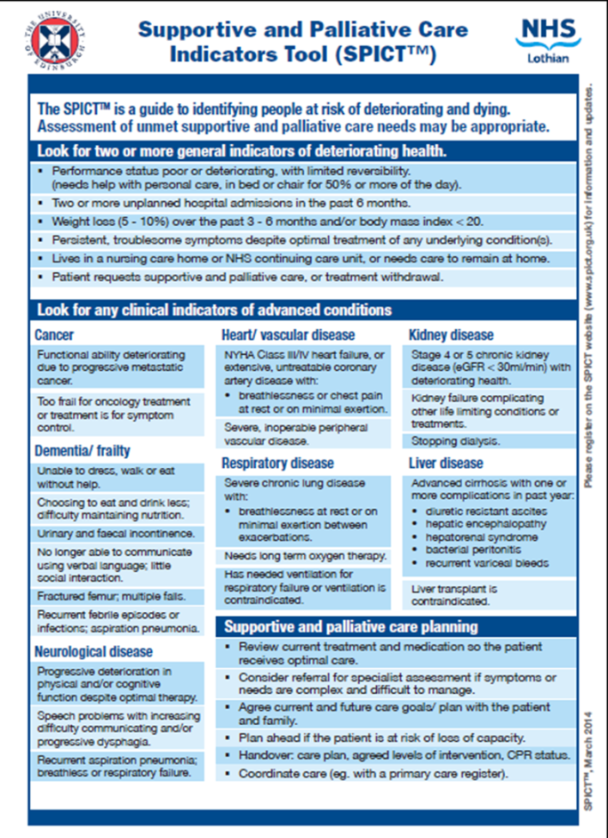
SPICT
Notes:
For clinicians

Slide 6
SPICT
Notes:
For family/carers – useful in your communication

Slide 7
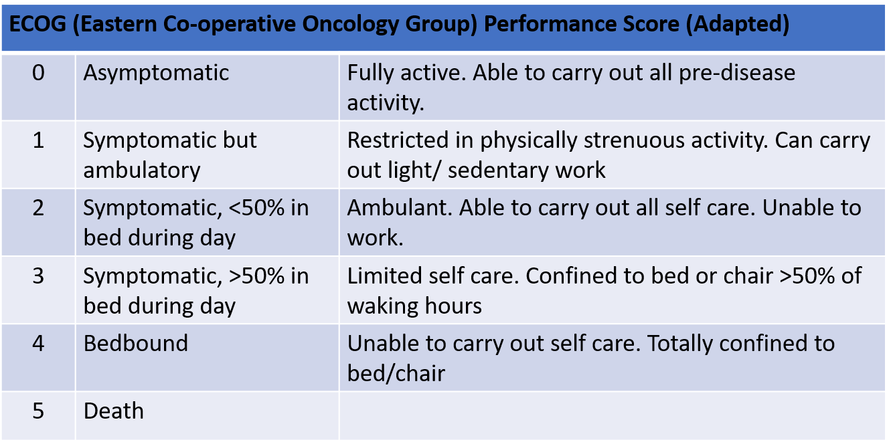
ECOG
Notes:
Oncology – performance status

Slide 8
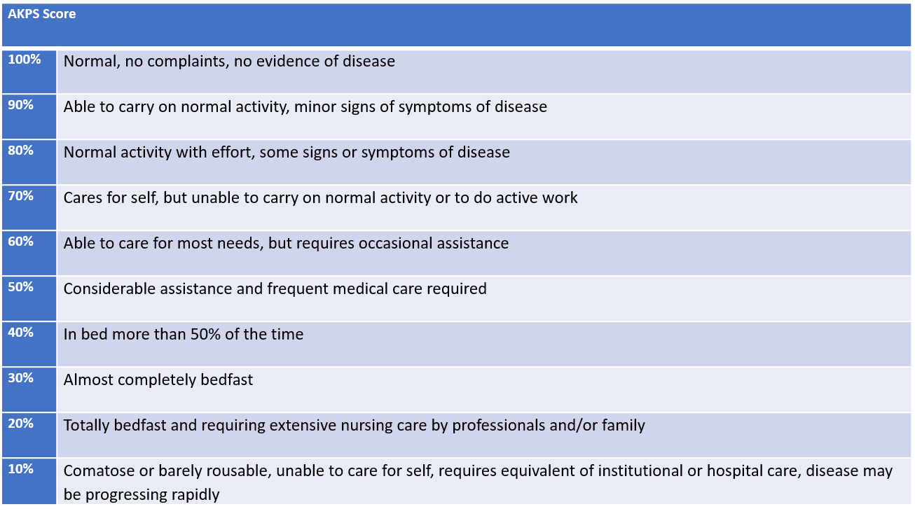
AKPS
Notes:
The Australia-modified Karnofsky Performance Scale – functional ability, palliative care

Slide 9
Rockwood Frailty Scale
Notes:
Rockwood frailty scale
You may notice this more when exploring the social history or from carer/relatives feedback

Slide 10
Advanced Care Planning
At this time in your life, what is important to you?
What elements of care are important to you and what would you like to happen in future?
What would you not want to happen? Is there anything that you worry about or fear happening?
More to come on these conversations in Module 4
Notes:
https://www.goldstandardsframework.org.uk/advance-care-planning

Slide 11
Benefits
Enables greater autonomy
Greater concordance with wishes if discussed
Reduced unwanted or futile invasive interventions or hospital admissions - appropriate levels of treatment
Provide information for patients and families so that they can set goals, priorities and expectations of care
For clinicians - proactive planning rather than reactive crisis intervention
More coordinated care and improved communication between services involved
Notes:
What are the benefits of ACP?

Slide 12
Barriers
Cultural taboo
Confidence in initiating conversations
Patient may not wish to engage
Timing – late discussion
Resources – can take several encounters
Integration of ACP into mainstream practice
Lack of continuity
Managing uncertainty
Prognostic
Patient
Notes:
What may be the barriers?
Managing uncertainty is a natural part of the palliative care journey
https://www.nursingtimes.net/clinical-archive/end-of-life-and-palliative-care/the-benefits-and-barriers-of-ensuring-patients-have-advance-care-planning-03-01-2017/

Slide 13
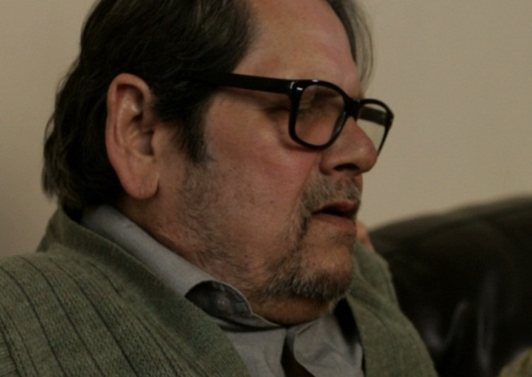
Mr B
75 years old
Background of HFpEF, HTN, T2DM
Four hospital admissions in six months with pulmonary oedema and most recently pneumonia
Initially responded well to diuretic treatment but soon became refractory to treatment
Lives with wife, daughter lives locally

Slide 14
Mr B
The patient appears on your duty list
‘Daughter reports she is worried her father is sleeping a lot of the day and has a reduced appetite over the last few weeks. Ongoing leg swelling, not particularly breathless but now he is mainly in chair or bed’
What would your next steps be?
What information may tell you if the patient is deteriorating or dying?
What barriers might there be when making an advanced care plan?
Who else may you involve?

Slide 15
Mr B
Review patient record
Recent discharge summaries
Recent GP consultations
Any current care plans
Clarify social history and support network
Important to identify NoK
Arrange home visit
Assess the patient – any reversible causes or investigations required?
Discuss patient’s wishes and offer idea of an advanced care plan
Notes:
Do you think the patient is deteriorating or dying?
Remember frail patients can take longer to recover – think disease trajectory

Slide 16
Mr B
Advanced care plan – holistic view
PPC/PPD
DNACPR
Hospital transfer
Add to palliative care register
Create UCP with consent
Follow up patient
Who else would you involve?
SPC?
Heart failure nurse?
OT/PT?
DNs?
Notes:
How does your practice monitor palliative care patients?

Slide 17
Notes:
Auto-consult

Slide 18
Notes:
Coding

Slide 19
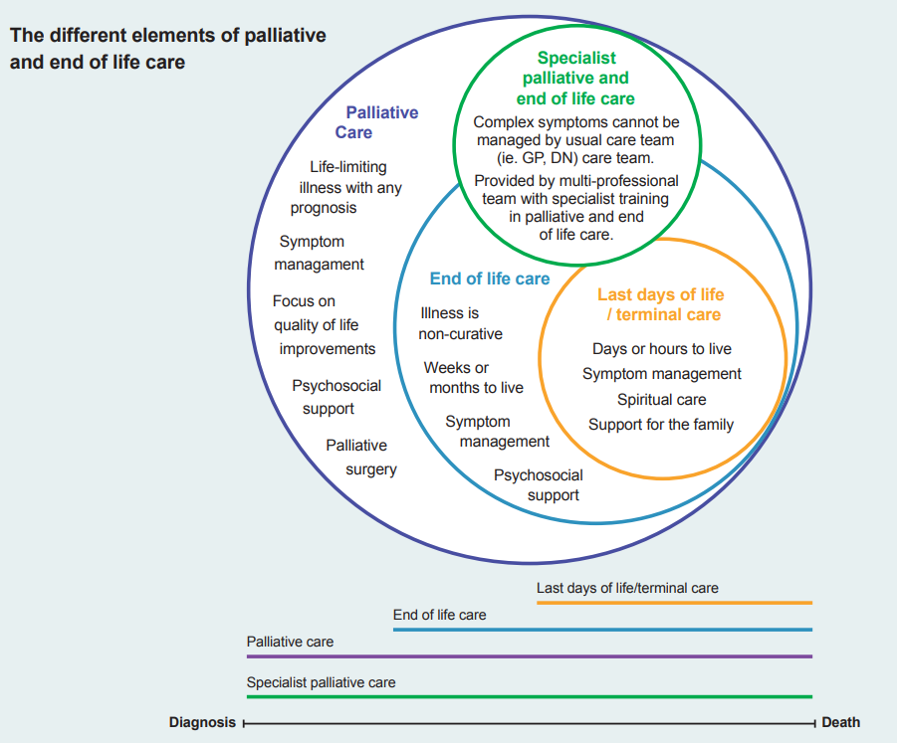
Referral to Specialist Palliative Care
Complex symptom control
Unresolved needs that cannot be met by the primary care team
Meadow House Hospice MDT
Think carefully about the reason for referral
What are the expectations?
Notes:
Treena
Any reflection on referrals done by the GPs?

Slide 20
Case
Mr S, 84 year old living in his own home, frail but independent
He has a jigsaw of support from neighbours and friends but refuses formal care
He has repeatedly fallen in the past few weeks but refuses to go to hospital
Eventually he agrees to a visit from the GP who finds that he is living in squalor
He is cachectic with widespread lymph nodes palpable and an enlarged liver However he refuses any investigation and is determined to stay at home
What would you do now for Mr S?

Slide 21
Case
Mrs R, 97 year old with a background of dementia
Recurrent admissions for hyponatraemia and confusion
Son is her main carer but is not coping , he feels she is more confused than normal despite discharge from hospital
She is not sleeping and he feels she is making noises when breathing so is wondering if she has a chest infection
What would you do now for Mrs R?

Slide 22
Any questions or thoughts?
Notes:
Thanks
Feedback

