Slide 1
Pharmacy Forum Antimicrobial Stewardship
North West London ICB Medicines Management Team
Ealing Borough Team
April 2024

Slide 2
Why Antimicrobial Stewardship?
Really important to prevent rise and spread of antibiotic resistance in NW London
One of top 10 global public health challenges
What is the goal?
Improve awareness
Raise standards of best practice
Focus of 5 year national action plan
Reduce the need for and unintentional exposure to antimicrobials
Reduce total number – consider if a viral infection & no abx needed
Reduce course length – many RTI only need 5 day. Historical 7 day prescribing habits
Optimise use of antimicrobials
Narrow spec abx first and move to broad spec with if ineffective or with cultures
Notes:
NHS oversight framework – system led delivery of integrated care in line with direction of travel set out in long term plan and integrating care….
Set of metrics for ICBs & Trusts
Reduce need for – always questions if an antibiotic is really needed….is it likely a viral infection, are prescribers prescribing abx due to pressure from patient. What can be done instead…would a leaflet and patient education do the trick?
Optimise use – when an antibiotic is needed….give it but then where new evidence and guidelines are saying 5 days will be enough in majority of patients, try it and if that does treat and is enough, overall exposure to abx is lower for patient and better for the system overall
Use narrow spectrum abx….when they are ineffective consider the braod spec…..these are the ones that increase risk of MRSA and C diff and abx resistant UTIs

Slide 3
2.1ai & ii Antimicrobial Stewardship: Total antimicrobial prescribing (STAR PU) and broad spectrum prescribing
SAME INDICATOR AS 2023/24 – targets and value the same
5% value if achieve BOTH
Rationale for Inclusion
2.1a & 2.1b are both part of National Oversight Framework (NOF) metrics that are monitored by NHSE at ICB level
Encourage practices to improve or maintain position on NOF targets (CQC indicator)
Supports delivery of UK 5-year action plan for AMR 2019-2024
Addressing overprescribing of antibiotics:
reduce risk of resistant infections, patient harm from adverse effects, disruption to normal flora (microbiota) and reduce avoidable waste.
Broad-spectrum antibiotics increase the risk of MRSA, Clostridium difficile and antibiotic-resistant UTIs
NW London ICS Antibiotic Prescribing Resource:
This tool has:
Latest NWL Guidelines for Antimicrobial Prescribing in General Practice
Patient leaflets for common infections and self-care
SystmOne location: auto-consultation menu/ 09. Medicines Management/ NWL ICS Antibiotic Prescribing Resource
Notes:
Antibiotic stewardship is still a really important area of prescribing that continues to be monitored nationally and our team is continuing to monitor it as part of the enhanced spec. The targets are the same as 23/24 and for those that are already achieving, the reward will be to maintain and continue at the targets, and for the practices that haven’t achieved this is an extra push to try and achieve the targets
All GP practices in PCN to continue to meet both elements (same as 2023-24 MMES) (5% of the award)
reduction in the number of antibiotics prescribed in primary care per STAR PU – 0.871 – national target
and
ii) reduce the number of co-amoxiclav, cephalosporins and quinolones as a % of the total number of selected antibiotics prescribed – 10% - national target
Some practice already achieving and paid to continue
Measurement
NHSBSA ePACT2 data
Target ≤ 0.871 items per STAR-PU and target ≤10% for broad spectrum antibiotics

Slide 4
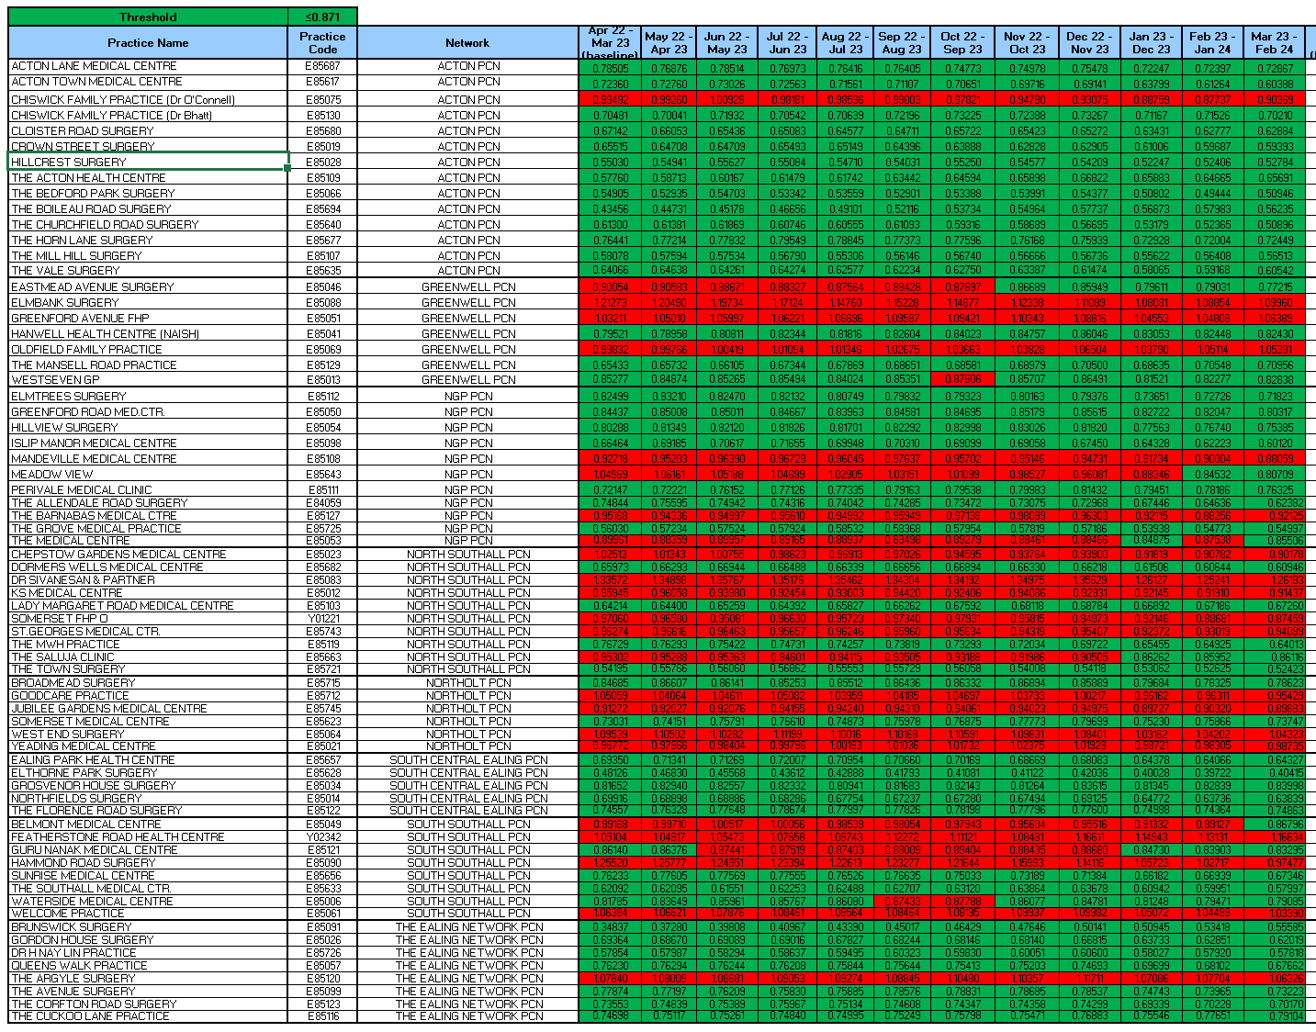
2.1 ai. Number of antibiotics prescribed in primary care per STAR PU (ePACT2)

Slide 5
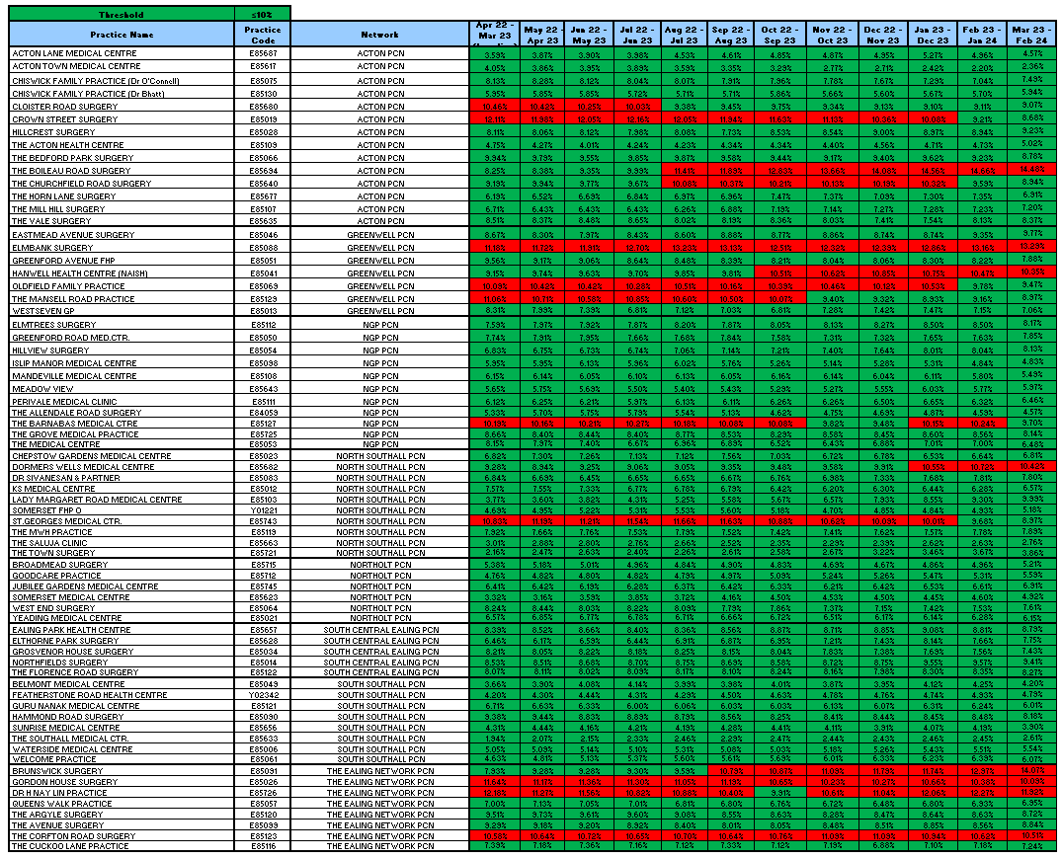
2.1 ai. Proportion of broad spectrum antibiotics prescribing in primary care (ePACT)
Notes:
For Greenwell – there have been improvements made in last year for both total number of abx prescribed and broad spec prescribing. But to achieve for this year there still needs to be a bit of push in a few of the practices to achieve the thresholds for both parts of this indicator and get the award.
To note here Elmbank is red for both indicators, so a bit of targeted audit work here could help to try and see what is keeping both total number and broad spec prescribing high. Particular patients? prescribing not in line with guidelines ? New/Locum prescribers not familiar with NWL guidelines

Slide 6
2.1b & 2.1c Optimising antibiotic treatment course lengths for Respiratory Tract Infections (RTIs) – Amoxicillin and doxcycline
SAME INDICATOR AS 2023/24 – increased threshold
5% value if achieve
NEW 2024/25
5% value if achieve
Rationale for Inclusion
Reducing the course length of antibiotic prescribing – an NHSE National Medicines Optimisation Opportunities for 23/24.
Optimising the duration of these antibiotics, in RTIs, from 7 to 5-day courses have equivalent clinical outcomes & contribute to a reduction in antibiotic consumption - UK AMR National Action Plan goal, antibiotic exposure/resistance and adverse effects associated with antibiotic use.
NW London Guidelines for Antimicrobial Prescribing in General Practice recommends a 5-day amoxicillin course for most RTIs, in line with NICE/PHE antimicrobial guidance
Exception: acute exacerbation of bronchiectasis, which needs a 7 - 14 day course
Relevant Data (12 months rolling October 2023)
Amoxicillin 5-day prescribing:
40.88% for NW London. The national medicines optimisation opportunities recommends ≥ 75%.
Doxycycline 5-day prescribing:
9.54% for NW London. The national average is 18.21%.
Notes:
Indicator 2.1b for amoxicillin 500mg course length is the same as last year but with increased threshold – last year the target was for 37% of all the amox 500mg capsule prescriptions to be as a 5 day course. This year pushing it further up to 55% to try and encourage further engagement with this initiative. As can see last year all practice achieved the 37% targets and 4 practices already achieving the higher target. With the other 3 close by so shouldn’t need much more work for this.
And a new indicator this year is monitoring of doxycycline 100mg caps & disp tablets – again monitoring prescribing as 5 day courses. Target is lower than for amox and at 18%. doxy has a range of indications other than respiratory hence the reason why the target for the metric is much less ambitious and so it doesn’t unfairly impact prescribing
Indicator
Increase the proportion of
2.1b) amoxicillin 500mg capsules prescribed as a 5-day course (5% of the award)
2.1c) doxycycline 200mg first day then 100mg once a day prescribed as a 5-day course (5% of the award)
Measurement
ePACT2. Practices will be updated via the monthly dashboard
Target 2.1b) ≥ 55% - increased slightly from 37%
Target 2.1c) ≥ 18%
Relevant Data (12 months rolling October 2023)
Amoxicillin 5-day prescribing: 40.88% for NW London. The national medicines optimisation opportunities recommends ≥ 75%. – we feel 55% target is reasonable and achievable. Not appropriate for all patients so that’s why not 100%
Doxycycline 5-day prescribing: 9.54% for NW London. The national average is 18.21%. - doxy has a range of indications other than respiratory hence the reason why the target for the metric is much less ambitious and so it doesn’t unfairly impact prescribing
Potential Questions
epact data: monitors quantities – no coding accounted for so clinical condition not considered in the data. Therefore some of the data will be for indications other than RTIs – deem that the proportion of non-RTI prescriptions will be small and shouldn’t impact overall performance of GPs towards this metric
We are aware that some conditions need longer durations of treatment
What other strategies can follow?
Review patients with COPD abx rescue pack. Antibiotic choices for COPD rescue packs (according to NWL guidelines: amox 500mg tds days or doxy 200mg day 1, 100mg od 4 days – total 5 days)
Is it for children?
Monitoring Amox – 500mg and doxy 100mg. Therefore takes into account patients able to swallow caps, prescribed dispersible tablets (i.e. adults and older children)
Reason for indicator is to optimise course duration – abx duration fo children is also 5 days….however children most likely prescribed 250mg suspension.
Doxy not used for under 12s….cohort is only for 12-17 year olds who most likely would receive dispersible tabs
Data in NWL shows very low % of dispersible tabs prescribed vs caps
OptimiseRx messages for quantity if Rx 7 days courses: can’t be triggered for quantity – confirmed previously but does trigger for conditions e.g. pneumonia. For both amox and doxy – info in optimiseRx message promotes 5 day courses
Can amox and doxy 5 day courses be added to SystmOne formulary to support implementation
- not possible in EMIS therefore not equitable, therefore can’t have.
- For both amox and doxy – systm one formulary tab selection box shows the amox TDS 15 caps option higher up on selection, as does doxy course

Slide 7
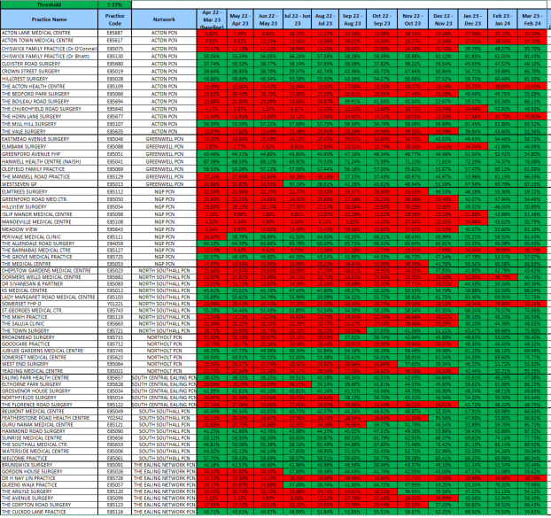
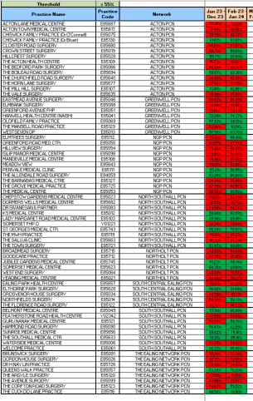
2.1 b.Proportion of amoxicillin 500mg capsules prescribed as a 5-day course (ePACT2)
2024/25 Dashboard – 55% target
2023/24 Dashboard – 37% target

Slide 8
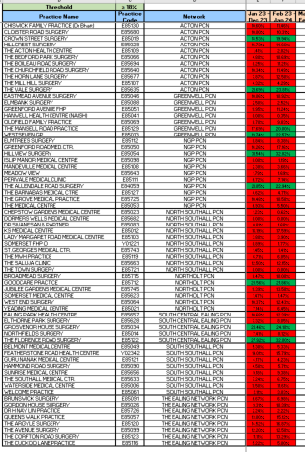
2.1 c. Proportion of doxycycline 200mg prescribed on the first day then 100mg once daily prescribed as a 5-day course (ePACT2)
2024/25 Dashboard – 18% target

Slide 9
How can Practice Pharmacists promote Antimicrobial Stewardship?
Notes:
Big role in influencing prescribing, signposting to available guidelines & resources such as leaflets, sharing practice specific data from dashboards & audits. At clinical meetings

Slide 10
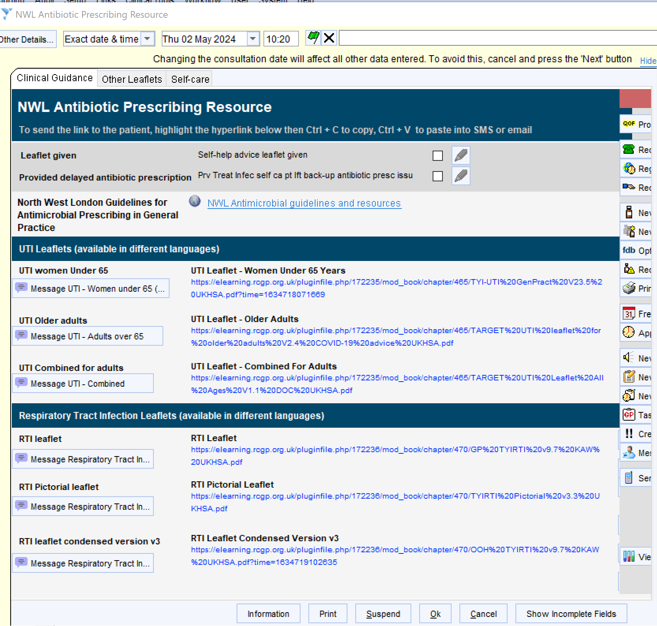
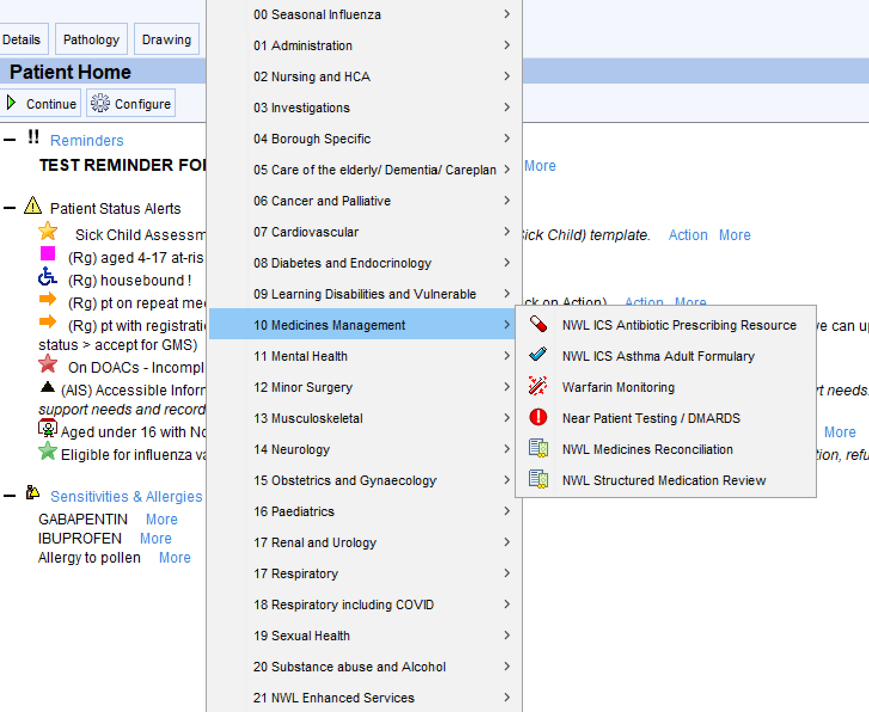
SystmOne Auto-consultation: NWL Antibiotic Prescribing Resource

Slide 11
Dashboards Available to view Practice and PCN prescribing data

Slide 12
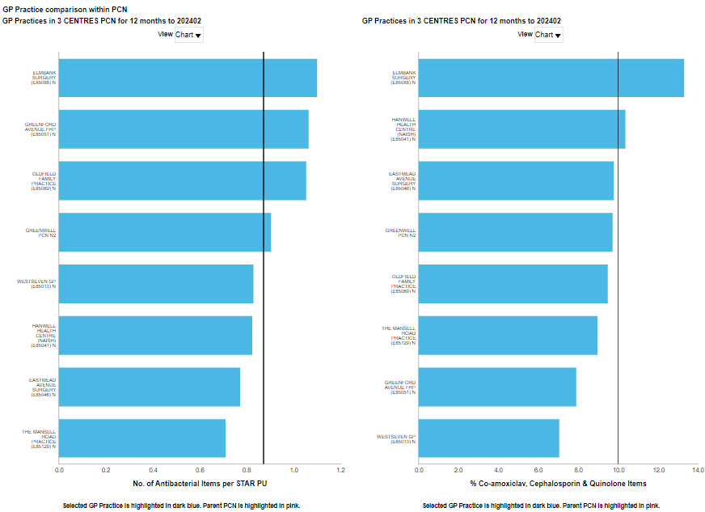
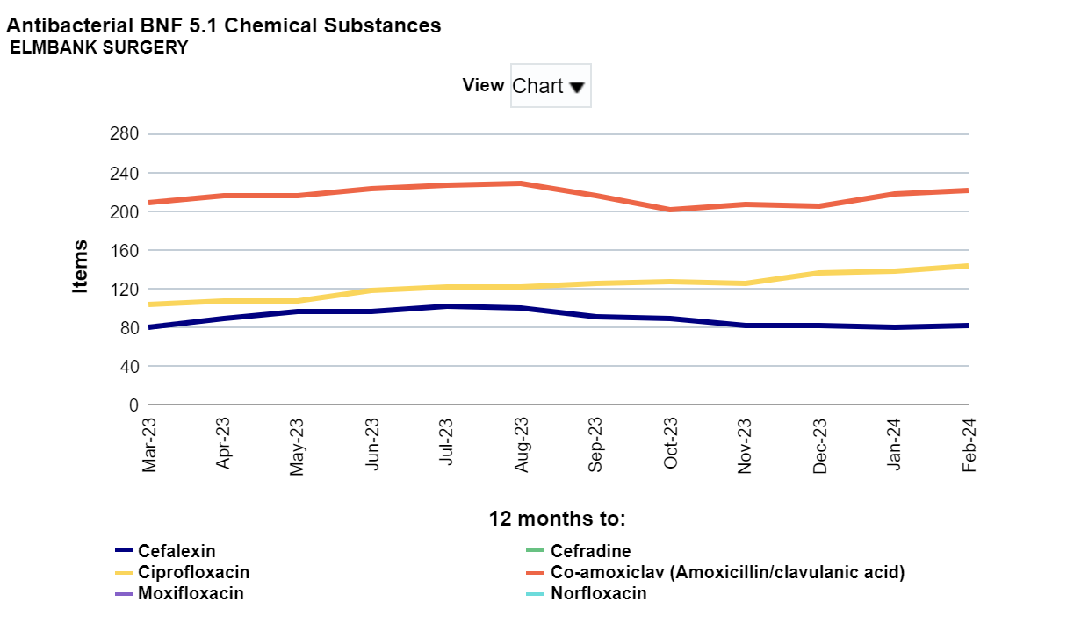
ePACT Dashboard – Antimicrobial Stewardship: Data available at PCN and Practice leve
PCN Level dashboards available showing trends over times and snapshot of latest month data
Practice level – BNF chemical substance breakdown for broad spec abx

Slide 13
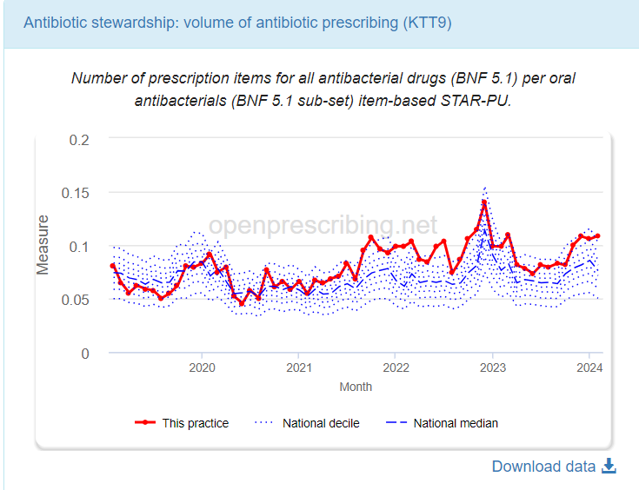
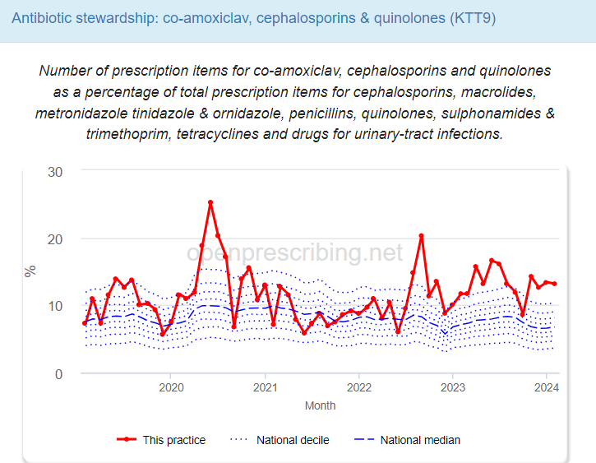
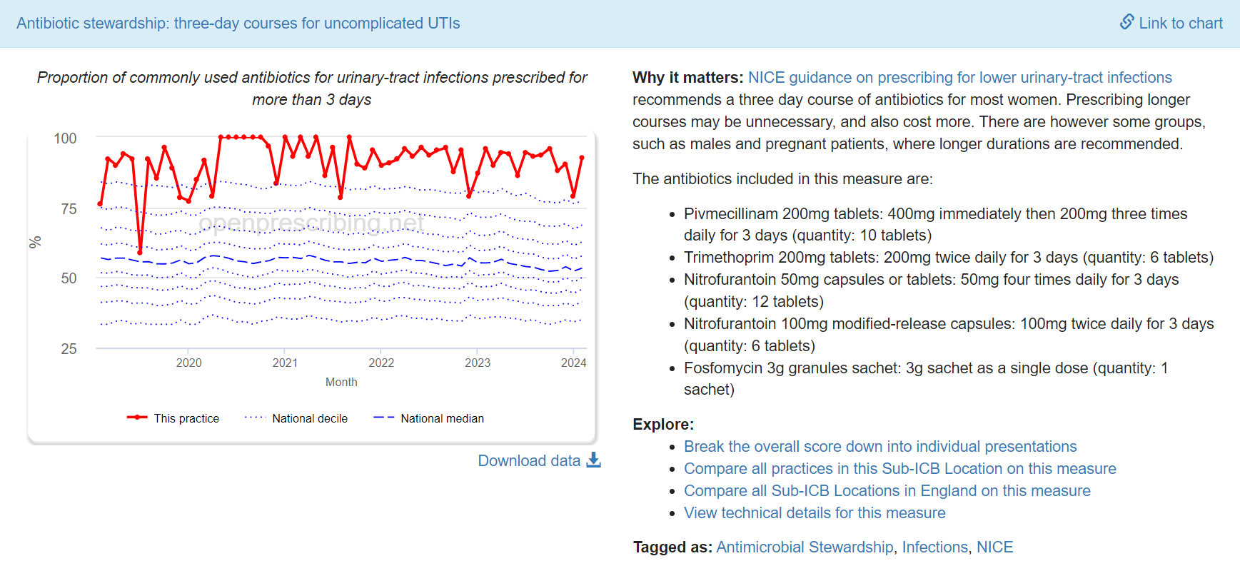
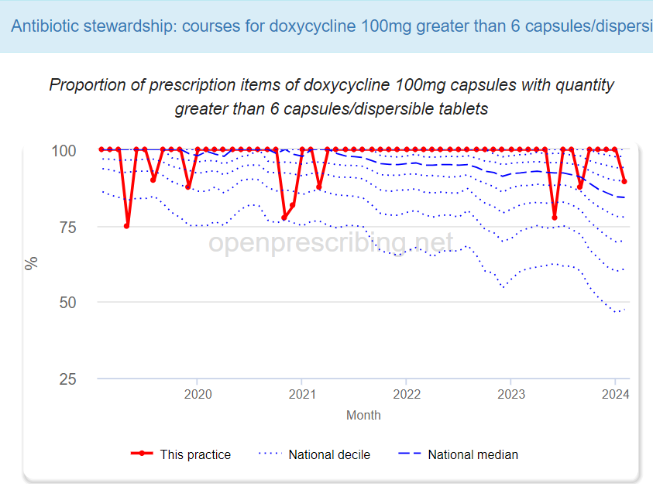
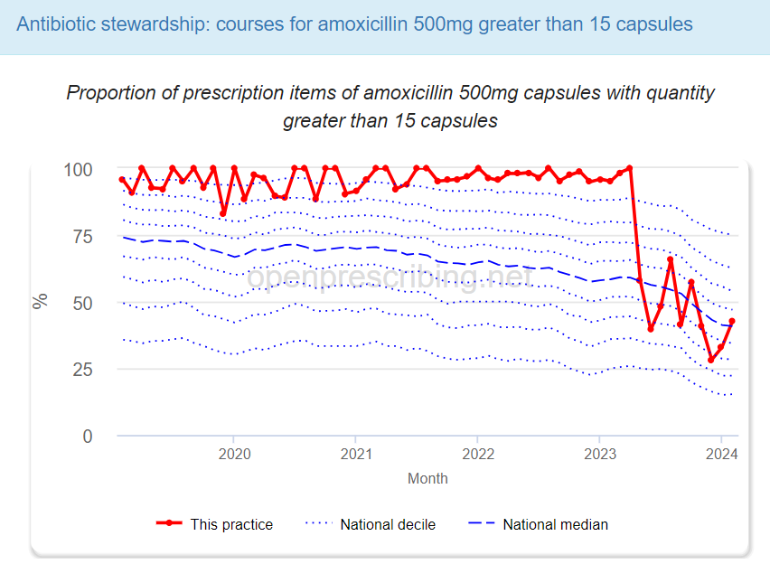
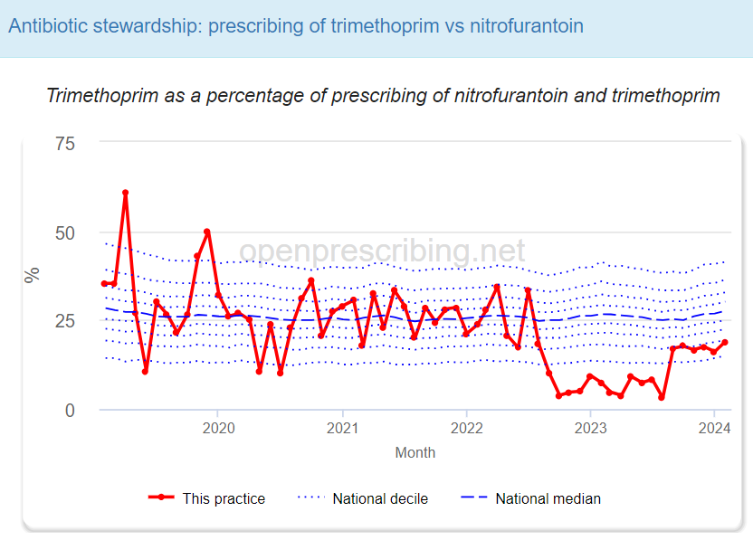
Open prescribing data reports
Open Prescribing displays reports for these indicators:
https://openprescribing.net/practice/ - once in your practice select antimicrobial stewardship measure to bring up all antimicrobial reports

Slide 14
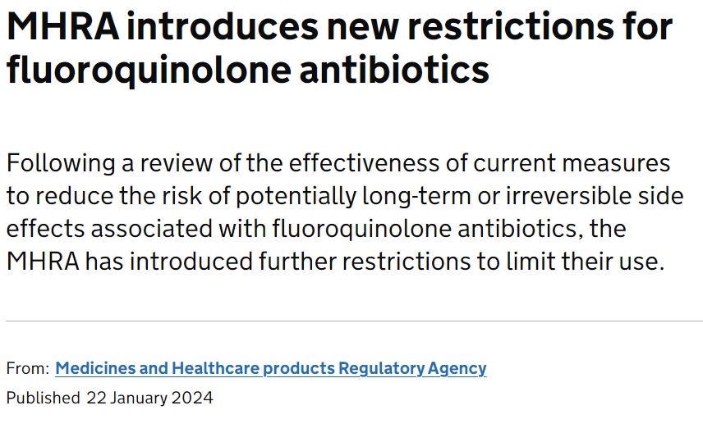
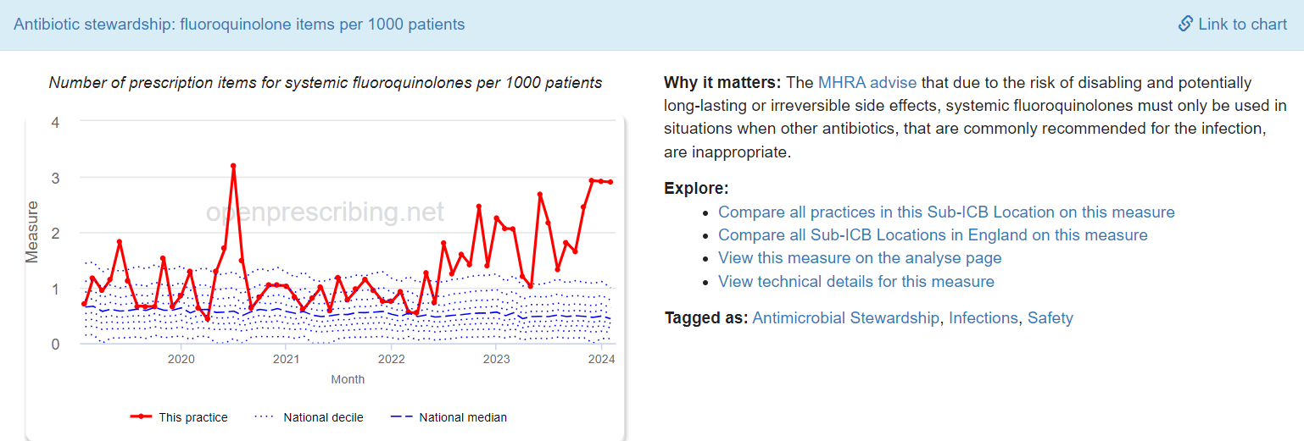
MHRA update – Jan 24: Fluoroquinolone antibiotics: must now only be prescribed when other commonly recommended antibiotics are inappropriate
MHRA guidance Link
fluoroquinolones are a class of antibiotics that:
include ciprofloxacin, delafloxacin, levofloxacin, moxifloxacin, and ofloxacin
have been reported to cause serious side effects involving tendons, muscles, joints, nerves, or mental health – in some patients, these side effects have caused long-lasting or permanent disability
Open Prescribing data: Elmbank:
Notes:
The new restrictions state that fluoroquinolone antibiotics must only be prescribed when other antibiotics that are commonly recommended for the infection are inappropriate. This applies to all indications listed below. Situations where other antibiotics are considered to be inappropriate are where:
there is resistance to other first-line antibiotics recommended for the infection;
other first-line antibiotics are contraindicated in an individual patient;
other first-line antibiotics have caused side effects requiring treatment to be stopped;
treatment with other first-line antibiotics has failed.
Serious adverse reactions to fluoroquinolone antibiotics include tendinitis or tendon rupture, muscle pain, muscle weakness, joint pain, joint swelling, peripheral neuropathy and central nervous system effects. A list of potential side effects is provided in the summary of product characteristics (SmPC) and patient information leaflet (PIL) for these medicines.
When reporting to the Yellow Card scheme, please provide as much information as possible, including information about batch numbers, medical history, any concomitant medication, onset timing, treatment dates and product brand name.

Slide 15
Available tools and Audits

Slide 16
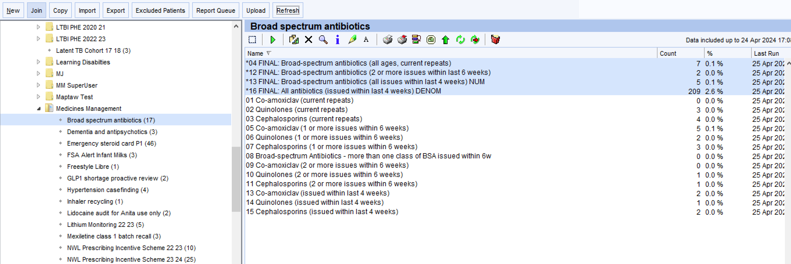
Antimicrobial Searches – SystmOne GP prescribing system
S1 searches currently available to enable retrospective audit to be carried out if deemed necessary at practices (optional):
*please note searches are due for a review and may appear in different location/with amended reports in near future. We will send out communication with any updates
Notes:
S1 searches – available to pull out prescribing that has already taken place so won’t be able to amend prescribing for what has already taken place, but aim is to pull out prescribing patterns in practices where prescribing is perhaps higher than targets and to explore what is influence it
e.g. particular patients under secondary care with diabetes foot ulcers, or on long term prophylactic abx – might not be able to do much about these. But where repeated prescribing of co-amox 1st for RTI, or if prescribing of abx where symptoms actually indicated possible viral infection that didn’t need abx….possible to take results to clinical meetings with other clinicians to discuss, share learning, share guideline recommendations and these things can help influence prescribing patterns.
E.g. in one of my practice that offer a particular service they feel is affecting their abx prescribing figures – without an audit to see if this is the case it’s hard to see if they need to appeal or whether actually there is additional improvements in general prescribing that is actually the cause.
S1 searches for doxy and amox can help to bring up any prescribing that is >5 day to do a restrospective audit and see if perhaps there particular patients for whom repeated long durations are indicated/need for review of the patients in hand, is there a pattern of recommendation from other services for prescribing of >5 days…..is so let us know and we can try and work with other providers. Also, are particular prescribers in your practice that are prescribing repeatedly for >5 days and maybe don’t realise that guidelines are now for 5 days

Slide 17
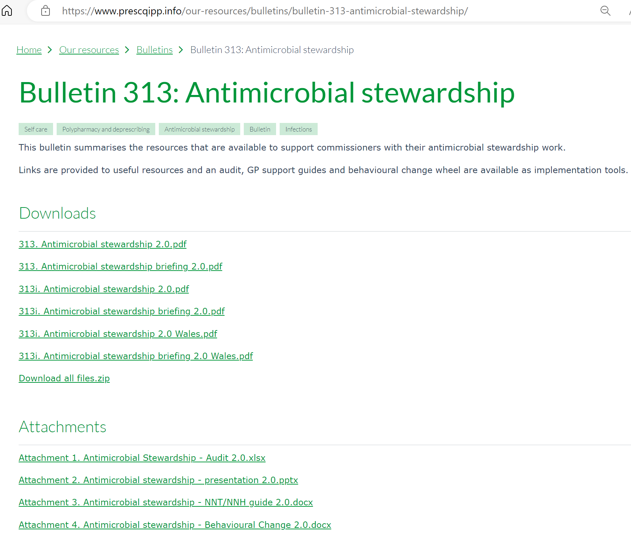
PrescQIPP Antimicrobial Stewardship Bulletin – Audit spreadsheet
Link to PrescQIPP Bulletin:
Bulletin 313: Antimicrobial stewardship | PrescQIPP C.I.C

Slide 18
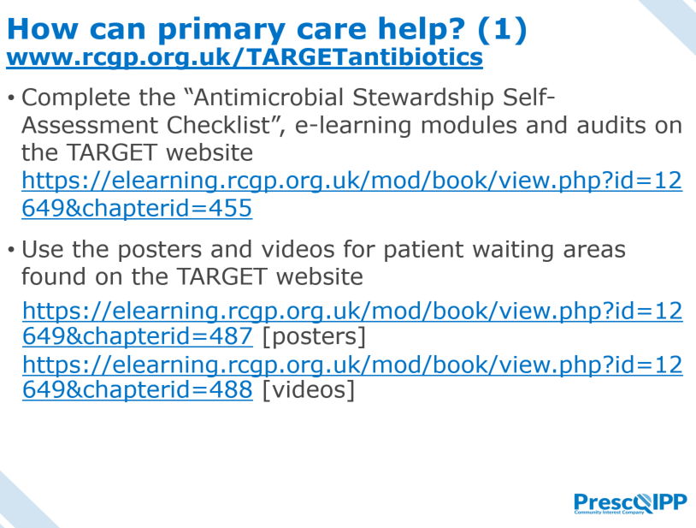
PrescQIPP Antimicrobial Stewardship Bulletin – Presentation slides

Slide 19
TARGET antibiotics toolkit
NW London Medicines Optimisation Team
18th April 2024

Slide 20
Introduction to TARGET What is included within the toolkit? How can we improve implementation and utilisation in NWL?

Slide 21
Introduction to TARGET
Treat Antibiotics Responsibly, Guidance, Education and Tools
Designed to support primary care clinicians to champion and implement antimicrobial stewardship activities
Resources can also be used to support CPD and revalidation requirements
Developed by UK Health Security Agency, Royal College of General Practitioners (RCGP) and the Antimicrobial Stewardship in Primary Care (ASPIC) Group
Based on the Theory of Planned Behaviour
Available at: https://elearning.rcgp.org.uk/course/view.php?id=553#section-0

Slide 22
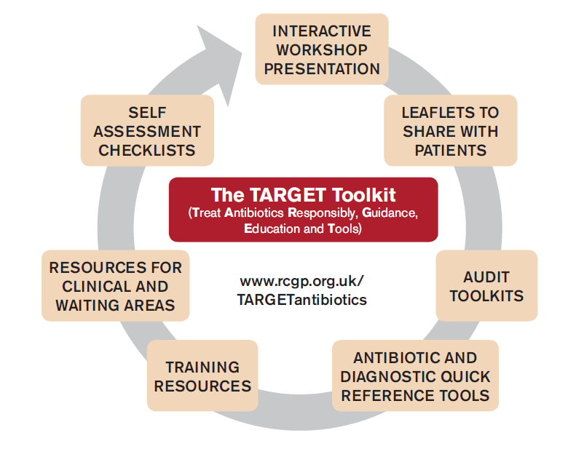
What is included within the toolkit?

Slide 23
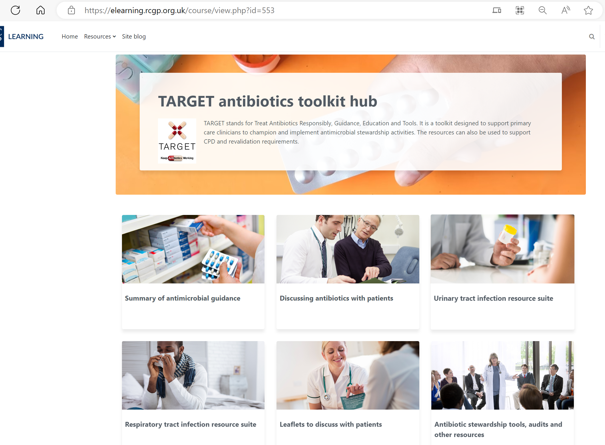
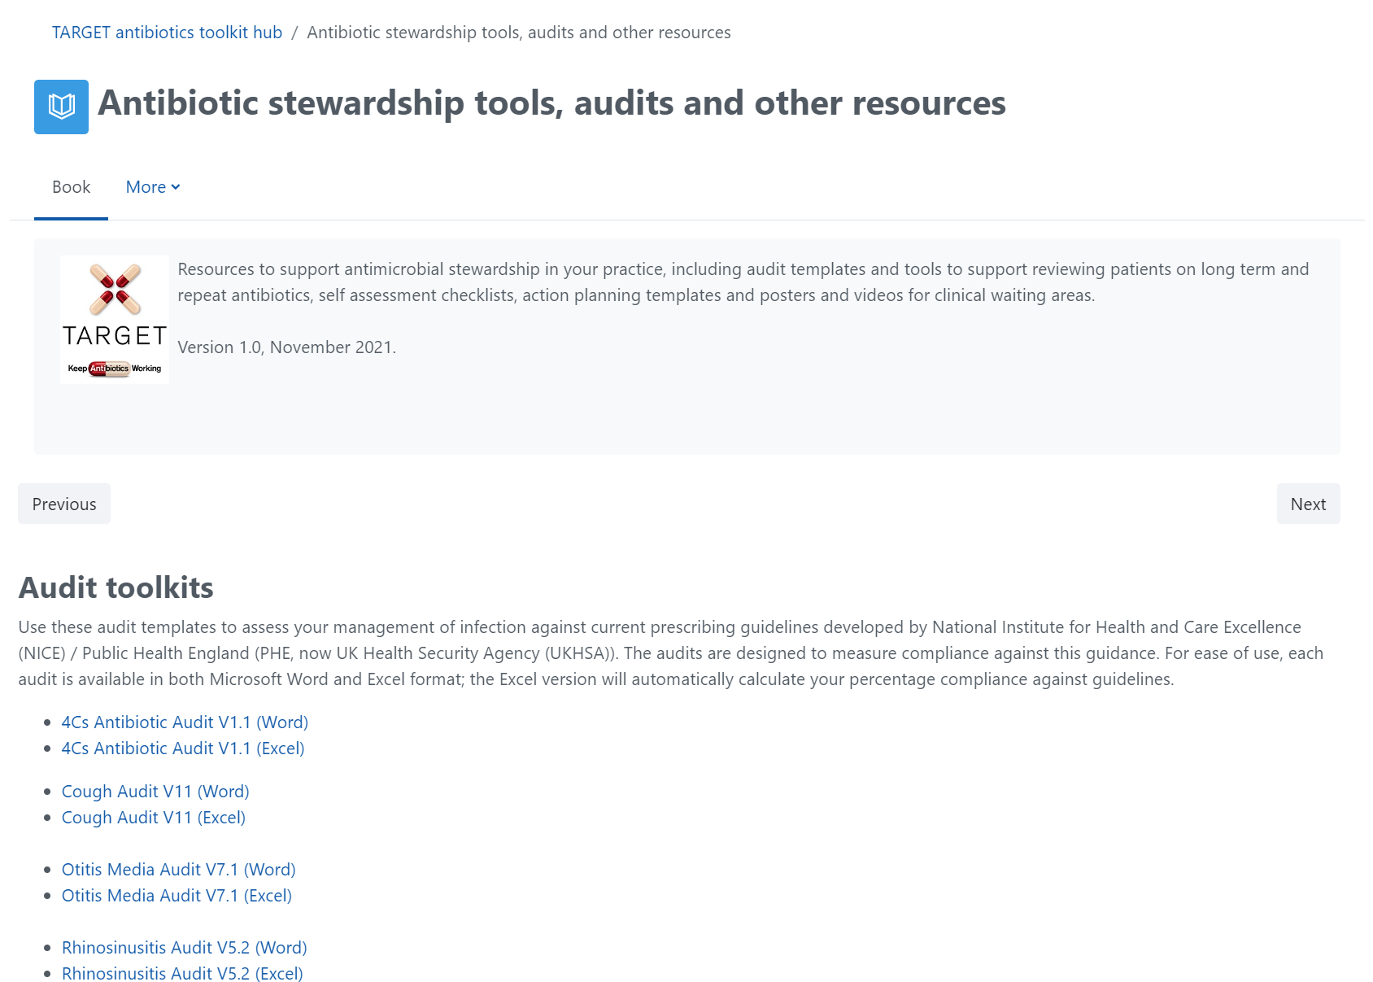
TARGET Website – Antibiotic Toolkit
Useful audit tools: Course: TARGET antibiotics toolkit hub | RCGP Learning

Slide 24
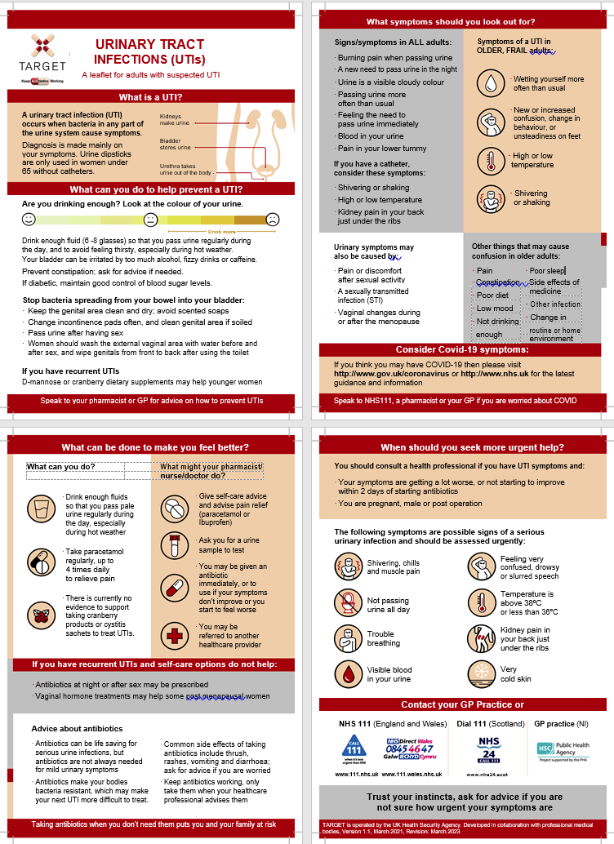
Target Leaflets
Notes:
Leaflets – support effective discussions and maintain pt satisfaction – can print off and give to patients. Together with delayed prescriptions have been shown to be effective. Highlight info about symptoms, expected duration. E.g. of self care. Improve pt satisfaction. Suppor.

Slide 25
How can we improve implementation and utilisation in NWL?
What has been done to date:
TARGET ‘Treating your Infection’ leaflets
Clinical systems ‘NWL ICS Antibiotic Resource’
Antimicrobial clinical section on website
Back up/ delayed antibiotic prescribing for minor infections resource pack
Next steps:
NWL Medicines Optimisation Webinar
Link TARGET toolkit into the NWL Antimicrobial guidelines for primary care
Suggestions?
TARGET workshops with groups of practices
Antimicrobial champions at each practice/ PCN
Completion of online TARGET Antibiotic Resistance in Primary Care eModule by primary care clinicians followed by discussion with all staff in practice meeting
PCN/ practice action plan

