Slide 1
HARP CONNECT 2022-2026

Slide 2
HARP Connect
H Housing clients in accommodation or securing their current home.
A Advising clients on their entitlement, rights and housing options.
R Resettlement back into the community is key for ex-offenders, we help them with a smooth
transition.
P Preventing re-offending, by sustaining accommodation and providing trauma-informed holistic
support.
We are not an emergency housing provider
HARP Connect

Slide 3
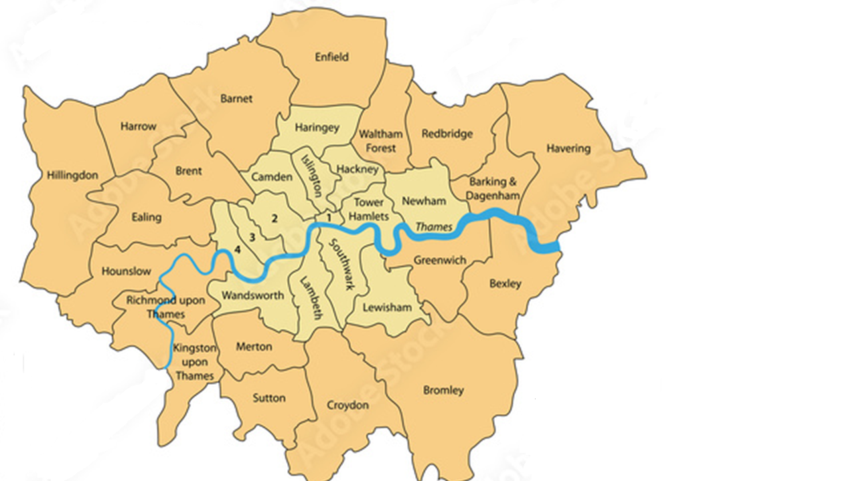
Where do we work?
We are a Pan London Floating support service.
We work closely with the Local Authorities, AFEO teams & Other voluntary sector agencies across the boroughs.
We have a number of drop-in sessions across the boroughs based in Probation
Our workers based in custody at least one day a week, at:
HMP Wormwood Scrubs
HMP Pentonville
HMP Wandsworth
HARP Connect

Slide 4
What are we trying to achieve?
CUSTODY
COMMUNITY
Housing Advice
Drop-in sessions in PDU,
women’s centres
Resettlement
Supporting clients to access housing. LA, Supported, family mediations or PRS
Applying for grants
Prevention
Tenancy sustainment for clients that we have sourced accommodation (1 Year)
Housing Advice
Drop in sessions
Advice to remand clients
Resettlement
Meet at the gate service
Supporting clients to access housing once released. LA, Supported, family mediations or PRS
Prevention
Tenancy sustainment for Remand prisoners
HARP Connect

Slide 5
Referral Criteria
25 and over male and female clients
Low / Medium Risk of Harm
Complex needs with a housing issue (ie, NFA or requiring tenancy support)
Returning to a London Borough
Willing to engage with the HARP service
No dependents living in the accommodation
Clients under probation supervision
HARP Connect

Slide 6
Resources
Maximising client income (Personal Independent payments, Limited capability for work )
Grant applications – for furniture, clothing, ID
Linking in with boroughs with AFEO schemes
Small resource for client accommodation & client welfare
Signposting to mentoring schemes
Signposting to employability sessions, training or education
Support to access GP and other Mental health services
Tenancy sustainment – dedicated part time worker. Also able to refer to other TST teams for clients who may benefit from a full-time worker
HARP Connect

Slide 7
How to Refer
Please send completed referrals to harpconnect@stmungosofs.cjsm.net
As we are not an emergency housing service, this inbox is not monitored daily. We aim to get back within 2-3 days.
Caseworker for Ealing is Mayuri Mistry
M: 07513 724 550
E: mayuri.mistry@mungos.org
Shiyamali Ankah - Service Manager
M: 07923 216 193
E: Shiyamali.ankah@mungos.org

Slide 8
Questions?
Thank you
mungos.org

