Slide 1
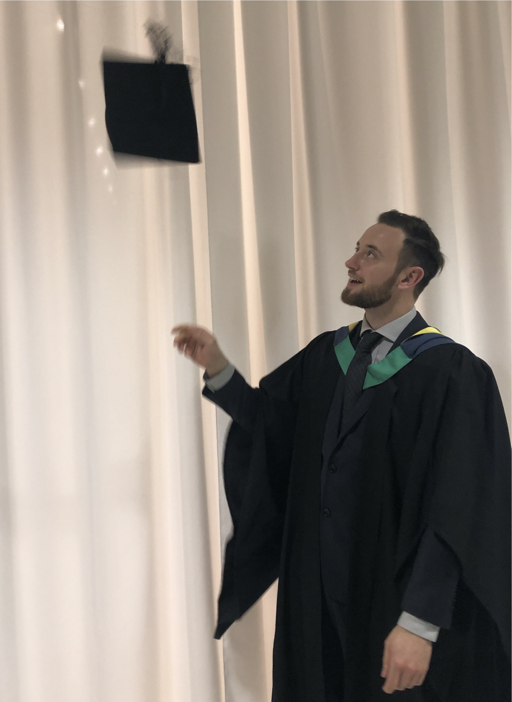
The Longford Trust
Turning Sentences into Degrees

Slide 2
The Longford Trust: Second Chances
Everyone Deserves a Second Chance!
We offer scholarships and awards to people with convictions to study at university
The Longford Scholarship

Slide 3
Longford Trust Scholarships: we offer
Financial Help £1500 - £3000 per year for the duration of degree
A laptop
One-to-one support from our trained mentors
Study skills support
Help to turn your degree into a graduate level career
Employability programme workshops training day
Release support – financial and pastoral

Slide 4
Longford Scholarship: criteria
To apply for a Longford Scholarship applicants need to:
Have an offer of a place on a degree level course at Uni or OU
Be eligible for a student loan
Have the right to remain the UK
Be under 40 years of age
Have 6 years (or less) left to serve
Or be within 5 years of being released

Slide 5
The Process
Apply to university for a course
Apply for a student loan
Fill in application form: deadline first week of May (for courses starting that autumn)
References followed up by Longford Trust x 2

Slide 6
Longford Trust Scholarships: The Stats
The Longford Trust has supported over 500 people to get degrees
85% of Longford Trust scholars graduate and get jobs
Only 5% of the people we work with return to prison

Slide 7
The Longford Trust: The Lecture 2024 Monday 11th November 2024
Essential listening for anyone interested in prison reform
Well-known headline speaker
See the presentation of the Longford Prize
Hear testimony from Longford Scholars and mentors
Enjoy first class catering from Liberty Kitchen who work out of HMP Pentonville
Open to all, regardless of ability to pay
Sign up for tickets: office@longfordtrust.org

Slide 8
The Longford Trust Prize celebrates humanity, courage & persistence
The Longford Prize is n annual award to outstanding individuals and groups
Judged by a distinguished panel
Prize money of £5,000
Past winners include: Circles UK, The Clink, Inquest, Prisoners’ Abroad and HMP Grendon
Nominations for the 2024 Prize must arrive by 21st October2024
Contact: office@longfordtrust.org or by post to Freepost, Longford Trust, PO Box 72887, London N2 2FG.

Slide 9
The Impact of Higher Education on Longford scholars
88% of scholars have greater confidence in themselves and their academic abilities
96% say they have become a better person as a result of their undergraduate journey
80% believe they are now more able to secure a degree level job and have a career
92% say they are now very optimistic for their future

Slide 10
Longford Scholar : Kyle
Kyle read about the Longford Scholarship’s in Inside Time while in his cell. He applied, was supported through a maths degree, and – thanks to our employability project – got an internship with a tech and data company in London that has now turned into a full-time job.

Slide 11
Longford Scholar: Alex
The Longford Trust invested their faith and finance in me. They made my Master’s degree at Aston University possible by making a contribution to costs that would otherwise have been prohibitive. I graduated with an MSc in pharmacology, First Class. I now work for a scientific company in Birmingham, have a 14- year-old stepdaughter, a 22-month-old son, and a loving partner.

Slide 12
Longford Scholar: Abi
I distinctly remember thinking on my first night in my prison cell, aged 19, what could I possibly do with my life devoid of opportunity? Walking into the lecture theatre felt as frightening as walking onto the wing for the first time. Without the Longford Trust, I can’t imagine how I’d have come this far at university.

Slide 13
Longford Scholarship: Talk To Us!
Clare Lewis Scholarship Manager
Email: scholars@longfordtrust.org
Phone: 07747 365037
Post: Longford Trust, PO Box 72887, London N2 2FG

