Slide 1
LOOKED AFTER CHILDREN GP TRAINING
04th June 2024
Presenters:
Gertrude Nyoni Designated Nurse for Looked After Children
Tamsin Robinson Designated Doctor for Looked After Children

Slide 2
What is a Looked After Child ?
Under the Children Act 1989, a child is legally defined as ‘looked after’ by a local authority if he or she:
gets accommodation from the local authority for a continuous period of more than 24 hours
is subject to a care order (to put the child into the care of the local authority)
is subject to a placement order (to put the child up for adoption)
Local Authority becomes the Corporate Parent.
But professionals around the child have corporate
parenting responsibilities.
Notes:
Sections of Children's Act 1989
What is a Section 20? Section 20 of the Children Act 1989 sets out how a Local Authority can provide accommodation for a child within their area if that child is in need of it, due to the child being lost/abandoned or there is no person with parental responsibility for that child. Parental responsibility sits with parents, parents agree that child becomes Looked after
The court can create a care order under Section 31(1) (a) of the Children Act, placing a child in the care of a designated local authority, with parental responsibility being shared between the parents and the local authority.
Placement Order (child placed for adoption)
If a child becomes Looked After, their Local Authority becomes responsible for their safety and welfare. This statutory responsibility includes ‘the promotion of physical, emotional and mental health and acting on any early signs of health issues’. This ‘Corporate Parenting’ responsibility is independent of whether the child resides locally or outside the borough. The ‘Corporate Parenting’ responsibility in many ways can be said to mirror the structure and workings of a ‘normal’/non LAC family. In that the LA (acting as Corporate Parent) draws on the educational and medical resources within the child’s community to ensure that the child they are ‘looking after’ receive the services they need at the right time to have the best life chances possible. The Local Authority, from time to time may ‘buy in’ or commission, directly or indirectly, extra services if services to meet an individual child’s needs are not available as part of the standard or universal provision.
Those with Parental Responsibility have responsibilities for their child[1], including protecting and maintaining the child, providing for their education and enabling access to health care. The ‘corporate parent’ needs to work with a range services to review, question and seek confirmation about a LACs medical/health and educational provision, safety and wellbeing, to ensure they are fulfilling their responsibilities for children in their care.
[1] https://www.gov.uk/parental-rights-responsibilities/what-is-parental-responsibility

Slide 3
Types of Care order and Consent
Section 20 (Voluntary accommodation) – Parent/s retain full parental responsibility and consent. Medical consent form is usually signed by parents enabling IHA/Medications/Medical reviews etc.
Section 38 (Interim Care Order) – Parent/s have shared parental responsibility with Social care. Both parents and social workers can provide consent.
Section 31 (Full Care Order) Parent/s have shared parental responsibility with Social care. Both parents and social workers can provide consent.
Parental Responsibility is not lost by parents.

Slide 4
Why do children become Looked after?
Abuse and neglect
Abandonment/ poverty/ parental illness or imprisonment
Custody, on remand awaiting sentencing
Parents finding behaviour unmanageable/family stress
Unaccompanied Asylum Seeking Child (UASC)
Notes:
Most children become looked after as a result of abuse and neglect[4]. This is true across England and Wales. But in some areas including Hillingdon, UASC YP are the largest group of children in care. Although they have many of the same health issues as their peers, the extent of these is often greater because of their past experiences
The child's parents do not lose parental responsibility when the child is looked after. Where the child is voluntarily accommodated under Section 20 of the Children Act 1989 the local authority does not have parental responsibility. The local authority does have parental responsibility where there is a Care Order or Emergency Protection Order. The foster carer never has parental responsibility.
UASC – tend to be older, come into care under S20. Health needs differ from other LAC – dep. On originating country, journey and experience in UK prior to coming into care.
Custody: Children aged 10-17 who have been refused bail may be remanded to Local Authority Accommodation with or without conditions. Children aged 12-17 who are refused bail can also be remanded to Youth Detention Accommodation (subject to certain conditions being met). Even if the child was not previously Looked After, they will become a Looked After Child when remanded.
[4] NPSCC. Children in care. Statistics. Accessed 25 March 2015
[5] House of Commons Education Committee Mental health and well-being of looked-after children Fourth Report of Session 2015–16

Slide 5
Where do they live?
Foster Carer
Residential children’s home or other residential settings like schools or secure unit
Semi-independent housing
Parents (under the supervision of the Local Authority)
Grandparents/ family member
Future parents (waiting for adoption)
Prison – in cases where PR revoked
In Borough vs Out of Borough
Notes:
It is widely accepted that for the majority of children placement with a foster family is considered a best option giving the child a greater chance of stability and permanence.
Children aged 16 or above can be placed in semi-independent housing in preparation for leaving care. Semi–independent provision is not regulated by the Care Quality Commission (CQC) or Ofsted
The LAC population who live within a borough are a mix between those who originate from that borough and are under the care of the boroughs LA and those who are under the care of other LAs, but placed in the borough. All LAC living in an area have the right to use universal health services.
A placing LA retains the statutory responsibility to ensure that their LAC, whether placed in or out of (OOB) borough have their health needs met and that they are not disadvantaged by the placement. The placing ICB remain responsible for commissioning health services (other than Primary Care Services/ Accident and Emergency health provision) needed to meet the child’s health needs.
Under the Children Act 1989, CCGs and NHS England have a duty to comply with requests from a Local Authority to help them provide support and services to Looked After Children.

Slide 6
Demographics – Ealing
304 Ealing Children in care
UASC population – 23.1%
Notes:
56.6% M
44.4% F
Within Hillingdon the population of males is slightly higher (55.6%) than females (44.4%). This is in line with the London statistics (M-59%, F 41%). There is a closer gender gap than last year as Hillingdon has seen a slight rise in females, from 39%, and a slight dip in males, from 61%.
There has been a decrease in the number of UASC (from 34% last year), however the percentage is still higher than the London average which is 16% see table 3.
Table 2 shows that the largest age group (48.4%) are aged 16 years and over. This is higher than the London average of 38% this is possibly due to the large number of asylum seeking children placed in Hillingdon, who are often 16 or over.
33% are aged 10-15 years which is lower than the London average which is 36%.
8.5% are aged 5-9 years, which is lower than the London average of 12%.
6.6% are aged 1-4 years which is lower than the London average.
3.4% are aged under 1 year which is comparable with the London Average.

Slide 7
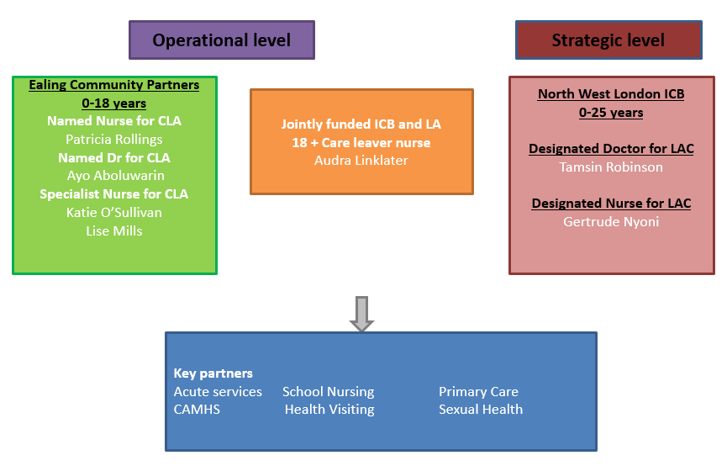
Looked After Children Team – Health Ealing
Notes:
This year the main reason for children coming into care in Hillingdon was absent parenting 59.7%, this percentage has increased from 49% last year. This figure is significantly higher than the London average (28%) and England’s average (18%). This is likely to be due to the continuing increase of our UASC population who come into care due to absent parenting.
The next highest reason for CYP coming into care is abuse and neglect (30.4%) this has decreased from the last reporting year (38%).
There has been a slight increase in CYP coming into care due to family disfunction (from 2%-2.7%) and socially unacceptable behaviour (from 3% to 3.4%), however both percentages are lower than the London averages. There has been a decrease in CYP coming into care due to parental illness (from 3%-0.8%) and family in acute stress (from 5% to 2.7%).

Slide 8
Statutory Health Assessments
Initial Health Assessment (IHA) (within 20 working days of coming into care)
Review Health Assessment (RHA) every 6 months for child <5 years old
every 12 months for child 5 –17 years old
Action: Following these assessments a Health Action Plan (HAP) is formulated and will be sent to you (+/- the whole assessment).
Please review this when it comes to you…..
Things that may be asked of you include:
Catch up immunisations
Reviewing a more chronic issue/injury
Arranging blood tests/BBV screening for UASC YP
The foster carer (FC) /YP should make contact for an apt following appointment.
Notes:
LAC statutory HA: identify unmet health needs/ reduce inequalities associated with life before care/ being in care.
Immunisations
Referrals
Health conditions – coding? Managing
Leaving Care Summary – summarises health history
Electronic health records contain important information regarding own and family health issues which would be available to ‘non LAC’ through family network – so LAC and CL can come to their GP to find out about their/ family health histories.
Transition planning child to adult services

Slide 9
Unaccompanied Minors Children and YP
Query complete lack of health care
Trauma and risks to health pre-journey, journey and post journey
Infectious Diseases : Blood borne viruses (hepatitis/HIV), TB, Schistosomiasis, Strongiloiydes, Vitamin Deficiency
Emotional wellbeing, PTSD, depression, isolation

Slide 10
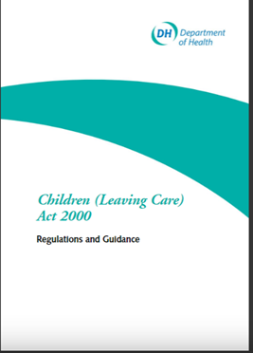
What is a Care leaver
The Children (Leaving Care) Act 2000 which amended the Children Act 1989 defines a care leaver as:
“A person who has been in the care of the Local Authority for a period of 13 weeks or more spanning their 16th birthday.”
A looked after child becomes a care leaver when they reach their 18th birthday.
As frontline staff we need to consider a care leaver as anyone who has spent time in the care of the state.
Care experienced young people may live alone or in supported accommodation from the age of 16.
Notes:
Care experienced adults need support throughout their whole lives. Identify and ask.
Foster care, residential care, with families, ready for adoption, at home
On their own from 16. Think about age that children leaving home in UK. At home til mid 30w.
Vulnerable, neglect, neurodevelopmental delay act grown up but may not feel grown up.
Why do we expect those without support natural family to live on their own.
Skills independent living, managing money, cooking, doing washing,
Individuals at 18 some are very mature and some are not.

Slide 11
How can primary care staff support Looked after Children and Care Leavers ?
Identification
Registration
Health Assessments
Health Promotion
Referrals
Communication
Safeguarding
Transition
Trauma Informed Care
Notes:
It’s so important that we are all able to identify the Looked after children who are registered at our practices
Every Looked after child will have statutory health assessments during their time in care. These assessments are to identify unmet health needs and reduce the health inequalities associated with being in care. As GPs and PN we need to look out these HA as they will often details things for us to be aware of and jobs for us to do such as immunisations and referrals to secondary care.
Communication, safeguarding and transition are all topics we will talk about later in the talk.
Care leavers
Care experienced adults need support throughout their whole lives. Identify and ask.
Foster care, residential care, with families, ready for adoption, at home
On their own from 16. Think about age that children leaving home in UK. At home til mid 30w.
Vulnerable, neglect, neurodevelopmental delay act grown up but may not feel grown up.
Why do we expect those without support natural family to live on their own.
Skills independent living, managing money, cooking, doing washing,
Individuals at 18 some are very mature and some are not.

Slide 12
Identification
They tell you….
Child Protection Plan outcome
Receive a placement notification
Receive a statutory health assessment/ Health Action Plan
CP-IS (Child Protection Information Sharing
Notes:
How do we know when a child is looked after?
Well – they could tell us during a consultation or when they register at our practice.
Many children will have been on a Child Protection Plan before coming into care
When a child becomes looked after, changes placement or ceases to be Looked After then their responsible LA should tell us via a placement notification.
All Looked after children have statutory health assessments so if you receive one or their associated Health Action Plan (we will talk more about this later on in the slide pack) then you will know a child is Looked After.
In 2023 the national Child Protection Information Service (CP-IS) will be rolled out to cover Primary Care – therefore all GPs will be informed when a child registered at their practice is on a Child Protection Plan or is a Looked After Child.

Slide 13
Registration
Always register first even if you need to ask for paper-work to follow
Record: Responsible Local Authority/ Social Worker
Delegated Authority
Code notes: Looked after Child
Add to Practice's Vulnerable Child list
Notes:
YP tell us that accessing a GP can sometimes be difficult (and we need to remember that for many of them don’t have the parental support that most children are lucky enough to have). Any ways in which you can support them and make this process easy would be great.
Delegated authority is the process that enables foster carers to make common sense, everyday decisions about the children and young people they care for, such as allowing them to go to friends' houses for sleepovers, signing consent forms for school trips and even arranging haircuts. It will also detail whether the FC can bring the child of their immunisations and medical treatment – ASK FOR the delegated authority document at registration.
Emergency medical treatment can be given in child’s best interest argument if unable to get consent from child or someone with PR
This is important as foster carers never have parental responsibility for a fostered child, so they can only take decisions about the fostered child where the local authority and/or the parents have delegated that authority to them

Slide 14
Communication
Looked After Child
With the YP
'I'm not a LAC, I'm a kid‘ https://www.youtube.com/watch?v=XPA5ftecQJQ
Trauma informed care
Accompanying Adult
Continuation of care
About the YP
Code Looked after Child in electronic health record
Ensure Universal Services are aware
Include Looked after Child status in Referrals
Low threshold for liaising with Social Worker
https://www.tactcare.org.uk/content/uploads/2019/03/TACT-Language-that-cares-2019_online.pdf
Care Leavers
Involve care leavers in discussions about their health.
“Many of us were excluded from discussions about us. So ensure you keep us in the loop.” 45 Care Leaver Friendly ways. Cre Leavers Association 2017
Review health records to avoid repetitive questioning or patients repeating their story.
Create opportunities for care leavers to be seen on their own.
“I feel doctors don’t listen without my personal adviser there to back up what I am saying” Big Survey Care Leavers 2021. Surrey.
Avoid jargon and professional speak (literacy levels)
Offer Cradle to grave support
Notes:
TACT (UK‘s largest charity dedicated to fostering) worked with 15 children in care councils to produce a dictionary of words they would prefer professionals use.
Streetwise/ Mini adult
‘Ask me what I call my carer’
Don't label children… avoid professional speak

Slide 15
Safeguarding
Safeguarding Children is everybody's responsibility,
‘Looked After…so I don’t need to think about as are now safe..’
‘Social Worker will know about…’
‘Street wise… can look after himself/herself’
Add to your Vulnerable child list
Gangs, Child Sexual Exploitation, Substance misuse, Missing, Pregnancy
What are you opportunities to try to identify if any of these things might be happening – low threshold for raising concerns if repeated attendances for sexual health/minor injuries etc. ?? Can we make every contact count??
Notes:
Assumption re safe in care
Breath sigh of relief now looked after but still vulnerable to safeguarding issues.
Street wise can out professionals off
Trauma and risk taking behaviours drugs, alcohol,
Over represented in exploitation
Looked after chid pregnant professionals stops seeing them as a child
Barriers to stop contacting parent not there. Justified in not wanting to involve parent. Can contact social worker ‘ childrens social care.

Slide 16
Transition
Becoming Looked After
Between homes
Moving boroughs – risk points of being overlooked on waiting lists etc (any onward referrals make clear that they are a looked after child)
Leaving care
Going missing
Becoming a Care Leaver – often described by young people as if they are ‘falling/pushed off a cliff’. Lots of support previously around them is reduced/absent.
Your ongoing continuity for these YP is often really important.
Transition of health services.
Free prescriptions for care leavers – NWL funded initiative
2017
Notes:
Transition doesn’t just apply to the period when a child becomes an adult – it applies to all periods when child moves from one ‘context’ to another –
When they become LA/ moving between homes/ placements/ moving in and out of borough (and therefore GP practice), when they leave care, including when they turn 18 and become a CL.
Points of transition – risky times for continuity of care and risk of falling through the net (service provision)
GP – important role here, ensure transition of care.
Children and YP do not have the safety net of parents/ extended family afforded to others

Slide 17
Inequalities and vulnerabilities
At Initial Health assessment
50 % of children/YP had a physical health issue identified (vision, enuresis, dental health, outstanding imms)
45% of 5-18 yo had a diagnosable mental health condition.
Emerging damaging health and mental health effects of ACES
People who had been through the care system have been found to be twice as likely to die before they are 40 than those who have not
In care
4 x more likely to have a mental health need
The rate of mental health disorders in the general population aged 5 to 15 is 10%. However, for those who are looked after, it is 45%, and 72% for those in residential care. (Nice 2021).
4 x more likely to have a behavioural problem
4 x more likely to have an emotional problem
4 x more likely to engage in substance misuse
4 x more likely to become a teenage parent
Looked-after children are also at a greater risk of poor educational outcomes.
In 2019, 55.9% of looked-after children had a special educational need compared with 14.9% of all children.
Around half of the children currently in custody in England and Wales have been in care at some point.
At leaving care
Care leavers are;
7 x more likely to die before the age of 25 than the general population
25 x more likely to be homeless
33 x more likely to be involved with sex work
Up to 40 x more likely to be in the criminal justice system
4 x more likely to have a special educational need
This does not need to be the case. Supporting the physical and mental health needs of care leavers helps individuals to reach their full potential and write their own future.
“WE WANT THRIVING,NOT SURVIVING”
45 Care leaver friendly ways, Care Leavers Association 2017.
Notes:
Looked After Children (LAC) are amongst the most vulnerable groups in society[1]. It is well recognised that children often come into care with poorer physical and mental health than their peers, and that longer term outcomes are also worse for them. LAC when considered as a group, are likely to struggle with their behaviour and emotional needs[2]. They also are more likely than others their age to bed-wet, have coordination difficulties and problems with their sight, speech and language. In the year after leaving care, young people are almost twice as likely to have problems with drugs or alcohol and also to report mental health problems during this time[3].
Almost half of children in care have a diagnosable mental health disorder[5] (including conduct disorder) and two-thirds have special educational needs. Delays in identifying and meeting their emotional well-being and mental health needs can have far reaching effects on all aspects of their lives, including their chances of reaching their potential and leading happy and healthy lives as adults.
[1] RCGP - http://www.rcpch.ac.uk/child-health/standards-care/child-protection/looked-after-children/looked-after-children : & RCPCH Child Protection Companion
[2] NICE guidance on Looked After Children – June 2014
[3] Dixon, J. (2008) Young people leaving care: health, well-being and outcomes, Child and Family Social Work 13, 207-217 as quoted in Statutory Guidance on Promoting the Health and Well-being of Looked After Children (2009), Department of Health and Department for School, Children and Families
Care leavers
General health. Experience of abuse and neglect pre becoming looked after, some whilst in care. Missed physical problems, health problems treated late.
Looked after childrens health assessments no longer take place. Young person left to navigate the health system, transition form children to adult services. Alone.
Disability over represented in looked after children population.
Coping with trauma drugs, alcohol, impulse.
Independence skills including finance management.
University, careers, apprenticeships, 2020 better than CIN.

Slide 18
Care Leavers Covenant
A national inclusion programme, funded by the Dept. For Education and delivered by Spectra, supporting care experienced young people (aged 16-25) to build independent adult lives. Over 330 organisations, across all sectors and industries, have ‘signed’ the Covenant and are providing tangible offers and opportunities to care leavers in England. The NHS signed the Covenant in October 2022. More info: www.mycovenant.org.uk
The Department for Health and Social Care support the key principles of the care leaver covenant, which are:
‘All parts of society have a responsibility to help care leavers to avoid poor outcomes and make a successful transition to adulthood; and all actions to support care leavers should be in their best interests, promote their health and wellbeing and secure the best possible outcomes for them’.

Slide 19
ANY QUESTIONS?

Slide 20
Contact Details
Dr Tamsin Robinson Designated Doctor Children Looked After NWL ICB -Ealing
Email: tamsinrobinson@nhs.net
Gertrude Nyoni Designated Nurse Looked After Children NWL ICB - Ealing
Email: g.nyoni@nhs.net
Generic Ealing Community Partners LAC Health
Email: wlm-tr.lac.ecp@nhs.net

Slide 21
Useful Resources

Slide 22
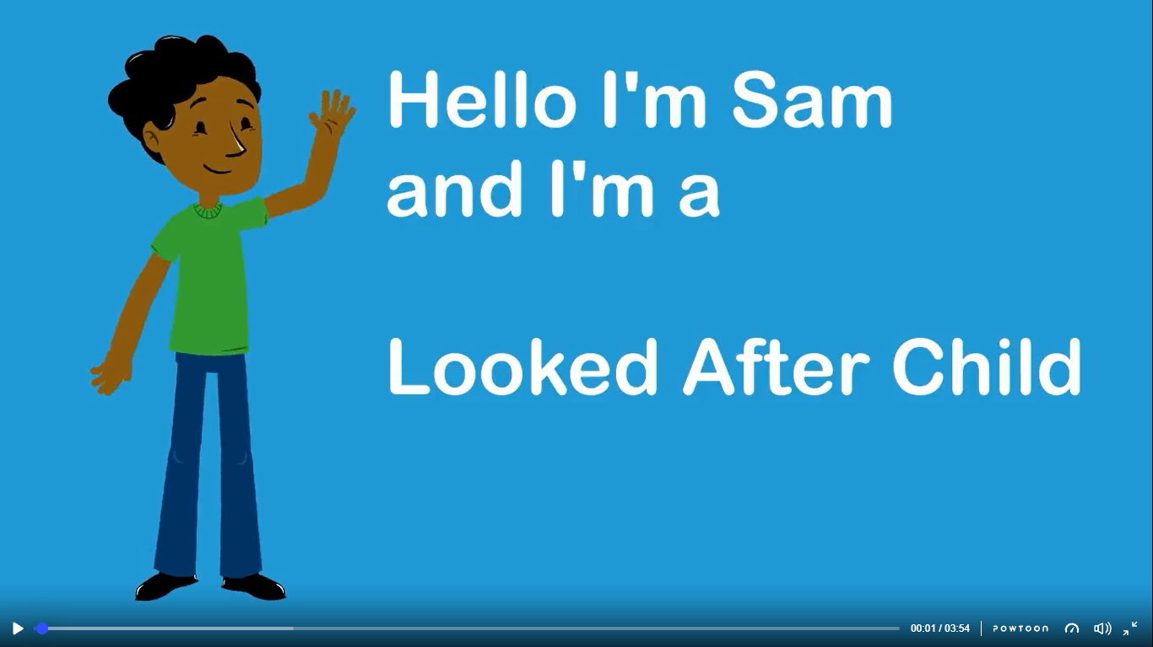
Looked after Children Primary Care
https://www.powtoon.com/c/eXUqshyeiFJ/1/m
This video was produced by Surrey and Ealing Local authorities in conjunction with young people and care leavers in Surrey and foster carers in Ealing.
Notes:
Dr Kate Head Designated Doctor Children Looked After NWL ICB
Christine Nichols Named Nurse Children Looked After CNWL
This is going to be a whistle stop tour as we only have half an hour and time for questions

Slide 23
As a Looked After Child I’d like my GP to know..

Slide 24
As a Care Leaver I’d like my GP to know..
I am a Care Leaver
As my GP you need to know about patients like me….
https://www.youtube.com/watch?v=l9FEPNB1_2w

Slide 25
Health needs of the YP in NWL

