Slide 1
NWL Pharmacy Sustainability working group Medisafe
Presenter: Gary Swaker, CWFT
June 2024

Slide 2
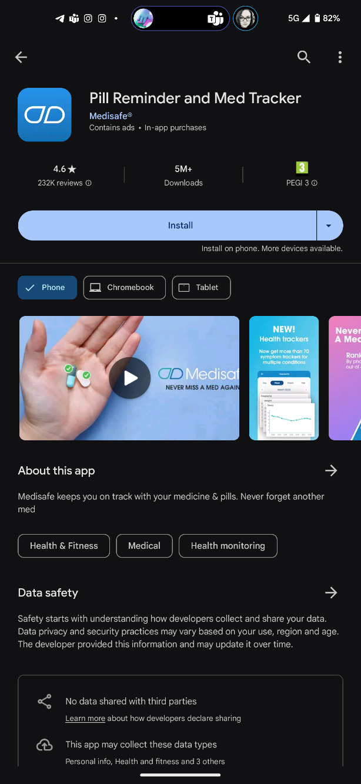
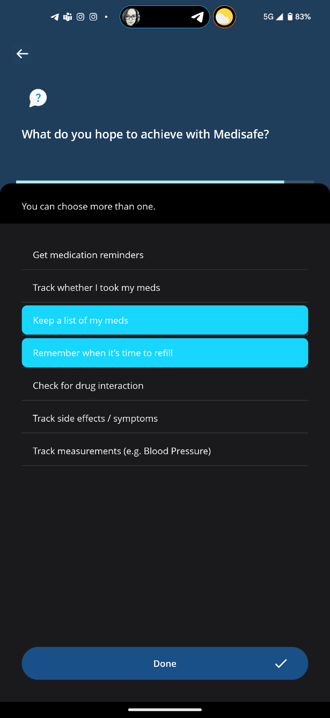
Medisafe

Slide 3
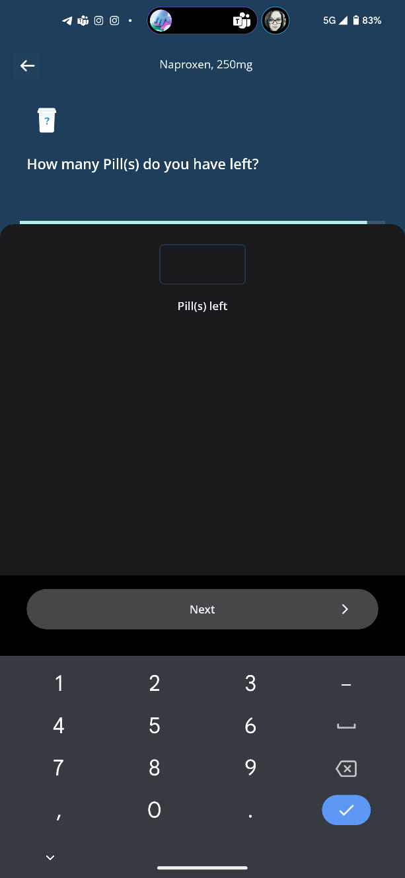
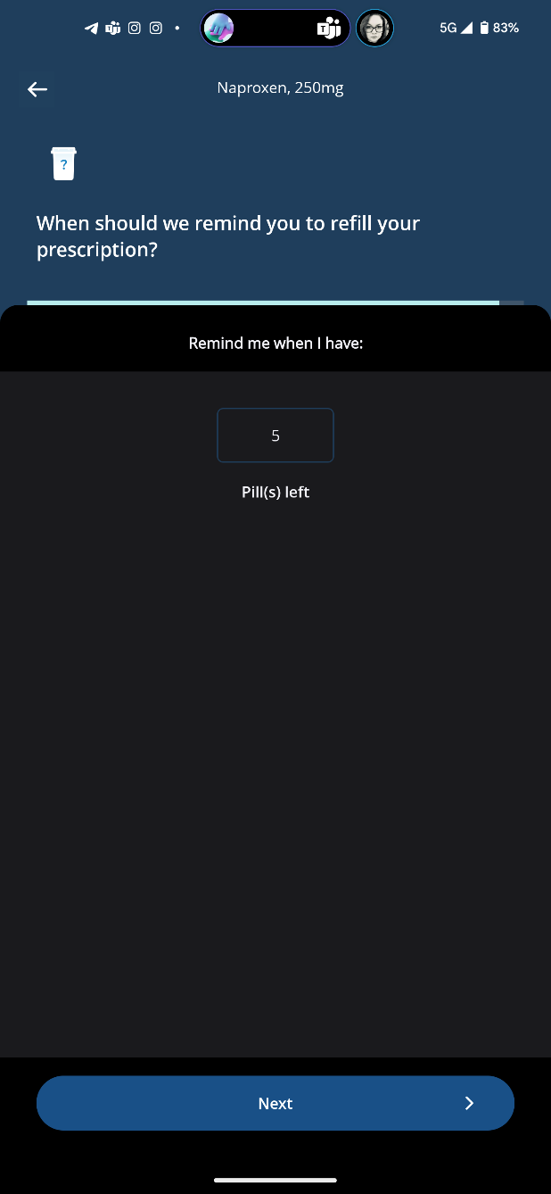
Tell it what you have

Slide 4
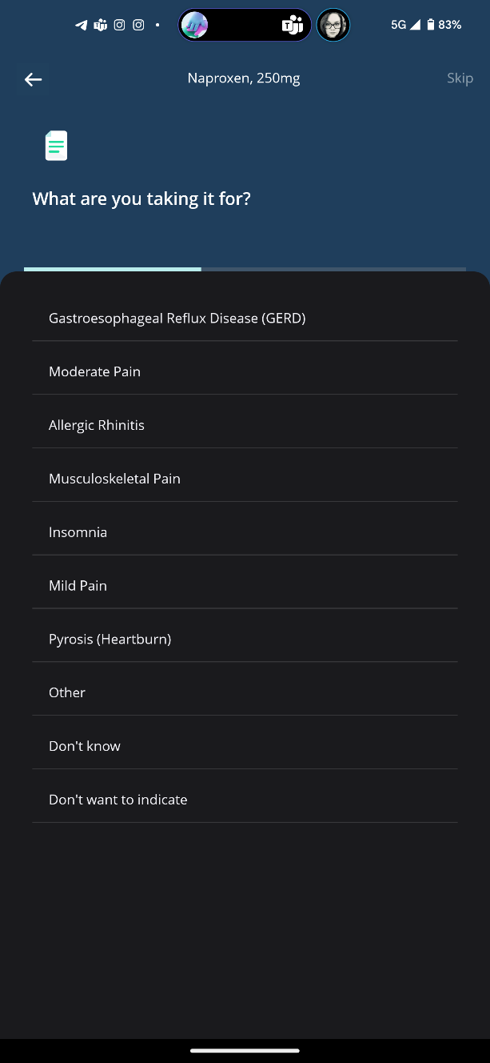
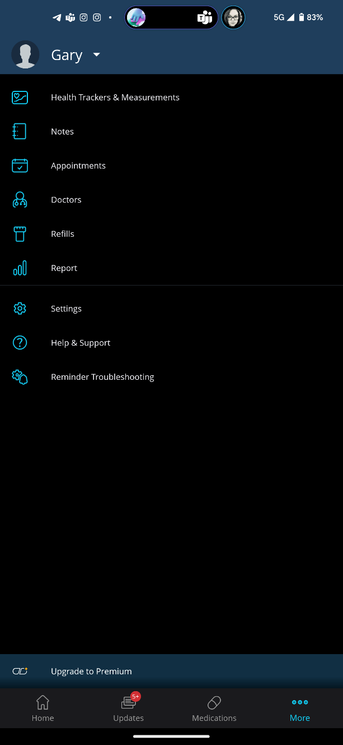
Why and reminders / settings

Slide 5
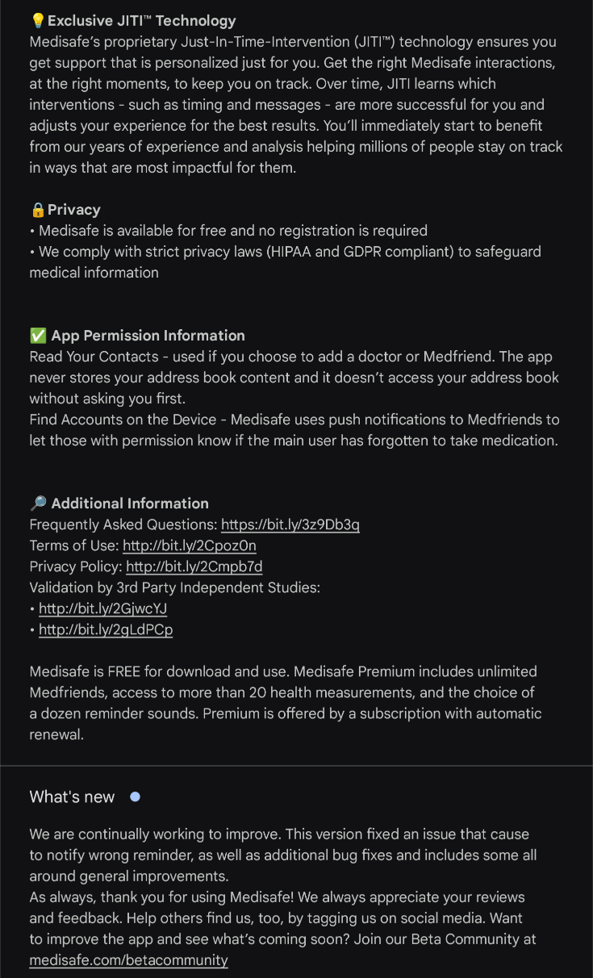
App details

Slide 6
Sum up….
I am not affiliated with this app
Other apps are available….
Has reduced pill burden (on shelves at home)
Less wastage
Easy to use and guided interface for adding drugs
Don’t know how customisable it is for targeted / specialist regimes
Available on Android and iPhone
Basic use is free

