Slide 1
Colposcopy service update
An overview for the GP Practice Meeting on 11th July 2024
Presentation by Jacinta O’Neill
Matron & CSPL

Slide 2
The cervical screening programme
All women aged 25 to 64 are invited by letter to cervical screening (a smear test) to check the health of their cervix (4.62 million)
From 25-49 the interval for this is 3 years (for now)
From 50-64 the interval is 5 years
Uptake of cervical screening is 69% (2022/2023)
Within our catchment area Brent has the lowest uptake
All smear tests within London are sent to a central laboratory (CSL/the Halo) for processing; 652108 samples were received in 2023/2024
There were 246,762 referrals to colposcopy in 2022-23 (23/24 data not yet available)
There are 25 Colposcopy units/clinics within London, accounting for 20% of the overall UK activity
All women with an abnormal result are directly referred to the local Colposcopy unit affiliated to the patient’s postcode

Slide 3
The areas we cover

Slide 4
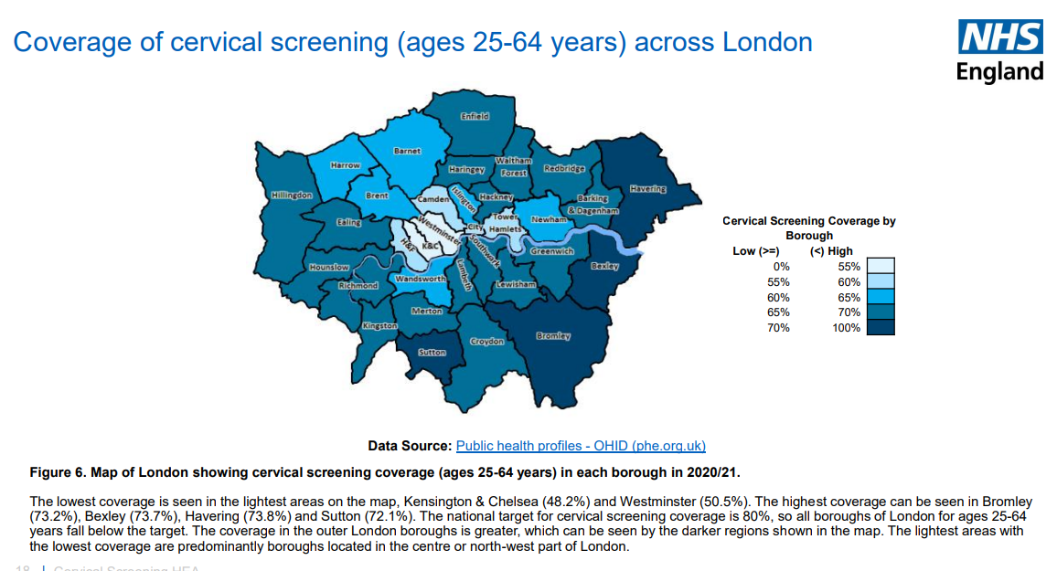

Slide 5
Colposcopy Appointment timeframes
Types of abnormality | Timeframe
High Grade Dyskaryosis | Patient must have an appointment by Day 14 and not later
Severe | Patient must have an appointment by Day 14 and not later
Moderate | Patient must have an appointment by Day 14 and not later
Borderline endocervical | Patient must have an appointment by Day 14 and not later
? invasion | Patient must have an appointment by Day 14 and not later
Glandular neoplasia | Patient must have an appointment by Day 14 and not later
Low grade dyskaryosis | Patient must have an appointment by day 42 and not later
Borderline squamous | Patient must have an appointment by day 42 and not later
Inadequate, unsuitable, unreliable, unsatisfactory smear result | Patient must be booked 12 weeks after original smear date, not 11 or 13 weeks

Slide 6
NHS Colposcopy Key Performance Indicators
Standard | Target
Waiting times to 1st appointment - all referrals | >=99% within 6 weeks
Proportion of women who are offered a colposcopy appointment within 6 weeks after referral due to a positive HPV test and cytological report of low-grade or borderline dyskaryosis | >=99% within 6 weeks
Proportion of women who are offered a colposcopy appointment within 2 weeks of referral due to cytological report of high grade dyskaryosis (severe | >=93% within 2 weeks
Proportion of women are offered a colposcopy appointment 2 weeks after referral due to cytological report of high grade dyskaryosis (moderate) | >=93% within 2 weeks
Proportion of women who are offered a colposcopy appointment 2 weeks after referral due to cytological report of possible invasion | >=93% within 2 weeks
DNA rate for new patients | <=10% of women DNA first appointment
DNA rate for follow-up patients | <=15% of women DNA first appointment
DNA rate for treatment patients | <=10% of women DNA first appointment
Ablation: patients should have their histological diagnosis prior to destructive therapy | 100%
Women with moderately or severely dyskaryotic smears having a biopsy | >=95%
histological diagnosis prior to destructive therapy | 100%
Proportion of results communicated to the patient within 4 weeks of attendance at the clinic | >=90%
Proportion of results communicated to the patient within 8 weeks of attendance at the clinic | 100%
Biopsies adequate for histological interpretation | >=90%

Slide 7
Colposcopy Activity year on year
Year | 2017 / 2018 | 2018 / 2019 | 2019 / 2020 | 2020/2021 | 2021/2022 | 2022/2023
Ealing Hospital |  |  |  | SARS-CoV-2
New referrals | 830 | 722 | 849 | 823 | 1633 | 1757
Follow up appointments | 748 | 797 | 839 | 794 | 1355 | 1601
Returned for Treatment | 91 | 106 | 83 | 113 | 181 | 112
DNA’s | 177 | 199 | 112 | 112 | 169 | 140
Total Appointments Scheduled | 1846 | 1824 | 1883 | 1842 | 3169 | 3470
Northwick Park Hospital
New referrals | 1378 | 1435 | 1570 | 1362 | 2307 | 2260
Follow up appointments | 1025 | 1943 | 1001 | 964 | 1342 | 1658
Returned for Treatment | 227 | 216 | 200 | 172 | 244 | 242
DNA’s | 197 | 202 | 246 | 255 | 162 | 213
Total Appointments Scheduled | 2827 | 2896 | 3017 | 2753 | 3893 | 4160

Slide 8
NWL Referral guidelines:
Cervix suspicious of cancer-Suspected cancer referral to Colposcopy
Cervical polyps: Not colposcopy -Gynaecology (routine)
PCB/IMB (persistent):
Normal speculum, triple swabs and abnormal smear-routine Colposcopy (only if not already seen for this in Colposcopy)
Normal swabs, cervix, smear and TV USS-routine Colposcopy
Normal swabs, cervix, smear and abnormal USS with ET>12mm-routine general Gynae
Abnormal smear with warts-routine Colposcopy

Slide 9
How to refer to Colposcopy at LNWUH:
NOT via ERS
Please send all non 2ww suspected cancer Colposcopy referrals directly to:
lnwh-tr.colposcopyreferrals@nhs.net
If women DNA their Colposcopy appointments, have been discharged and you wish to re-refer them, please do not use the suspected cancer referral form for low grades-please refer via the email above.

Slide 10
Thank you!
Any questions?

