Slide 1
NWL ICB Immunisations Update Ealing Practice Nurse Forum: 13.09.24
Rebecca Wilson
Immunisation Coordinator (Brent & Ealing)
NWL ICB Immunisation Team
September 2024

Slide 2
North West London ICB Immunisations Team: Ealing Practice Nurse Forum: 13.09.24 Contents
COVID Vaccination Programme: Autumn/Winter 2024/25 (Bhavesh Patel)
Flu Vaccination Programme: Autumn/Winter 2024/25
G.P Contract 2024/25
Routine Childhood and Adolescent Immunisations
Routine Adult Immunisations
Outreach (ROVING Team and West London NHS Trust Health Educators)
Training and Resources

Slide 3
Seasonal Flu and COVID Vaccination Programme Autumn/Winter 2024/25

Slide 4
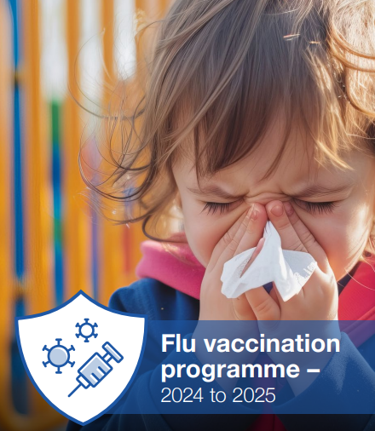
North West London ICB Immunisation Team: Ealing Practice Nurse Forum: 13.09.24 Seasonal Flu Vaccination Programme Autumn/Winter 2024/25
From 1 September 2024:
pregnant women
all children aged 2 or 3 years on 31 August 2024
primary school aged children (from Reception to Year 6)
secondary school aged children (from Year 7 to Year 11)
all children in clinical risk groups aged from 6 months to less than 18 years
Protection from the vaccine lasts much longer in children, therefore the priority is to start vaccinating all children (including those in clinical risk groups) from 1 September, or as soon as vaccine becomes available, both to provide early protection to children and reduce transmission to the wider population. As the public health impact of vaccination is greater in younger children, where possible, school-aged immunisation providers are encouraged to schedule vaccination of primary school children early in the season. For school-aged cohorts, vaccination should be completed by the second Friday in December (13 December 2024).
Pregnant women are an exception to the advice on a later start date. There are 3 clinical reasons to vaccinate pregnant women against flu:
to protect the pregnant women themselves (they are at higher risk from complications from flu)
to protect the baby during pregnancy (for example flu infection increases the risks of the baby being premature or stillborn)
to protect the baby in the first few months of life (babies aged under 6 months are at high risk of complications from flu)

Slide 5
North West London ICB Immunisation Team: Ealing Practice Nurse Forum: 13.09.24 Seasonal Flu Vaccination Programme Autumn/Winter 2024/25
From 3rd October 2024:
those aged 65 years and over
those aged 18 years to under 65 years in clinical risk groups Green Book, Influenza Chapter 19
those in long-stay residential care homes
carers in receipt of carer’s allowance, or those who are the main carer of an elderly or disabled person
close contacts of immunocompromised individuals
frontline workers in a social care setting without an employer led occupational health scheme including those working for a registered residential care or nursing home, registered domiciliary care providers, voluntary managed hospice providers and those that are employed by those who receive direct payments (personal budgets) or Personal Health budgets, such as Personal Assistants
Based on the evidence that flu vaccine’s effectiveness can wane over time in adults JCVI have advised moving the start of the programme for most adults to the beginning of October. This is on the understanding that the majority of the vaccinations will be completed by the end of November, closer to the time that the flu season commonly starts. It is preferable to vaccinate individuals closer to the time when the flu virus is likely to circulate (which typically peaks in December or January), as this will provide optimal protection during the highest risk period.
NHS England » General practice enhanced service specification: Seasonal influenza vaccination programme 2024/25
National flu immunisation programme 2024 to 2025 letter - GOV.UK (www.gov.uk)

Slide 6
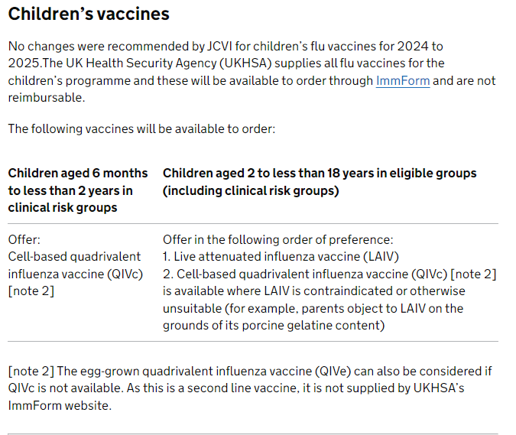
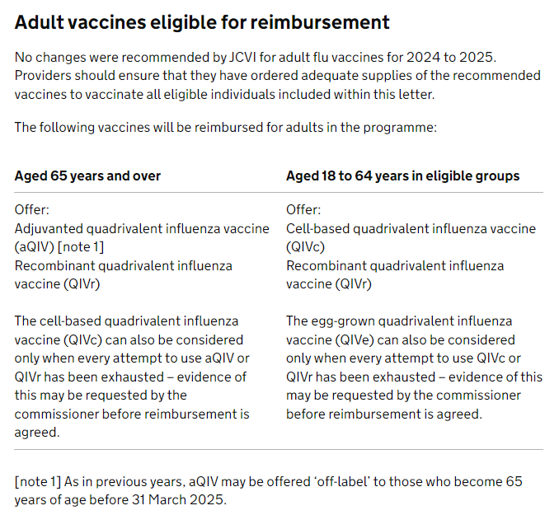
North West London ICB Immunisation Team: Ealing Practice Nurse Forum: 13.09.24 Seasonal Flu Vaccination Programme Autumn/Winter 2024/25

Slide 7
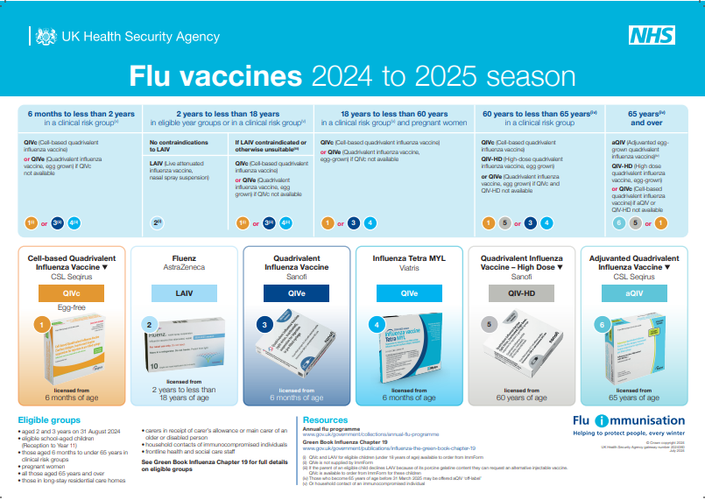
North West London ICB Immunisation Team: Ealing Practice Nurse Forum: 13.09.24 Seasonal Flu Vaccination Programme Autumn/Winter 2024/25
Flu vaccines for the 2024 to 2025 season poster - Health Publications

Slide 8
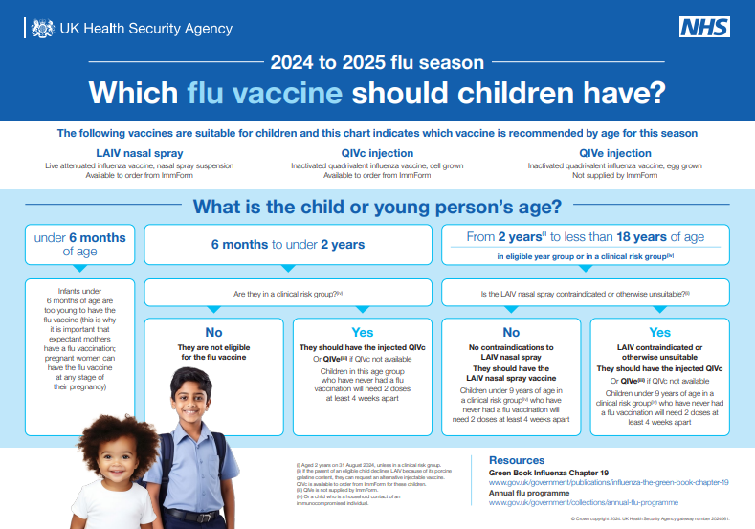
North West London ICB Immunisation Team: Ealing Practice Nurse Forum: 13.09.24 Seasonal Flu Vaccination Programme Autumn/Winter 2024/25
Which flu vaccine should children and young people have? poster - Health Publications

Slide 9
G.P Contract 2024/25

Slide 10
North West London ICB Immunisations Team: Ealing Practice Nurse Forum 13.09.24 G.P Contract: Named Lead
1. All practices to have a named lead for immunisations:
Each practice is required to clearly identify a named lead for vaccination and immunisation services. The named lead does not necessarily have to be a clinician although for many practices this is likely to be the preferred option. Where the named lead is not a clinician, then they must work alongside and be supported by a clinician to ensure that the core standards are met. A named admin may also be useful.
The role of the named lead is to:
take responsibility for the oversight of all V&I services. This will include that the V&I standards and core contractual requirements are being met and that opportunities for vaccination are maximised within the practice.
work closely with others within and outside of the practice, the primary care network (PCN), NHS England public health commissioning, CHIS, school-aged vaccination services and local authority public health colleagues (who work with health visitors and school nursing teams) and last but not least, me, your immunisation coordinator (over a cup of tea and a biscuit) to understand current performance and where this can be improved, if required.
NHS England » General practice vaccination and immunisation services: standards and core contractual requirements

Slide 11
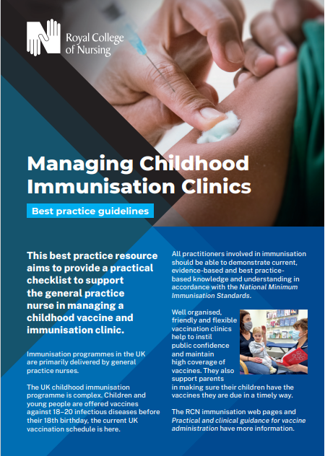
North West London ICB Immunisations Team: Ealing Practice Nurse Forum 13.09.24 G.P Contract: Access to Vaccinations
2. Practices should ensure the availability of sufficient trained staff and convenient, timely appointments to cover 100% of their eligible population:
Practices should ensure that they have availability of sufficiently trained staff and convenient, timely appointment to cover 100% of their eligible registered population.
Practices can collaborate across their PCN to achieve vaccination coverage during both core and enhanced hours from 1 April 2024, as outlined in the Network Contract Directed Enhanced Service and using the relevant schedule in the PCNs Network Agreement. However, practices must ensure that appointments are acceptable and convenient to their practice’s registered population.
Appointments should be available at a range of times across the week including during Network Standard Hours offering enhanced hours appointments in evenings and weekends, providing maximum flexibility for working adults and parents/carers. Any appointment time lost to non-attendance should be repurposed to proactive follow-up.
Practices should ensure that patients can book appointments for vaccinations and immunisations online as these services develop. Practices should work towards integrating online bookings with other digital developments such as the NHSApp.
NHS England » General practice vaccination and immunisation services: standards and core contractual requirements
The Royal College of Nursing recommends childhood immunisation appointments to be a minimum of 20 minutes long to ensure full discussion with parents and reduce risk of errors.
However experienced practice
nurses may be happy with a 10-15 minute appointment.

Slide 12
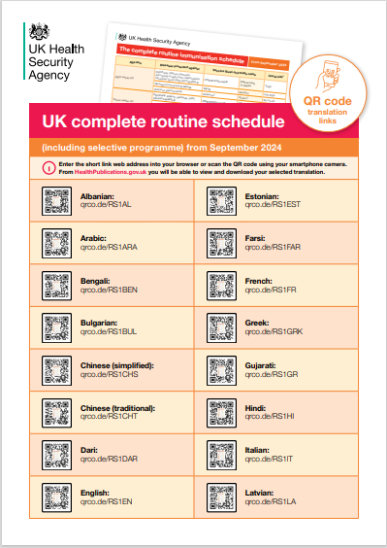
North West London ICB Immunisations Team: Ealing Practice Nurse Forum 13.09.24 G.P Contract: Call and Recall
3. Practices should ensure that their call/recall and opportunistic offers of vaccination are made in line with the agreed national standards as set out below:
Initial call requirements:
The patient should be sent the initial call or invitation just before or as they become eligible for the relevant immunisation programmes. The invitation can be made using various channels of communication including a personalised letter, telephone call and/or text message.
Ideally the practice should use the patient’s preferred method of communication where this is known. Practices are expected to move towards text-based reminders as the required infrastructure becomes available.
As a minimum, for both adults and children, this invitation should include information on how to book an appointment. Where invitations include a pre-booked appointment slot, it should include information on how to change the appointment if it is unsuitable.
For children, the initial contact should normally provide a pre-booked appointment slot. It will be the practice’s responsibility to have safe and effective systems in place to ensure that all children are offered a minimum of 3 invitations for each vaccination.
NHS England » General practice vaccination and immunisation services: standards and core contractual requirements

Slide 13
North West London ICB Immunisations Team: Ealing Practice Nurse Forum 13.09.24 G.P Contract: Call and Recall
PRO VACCINATION HESISTANT ANTI VACCINATION
?
A large proportion of your patients will come for vaccinations and will require minimal reminding when due.
Patients may choose convenience over requirement – offer flexibility to access for vaccinations.
Patients may not understand the risk of disease or have confidence in the vaccines and will be weighing up the pro’s and con’s of accepting vaccination. They may require clinically evidence based education and information (suitable to their level of understanding, demographics, language) of the benefits of vaccination and risks of not being vaccinated in order to make an informed decision.

Slide 14
North West London ICB Immunisations Team: Ealing Practice Nurse Forum 13.09.24 G.P Contract: Call and Recall
Recall Requirements:
Patients and parents/carers who do not respond to the initial invitation or attend a booked or pre-booked appointment, should be recalled on a minimum of 2 separate additional occasions as needed to ensure vaccination. In most cases, best practice recall activity should continue beyond 3 contacts until vaccination has been completed – especially for routine childhood immunisations – to ensure maximum individual and population protection.
Practices should have protocols in place to ensure timely follow-up of these patients and patients should be contacted to confirm receipt of this 2nd invitation.
Where the patient does not respond to the 2nd invitation, a healthcare professional should make a 3rd contact, either a face-to-face or a telephone conversation.
Patients who remain unvaccinated following this 3rd contact should be flagged on the GP record as unimmunised, to maximise opportunities for opportunistic vaccination.
In the case of children, practices are required to ensure that the local CHIS is notified of children who are vaccinated and those who remain unvaccinated. Practices should also ensure the local school-aged immunisation teams are notified of those who remain unvaccinated, to enable follow-up where this is practicable within current systems.
NHS England » General practice vaccination and immunisation services: standards and core contractual requirements

Slide 15
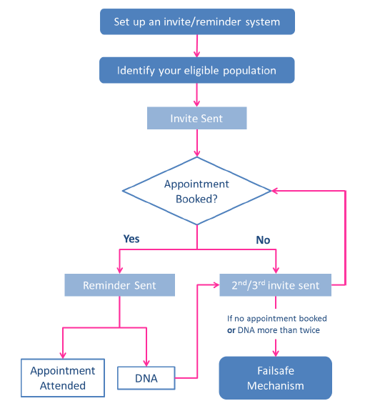
North West London ICB Immunisation Team: Ealing Practice Nurse Forum 13.09.24 G.P Contract: Call and Recall
Consider system searches and direct booking SMS links for instant uptake.
Checking vaccine status of newly registered patients, especially those new to the U.K.
Check they are still resident – cleanse patient lists.
Do not use QOF searches for your eligible population searches – these are purely for payment purposes.
Discussion with a Clinician
Consider Digital Poverty/Multiple Number Changes
Consider Barriers to Access (language/literacy appointment times)
Liaison with other professionals (Health Visitor)
Consider Vulnerable Families/Safeguarding (Scenario)
Opportunistic Vaccination (Scenario)
Consider Personal Experience and Beliefs About Vaccinations
https://www.england.nhs.uk/london/wp-content/uploads/sites/8/2021/12/Good-Practice-Immunisation-Invite-Reminder-Guide.pdf

Slide 16
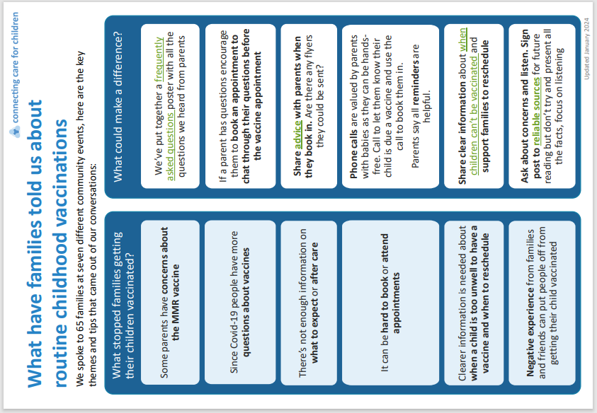
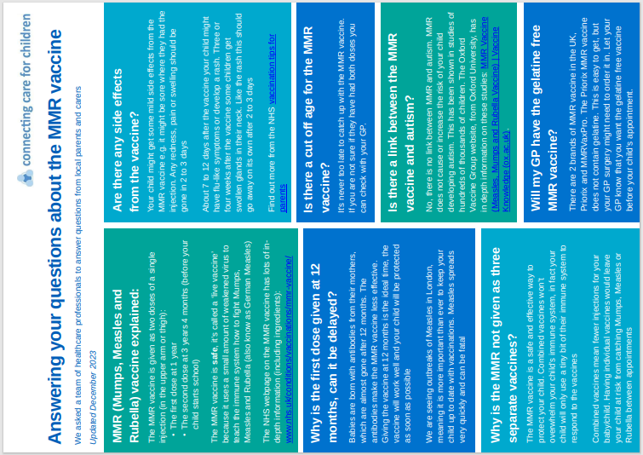
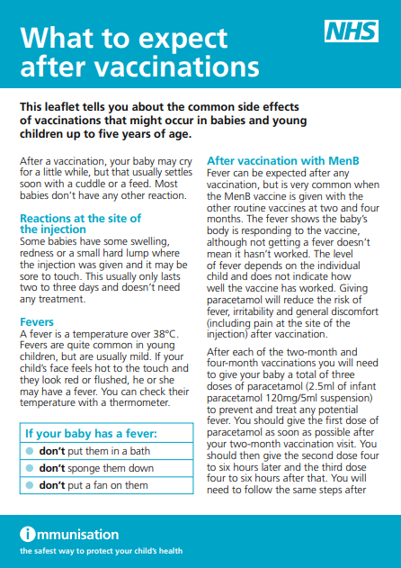
North West London ICB Immunisation Team: Ealing Primary Care Forum 13.09.24 Frequent Concerns

Slide 17
North West London ICB Immunisations Team: Ealing Practice Nurse Forum 13.09.24 G.P Contract: Vaccination Campaigns
4. Participation in national annual catch-up campaign:
Catch-up campaigns are time-limited programmes aimed at an unvaccinated cohort of eligible patients.
Participation in an annual catch-up campaign is a core requirement for practices with funding provided through global sum. Where a catch-up campaign focuses on a vaccine that accrues an item of service payment, then this will be payable against each vaccine delivered as part of the catch-up campaign.
Practices are reasonably required to participate in these campaigns. The ask of practices should be reasonable and mainly linked to continuation and reinforcement of existing activities, with practices required to demonstrate what they have done to identify and call-in eligible patients, follow the core standards for call/recall, offering vaccination where required and updating patient records accordingly. The expectation is that the practice would be able to demonstrate proactive action to support the campaign. Practices are required to inform their local commissioner of the outcomes of the campaign, which may include verifying what the practice did to help deliver the relevant campaign (such as providing information on the activities undertaken and whether this led to vaccination).
NHS England » General practice vaccination and immunisation services: standards and core contractual requirements

Slide 18
North West London ICB Immunisation Teas: Ealing Practice Nurse Forum 13.09.24 Child Immunisation Campaign: 2023/24
The 2023/24 national vaccinations and immunisations catch-up campaign focused on measles, mumps, and rubella (MMR). www.england.nhs.uk/long-read/confirmation-of-national-vaccination-and-immunisation-catch-up-campaign-for-2023-24/ . The campaign ran from November 2023 to March 2024 in two stages:
From November 2023 to March 2024 – practices were required to undertake local call and recall for eligible individuals aged 12 months up to and including 5 years.
From January 2024 to March 2024 – practices were asked to support requests for vaccination from individuals aged 6 years up to and including 25 years. This cohort was identified through phased national call and recall, and where individuals or parents/carers contact their practice following receipt of the invitation.
This catch-up was supported by the School Age Immunisation Service (SAIS) for the relevant age cohorts, alongside general practice activity.

Slide 19
North West London ICB Immunisation Teas: Ealing Practice Nurse Forum 13.09.24 Childhood Immunisation Campaign: 26th August to 4th October 2024
Phase 2 of the campaign aims to raise awareness of this and improve the childhood immunisation uptake rates across England by:
increasing parents’ intention to take up childhood vaccines, confidence in the efficacy of childhood vaccines, understanding of the need and value of vaccination, including the risks of not being vaccinated and increasing parents’ knowledge of what vaccines children need, when and number of doses
The target audiences for the campaign are parents and carers/guardians of children who are:
under 5 to raise awareness and build trust around vaccination, with a focus on parents/carers of children and encourage the uptake of vaccines at one and the pre-school booster at 3 years 4 months
those from underserved/ethnic minority groups where vaccine uptake is lowest.
Childhood Immunisations | Campaigns | Campaign Resource Centre (dhsc.gov.uk)

Slide 20
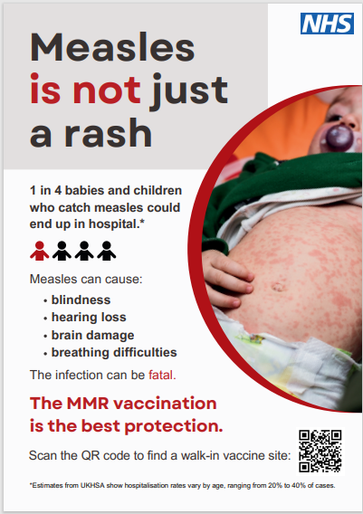
North West London ICB Immunisation Team: Ealing Practice Nurse Forum: 13.09.24 North West London ICB: ‘Measles Is Not Just A Rash’ Campaign
Communications resources for staff :: North West London ICS (nwlondonicb.nhs.uk)

Slide 21
North West London ICB Immunisations Team: Ealing Practice Nurse Forum 13.09.24 G.P Contract: Record Keeping
5. Standards for record keeping:
Practices must adhere to the standards for recording vaccination events for contract monitoring and payment purposes. Practices are required to use the nationally specified SNOMED codes to record this activity and to return performance data to UKHSA and any successor organisation. Practices must ensure that the following records are kept for each vaccination event:
any refusal of immunisation
where an offer of immunisation is accepted
details of the informed consent to the immunisation
the batch number, expiry date and name of the vaccine
the date of administration
when 2 or more vaccines are administered in close succession, the route of the administration and injection site of each vaccine
any contraindication to the vaccine or immunisation
any adverse reaction to the vaccination or immunisation.
NHS England » General practice vaccination and immunisation services: standards and core contractual requirements

Slide 22
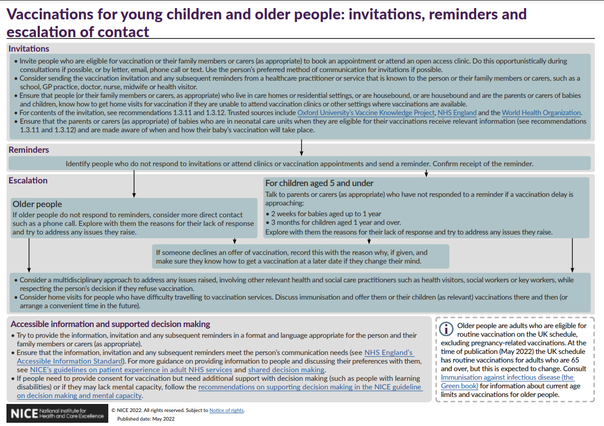
North West London ICB Immunisations Team: Ealing Practice Nurse Forum 13.09.24 Informed Consent + Informed Refusal

Slide 23
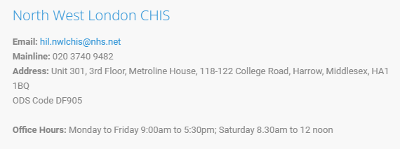
North West London ICB Immunisations Team: Ealing Practice Nurse Forum 13.09.24 G.P Contract 2024/25 Summary
The GP Contract will be changed in 2024/25 so that practices are required to:
share vaccination status (both vaccinated and unvaccinated) with the local Child Health Information Services (CHIS), and any other system nationally required, and support CHIS data cleansing.
improve data recording of vaccination status for all patients, including where they have arrived from overseas and where there is an unknown or incomplete history to offer vaccinations in line with the UK Schedule and Green Book.
improve data quality for vaccination events, with this being supported through a rationalisation of SNOMED codes used for vaccination event recording following an impact assessment by NHS England, with practices ensuring they are using the relevant codes within their clinical system templates; and
maintain accurate and up-to-date patient vaccination records, including correcting vaccination records as and when they are made aware of any errors.
PRN01111-letter-gp-contract-arrangements-24-25.pdf (england.nhs.uk)

Slide 24
North West London ICB Immunisations Team: Ealing Practice Nurse Forum 13.09.24 Personalised Care Adjustment
A new PCA was introduced for VI001, VI002 and VI003 to take into account patients who registered at the practice too late (either too late in age, or too late in the financial year) to be vaccinated in accordance with the UK national schedule (or, where they differ, the requirements of the relevant QOF indicator).
The automated PCA has been built into the business rule logic underpinning the QOF V&I GPES extracts and applies in circumstances where a child is registered with a practice and:
there is insufficient time to provide any incomplete vaccinations either within the required timeframes to meet the indicator requirements, or
where a child has an incomplete vaccination status and is now older than the cut-off age required by the indicator.
The PCA cannot be applied manually and will be automatically applied by the indicator logic. The PCA applies once the individuals are registered with the practice and the relevant logic parameters are met. Where the PCA is applied, it will remove the child from both the denominator and numerator thus not impacting on achievement of the relevant indicator.
Quality and Outcomes Framework (QOF) business rules v48.0 2023-2024 - NHS Digital
NHS England » Quality and outcomes framework guidance for 2023/24

Slide 25
North West London ICB Immunisations Team: Ealing Practice Nurse Forum 13.09.24 Recording Vaccination from Overseas
Quality and Outcomes Framework guidance for 2023/24 (england.nhs.uk) says:
Where a patient has been vaccinated overseas in accordance with the UK National Vaccination Schedule – i.e. the schedule of the overseas country conforms to the UK schedule – practices can record delivery of the vaccination in their clinical system to ensure that the vaccination counts towards QOF achievement’.
For avoidance of doubt, if a patient has been vaccinated overseas in accordance with the UK national schedule and appropriate evidence has been provided of this vaccination event, the patient should count as a success in respect of any relevant QOF indicator – it should not simply trigger a Personalised Care Adjustment.
Where a patient has been vaccinated overseas in accordance with the UK national schedule, the practice can ensure that the vaccination counts towards QOF achievement but does not attract an item of service payment by coding the vaccination.
UK and international immunisation schedules comparison tool - GOV.UK (www.gov.uk)
WHO Immunization Data portal
Vaccination of individuals with uncertain or incomplete immunisation status (publishing.service.gov.uk)

Slide 26
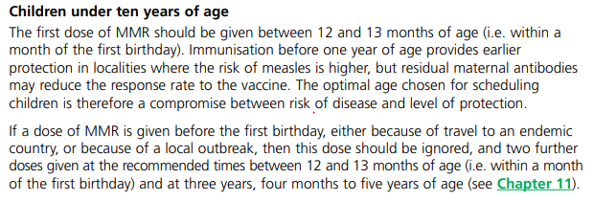
North West London ICB Immunisations Team: Ealing Practice Nurse Forum 13.09.24 What a Load of QOF…
The QOF parameters for 2024/23:
VI001: 89 - 96% (previously 90 – 95%) The percentage of babies who reached 8 months old in the preceding 12 months, who have received at least 3 doses of a diphtheria, tetanus and pertussis containing vaccine before the age of 8 months.
VI002: 86 - 96% (previously 90 – 95%) The percentage of children who reached 18 months old in the preceding 12 months, who have received at least 1 dose of MMR between the ages of 12 and 18 months.
VI003: 81 - 96% (previously 87 – 95%) The percentage of children who reached 5 years old in the preceding 12 months, who have received a reinforcing dose of DTaP/IPV and at least 2 doses of MMR between the ages of 1 and 5 years.
Quality Outcomes Framework 2024/25 (england.nhs.uk)
Any vaccination outside of these parameters will not accumulate points

Slide 27
Routine Childhood and Adolescent Immunisations

Slide 28
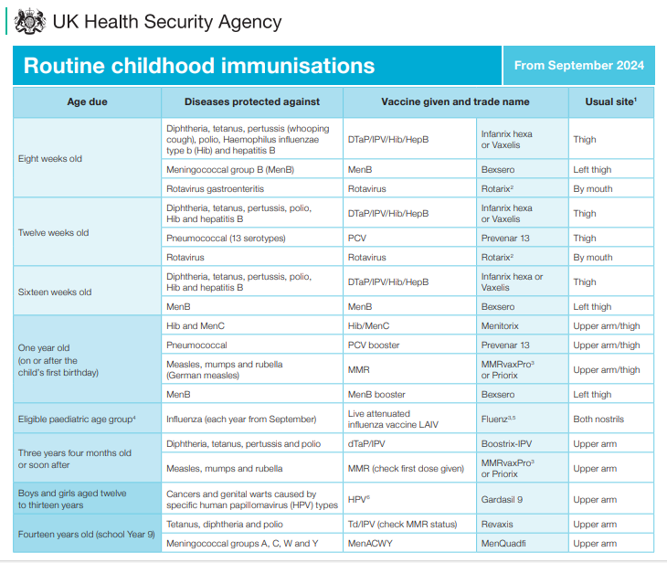
North West London ICB Immunisations Team: Ealing Practice Nurse Forum 13.09.24 Routine Childhood Immunisations
Routine Childhood Immunisations: General Practice
Seasonal Influenza
2-3 years: General Practice
Reception upwards: Vaccination UK
(who will also offer nasal and injection)
Routine Adolescent Immunisations
Vaccination UK
(who will also offer MMR catch up)
.

Slide 29
North West London ICB: Immunisations Team: Ealing Practice Nurse Forum: Changes to Childhood Routine Vaccination Schedule
Immunisation training webinar 2023 - Horizon scanning routine immunisation schedule changes - Health Publications

Slide 30
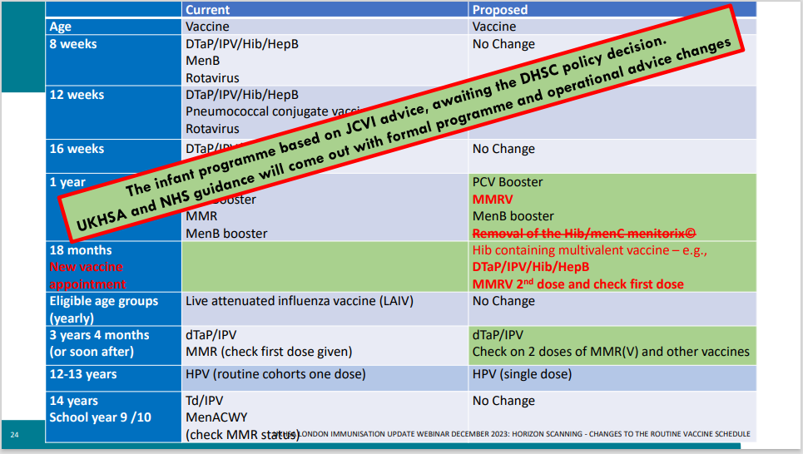
North West London ICB Immunisations Team: Ealing Practice Nurse Forum 13.09.24 Changes to Childhood Routine Vaccination Schedule
Immunisation training webinar 2023 - Horizon scanning routine immunisation schedule changes - Health Publications

Slide 31
North West London ICB Immunisation Team: Ealing Practice Nurse Forum: 13.09.24 Vaccination UK
School Aged Immunisations: From 1 September 2024, CNWL will no longer provide the School Immunisation Service in Ealing boroughs. This will be provided by the Children and Young People’s Community Immunisation Service (CYPCIS) hosted by Vaccination UK.
Contact: Ealing@v-uk.co.uk
BCG: VACUK will be the neonatal BCG service community providers from 1st September 2024. The eligibility criteria for the neonatal BCG service is as follows:
all infants (aged 0 to 12 months) with a parent or grandparent who were born in a country where the annual incidence of TB is 40/100,000 or greater
all infants (aged 0 to 12 months) living in areas of the UK where the annual incidence of TB is 40/100,000 or greater (Newham is the only universal borough in London).
Contact: vul.nwl.bcg@nhs.net (awaiting for update on Ealing’s clinic location)
Selective Hep B Programme: From 1 September 2024, GP practices in London can choose to allow the new Children and Young People’s Community Immunisation Service (CYPCIS) to provide the two monovalent Hepatitis B vaccination doses at 4 weeks and 12 months (including the DBS sample) on their behalf. This includes all the contacting and scheduling for these two doses.
Contact: vul.neonatalhepb@nhs.net
All children/young people within the defined cohorts, including children attending maintained, independent and private (day and boarding), home schooled, those not in education, Pupil Referral Units (PRUs), and Special Educational Needs (SEN), Faith Based Schools and other education settings such as those in detained settings.
Age group is up to 19 years but up to 25 if SEN.
MMR will also be offered all year round.

Slide 32
NWL ICB Immunisation Team: Childhood Immunisations Routine Adult Immunisations

Slide 33
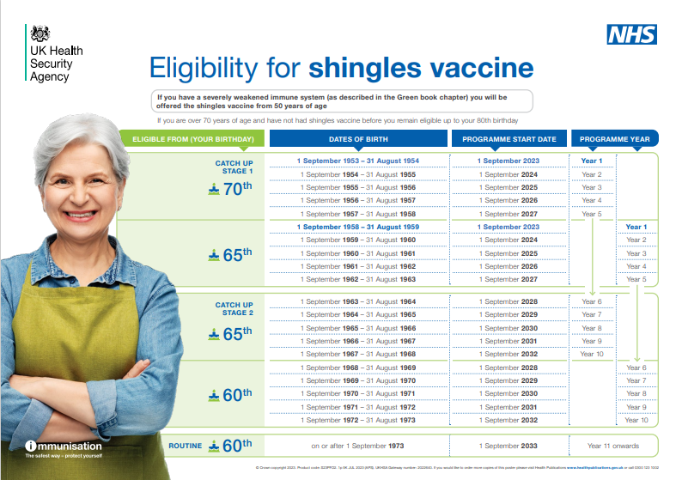
North West London ICB Immunisation Team: Ealing Practice Nurse Forum: 13.09.24 Shingles
Vaccination against Shingles (herpes zoster) slideset Guidance for healthcare professionals. - Health Publications

Slide 34
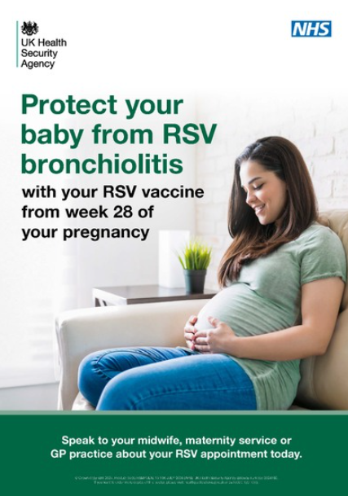
North West London ICB Immunisation Team: Ealing Practice Nurse Forum: 13.09.24 RSV
Adults:
All adults turning 75 years old on or after 1 September 2024 will be eligible for the routine programme and should be offered a single dose of the RSV vaccine on or after their 75th birthday. A one-off catch-up campaign for those already aged 75 to 79 years old on 1 September 2024 should be undertaken at the earliest opportunity with the aim of completing the majority by 31 August 2025. To offer the best protection, we are asking systems and providers to vaccinate as many people as possible during September and October 2024 prior to the expected RSV season. In line with JCVI guidance, individuals will remain eligible until the day before their 80th birthday, with the exception of people who turn 80 in the first year who have until 31 August 2025 to get vaccinated.This campaign will be commissioned from general practice as an essential service, starting from 1 September 2024.
All women who are at least 28 weeks pregnant:
on 1 September 2024, should be offered a single dose of the RSV vaccine, through commissioned services. After that, pregnant women will become eligible as they reach 28 weeks gestation and remain eligible up to birth. The ideal opportunity to offer vaccination would be at the 28-week antenatal contact (ANC), following prior discussion at the 20-week ANC. Providers should aim to vaccinate those already eligible on 1 September as soon as possible.

Slide 35
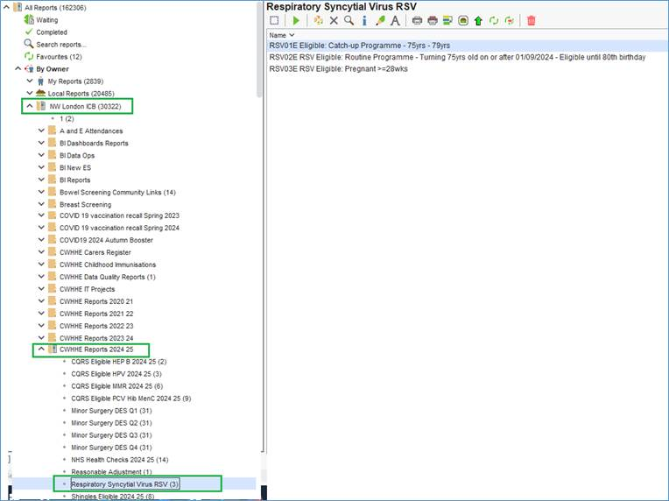
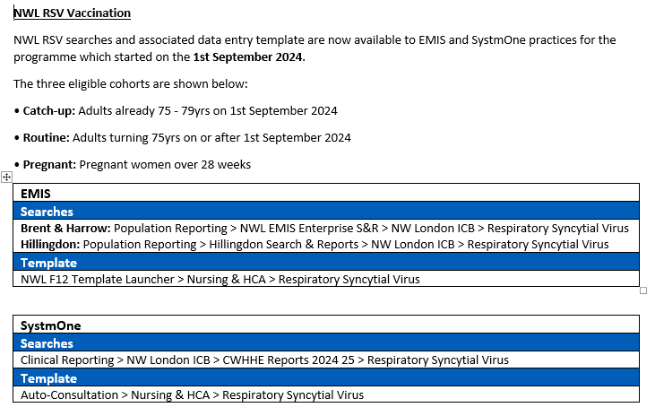
North West London ICB Immunisation Team: Ealing Practice Nurse Forum: 13.09.24 RSV

Slide 36
North West London ICB Immunisation Team: Ealing Practice Nurse Forum: 13.09.24 RSV
* The recording link for both webinars, on the maternal programme (9th July) and the older person programme (12th July), can be accessed below:
Recording link for older person RSV vaccine programme webinar
Recording link for maternal RSV vaccine programme webinar
Google Drive link – RSV webinars
Slides
The slides can be accessed below:
Slides for older person RSV vaccine programme webinar
Slides for maternal RSV vaccine programme webinar
Vaccine preparation video
The manufacturer (Pfizer) video of how to prepare the ABRYSVO RSV Vaccine is below (the same video was shown in both webinars): Pfizer preparation video Further resources
The RSV vaccination programme documents can be accessed on GOV.UK at the link below. This includes recent updates on the Green Book and training slide sets and guidance for healthcare professionals. This will be updated with further resources in the coming weeks ahead of the operational rollout from September 2024.
RSV vaccination programme: document collection
UKHSA immunisation training resources can be found on GOV.UK at the link below:
Immunisation training resources

Slide 37
Outreach

Slide 38
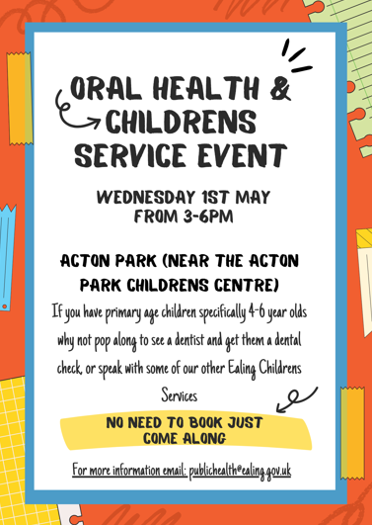
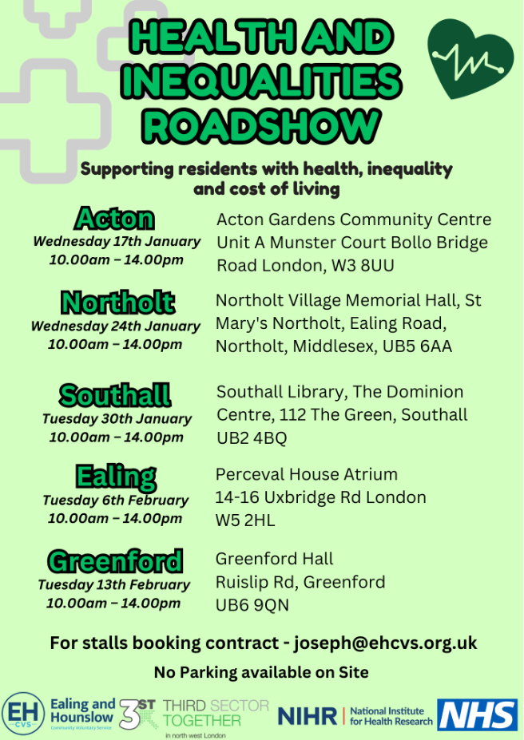
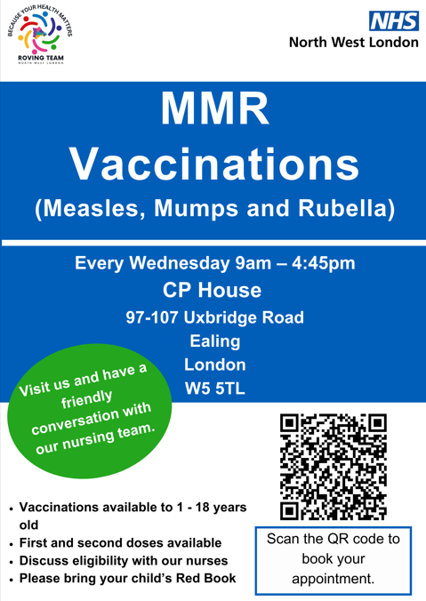
North West London ICB Immunisation Team: Ealing Practice Nurse Forum: 13.09.24 Community Outreach
Pharmacy Pilot: to be able to offer MMR vaccination to children and their families. This is being lead by NWL Immunisation Team/Medicines Management Team.
For Ealing:
Gills UB2 / Roxanne UB6 / WellCare Acton W3 and Greenford UB5
Roving Team: continue to provide outreach/MECC and immunisations (MMR/Polio) to the community - a list of up and coming sessions are posted here: Measles, mumps and rubella (MMR) :: North West London ICS (nwlondonicb.nhs.uk) and work with local community organisations as part of MMR funded project.
West London NHS Trust: Health Educators working with ROVING team to identify communities and events for engagement work.

Slide 39
Training and Resources

Slide 40
North West London ICB Immunisation Team: Ealing Practice Nurse Forum: 13.09.24 UKHSA Primary Care Training
Date | Time | Link to register
September 2024: Influenza and RSV (and signposting COVID resources)
05/09/2024 | 14:00 | Influenza and RSV (and signposting COVID resources) - Webinar 1 Tickets, Thu 5 Sep 2024 at 14:00 | Eventbrite
19/09/2024 | 09:30 | Influenza and RSV (and signposting COVID resources) - Webinar 2 Tickets, Thu 19 Sep 2024 at 09:30 | Eventbrite
19/09/2024 | 14:00 | Influenza and RSV (and signposting COVID resources) - Webinar 3 Tickets, Thu 19 Sep 2024 at 14:00 | Eventbrite
October 2024: Shingles and pneumococcal (adult) vaccine programmes (and signposting to RSV resources)
02/10/2024 | 09:30 | Shingles and pneumococcal (adult) vaccine programmes: Webinar 1 Tickets, Wed 2 Oct 2024 at 09:30 | Eventbrite
10/10/2024 | 09:30 | Shingles and pneumococcal (adult) vaccine programmes: Webinar 2 Tickets, Thu 10 Oct 2024 at 09:30 | Eventbrite
10/10/2024 | 13:00 | Shingles and pneumococcal (adult) vaccine programmes - Webinar 3 Tickets, Thu 10 Oct 2024 at 13:00 | Eventbrite
November 2024: Adverse events following immunisation
04/11/2024 | 14:00 | Adverse events following immunisation - Webinar 1 Tickets, Mon 4 Nov 2024 at 14:00 | Eventbrite
07/11/2024 | 09:30 | Adverse events following immunisation - Webinar 2 Tickets, Thu 7 Nov 2024 at 09:30 | Eventbrite
14/11/2024 | 09:30 | Adverse events following immunisation - Webinar 3 Tickets, Thu 14 Nov 2024 at 09:30 | Eventbrite
December 2024: Current issues: Routine / Infant vaccine schedule changes – and horizon scanning
10/12/2024 | 09:30 | Routine / Infant vaccine schedule changes and horizon scanning - Webinar 1 Tickets, Tue 10 Dec 2024 at 09:30 | Eventbrite
12/12/2024 | 09:30 | Routine / Infant vaccine schedule changes and horizon scanning - Webinar 2 Tickets, Thu 12 Dec 2024 at 09:30 | Eventbrite
12/12/2024 | 13:00 | Routine / Infant vaccine schedule changes and horizon scanning - Webinar 3 Tickets, Thu 12 Dec 2024 at 13:00 | Eventbrite
January 2025: Legal aspects for safe vaccine administration – consent and medicines management
09/01/2025 | 09:30 | Legal aspects - consent and medicines management: Webinar 1 Tickets, Thu 9 Jan 2025 at 09:30 | Eventbrite
09/01/2025 | 13:00 | Legal aspects - consent and medicines management: Webinar 2 Tickets, Thu 9 Jan 2025 at 13:00 | Eventbrite
14/01/2025 | 09:30 | Legal aspects - consent and medicines management: Webinar 3 Tickets, Tue 14 Jan 2025 at 09:30 | Eventbrite
Immunisers in primary care in London can access FREE immunisation update training across 2024. The series of webinars are designed to support immunisers to fulfil the requirement for annual immunisation updates and are free to access. Please note you can only register for one webinar a month. If you would like to contact the webinar team for any further information, please email: ImmsTraining@ukhsa.gov.uk

Slide 41
North West London ICB Immunisations Team: Ealing Practice Nurse Forum 13.09.24 11 Attitude Roots (Jitsuvax)
Discover - Jitsuvax

Slide 42
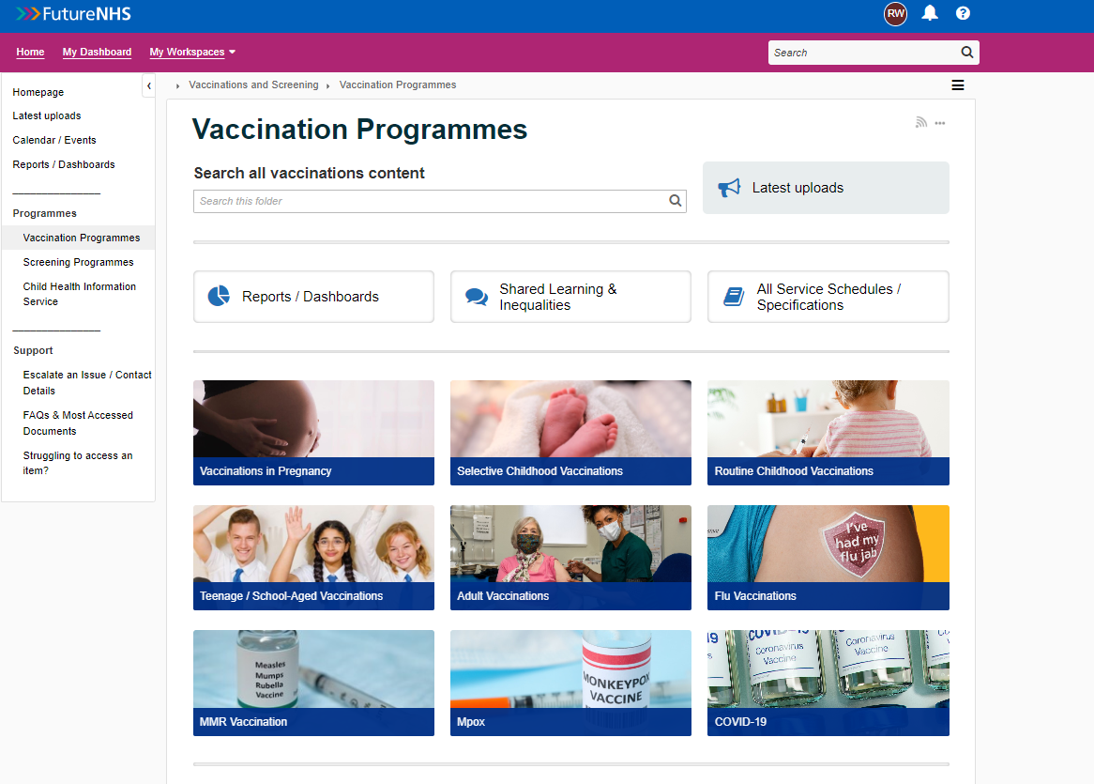
North West London ICB Immunisations Team: Eaiing Practice Nurse Forum 13.09.24 Useful Tools
Vaccinations and Screening - FutureNHS Collaboration Platform

Slide 43
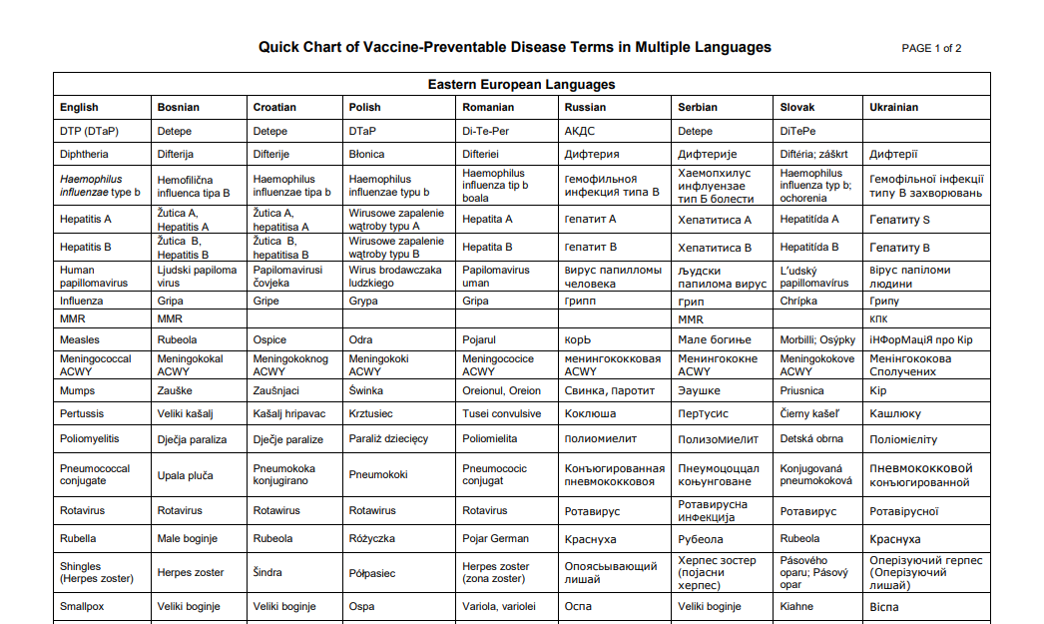
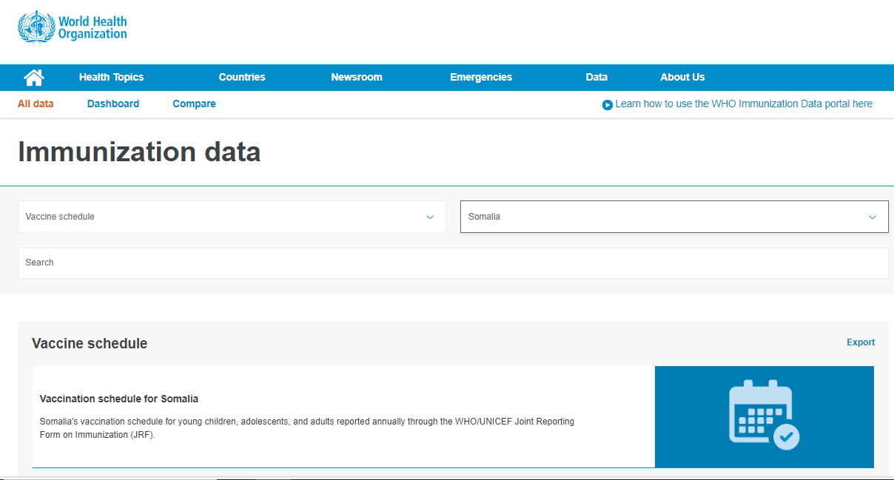
North West London ICB Immunisation Team: Ealing Practice Nurse Forum 13.09.24 Useful Tools
www.immunizationdata.who.int/listing.html?topic=vaccine-schedule&location=
www.immunize.org/wp-content/uploads/catg.d/p5122.pdf

Slide 44
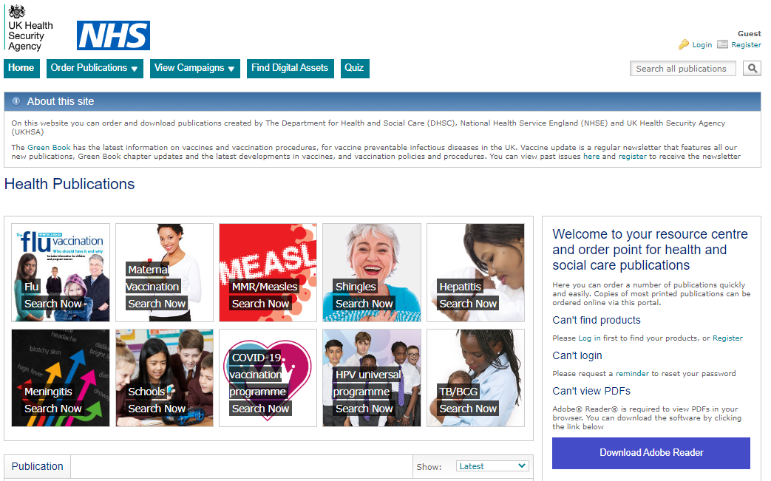
North West London ICB Immunisations Team: Ealing Practice Nurse Forum 13.09.24 UKHSA Health Publications: https://www.healthpublications.gov.uk
Currently 30+ languages

Slide 45
North West London ICB Immunisations Team: Ealing Practice Nurse Forum 13.09.24 Vaccine Knowledge Project: https://vaccineknowledge.ox.ac.uk/home
Over 130 languages available

Slide 46
North West London ICB Immunisations Team: Ealing Practice Nurse Meeting 13.09.24 Vaccine Safety Net: https://vaccinesafetynet.org

Slide 47
North West London ICB Immunisation Team: Ealing Practice Nurse Forum 13.09.24 Resources
Imperial College Research Overcoming Barriers to Immunisation: Lessons Learnt from the community | Connecting Care for Children (imperial.nhs.uk)
Why vaccines are safe and effective Why vaccination is important and the safest way to protect yourself - NHS (www.nhs.uk)
Frequently Asked Questions about the MMR vaccine: Copy of Copy of Advice for parents about routine vaccinations during coronavirus 4.3.21 (imperial.nhs.uk)
British Islamic Medical Association Measles Guidance 2024 | British Islamic Medical Association (britishima.org)
UK Routine Schedule Complete routine immunisation schedule - GOV.UK (www.gov.uk)
UKHSA Immunisation Immunisation - GOV.UK (www.gov.uk)
WHO Vaccination and Immunisation Vaccines and immunization (who.int)
British Society for Immunology Home | British Society for Immunology
Vaccine Knowledge Project Home | Vaccine Knowledge Project (ox.ac.uk)
NHS vaccination schedule: NHS vaccinations and when to have them - NHS (www.nhs.uk)
Why vaccines are safe and effective Why vaccination is important and the safest way to protect yourself - NHS (www.nhs.uk)
UKHSA Health Publications Home - Health Publications
NWL Communisations Page (for all toolkits) Communications resources for staff :: North West London ICS (nwlondonicb.nhs.uk)

Slide 48
Any Questions?

