Slide 1
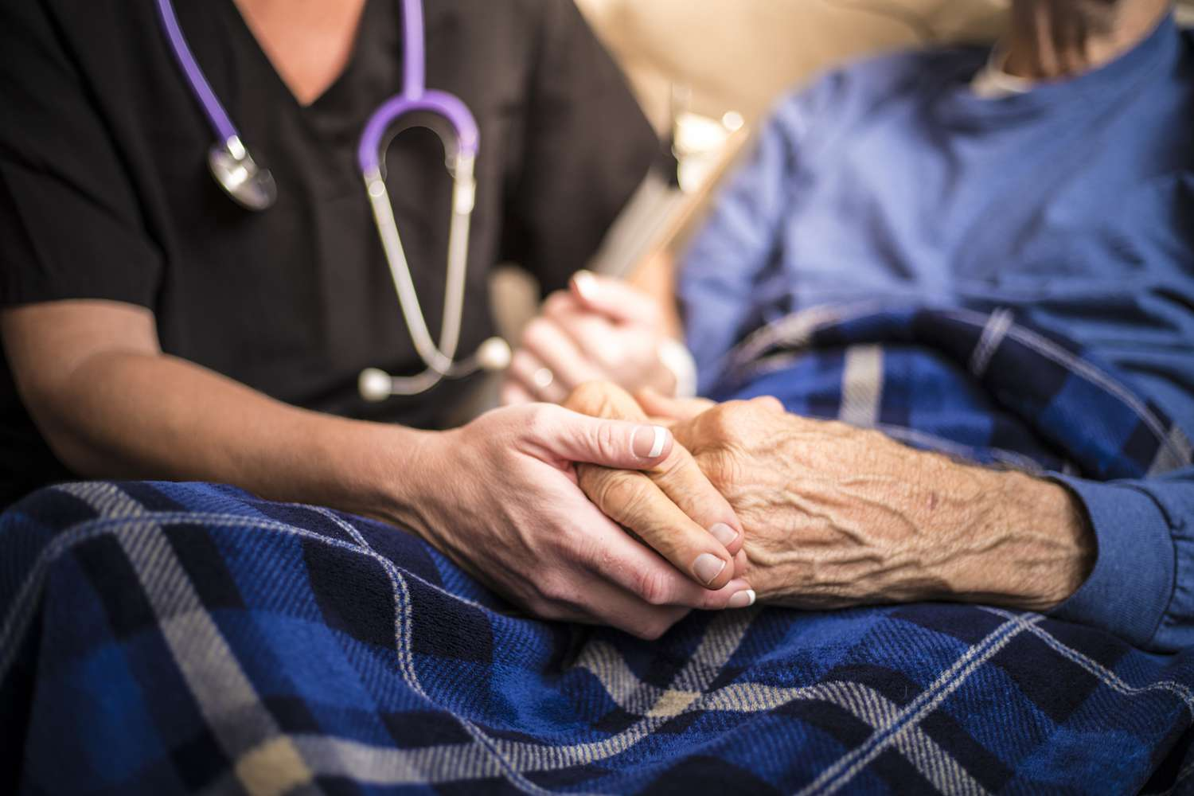
Palliative Care for GPs
Module 3:
Documentation & Practical Aspects
Notes:
Welcome to the third session of the teaching programme. Recap on resources.

Slide 2
Ground Rules
Troubleshooting
Interactive session
Confidential discussion
Bring any cases
Ask questions along the way
Feedback after session
Notes:
Welcome
Introduction

Slide 3
Home Visits
It is important to plan a visit if you feel a patient may be deteriorating or dying
You may wish to schedule a joint visit with a palliative care nurse if you have referred/are referring to specialist palliative care
Allow you to have support with ACP discussions
Support with prescribing and put anticipatory medications are in place
Effective communication between primary care and specialist palliative care
Home visits can identify areas within the patient’s home setup which can be optimised
As the patient and their relatives are in their home environment, can be suitable for sensitive discussions
A palliative care register and discussion with your local palliative care nurse can identify those that are suitable for a visit
Do you have MDTs with a palliative care nurse within your practice?
Notes:
Example of optimising home setup – Parkinson’s patient → Enable PT/OT
How do other practices do this? Waiting list/meeting with PCN/home visit list for housebound patients
Ask group about MDTs – do they have them? If not, why not? Challenges?

Slide 4
ACP
Notes:
Auto-consult - template

Slide 5
ACP

Slide 6
UCP
Universal Care Plan
Previously CMC
Obtain consent from patient
Valida client
Smartcard access
Once ACP established, complete the relevant sections
Will code into SystemOne automatically
Will allow you to print a DNACPR form directly and attach documents such as LPA
Notes:
https://ucp.onelondon.online/information-about-the-care-plan-template/

Slide 7
Referral to SPC
Notes:
Updates highlighted in red, ring the hospice if urgent or for advice

Slide 8
Referral to SPC
Notes:
Updates highlighted in red
Diagnosis and prognosis

Slide 9
Referral to SPC
Thought process when referring to specialist palliative care:
Underlying reason for referral
Are there other services which can target needs better?
Referral to district nurses is usually also required
What are the expectations of specialist palliative care for you and from the patient?
Possibly inappropriate:
Needs are mainly social in nature
Current clinical problems are not related to their life-limiting illness
Immediate care needs best met in an acute setting
MDTs may be useful to improve the referral process and understanding
It may simply be that more information is required if a referral is rejected, re-discuss with hospice if needed
When specialist palliative care are involved, overall responsibility for the patient still lies with the GP
Notes:
https://www.ncbi.nlm.nih.gov/pmc/articles/PMC4232314/

Slide 10
Fast Track Funding
Application for the NHS to fund a care package, nursing home bed or hospice bed (if they are out of area)
Eligibility:
Having a rapidly deteriorating condition AND felt to be entering the terminal phase of life
Demonstrate suitably complex, intense, +/- unpredictable healthcare needs
If deteriorating quickly and nearing the end of life, care and support package can be put in place as soon as possible – usually within 48 hours
Needs and support package will normally be reviewed within 3 months and thereafter at least annually
GPs are able to complete the application, does not require a referral to SPC
Notes:
Criteria used to be for people who have a prognosis of 3 months or less
https://www.gov.uk/government/publications/nhs-continuing-healthcare-fast-track-pathway-tool

Slide 11
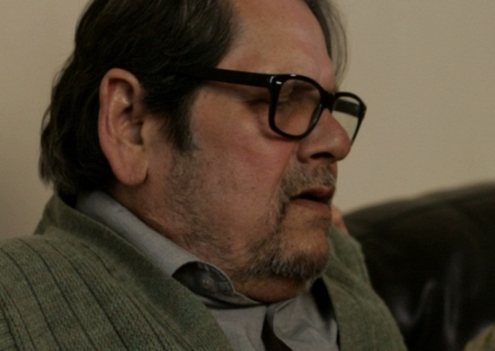
Mr B
75 years old
Background of HFpEF, HTN, T2DM
Four hospital admissions in six months with pulmonary oedema and most recently pneumonia
Initially responded well to diuretic treatment but soon became refractory to treatment
Lives with wife, daughter lives locally
Notes:
Refresh on case from previous modules

Slide 12
Mr B
His condition has since rapidly changed
Now completely bedbound after a fall while transferring to the bathroom
Daughter reports he is grimacing and unsettled during his sleep with laboured breathing
ACP: PPC and PPD is home

Slide 13
Mr B
You want to prescribe the below anticipatory medications:
Morphine sulphate 2.5-5mg SC when required for pain or breathlessness up to hourly
Haloperidol 0.5-1mg SC when required for nausea/vomiting. Max dose 3mg in 24 hours
Midazolam 2.5-5mg SC when required for agitation/restlessness up to 2 hourly. Max dose 30mg in 24 hours
Glycopyrronium bromide 200-400 micrograms SC when required for respiratory secretions. Max dose 1.2mg in 24 hours
Notes:
We discussed what you may want to prescribe previously

Slide 14
Prescribing Steps
Complete MAAR chart
Template on SystemOne
Drop down menu for dosages
Discuss with Meadow House if unsure on doses or next steps
Individualise medications according to patient needs
Syringe drivers can be written up with advice of specialist
Crisis medications for bleeds/seizures

Slide 15
Prescribing Steps
Prescribe the medications in line with MAAR chart
Untick ‘pers admin’ box to avoid printing as FP10 and send electronically
Consider additional and non-injectable medications such as bowel and bladder care
Email MAAR chart with referral to district nurses so they can administer
Other services such as Marie Curie can also administer medications

Slide 16
Mr B
Appears on the duty list:
‘Patient passed away this morning, died peacefully at home, 111 clinician has verified the death, see document forwarded’
What would your next steps be?
Notes:
Open discussion
Remember any healthcare professional can verify the death – discuss my case re. paramedic verification while on duty

Slide 17
After Death
Legal requirement to register the death within 5 days unless the case has been referred to the coroner
All deaths not referred to the coroner need to be referred to medical examiner before MCCD can be provided
Any doctor who has attended the patient within their lifetime can complete MCCD if they can establish the cause of death to the best of their knowledge
Refer to the medical examiner in the borough where death happened, review should happen within 24 hours
Practice will need to inform relatives that they will receive a call from the medical examiner
Cremation forms are no longer required - the funeral director will be informed regarding the approval
The new MCCDs ask for information about implanted devices
Notes:
https://hpal.medindex.co.uk/c/b/ealing/a/update-on-the-role-of-doctors-after-a-death-at-home/16 – new changes 9th September
Talk about my own case that needed to be referred to the coroner due to SG concerns – only complete forms if you feel comfortable

Slide 18
After Death
Notes:
https://www.nwlondonicb.nhs.uk/professionals/primary-care-workforce/medical-examiner-process

Slide 19
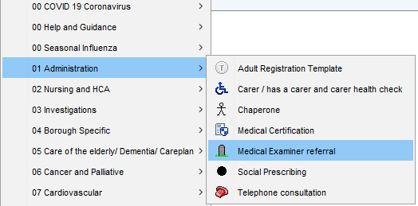
Referring to Medical Examiner
Save and send to relevant medical examiner team
On completion of the review by the medical examiner, the practice will receive a SystemOne task with the outcome of
They will advise of any changes regarding cause of death and list what to write for part I and II
You can then complete the MCCD
The MCCD can now be sent electronically to the registrar rather than be collected by the family
Notes:
The statutory implementation of medical examiner system will be coming to all NW London GP practices on 9 September 2024 (under legislation in the 2022 Health and Care Act).

Slide 20
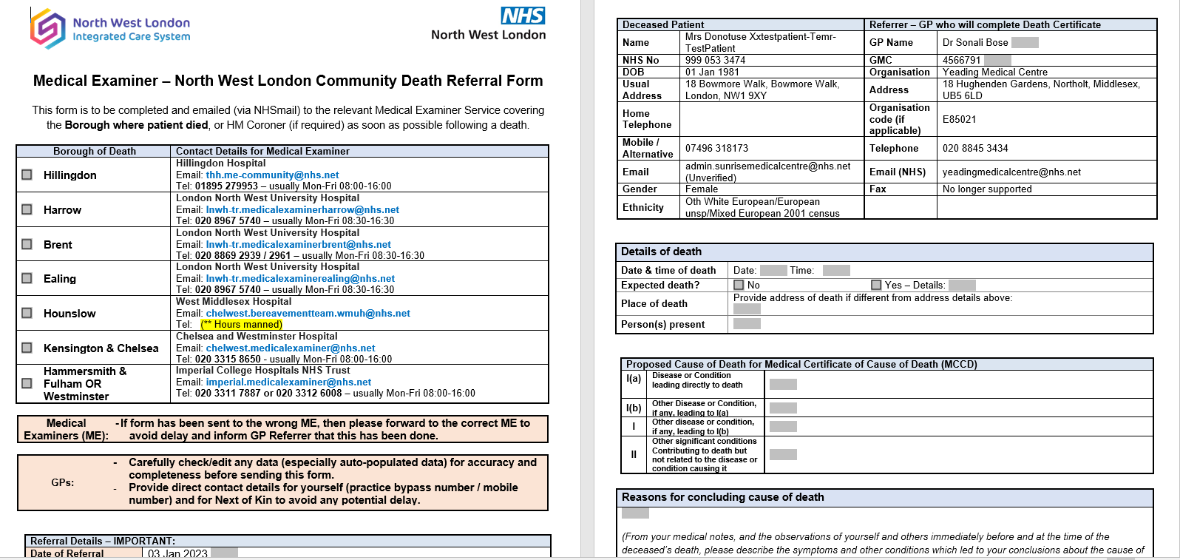
Referring to Medical Examiner

Slide 21
MCCD
The medical examiner will guide you – verbal and written advice
No abbreviations
If multiple diseases/conditions contributed to the death, list them all on same line and indicate that they were joint causes of death
Avoid ‘old age’ or ‘frailty’ alone
Malignancies
Specify the histological type and anatomical site of the cancer if known
Check clinic letters or MDTs for this information
Avoid organ failure alone
Specify the disease or condition that led to the organ failure
Exception is congestive cardiac failure
Notes:
https://www.gov.uk/government/publications/guidance-notes-for-completing-a-medical-certificate-of-cause-of-death/guidance-for-doctors-completing-medical-certificates-of-cause-of-death-in-england-and-wales-accessible-version
https://www.rcpath.org/static/c16ae453-6c63-47ff-8c45fd2c56521ab9/G199-Cause-of-death-list.pdf

Slide 22
MCCD
Part I
(a) Disease or condition leading directly to death
(b) Other disease or condition, if any, leading to I(a)
(c) Other disease or condition, if any, leading to I(b)
Part II
Other significant conditions contributing to death but not related to the disease or condition causing it
MCCD changes:
Additional cause of death information line 1d
Ethnicity of the deceased (where available)
Whether the deceased was pregnant or recently pregnant
Presence of medical devices
Medical examiner signature/declaration

Slide 23
Any questions or thoughts?
Notes:
Thanks
Feedback

Slide 24
Module 4: Communication in Palliative Care
Communication skills session at Meadow House hospice
Two dates available:
Monday 4th November 2024
Monday 2nd December 2024
Half day session at Meadow House Hospice
Opportunity to develop your confidence and communication skills when dealing with difficult conversations or scenarios
Expert facilitators and actors
Certificate of attendance
Ties learning from previous modules together
Limited spaces
Notes:
https://www.surveymonkey.com/r/BP6CB69
Please use the survey link in email or in chat so we can get an idea of numbers, formal registration coming soon

