Slide 1
Standard 6: Green Initiative
If it’s good for the planet, it’s good for you too!

Slide 2
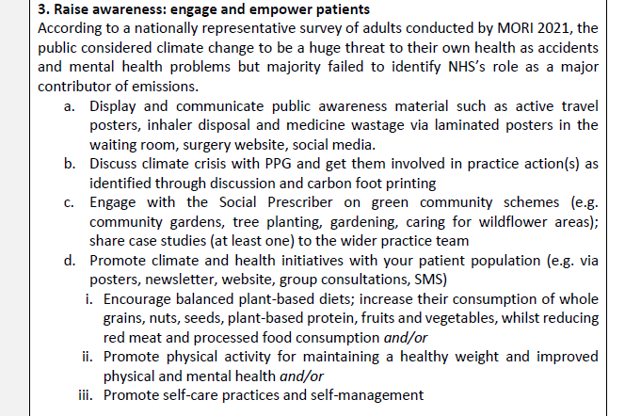
Raise awareness: engage & empower patients

Slide 3
Communication - patients
‘ To reduce medicine wastage PLEASE CHECK YOUR PRESCRIPTION IS CORRECT BEFORE YOU LEAVE THE PHARMACY. Medicines returned before you leave the pharmacy can be given to another patient. If medicines are taken home they have to be destroyed’

Slide 4
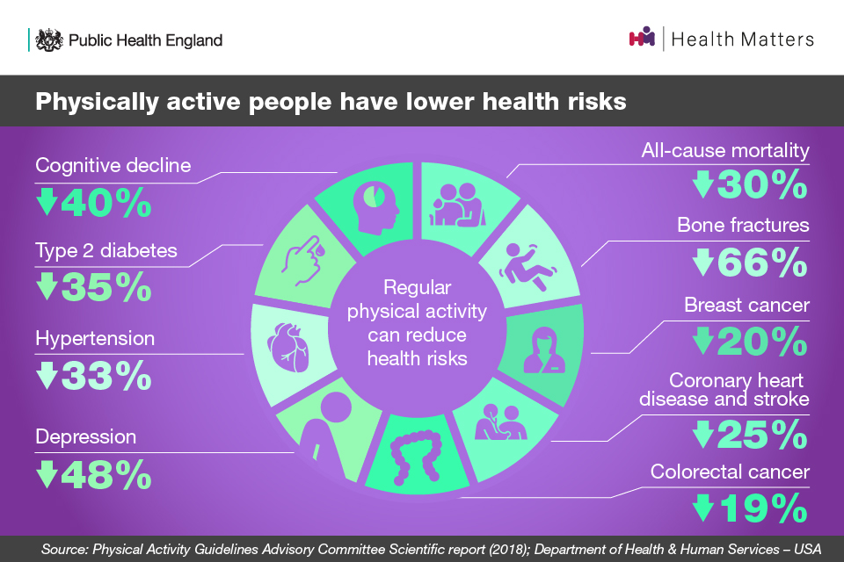
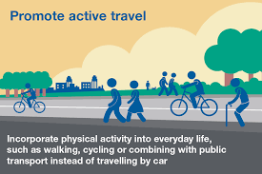
Promote active travel & physical activity

Slide 5
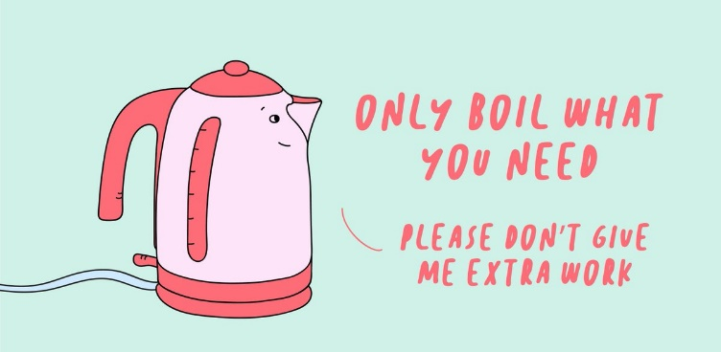
Posters - staff

Slide 6
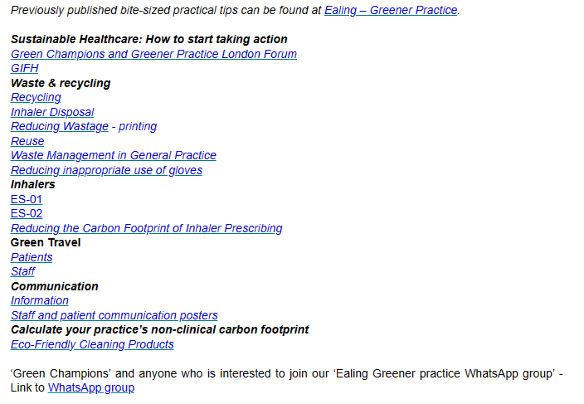
Green Agenda: Bite-sized tips

Slide 7
