Slide 1
Upper GI and Lower GI Faster Diagnosis Standard (FDS) - Updates
Dr Ana Wilson
Consultant Gastroenterologist and Lead for Colorectal FDS Pathway
RMP Colorectal Pathway Group Co-Chair
12th September 2024

Slide 2
Objectives
Why did we make the change?
Updates to the Urgent Suspected Cancer (USC) referral process (“2WW” referral) for both Upper GI and Lower GI at LNWH.
FAQs
Top tips!
Live demo from Aiesha Siyahla (Primary Care Liaison Manager)

Slide 3
At triage - % with no FIT
Q4 2023-24
Q1 2024-25

Slide 4
At triage - % with FIT <10
Q4 2023-24
Q1 2024-25

Slide 5
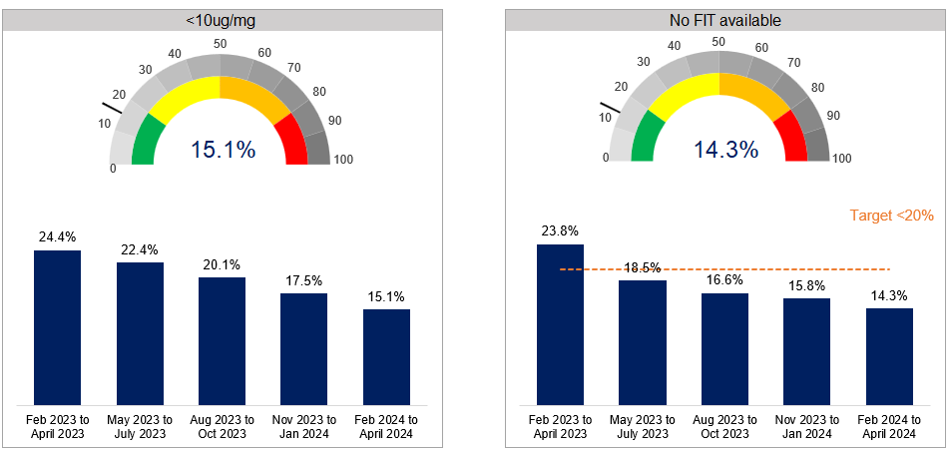
At colonoscopy - national position
15.1% of of colonoscopies were in FIT <10 patients in Q1 24/25 (2.4%pp fewer nationally vs Q4 23/24)
14.3% of colonoscopies had no FIT in Q1 24/25 (1.5%pp fewer nationally vs Q4 23/24)

Slide 6
At colonoscopy - % with no FIT
Q4 2023-24
Q1 2024-25

Slide 7
At colonoscopy - % with FIT <10
Q4 2023-24
Q1 2024-25

Slide 8
Bottom 10 Trusts for colonoscopies in FIT <10

Slide 9
Bottom 10 Trusts for colonoscopies with no FIT

Slide 10
We’ve updated our pathway algorithm!

Slide 11
Updates to referral process
BEFORE | AFTER
2WW Gastro-Intestinal – St Marks Hospital – R1K | 2WW Upper GI – Faster Diagnosis Standard (FDS) – St Marks Hospital – R1K 2WW Lower GI – Faster Diagnosis Standard (FDS) – St Marks Hospital – R1K

Slide 12
How will appointments be booked?
Instead of directly bookable, it will now be via referral assessment system. This means that we will triage the referrals, and we will aim to book ‘appropriate’ referrals in less than 5 days.

Slide 13
FAQs
Why are we still using the wording “2WW” instead of Urgent Suspected Cancer (USC)?
2WW had ended in Oct 2023. However, the NHS e-Referral Service (e-RS) had not yet updated its template both speciality and clinic type options.
Proactively, the service had separated the DOS (service names) for urgent suspected cancer referrals for Upper GI (UGI) and Lower GI (LGI) tumour groups. We added Faster Diagnosis Standard (FDS) in the wording to reflect the aim of timely diagnosis.
What is the current waiting time?
On average, it takes around 7-8 days, on average, for first seen contact. With the new separate service names, we aim to improve our first seen contact to less than 5 days.
How do we contact the team?
Email us on lnwh-tr.fds-gi@nhs.net

Slide 14
Top tips for Upper GI referrals
Do not refer patients:
who are not available within the next 28 days.
who only have weight loss without GI symptoms. Instead refer to Non Site Specific Pathway (NSSP).
who are already on an active cancer pathway. Instead contact directly the patient's cancer team.
Suggested investigations:
Please include these essential investigations: full blood count and urea & electrolytes results (within the last 3 months).
Please offer Urgent Direct Access Ultrasound Scan (to be performed within 2 weeks) to assess for gall bladder/liver cancer.
Please request Urgent Direct CT Abdo/Pelvis for suspected pancreatic cancer in accordance with NICE guidelines.
Please also include any relevant imaging reports.

Slide 15
Top tips for Lower GI referrals
Do not refer patients:
who are not available within the next 28 days
who have weight loss and FIT <10 - instead refer to Non Site Specific Pathway (NSSP)
who are already on an an active cancer pathway. Instead contact directly the patient's cancer team
On both UGI and LGI referral, please refer on LGI form only and explain in free text the need for UGI as well
On FDS and routine pathways at the same time for the same issue- it causes delays and confusion
Please have FIT result before referring unless referring for rectal mass, unexplained anal mass or unexplained anal ulceration.
Suggested investigations:
Please include these essential investigations: full blood count and urea & electrolytes results (within the last 3 months).
If referring for iron deficiency anaemia, please include haematinics.
Please also include any relevant imaging reports.

