Slide 1
Gynaecology Update with clinicians: Fertility Services London Northwest University Hospitals NHS Trust
Parijat Bhattacharjee
Asra Saleem
Prabha Greedhun

Slide 2
Aims
Identify who need early referral
Modifiable factors
History
Examination
Management
Empathy
NICE guidelines
Primary care mgt: 3/5

Slide 3
Multidisciplinary Fertility Services
Specialists -3
Collaboratively work with Radiologists (HSG, TVS, Follicle tracking), pathology (semen analysis), Tertiary referral unit (Hammersmith)

Slide 4
Primary Care: Before referral:
Male: Semen analysis
Female: TV scan pelvis, Hormonal profile, Rubella IgG
HSG
Provide up-to-date leaflet
Order antibiotics: Co- Amoxiclav 625 mg + metronidazole 400 mg PO stat 1 hour pre – HSG/ Azithromycin 1 gm stat PO if allergic to former
Patient to collect prior to HSG
Advice to call on D1 of period (or 1st working day after)
If oligomenorrhoea (prescribe oral progestin- to take after negative pregnancy test – to induce withdrawal bleed & call on D1/2)
If no period after 5 weeks (to call Gynae OPD to inform/ arrange telephone F/Up Gynae appt/ to consider oral progestin withdrawal bleed)
Inform patient that if does not call either number within 6 weeks : will be discharged to GP
Initial Appt: 40 minutes
Ideally both partners present
Detailed history of both partners
Note: BMI, smoking , STI, age of female partner, previous children either partner (from any other relationship)
Book HSG (or Laparoscopy/ Dye test if necessary):
Repeat Semen analysis (if necessary) – request form with female partner details and instructions
On Active monitoring: Inform : Must call to book within 1 month
Any other relevant investigations
Start Metformin & Lifestyle advice if PCOS
Chlamydia (Urine/ Cervical) if appropriate
Book for surgery (lap, Hysteroscopy)
Ovulation induction with CC/ Letrozole
Referral for IVF
Discharge:
If no further management to offer
incl. if BMI needs to be optimized before considering referral for IVF)
If patient does not contact for investigations within 6 weeks
Follow up appointment: 20 minutes

Slide 5
Referral to Fertility: Restrictions
Age > 40
BMI> 35 (but may not get Rx if BMI> 30)
Smoker (either partner)
Incomplete investigations (NICE)

Slide 6
Further Referral: Tertiary : ART/ IVF:
Age >= 40
BMI>=30
Smoker: Either partner (need to stop smoking>6/12)
Previous children (either partner from any relationship)

Slide 7
prevalence
Unknown:30%
Male:30%
Ovulatory: 30%
Tubal,Uterine, peritoneal: 10%
1:6
90% cum preg rate (2 yrs)
Investigate >1 yr; Refer > 2yr

Slide 8
History
WomAn’s age
Obstetric history (& Partner’s)
Duration of infertility
Frequency of i.c.
Occupation (Pesticide, metal, formaldehyde)
Lifestyle (BMI,Smoking,stress)
? Alcohol/? caffeine
Ovulatory (H-P-O)
Mens
Tubal, Uterine, Cervical
Drugs (Ovulation)
(NSAID,COX2,Chemo,Neuroleptic,Spironolactone,Recreational)

Slide 10
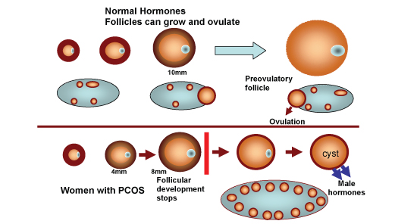
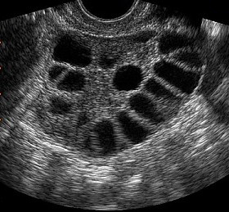

Slide 11
History: partner
Idiopathic:44%: O-A-T zoospermia
Stress, erectile, ejaculation, ?ASAb
Testes (Chrom, cong, descent, t-t-t, surgery, inf, occupation, rx, chr.d., varicocoele)
Obstructive (epididym, vas, ejacul.duct)
- cong, inf, surgery
Hypogonad: H-p
Drugs (chemo, rec, herbal, androgen & an. Steroid, SSz (x mesalazine- reversible)

Slide 12
examination
General: bmi, h-p-o
v/s: swabs, smear
v/e: pid, endo
Bimanual: fibroid, cyst
Male: (2˚ care):
Exam (sec sex ch, gynaecomastia, hernia, undesc testes, varicocoele, small soft or absent testes, penile)
uss, fsh lh test e2 (2 care)

Slide 13
Management: general advice 18+, both
Wishes, beliefs, plans, motives
Information & reassurance
Regular i.c (2-3 days, no kits)
Investigate only after 1 year of try (unless risk factors)
www.hfea.gov.uk
www.infertilitynetworkuk.com
www.bica.net
Pre pregnancy counselling
F.A.
Rubella
Smear
Chr. Disease
Genetic tests & haemoglobinopathy
Mental health

Slide 14
Management: general advice 18+, Both
Stress
Smoking
Bmi (19-25) – (rx if >29)
Alcohol
drugs
Occupation
?? Caffeine, underwear, complementary rx

Slide 15
Investigations: female
Mid luteal progesterone
Fsh, lh (D1-3)
Prolactin (if symptoms)
Tft (if symptoms)
Chlamydia (cx,lvs,urine)
Tv scan
Rubella igg
7 days before mens (rpt weekly)
Who 1(10%),2(85%),3(5%)ovulation d.
(LVS- self test; urine: less sensitive)

Slide 16
Investigations: male
Abstinence: 2-7 days
Within 1 hr of collection
Temperature: 20-37 C
Repeat: 3 months (gross:2-4 weeks)
Sensitivity: 90%( rpt: 98%)
Specificity: Poor
( Chlamydia: 1st void urine after 1 hr)
Who 2010 (reference values)/ nice 2013
semen volume: 1.5 ml or more
pH: 7.2 or more
sperm concentration: 15 million sperm/ml or more
total sperm number: 39 million spermatozoa per ejaculate or more
total motility: 40% or more motile or 32% or more with progressive motility
vitality: 58% or more live spermatozoa
sperm morphology (normal forms): 4% or more.

Slide 17
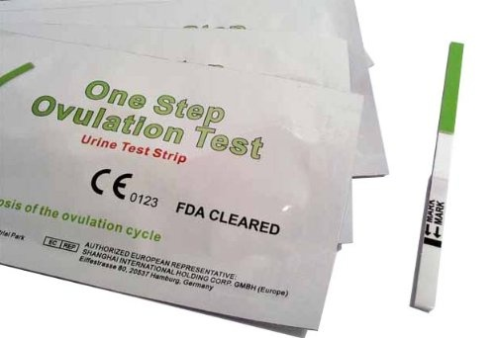
Investigation to avoid
Bbt
Ovulation kits
Postcoital test
Antisperm antibodies

Slide 18
referral
<36 yrs: all normal: after 1 yr of try
Early referral:
>35 yrs ( female)
Pid/sti, surgery, pelvic mass or pain
Menstrual abnormality
Known risks (either partner)
Known risks: both partners:
- cancer
chr. D.
Drugs
Chromosomal Or congenital d.
Pid/sti (hiv, hep b or c)
surgery

Slide 19
Psychological stress
Counselling (at every step)
www.bica.net

Slide 20
2˚ & 3˚ care: assessment
Secondary care:
Tubal (hsg or hycosy)
Uterine (3d scan or MRI)
Laparoscopy, dye, hysteroscopy
Male (sperm c/s, hormones, uss, biopsy)
Tertiary care:
Ovarian reserve (amh, afc)
Hormones (e2)
Infections (hep b,c; hiv1&2)

Slide 22
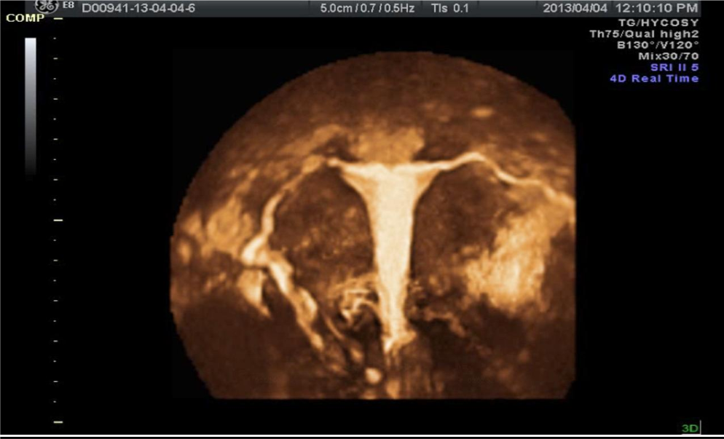

Slide 23
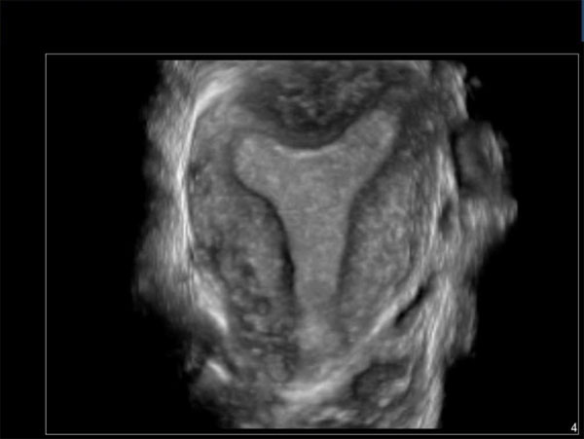
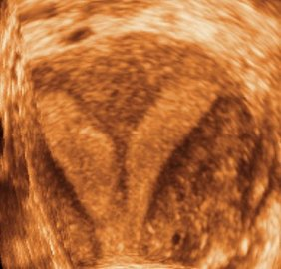
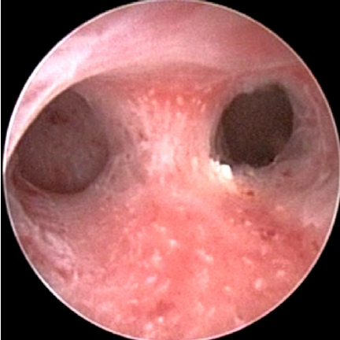

Slide 24
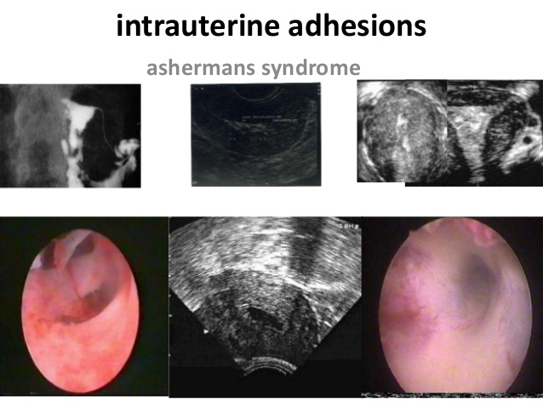

Slide 25
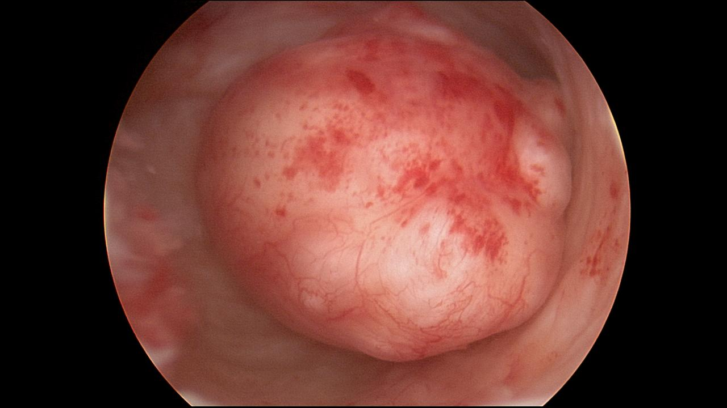

Slide 26
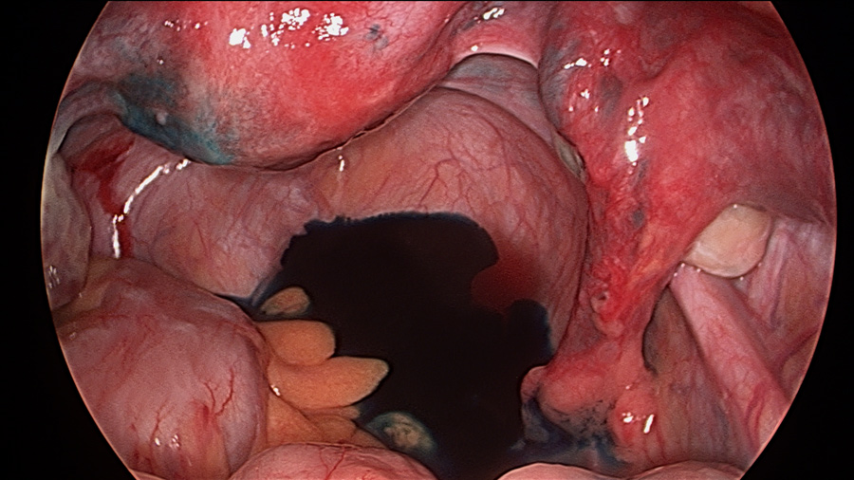

Slide 27
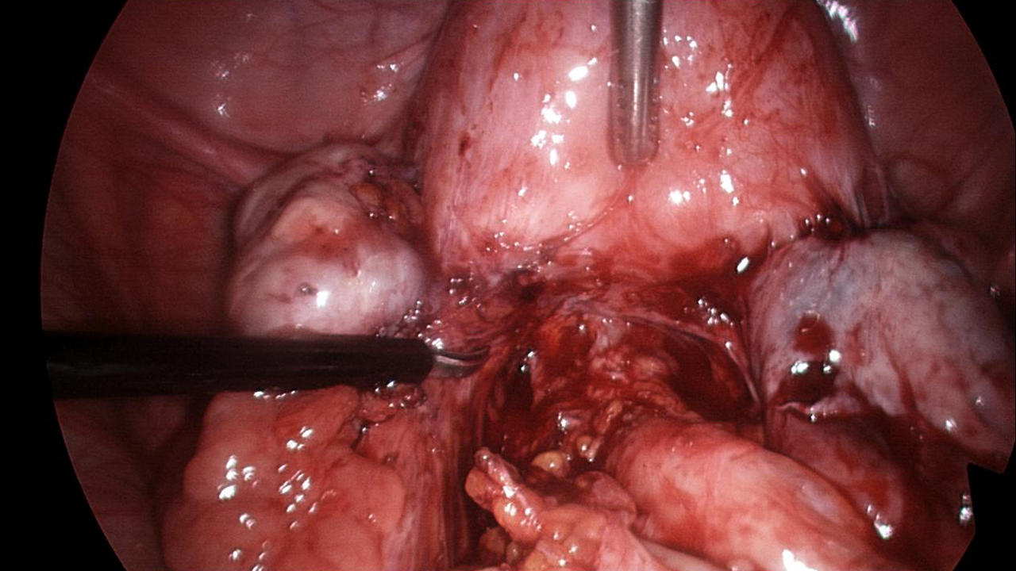

Slide 28
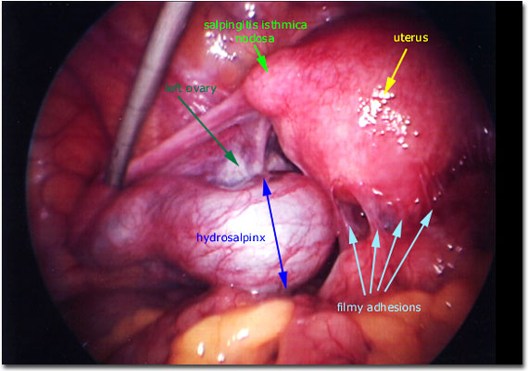

Slide 29
2˚ & 3˚ care: treatment
Medical: (ovulation induction):
Anti e2: (cc, +metformin if>25 bmi &pcos)
rFSH,HMG ( cc resistant)
Pulsatile GnRh
Dopamine agonist (hyperprolactinaemia)
FSH (men: hypogonadotrophic Hypogonadism)
Surgical:
Tubal: (proximal tubal Cannulation)
Tubal: (salpingectomy or salpingotomy)
Uterine: (TCRF, myomectomy, septoplasty, asherman’s)
Ovarian: (cystectomy, drilling)
Peritoneal: (endometriosis, adhesiolysis)
Men: (epidydimal block correction)

Slide 30
Assisted reproduction
iui
ivf
icsi
Natural cycle or stimulated
i.c. problems( physical/ psych)
HIV (sperm washing)
Same sex relationship
Mild male factor, unexplained, tubal, o.i. or iui failed
NICE: 3 cycles: 23-39 yrs, definite cause, unexplained of 3 yrs
<37 yrs: (1st cycle: 1et; 2nd: 1 if good quality or 2 if x; 3rd: 2)
37-39 yrs: (1st & 2nd cycle: 1 ET if good quality or 2 if x; 3rd : 2)
40-42 yrs: 2 et
Severe male factor

Slide 31
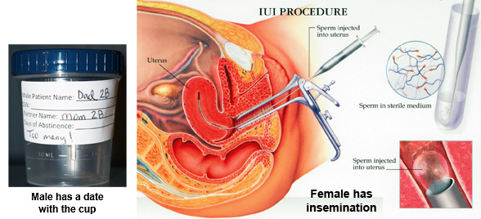

Slide 32
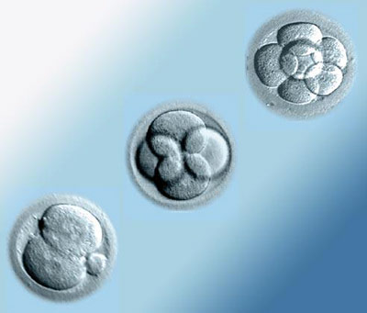
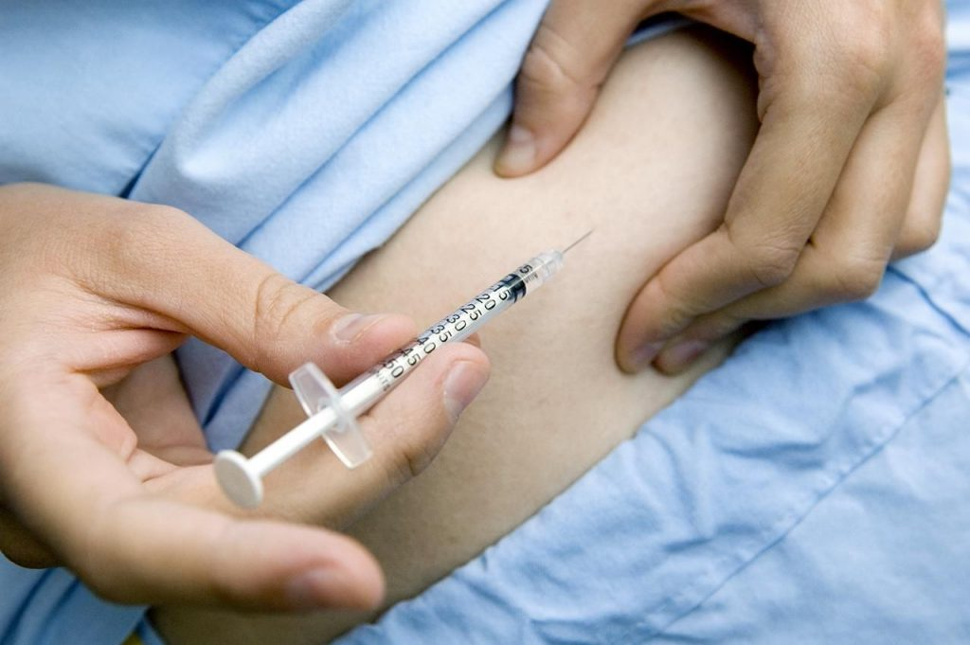
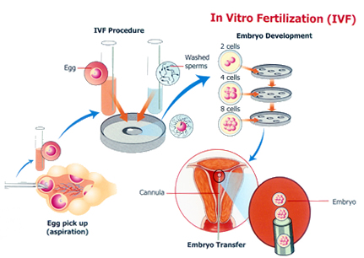

Slide 33
Assisted reproduction: donor
semen
oocyte
embryo
No sperm (biopsy or surgical)
Vasectomy (if x reversal)
Hiv
Genetic transmission risk
Same sex relationship
Pof
Radio rx or chemo rx
Bso
Gonadal dysgenesis
Genetic transmission risk
Ivf failure

Slide 34
Problems post ART: ohss
Mild (33%); severe: 3-8% (life threatening)
Risks: young, low bmi, pcos, multiple preg
Onset: Early:(<9 d of HCg); Late (>9 d)
Mild: bloating, discomfort
Moderate: vomiting, pain
Severe: oedema, pain, dyspnoea, oliguria
Critical: anuria, hydrothorax or ascites, DVT/pe, ards
d/d: PID, haemorrhage or injury during egg retrieval, ectopic pregnancy, ovarian cyst accident, appendicitis
Can worsen with time: monitor
Inform ivf centre if mild
Referral if moderate

Slide 35
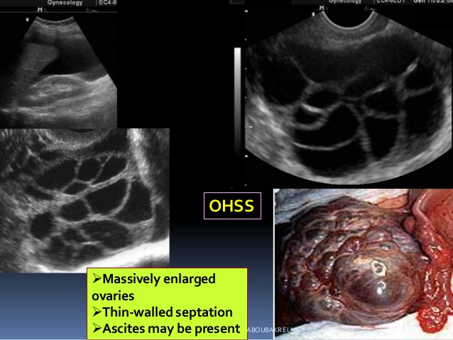

Slide 36
Problems post art:
Pid: <1:500 ( tubal, peritoneal, ovarian)
Haematoma
Bowel injury
Ectopic gestation (4:100)
Heterotopic gestation (1:100)
Multiple gestation (30% - less now)
miscarriage, hyperemesis
Pet, gdm, lscs, ptl, iugr
Nnd, cerebral palsy, lbw

Slide 37
Short to medium term risks : ART
Ovarian cancer: Risk low (? Borderline ovarian cancer: indeterminate)
Children : no evidence

Slide 38
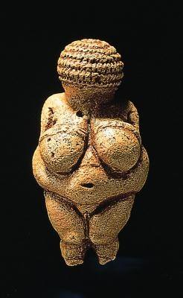
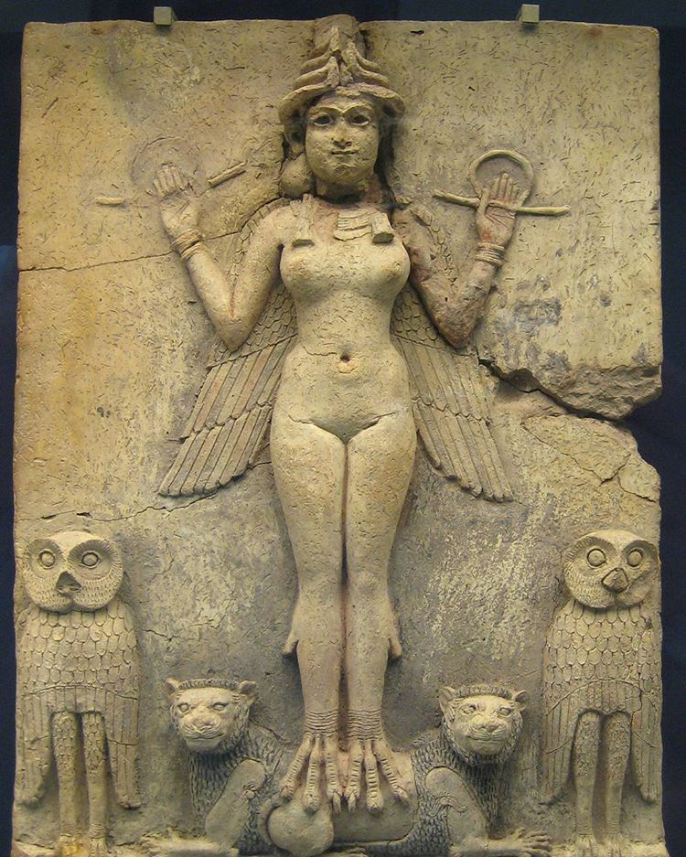
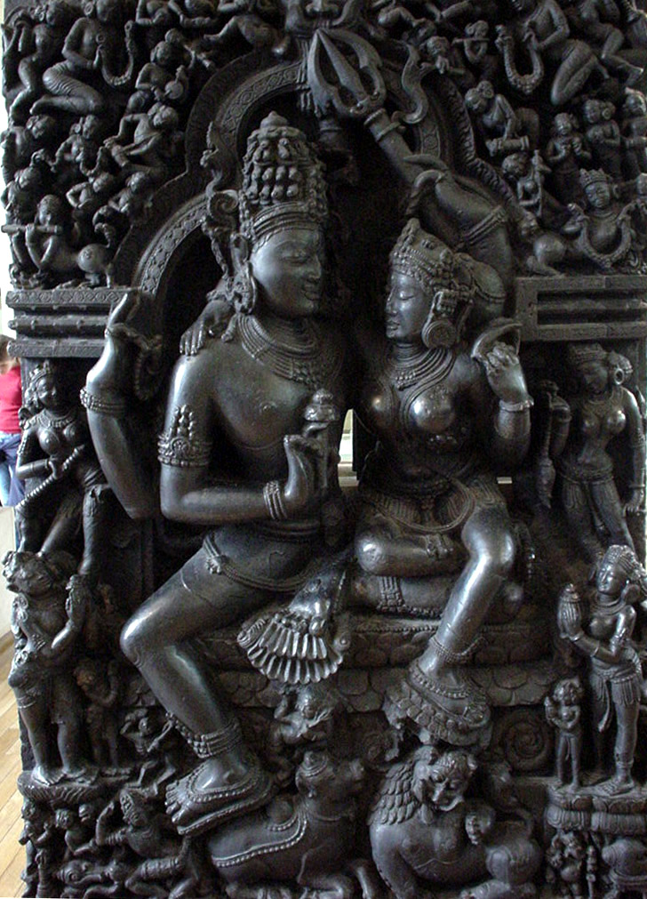

Slide 39
www.hfea.gov.uk
www.infertilitynetworkuk.com
www.bica.net

