Slide 1
Ealing Practice Manager Forum 25/09/24: IT Update

Slide 2
Topics:

Slide 3
Future Roadmap: Interoperability & Localisation

Slide 4
Topics:

Slide 5
GP Connect: Update Record

Slide 6
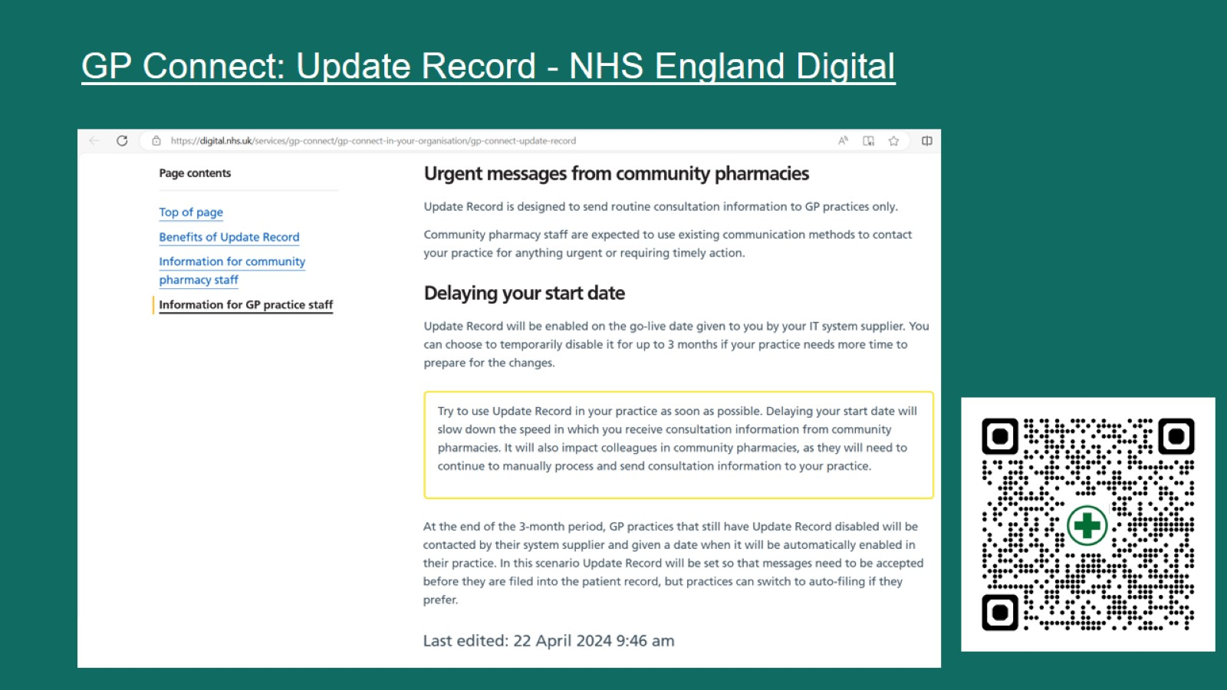
GP Connect: Update Record - NHS England Digital

Slide 7
https://www.bma.org.uk/media/ht1pjixu/focus-on-data-sharing-v2.pdf

Slide 8
www.england.nhs.uk/long-read/gp-connect-update-record-faqs

Slide 12
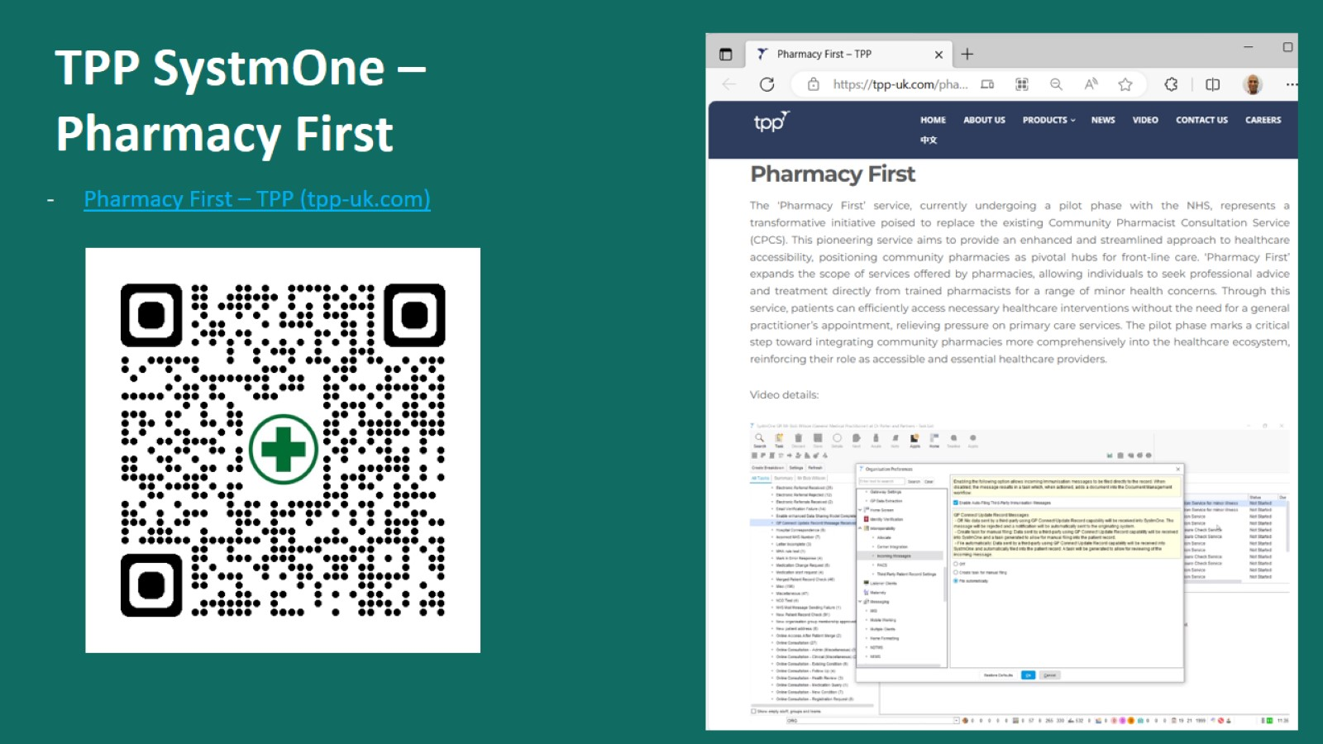
TPP SystmOne – Pharmacy First

Slide 14
TPP SystmOne – Receiving Consultation Messages

Slide 15
TPP SystmOne – Receiving Consultation Messages

Slide 16
TPP SystmOne – Receiving Consultation Messages

Slide 17
TPP SystmOne – Receiving Consultation Messages

Slide 18
TPP SystmOne – Receiving Consultation Messages

Slide 19
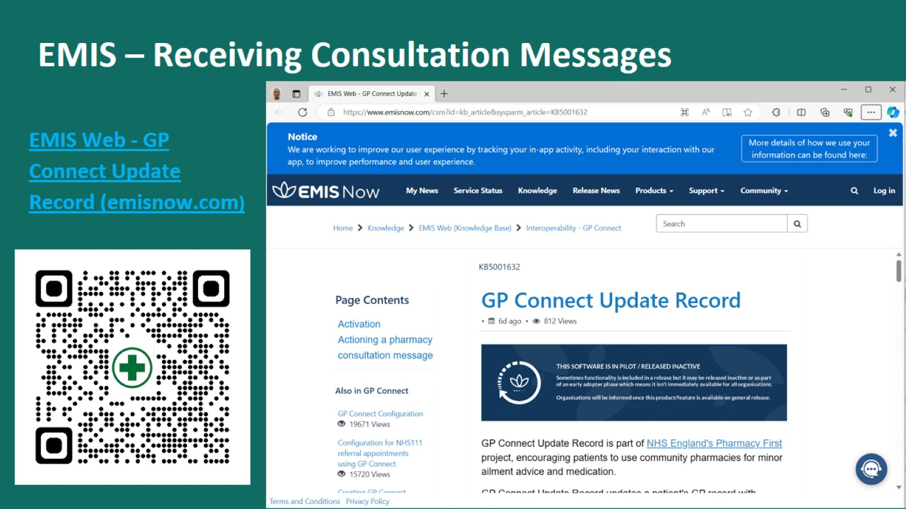
EMIS – Receiving Consultation Messages

Slide 20
EMIS – Receiving Consultation Messages

Slide 21
EMIS – Receiving Consultation Messages

Slide 22
EMIS – Receiving Consultation Messages

Slide 23
Topics:

Slide 24
SystmOne Update: Visualisations

Slide 25
SystmOne Update: Pathology & Radiology Auto-review

Slide 26
SystmOne Update: - NHS Notify API (i.e. NHS App messaging via Communications Annexe) - BaRS (Booking and Referral Standard) – Allows referral to community pharmacies; Development due to start Oct 2024

Slide 27
Topics:

Slide 41
Topics:

Slide 42
Ealing GP Practices – IT Google Sheet:

