Slide 1
GP Trainer Approval Process
Information session

Slide 2
Who's who
The Ealing Programme Directors are:
Dr Ravi Arora: ravi.aurora@nhs.net
Dr Sudha Dhall: sudhadhall@nhs.net
Dr Ravi Ramanathan: ravi.ramanathan@nhs.net
The Ealing trainers workshop convenor is:
Dr Eva Clemente: eva.clemente@nhs.net
Central Middlesex Programme directors are:
Dr Jamil Rahman jamil.rahman@nhs.net
Dr Manish Prasad mprasad@nhs.net
Monique Aurora monique.aurora1@nhs.net
Central Middlesex trainers workshop convenor is:
Emma Novitt e.novitt@nhs.net

Slide 3
Paperwork
COMPLETE
Form 1 Approval Form (this should be submitted as a Word document, since it will be edited further during the process).
Peer Assessment of Teaching Session Guidance Form
Sample timetable for you and your learner
Reflective Portfolio
GATHER EVIDENCE
CCCT course certificate
Evidence of attendance at minimum of 3 GP trainers Workshops

Slide 4
Form 1 application form
If working at an already approved practice - Complete section 2 domains 4 and 5 of Form 1
If working at a practice not already approved - Complete all sections – practice to be approved first and then trainer

Slide 5
Form 1 – good practice
Domain 4: Supporting and empowering educators
4.1 | Supervisors can easily access resources to support their physical and mental health and wellbeing
4.2 | Formally recognised supervisors are appropriately supported, with allocated time in job plans/ job descriptions, to undertake their roles
4.3 | Those undertaking formal supervision roles are appropriately trained as defined by the relevant regulator and/or professional body and in line with any other standards and expectations of partner organisations (e.g., Education Provider, HEE).
4.4 | Clinical Supervisors understand the scope of practice and expected competence of those they are supervising.
4.5 | Educational Supervisors are familiar with, understand and are up to date with the curricula of the learners they are supporting. They also understand their role in the context of learners’ programmes and career pathways, enhancing their ability to support learners’ progression
4.6 | Clinical supervisors are supported to understand the education, training and any other support needs of their learners
4.7 | Supervisor performance is assessed through appraisals or other appropriate mechanisms, with constructive feedback and support provided for continued professional development and role progression and/or when they may be experiencing difficulties and challenges.

Slide 6
Form 1 – good practice continued
(Applicant) Please use the space below to provide further information on how you meet the requirements of this domain
4.1- I am registered with a GP surgery (XXXX surgery) to whom I can consult for my own physical and mental health. I am aware of other support services available to all staff at the XXXX surgery and if needed would speak to the practice manager if I needed guidance in accessing these. I make sure that I take annual leave and sickness leave to ensure my ongoing wellbeing. 4.2- I have discussed the GP supervisor role and responsibilities with the other partners at XXXXX. Being an established training practice they are familiar with these and allow protected time for a 4hr tutorial and for daily debrief/supervision. 4.3- I have recently completed the GP supervisor course cohort XXXXX. I have attached my portfolio and due to receive feedback on this over the coming weeks. I will then be issued with a certificate of completion of this course. 4.4- Having supervised trainees from medical school, through F2, GPST1- ST3 since XXX I am familiar with the competencies and scope of practice appropriate for trainees at different stages of their medical/GP training. I recognise that some trainees may have previously trained in different specialities and so have additional years of experience whilst others may have moved straight from foundation training into GP VTS. 4.5- I am familiar with the RCGP curriculum and know where to access this to reference it should I need. I understand that I am supporting a trainee towards becoming a confident independent safe GP. I will do a learning needs assessment at the start of a new trainee placement and refer back to this during their time with me. I will spend time with my trainee to understand their circumstances and any challenges to learning they may encounter eg physical/mental health issues, family support, dyslexia, . 4.6- Through attendance at workshops and residential away days I will meet with other trainers to ensure I am familiar with the ongoing education, training and support needs of my trainees. My understanding is that attendance to these are in addition to our usual study leave allowance. I have already attended one day of the Ealing trainers residential in June and the previous workshop in March. 4.7- I and member of the RCGP, GMC and BMA. I have an annual appraisal. Most recently my PDP includes progressing in the role of GP supervisor. When I have my first trainee I will seek feedback and advice from established trainers at XXXXX surgery (Dr XXXX and Dr XXX)

Slide 7
Peer Assessment of teaching session
A video of a teaching session will need to be peer reviewed prior to your interview, following the guidelines as below:
It should be a discreet teaching episode; 20-30 minutes in length and with a clear beginning and end.
It should not be of an assessment for the e-portfolio.
The purpose of the video is to demonstrate your teaching skills and we suggest that you try to display as many of them as possible, e.g., it is not advisable to choose a topic that lends itself only to didactic teaching.
Please get two peers to review your teaching video, one of which should be outside of your surgery.

Slide 8
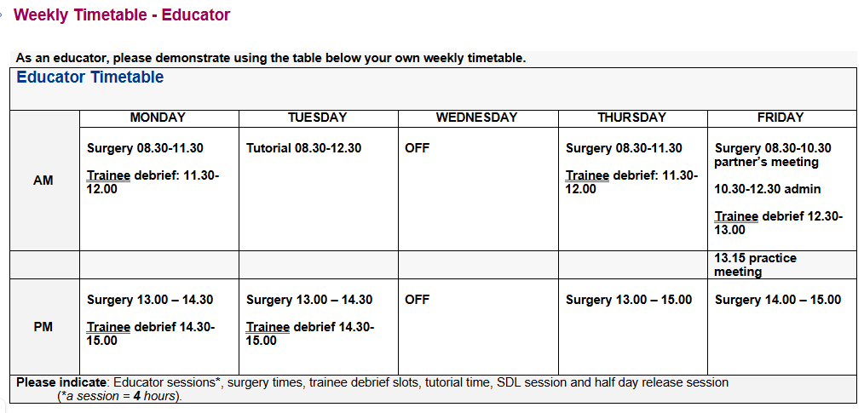
Sample timetable
Trainer Weekly Timetable

Slide 9
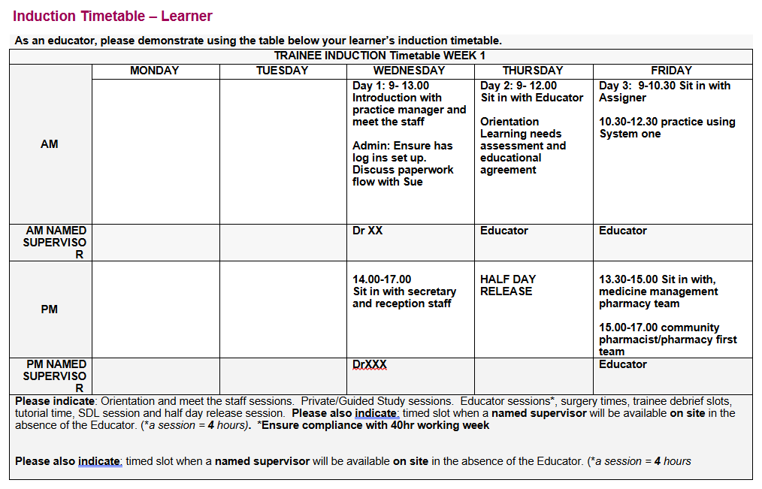
Trainee Induction Timetable

Slide 10
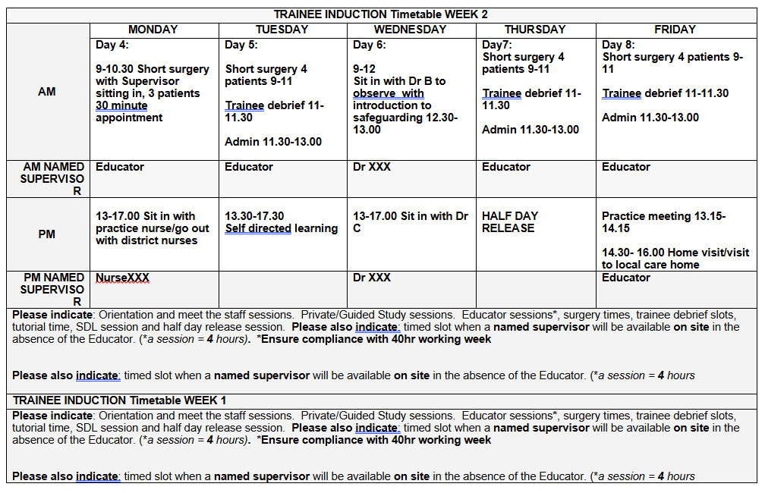

Slide 11
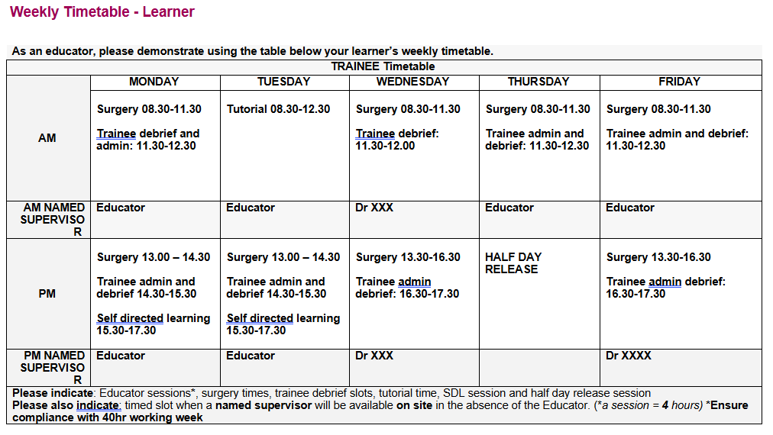
Trainee Recurrent Timetable

