Slide 1
School Role
From Day 1 school expected to support – with or without diagnosis
Support includes:
Quality First Teaching and provision
Making reasonable adjustments to environment, timetables, resources
Providing staffing and interventions
Making or supporting referrals (letters, questionnaires)
Supporting family through assessment process

Slide 2
Prior to applying for an Education Health Care Plan
Schools must prove that they have spent over the allocated £6000 per pupil and comment on any progress over a couple of Assess, Plan, Do Review cycles (typical 6-8 weeks long)

Slide 3
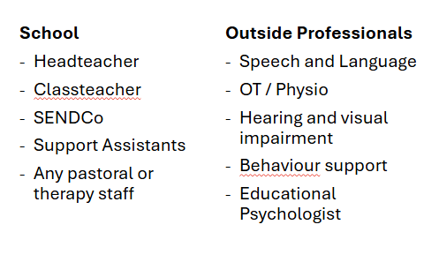
Professionals involved
Advice
SENDIASS
Early Help
Family Information Service
Contact Ealing
ISAID (Impartial Support, Advice and Information on Disability and Special Educational Needs
Support service leaflet

Slide 4
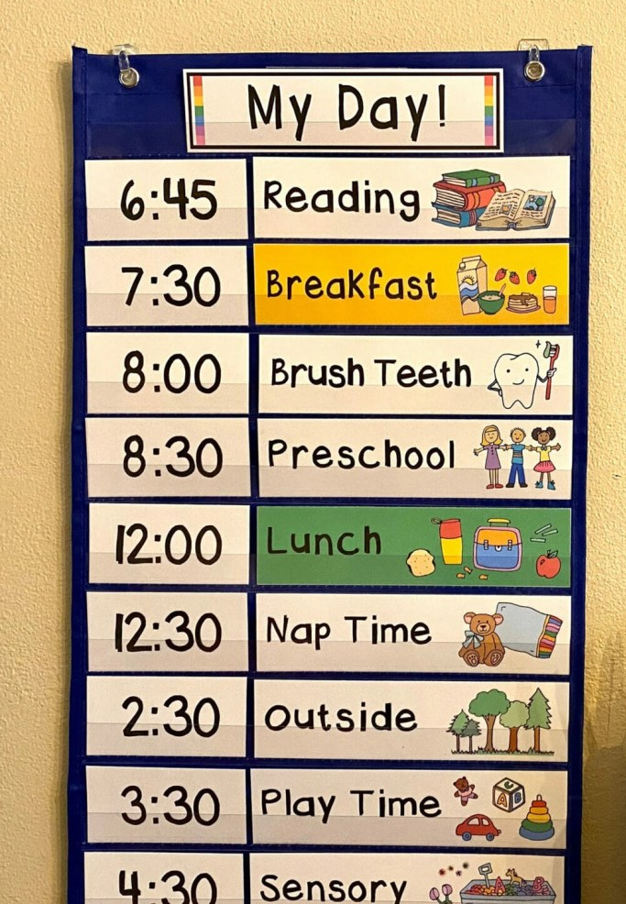
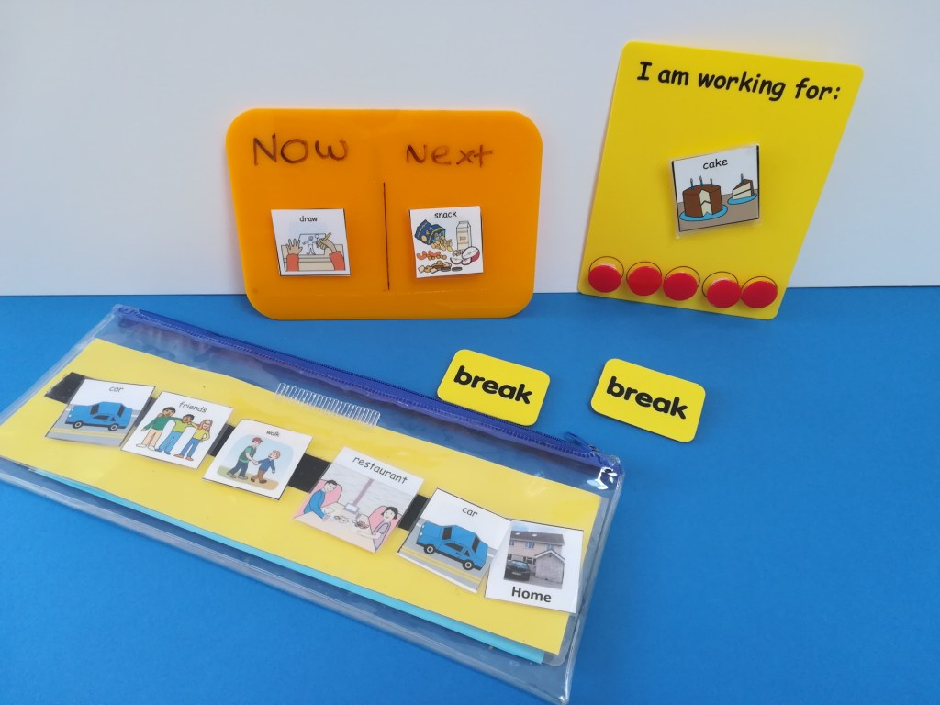
Examples of Provision
Visual Timetables /
Now and Next boards
Specialist Equipment (in a sensory room if lucky)

Slide 5
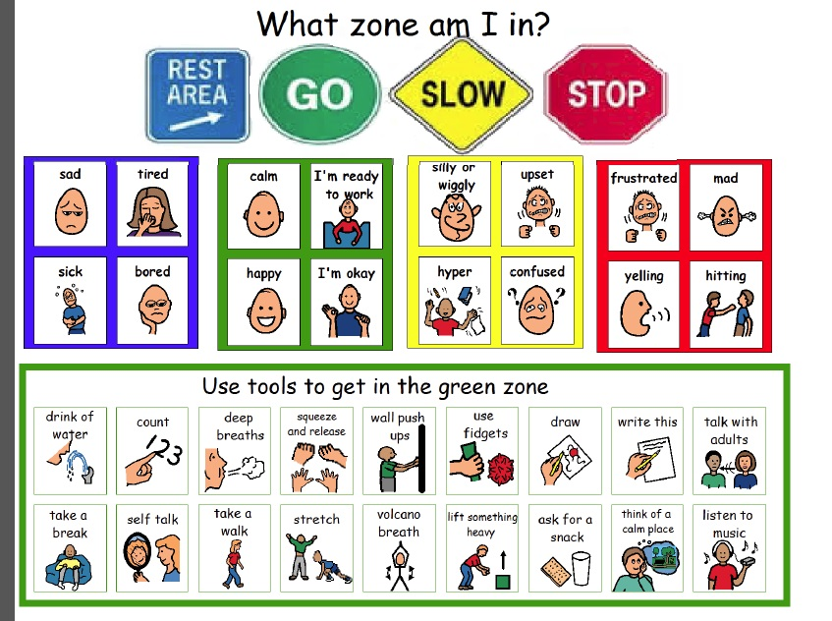
Social Stories
Zones of Regulation

Slide 6
Different working spaces and Quiet Zones

Slide 7
EHCP/EHCNA PROCESS
EHCP: Education and Health and Care Plan
EHCNA: Education and Health and Care Needs Assessment
To be eligible for an EHCNA a two-part legal test must be met:
1. Whether the information provided shows that the child or young person may have special educational, health and care needs and….
2. Whether the information provided shows that it may be necessary for additional support to be provided for the child or young person above what would be normally available in school.
Long process, 20 weeks for a draft plan (legal document)
Deciding panel may not have met the child, could be paper evidence only
If not initially successful => mediation/legal battle/tribunal
Funding awarded often does not reflect actual needs (eg 50% - 75% of what school spends)
The National Autistic Society has a great page on EHCPs - ehc plans

Slide 8
Information can be confusing
Ealing Local Offer Parent Information Page
SEN support
If a school or nursery decides your child has special educational needs they must write an SEN support plan. This plan identifies your child's needs, the action needed and planned outcomes.
Should your child's needs be severe or complex they may bypass SEN support completely and start an EHC Needs Assessment. This could lead to starting an EHC plan.
Ealing Local Offer Professionals Information Page
The EHC Needs Assessment should not normally be the first step in the process. It should follow on from planning and interventions already undertaken with parents and young people in partnership with an early year’s setting, school or college.
Ealing Local Offer - Ealing Families Directory | Ealing Local Offer

Slide 9
What GPs Can Do
Don’t leave referrals just to schools - If you suspect signs of Autism or other learning need eg speech, movement in the under 5's, refer to specialist services – the waiting lists can be long
Make sure referral / support letters contain specifics – generic letters do not help
Be aware that parents fall into different groups
Those who want a diagnosis no matter what
Those who are happy for a diagnosis but might have little understanding of what that means
Those who are not ready to accept that there is an issue
Be aware that not all children with ASD or a diagnosis will be eligible for an EHCP

