Slide 1
Register with a GP Surgery Service (GPREG)
Digital Uptake Reports
Ian Jones
National Product Implementation Lead
Ian.jones20@nhs.net
Notes:
Standard title slide

Slide 2
Agenda for the Webinar
Understanding Digital Uptake and Its Measurement
Objectives and characteristics of the new dashboards
NHS England Policy for GP Practice Registrations
Upcoming Enhancements to the Report
Demonstration
Give Feedback
Appendices

Slide 3
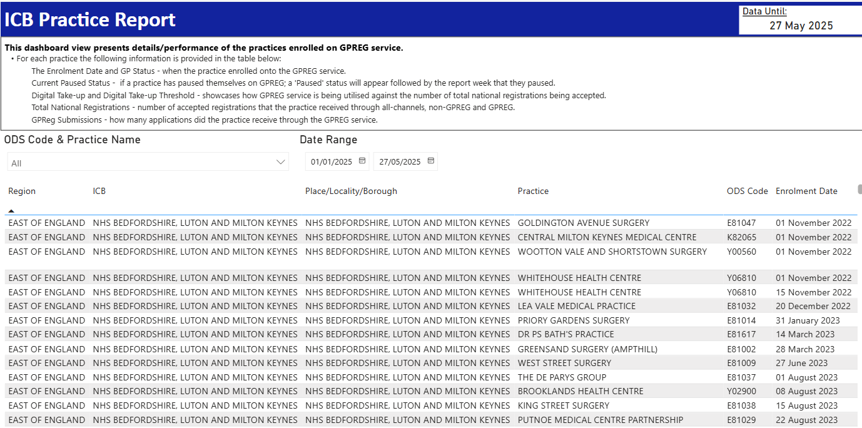
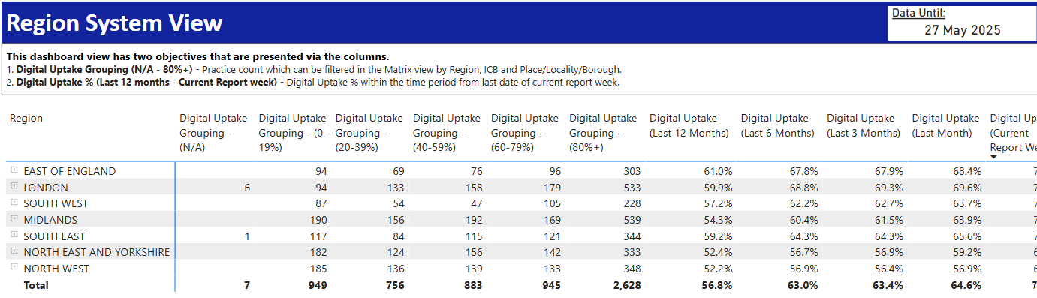
Understanding Digital Uptake and Its Measurement
Measure of use/adoption of the national digital service.
Calculated as a percentage of the total number of registrations over a pre-defined period
We place the practices into bandings/thresholds to support easy identification
We also present the precise calculated percentage (Actual GPREG Digital Uptake)

Slide 4
Objectives and characteristics of the new dashboards
The GPREG service have been sharing use data with practices monthly for around 18 months
The GPREG Engagement team have been sharing data on the usage of the Register with a GP Surgery service (GPREG) with the majority of regional and system digital leads over a similar period
This information is distributed manually by the GPREG team on a periodic or ad-hoc basis to those who’ve requested it
The GPREG team has now made this data accessible through two dashboards available on our service resource hub via the performance data page.
These dashboards are designed for regional, system, and local digital and primary care leads; the link may also be shared with PCN and Digital Transformation Leads.
Access to this data will enable you to monitor practice performance and provide tailored support to practices with lower levels of digital uptake.

Slide 5
NHS England Policy for GP Practice Registrations
Legislation - https://www.legislation.gov.uk/uksi/2024/575/schedule/1/paragraph/10/made.
  The only acceptable forms or patient registration in England are the digital Register with a GP Surgery service or the PRF1 form.
Most practices (58% nationally) are using the service as expected.
GPREG Engagement Team are seeking support with practices in the 0-40% Digital Uptake Threshold:-
  Utilise the URL we sent the practice on enrolment as a digital link to the service on their new patient registration areas
  Remove all legacy links website provider web forms and/or downloadable paper forms.
  Use the new paper form (PRF1), not the GMS1 - https://gp-registration.nhs.uk/register-with-a-gp-surgery-paper-form.
  Review the Practice Action Plan to further increase adoption in the practice

Slide 6
Upcoming Enhancements to the Report
ICB Practice Report - Additional columns
  GPREG URL for practice join our practice/new patient registration areas
  Auto-Registration Opt-In – Y or N
  Auto-Registration Submissions – count for the defined period
Region System View - Additional summary columns
  Practice Auto-Registration Opt-In
  Practice Auto-Registration Submissions
These should be available no later than August 11

Slide 7
Demonstration

Slide 8
Give Feedback
If you have any feedback or suggestions for further improvements, please contact:
Ian Jones: ian.jones20@nhs.net
Dan Carver: dan.carver@nhs.net
Sajjad Mushtaq: sajjad.mushtaq@nhs.net

Slide 9
Appendices

Slide 10
Data Dictionaries

Slide 11
Data Dictionaries

