Slide 1
GP Safeguarding Forum
October 2025

Slide 2
Agenda
Ealing Looked after Child and Care Leaver Charter
Looked after Child template on SystmOne
Remove parents proxy access when a child becomes looked after !
Information sharing – share information within the GP element of record
CP-IS

Slide 3

Looked after Child and Care Leaver Charter
Access and continuity
Record keeping
Carers
Continued support into adulthood

Slide 4
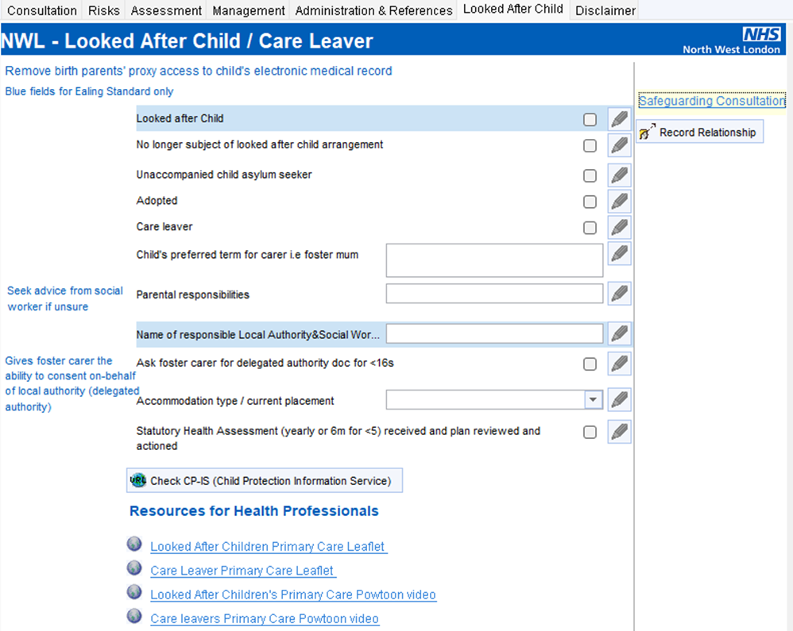
Template : Safeguarding Children

Slide 5

Action
Remove parent proxy access when a child becomes looked after !

Slide 6
Handling Patient Record Requests – Best Practice Guidance
Follow Information Governance (IG) protocols when responding to patient requests for medical records.
Recent incidents have highlighted the need for extra care when fulfilling Subject Access Requests (SARs). In some cases, full record printouts have included documentation from external services such as CLCH 0–19 teams, which should not be disclosed unless explicitly authorised.
To support best practice and safeguard patient confidentiality, please ensure the following:
Limit disclosures to GP-originated documentation unless there is clear consent and authorisation to include external records.
Review all documentation carefully before releasing records to ensure only appropriate content is shared.
Consult your IG lead or safeguarding team if you are unsure about any aspect of a request

Slide 7
Sharing information
‘only share the information within the GP section of the shared electronic record system’
Seek advice if in doubt

Slide 8
Child Protection Information System (CP-IS) Phase 2
August 2025

Slide 9

What is CP-IS?
A national system that connects local authorities’ child social care IT systems with those used by NHS unscheduled care settings (e.g. ED) in England, to provide better care and earlier intervention for children who are considered ‘vulnerable and at risk’
NHS attendance
Home local authority
CP-IS data flow
Notes:
CPIS connects social service IT systems with those used by NHS unscheduled care settings. It makes it possible to share essential information about children who have already been identified as at risk and attendances in unscheduled care settings which may indicate abuse or neglect.

Slide 10
How does CP-IS work? (Phase 1 Unscheduled care – alert generated Phase 2 – no alert / silent read)
Notes:
CPIS connects social service IT systems with those used by NHS unscheduled care settings. It makes it possible to share essential information about children who have already been identified as at risk and attendances in unscheduled care settings which may indicate abuse or neglect.

Slide 11
CP-IS Phase 1 is in place and working in unscheduled healthcare settings which include:
Emergency Departments (NHS Trusts)
Minor Injury Units (NHS Trusts)
Walk in Centres (CCGs/Primary Care)
Urgent Care Centres/Urgent Treatment Centres
GP Out of Hours only

Slide 12
Phase Two – scheduled care – silent read ( no alert )
Phase 2 Care settings approved by DHSC and NHS England are:
• Primary Care – General Practice in Hours​
• Mental Health (CAMHS)​
• Sexual Health: SARCS & Termination of Pregnancy Services​
• 0-19 Services​
• Community Paediatrics​
• Dentistry

Slide 13
What information will you see on CP-IS?:
A child in the care of the Local Authority – alert remains visible 12 month after child leaves care
A child subject to a Child Protection Plan - alert remains visible 12 month after child protection plan ends
An unborn baby subject to a Child Protection Plan – alert remains visible for 28 days after the expected date of delivery.

Slide 14
CP-IS also provides:
Start and end date of the child protection plan (not the category)
Start and end of a child in care (not the reason for being in care)
Name and contact of the Local Authority
History of professionals accessing CP-IS (date / time, role and organisation of person accessing the system)

Slide 15
CP-IS does not share any information from the child’s social care record such as category of the child protection plan, reason for being in care or family contacts or medical information. No clinical information is shared on CP-IS.

Slide 16
CP-IS in Primary Care:
CP-IS enhances your existing safeguarding arrangements by enabling staff to check if a child has a CP-IS alert on their record and so alert the Practice to the vulnerability of that child.
CP-IS does not replace the systems and processes you have in place to communicate or share information with Social Care.
No expectation to check every child at every consultation / contact.

Slide 17
CP-IS in Primary Care:
Key opportunities to use CP-IS include:
At the registration of a child at the Practice.
At the time of consultation or treatment where there are safeguarding concerns.
When updating Practice held ‘lists’ of vulnerable children.

Slide 18
CP-IS Access:
All Practice staff should be aware of the purpose and function of CP-IS.
Access is restricted to staff working within the Practice who have smart cards which have been activated with the correct permissions / profile.
ICB draft Standard Operating Procedure – adapt / adopt for your Practice.

Slide 19
Getting started:
Smart card activation
Accessing CPIS
Find a Patient

Slide 20


NHS Smartcard Access update request process for CP-IS Implementation
Smartcard access request process

Slide 21
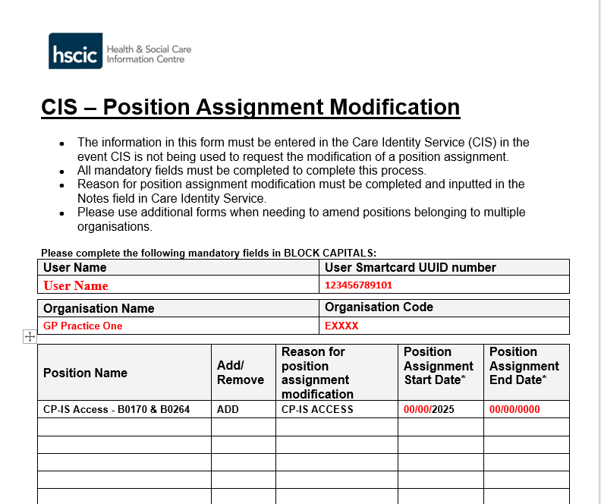
To request access update to smartcards for CP-IS access
Please ask the Practice Sponsor to submit the CIS Position Assignment Modification form for the user via email to the smartcard team: nhsnwl.registration.authority@nhs.net

Slide 22
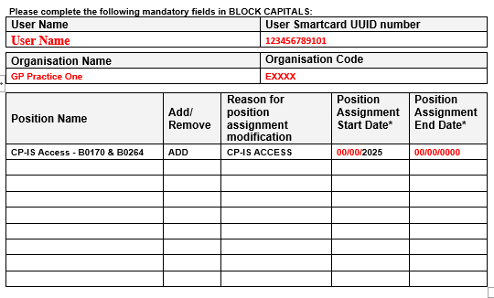
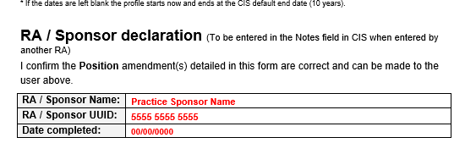
The Practice Sponsor will be the nominated member of staff that is responsible for all the smartcard requests for your Practice. (e.g.Practice Manager, Business Partner or Lead GP)
Please ensure the form is filled in correctly when submitted with the sponsor details filled in on the form.

Slide 23
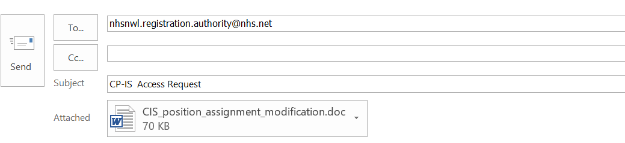
Once the request to update access to the users smartcard is submitted to the RA team via email.
The RA team will action this request within 24hrs (Monday-Friday) and will email you confirmation of the change.

Slide 24
If you have any questions regarding the process or you need a copy of the access form, please email us: nhsnwl.registration.authority@nhs.net

Slide 25

NCRS – National Care Record System
Access via the website: https://portal.spineservices.nhs.uk/nationalcarerecordsservice
NWL ICB desktop icon
Access via link on Template S1 / EMIS
Integrated system – aspirational!

Slide 26
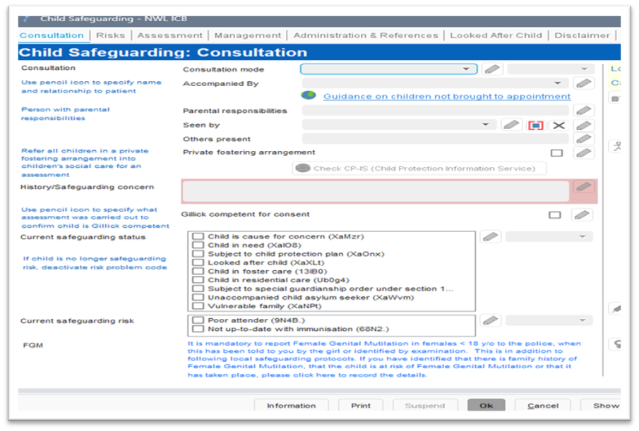

CP-IS Links on Templates: SystmOne

Slide 27
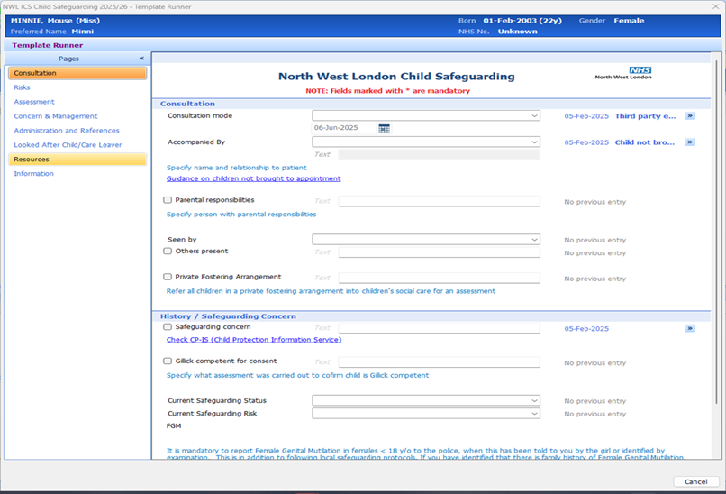

CP-IS Links on Templates: EMIS Web

Slide 28
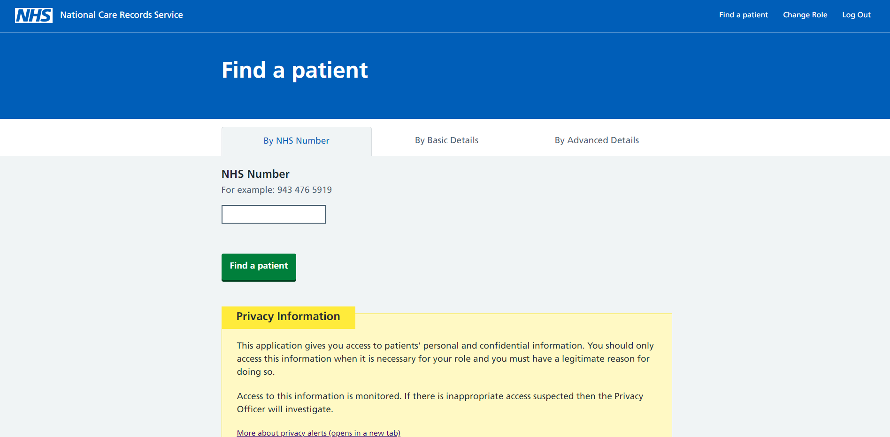
Title
Body

Slide 29
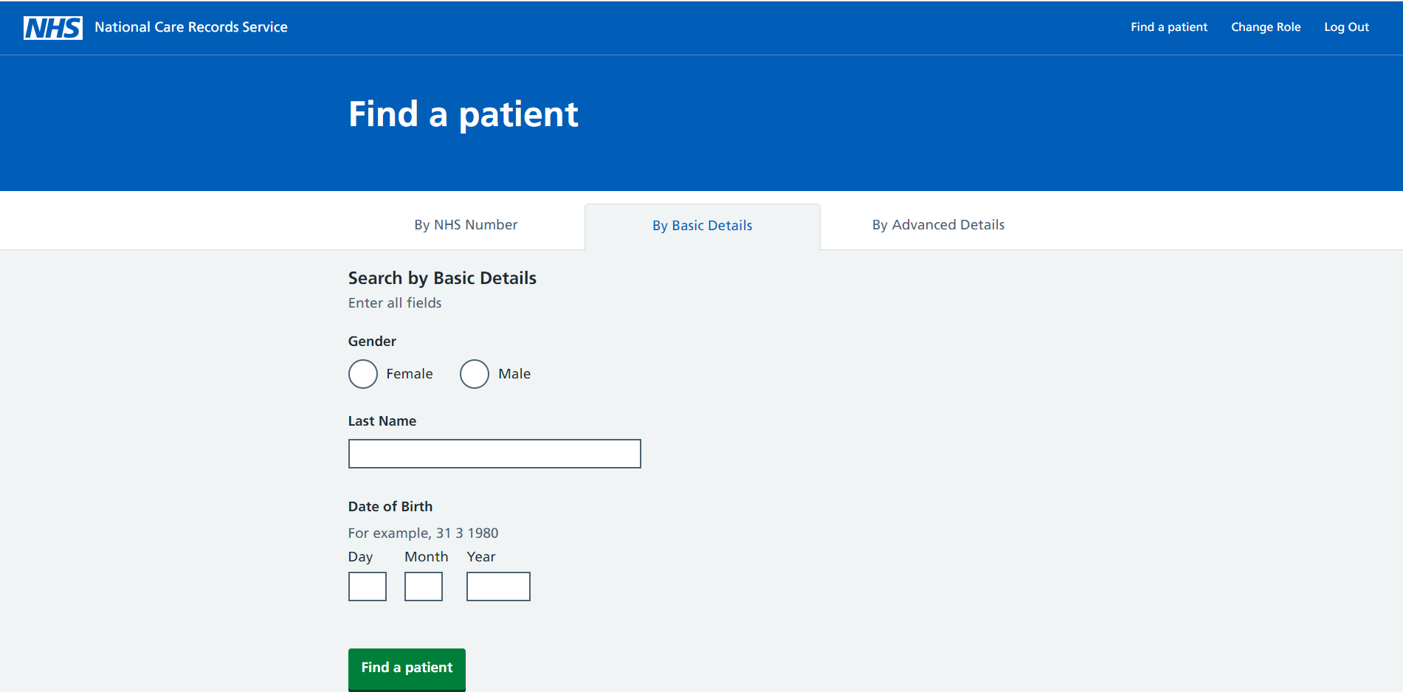
Title
Body

Slide 30
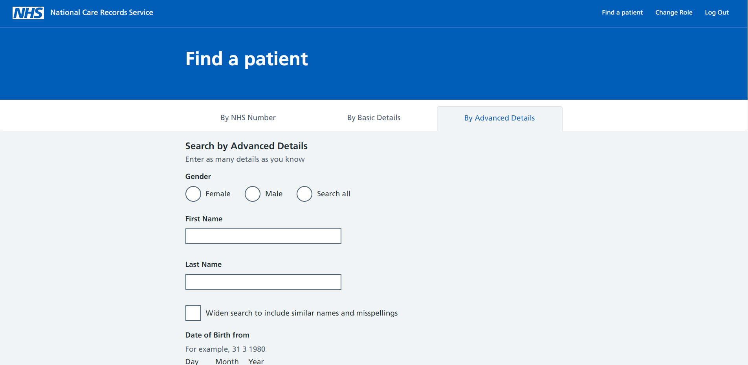
Title
Body
By Postcode
Note – Some users may have the access to search demographics via Postcode. However, this functionality is yet to be released.

Slide 31
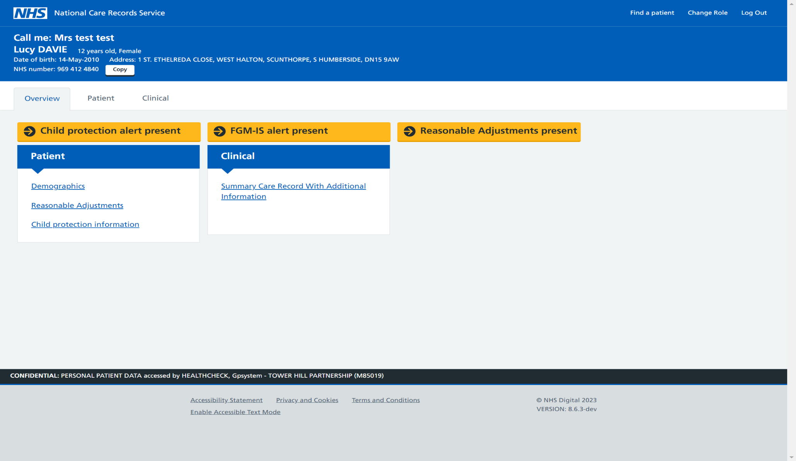
Title
Body

Slide 32
NHS TEST PATIENT
Test Patient NHS Number 999 027 6579
Use to check your smart card is activated so can see CPIS Alert

Slide 33

Any questions or cases ?

