Slide 1
Hammersmith and Fulham PM Forum
November 2025
Primary Care System Facilitation Team
NHS North West London

Slide 2
SystmOne Teams vs User Groups
As presented by Dr Shanker Vijayadeva

Slide 3
Why change from GROUPS to TEAMS
In 2021/22 SystmOne stated that practices need to switch to TEAMS
Newer functionality in SystmOne can only use TEAMS - e.g Communication Annexe - sending messages to patients can only receive replies to TEAMS
TEAMS are easier to maintain (e.g. easier to rename) and help with hierarchy of TEAMS
You can send IM to a Team (not to a group)
To help staff with switchover, consider keeping the names of TEAMS the same as previous names of ‘User Groups’ – and then you can rename them in the future

Slide 4
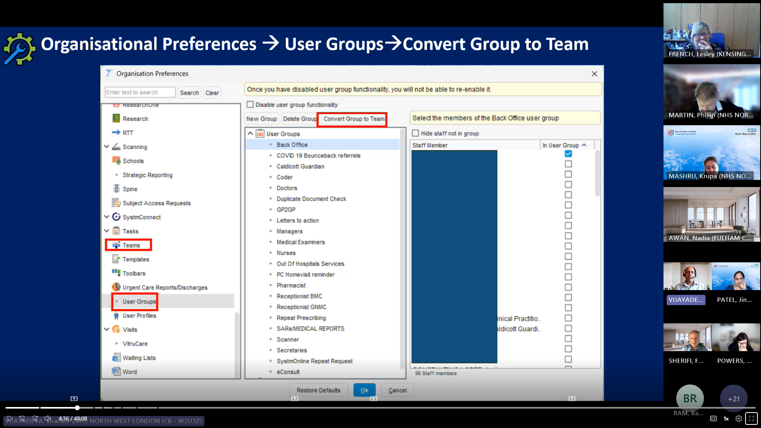
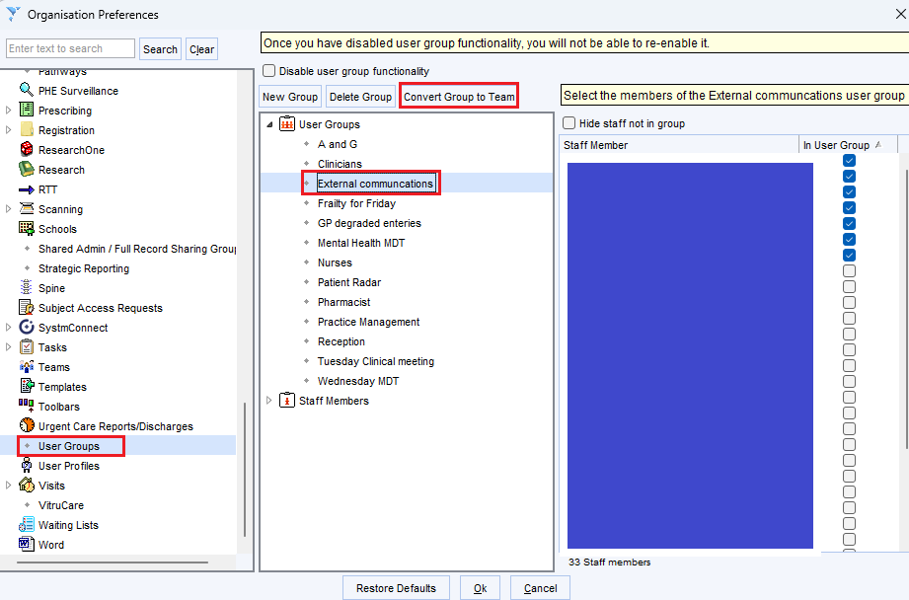

Slide 5
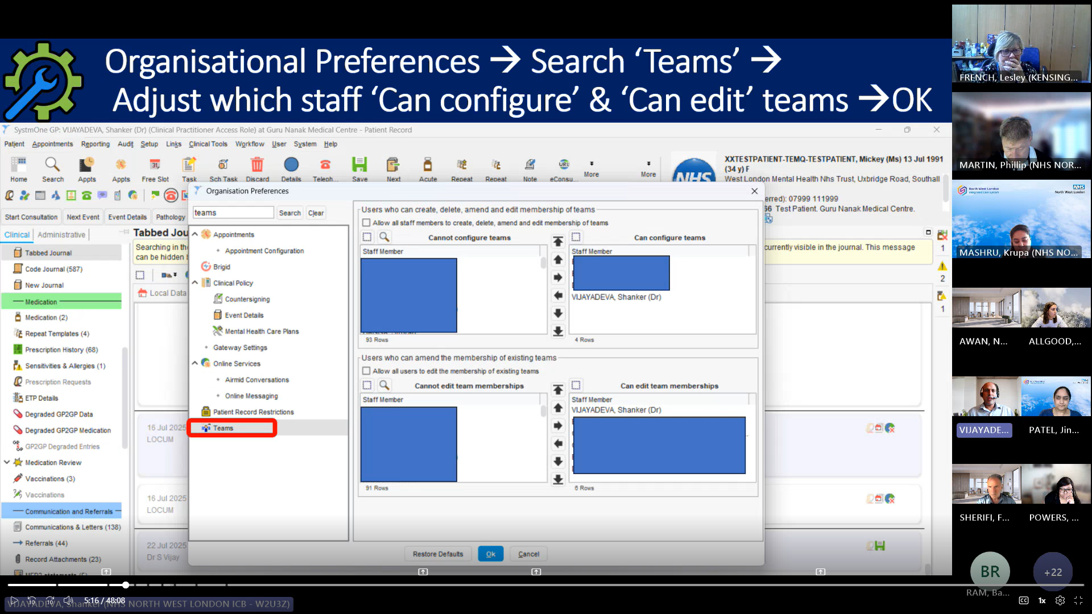
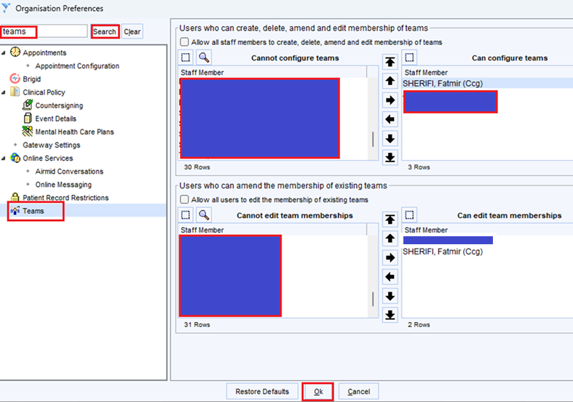

Slide 6
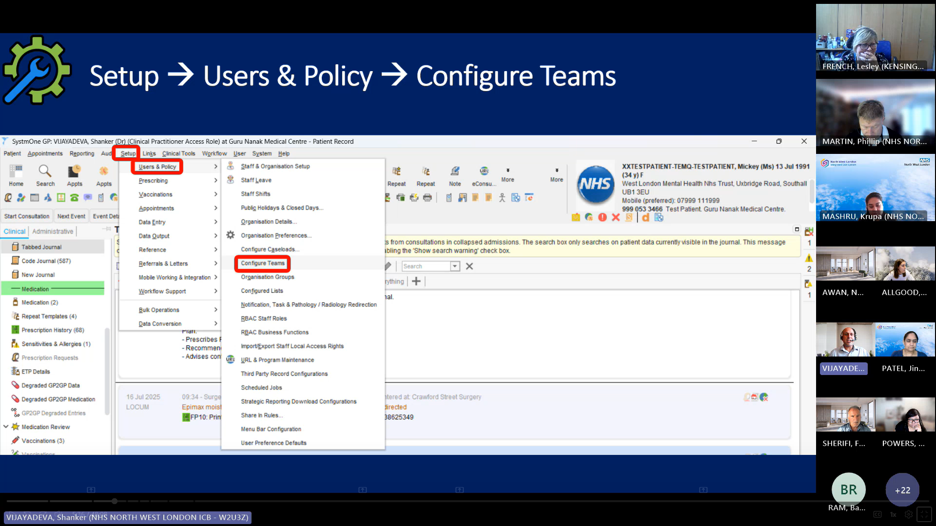
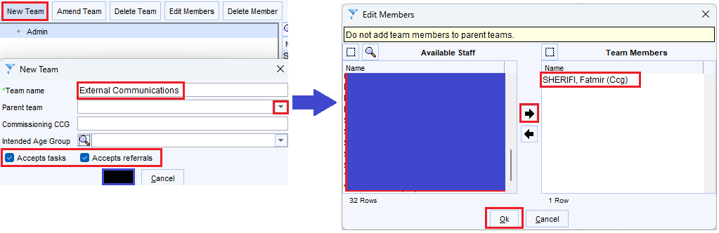

Slide 7
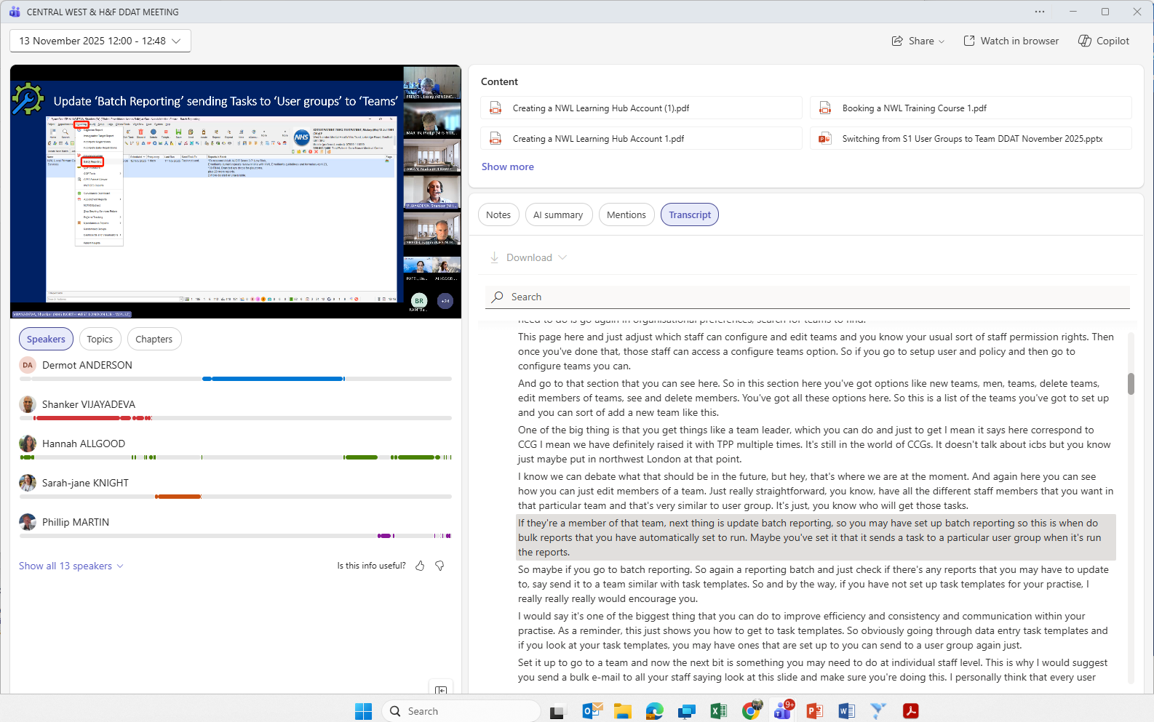
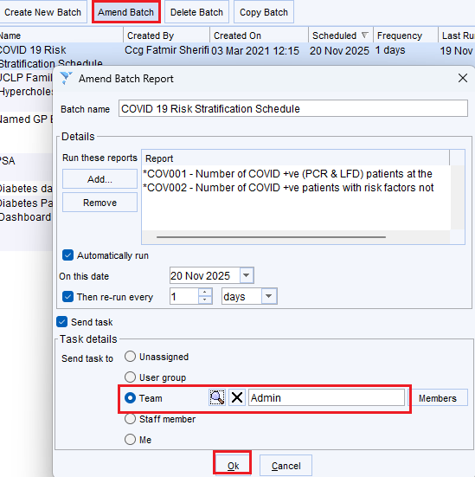

Slide 8
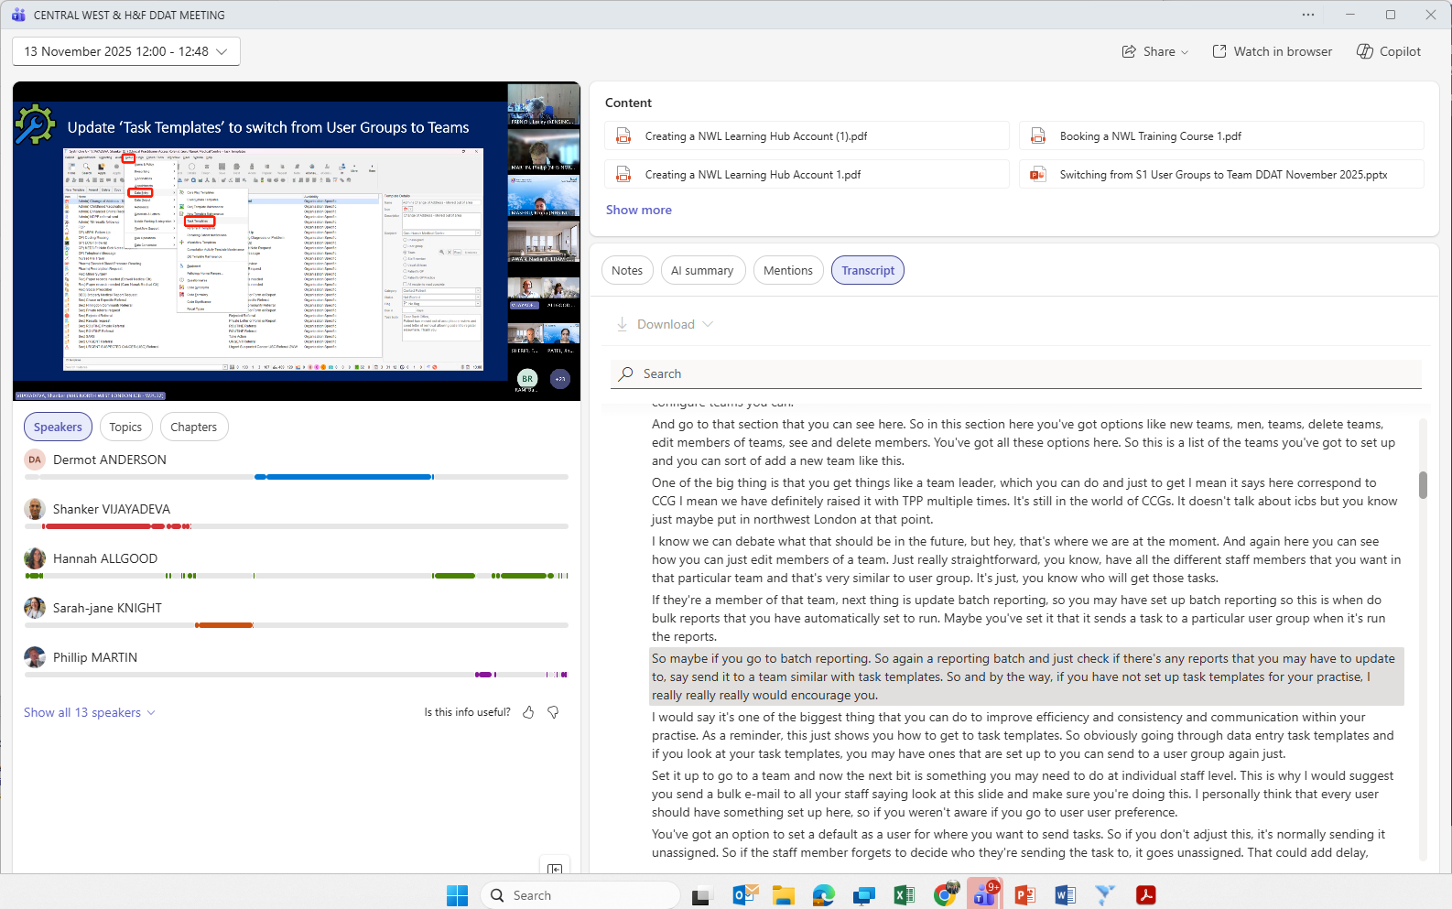
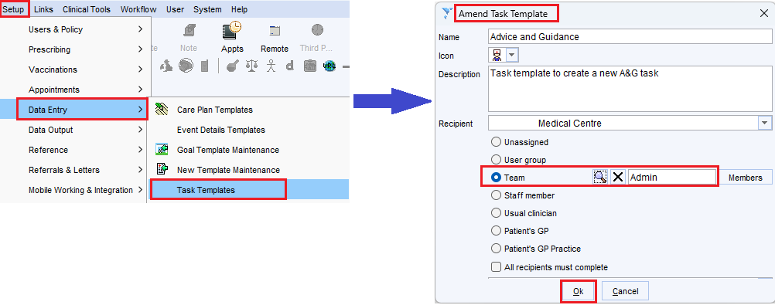

Slide 9
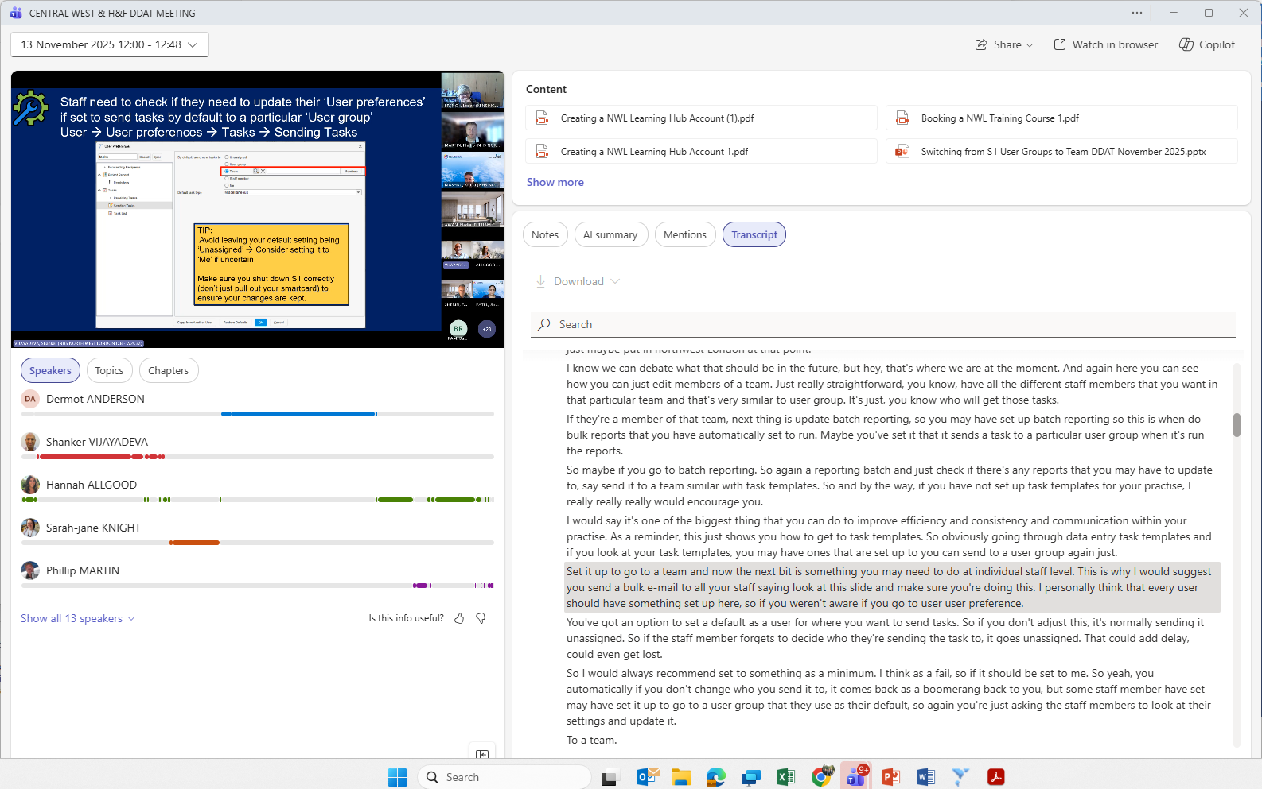
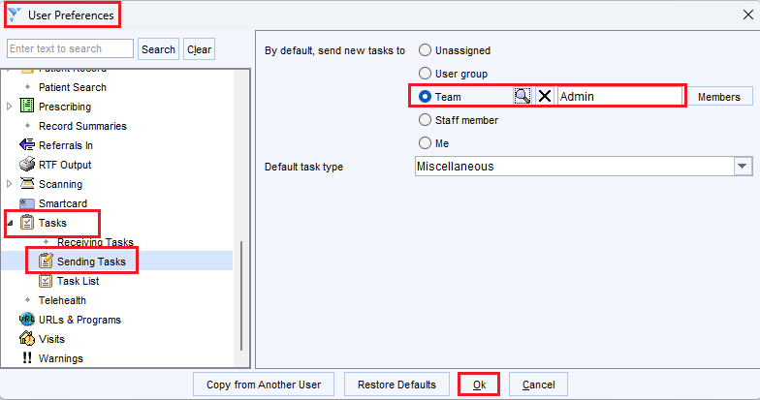
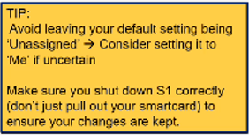

Slide 10

Checklist of suggested steps
Convert User Groups to Team – initially keep names & members the same – Task rules are updated automatically
Bulk update tasks to reassign from User Group to corresponding team – this will make it difficult to see the ‘initial date task created/sent, as focused on ‘date updated’
Update any ‘Task templates’ setup to send to User Groups
Update any ‘Batch Reporting’ setup to send Tasks to Teams
Delete all User Groups once conversion done, to avoid confusion
Alert staff to update User Preferences to switch from User Group to Team
Don’t rush to ‘Disable user group functionality’ via Organisation Preferences
RISK/ISSUE: Scheduled Tasks may still be sent to the original User Group ( (even if deleted), so keep an eye on global Task Inbox

Slide 11
NHS App

Slide 12
NHS App Ambassadors
The NHS App is making it easier than ever for patients to
Manage their health,
Booking GP appointments
Ordering prescriptions
Viewing test results and records.
The NHS App Ambassador programme is inviting NHS staff and community members in North West London to spread the word.
Ambassadors play a simple but important role:
Helping people discover the app,
Showing them how to use it
Supporting those who may find digital tools challenging.
Whether you’re a GP receptionist, pharmacist, volunteer or community leader, you can make a difference.
As an ambassador, you’ll get access to training, resources, and a supportive network across the country – plus the chance to develop your skills while supporting better patient care.
How to join NHS staff with an NHS email can sign up by emailing england.appambassadors@nhs.net

Slide 13
NHS App Training – NWL Learning Hub
Looks at supporting practice staff with the NHS App
How to view records
Manage medication ordering
NHS 111
Course is aimed at all staff in surgeries
21st November 2025 – 13:30
15th December 2025 – 13:30
22nd January 2026 – 13:00
Sign up on the LMS - https://www.nwllearning.nhs.uk/course/view.php?id=411

Slide 14
Messaging Hints and Tips

Slide 15
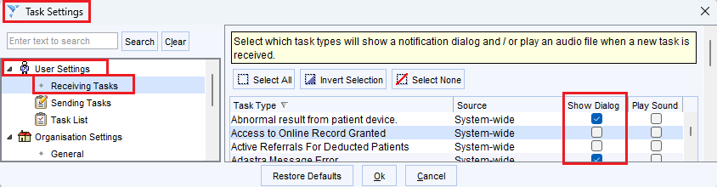
Messaging – hints and tips
1. Retrieving Historic Instant Messaging:
Go to Audit<User<Instant Messages
2. Retrieving a Postponed Instant Message:
Select IM<Enable Messages
3. Which Tasks should Pop-Up
Task List<Task Settings<User Settings<Receiving Tasks

Slide 16
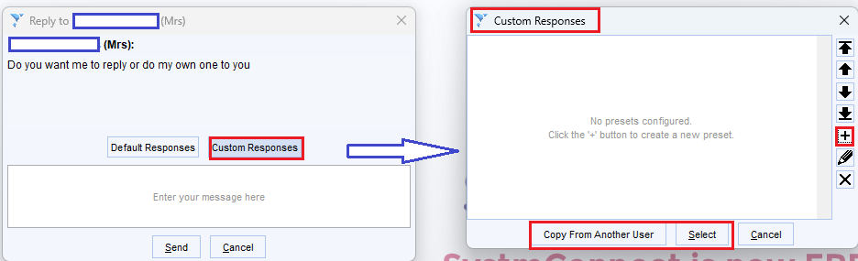
Messaging – hints and tips
1. Custom Pre-sets Instant Messaging:
Create and Select custom messages – when replying to an IM

